Slide 1
BONE DISEASES
Dr. Ahmed M. Attay

Slide 2
Dystrophic bone diseases

Slide 3
Dystrophic bone diseases
Paget's disease of bone
(Osteitis derformans)
Chronic slowly progressive condition of unknown etiology, characterized by abnormal resorption and deposition of bone resulting in distortion and weakening of affected bones.
Etiology
It is of unknown cause, but many theories are suggested:
Inflammatory in origin.
Autoimmune.
Endocrine: related to hyperthyroid disease.
Inborn error in the connective tissue metabolism.
Autonomic nervous system mediated vascular disorder.
Slow viral infection, but this is not proven yet.

Slide 4
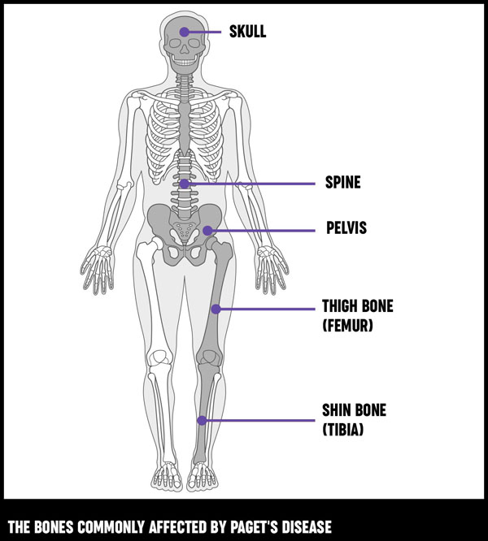
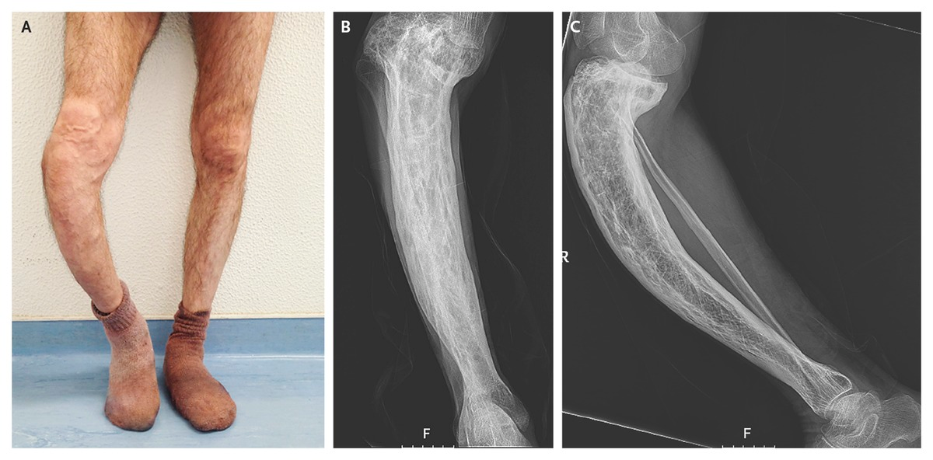
Dystrophic bone diseases
Paget's disease of bone
Clinical features:
It is a disease of old age usually above 40 years, rarely to occur before that age.
Men are affected about twice as women.
Whites are affected more than blacks, thus this disease is more prevalent in America and Europe than Africa and Asia.
More than one bone is affected, however it may be limited to one bone (less common).
The vertebral column is the most common site, particularly the sacrum vertebrae followed by lumbar vertebrae, thoracic vertebrae and then the least one is cervical vertebrae.
The next most affected sites are the skull and finally the jaws where they are involved in 10-15% of cases.
Maxilla is more involved than mandible.

Slide 5
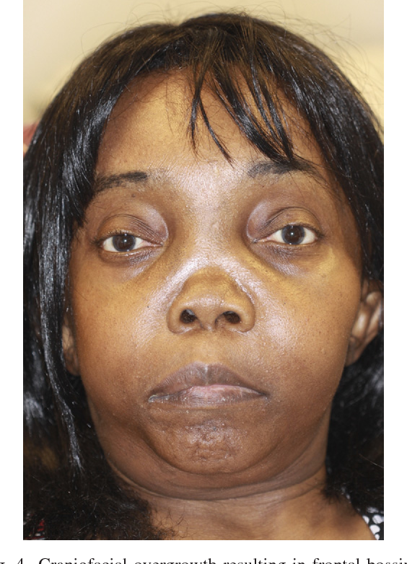
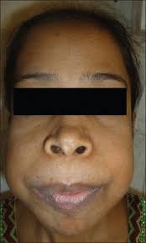
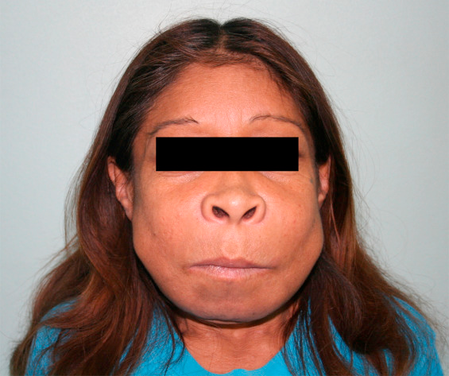
Dystrophic bone diseases
Paget's disease of bone
Clinical features:
Bone pain is the chief complaint as bone become thickened, enlarged and weakened. Also the bone is warm to touch because of the high vascularity.
Pelvic bones become swelled, bended and break easily. This result in bowing deformity in the weight bearing bone, giving the patient “monkey like appearance” as the long bones become shorter.
Skull is involved by a progressive increase in the circumference of the head (hats are replaced with larger ones). Skull foramina become narrowed and this may cause deafness, blindness, facial paralysis and headaches because there is a pressure on cranial nerves.
Deformities in the spine. High fragility of bone causes pathologic fractures.

Slide 6
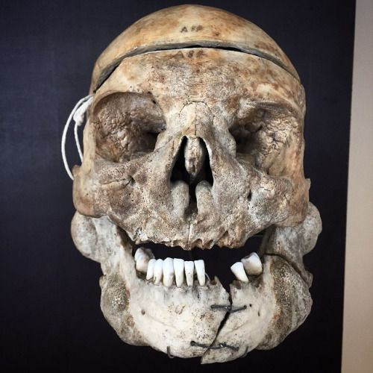
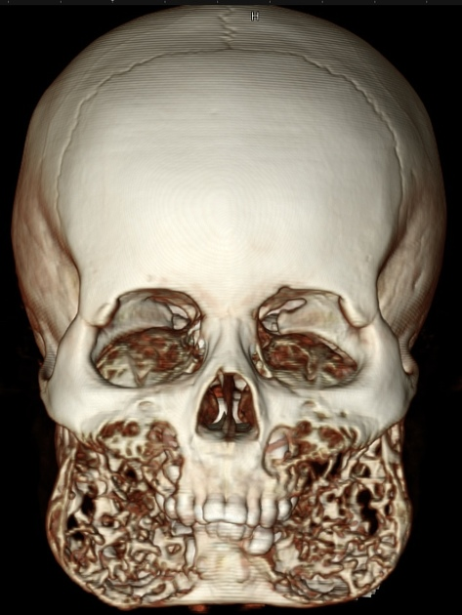
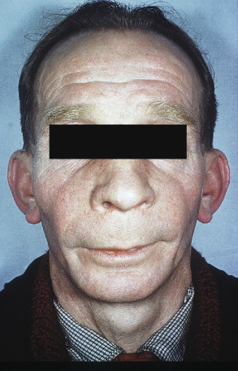
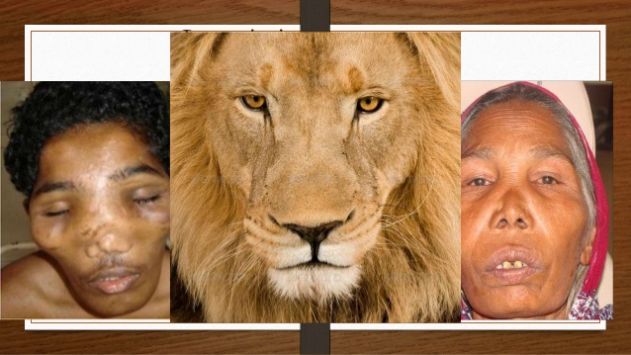
Dystrophic bone diseases
Paget's disease of bone
Oral manifestations:
When maxilla is involved this will result in enlargement of the middle third of the face.
In severe cases, the enlargement results in a lion-like facial deformity (Leontiasis ossea).
The alveolar ridge becomes wider and the teeth may drift apart and become spaced.
The lips are too small to cover the enlarged jaws.

Slide 7
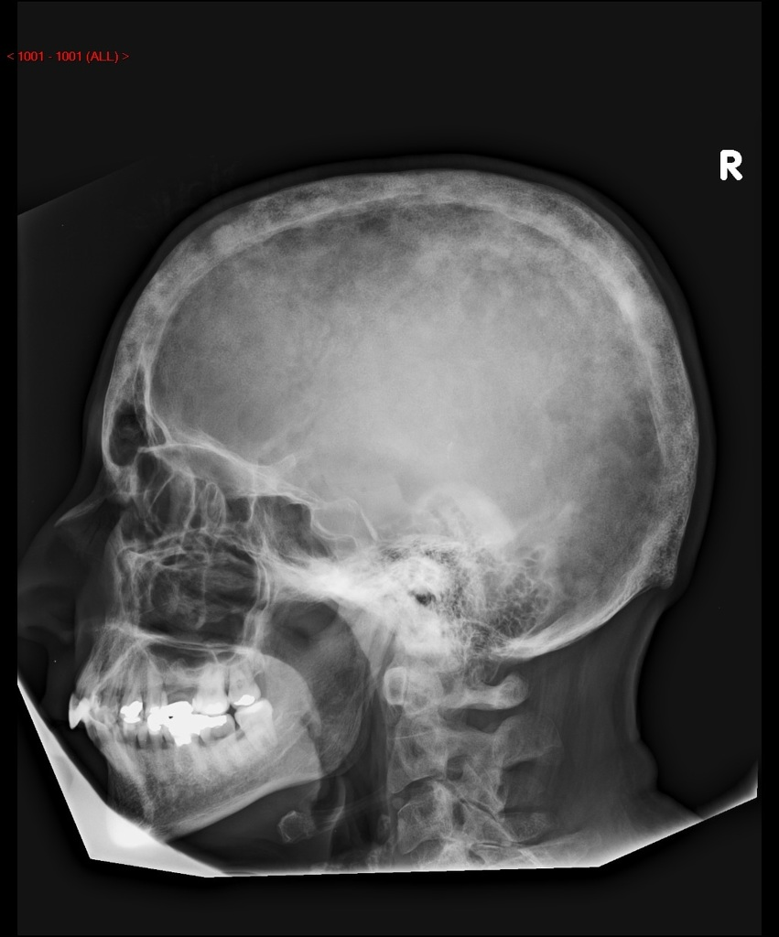
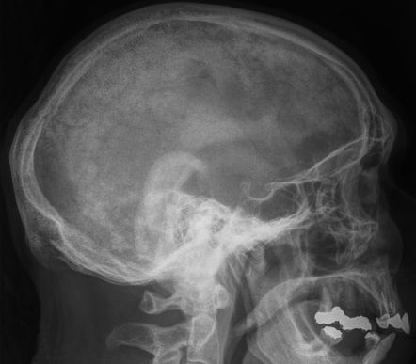
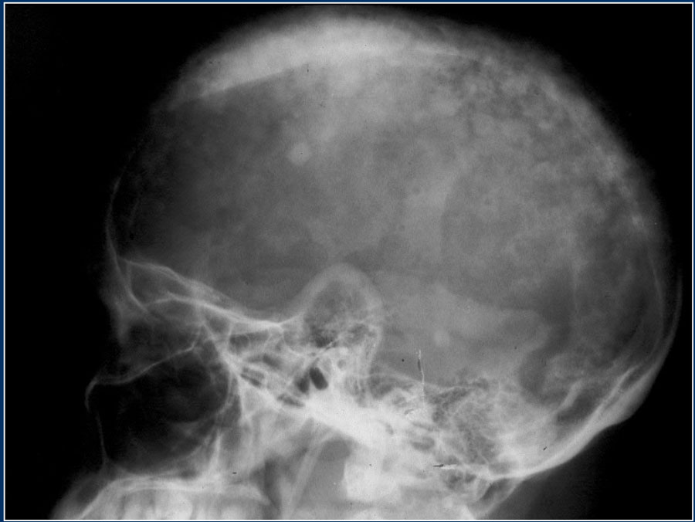
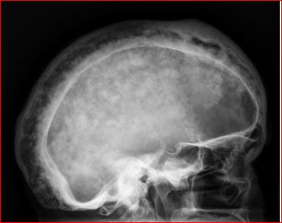
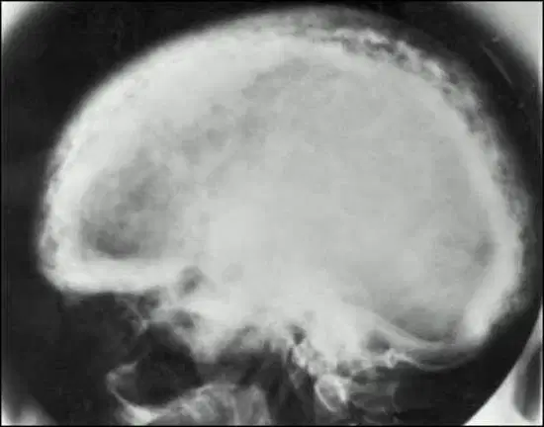
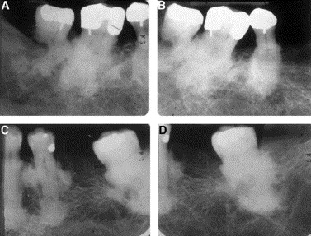
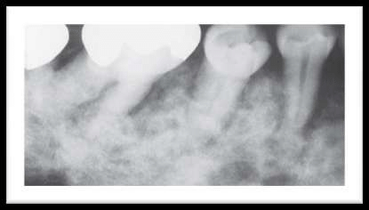
Dystrophic bone diseases
Paget's disease of bone
Radiographic features:
Early osteolytic stage:
Concerning teeth, lamina dura is lost and periodontal ligament space is obliterated.
Teeth appearing floating on the bone. Resorption of apices of teeth is evident.
Concerning bone, there is osteoporosis followed by definite radiolucent area. In the skull there are large circumscribed areas of radiolucency may be present.
Intermediate stage:
In the jaws, the normal trabecular pattern is lost and areas of radiolucency are replaced by cotton wool appearance (patchy radiopacities).
Late osteoblastic/sclerotic stage:
The bone continues apposition and becomes homogeneously dense. Hypercementosis of the teeth.

Slide 8
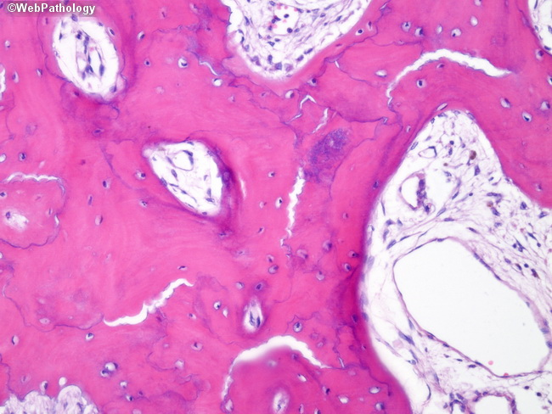
Dystrophic bone diseases
Paget's disease of bone
Histological features:
Microscopic picture varies with the stage of the disease. The disease is a struggle between osteoclasts and osteoblasts.
In early stages, osteoclastic resorption predominates over the osteoblastic activity. As resorption and apposition occur the trabeculae become abnormally shaped.
Episodes of resorption and apposition result in numerous basophilic reversal lines which make each trabeculae appears to be composed of several smaller pieces fitted together.
This is known as the "Jigsaw puzzle" or "mosaic pattern".
The bone marrow shows vascular fibrous connective tissue replacement. The bone trabeculae are lined by osteoblasts and osteoclasts according to the stage of the lesion, whether osteoclastic or osteoblastic.
Osteoclasts presence is due to the active resorptive stage.

Slide 9
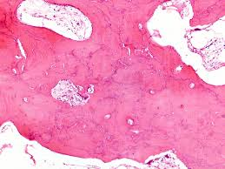
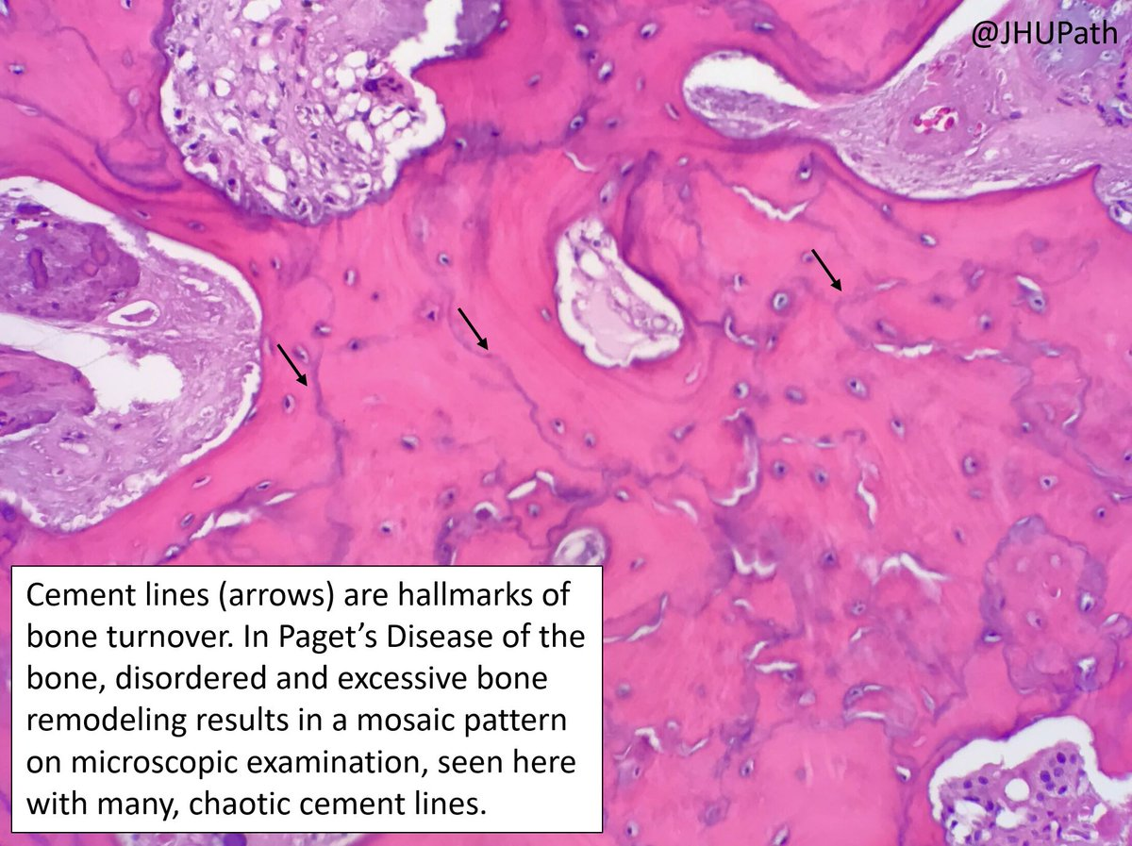
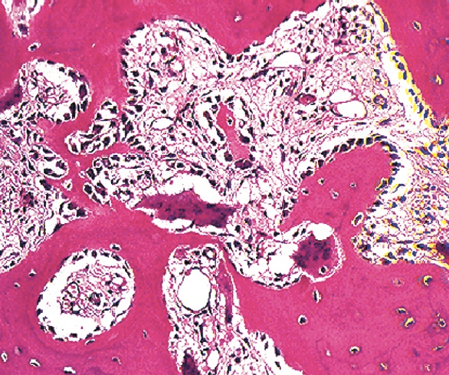
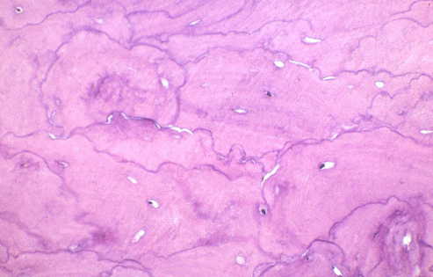
Dystrophic bone diseases
Paget's disease of bone
Histological features:
Paget's disease is described in 3 phases:
a. Initial phase: phase of bone resorption.
b. Intermediate phase: vascular phase and haphazard osteoblastic repair.
c. Final phase: appositional or sclerosing phase (re-ossification stage). In this phase mineralization of bone matrix and diminution of all over cellularity and vascularity.

Slide 10
Dystrophic bone diseases
Paget's disease of bone
Laboratory investigations:
Elevated serum alkaline phsophatase level (normal 3-13 King Armstrong unit).
Elevated urinary hydroxyproline levels.
Normal calcium and phosphorous levels.
Differential diagnosis:
Fibrous dysplasia.
Giant cell lesion.

Slide 11
Dystrophic bone diseases
Paget's disease of bone
Complications:
Enlargement and widening of alveolar ridge may result in drifting and spacing of teeth and the patient becomes unable to close the lips. There is need for changing dentures in edentulous patients.
Development of dry socket and osteomyelitis can happen because of the lowered blood supply and lowered resistance of infection.
Hypercementosis will lead to difficult extraction with excessive bleeding hemorrhage or even fracture of the alveolar bone or the tooth.
Flat palate is one of the complications.

Slide 12
Dystrophic bone diseases
Paget's disease of bone
Complications:
Blindness, deafness, severe facial neuralgia and paralysis can occur due to increased pressure on cranial nerves.
High output cardiac failure is a serious complication that happens due to arteriovenous shunt or increased peripheral vascularity.
Benign of malignant giant cell lesions may also occur.
Development of osteosarcoma has been reported.
N.B: Osteosarcoma is a disease of young age, while Paget's disease of bone is an old age disease, so development of osteosarcoma in old age may indicate the presence of Paget's disease of bone.

Slide 13
Dystrophic bone diseases
Paget's disease of bone
Treatment:
No specific treatment, careful management is needed to avoid inflammation and osteomyelitis.
If a tooth is to be extracted, this must be done surgically, the socket saucerized to reduce the size of blood clot and sutured to control bleeding and infection.
Dentures may need frequent remaking to avoid pressure and necrosis of bone.
In late stages, analgesics are needed to relieve continuous aching pain.
Calcitonin and bi-phosphonates (parathyroid hormone antagonist) are indicated to reduce bone turn over and improve biochemical abnormalities.

Slide 14
Hormonal bone diseases

Slide 15
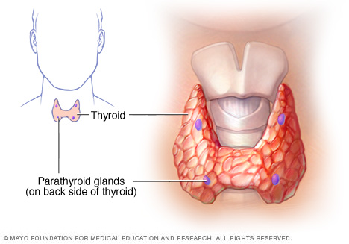
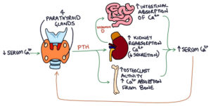
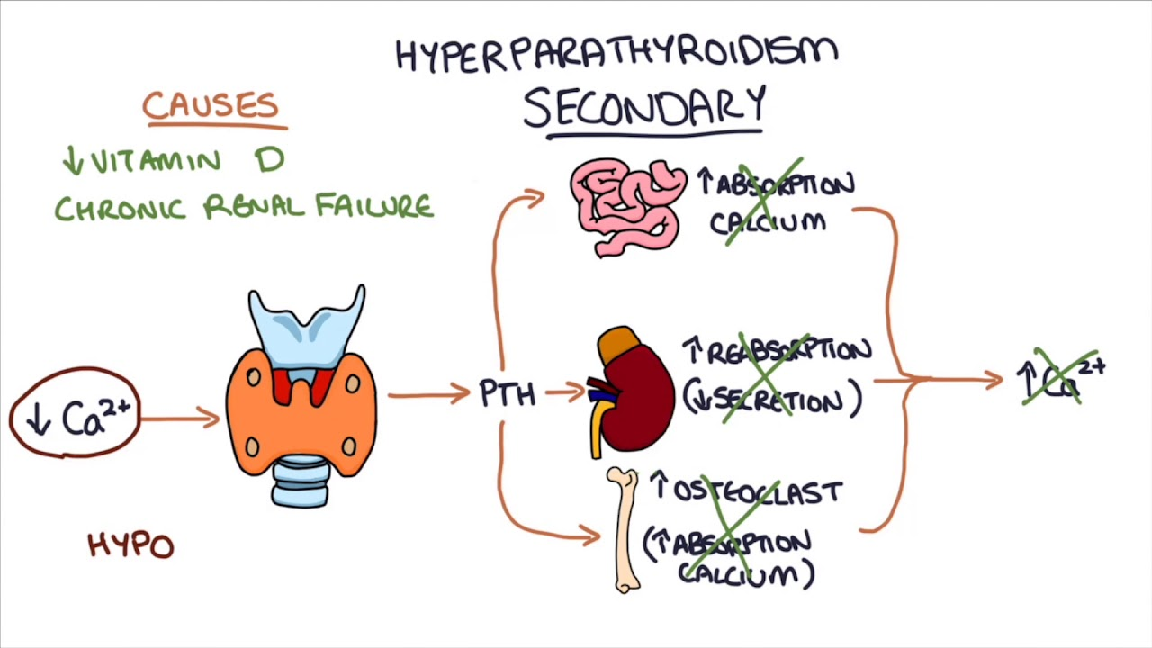
Hormonal bone diseases
Hyperparathyroidism
Excess production of parathyroid hormone (PTH).
PTH normally is produced by the parathyroid gland in response to decrease in serum calcium levels. Hyperparathyroidism may be primary or secondary.
Primary hyperparathyroidism: is the uncontrolled production of PTH usually as a result of parathyroid adenoma, parathyroid hyperplasia or parathyroid carcinoma.
Secondary hyperparathyroidism: develops when PTH is continuously produces in response to chronic low levels of serum calcium as a compensatory response to hypocalcemia as in chronic renal diseases. The vitamin D which is necessary for calcium absorption from the gut. In patients with chronic renal disease active vitamin D is not produced, resulting in lowered serum calcium levels.

Slide 16
Hormonal bone diseases
Hyperparathyroidism
Clinical features:
Occur in middle age, sometimes in children and young adults, as well as old age.
Females are most commonly affected than males.
Hypercalcemia is manifested by:
Poor muscle tone and decreased neuromuscular excitability.
Pathological fracture of bones, bone pain and joint stiffness.
Jaw lesions may result in teeth drifting and malocclusion.
Kidney stones (renal calculi) due to elevated serum calcium levels.
Metastatic calcifications are also seen involving other soft tissues as blood vessels walls, subcutaneous soft tissue, sclera, brain dura and other regions around joints.

Slide 17
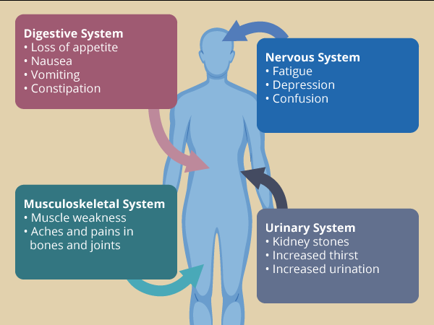
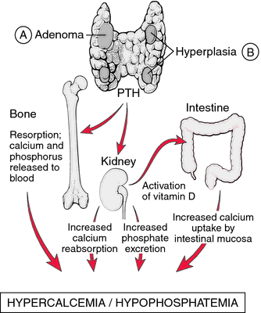
Hormonal bone diseases
Hyperparathyroidism
Clinical features:
The bones are affected in the skeletal system with osteitis fibrosa cystica.
Osseous lesions in the skull and jaws such as, giant cell tumor or jaw cysts.
There is loss of phosphorus and calcium from bone.
Bone is replaced by fibrous tissue leading to generalized osteoporosis.
Bone repair resulting in pseudocyst formation.
Refers to the tendency for the development of duodenal ulcers.
Changes in the mental status are often seen, ranging from weakness to confusion or dementia. Also development of hyperparathyroidism crisis and coma.

Slide 18
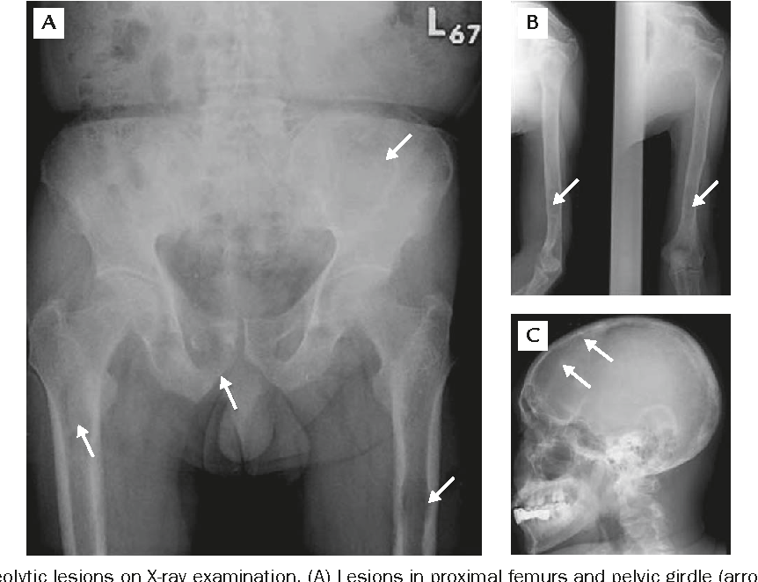
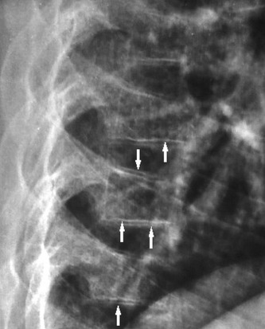
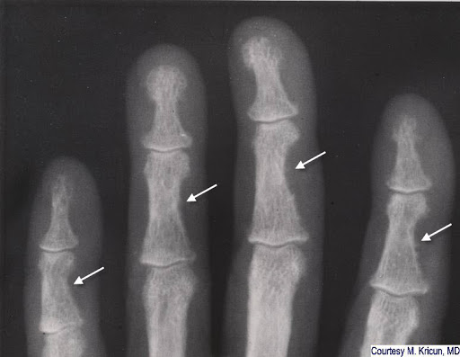
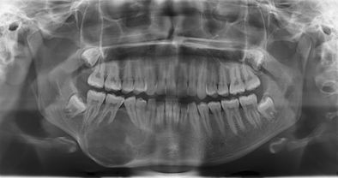
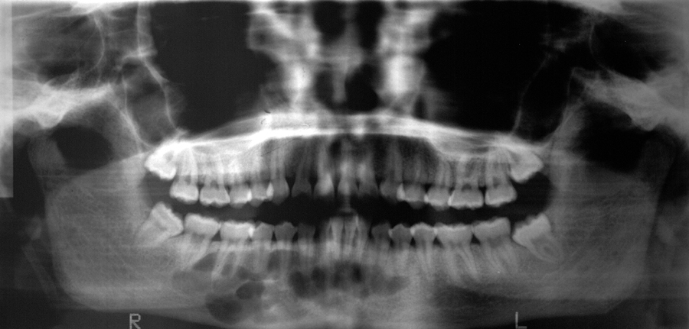
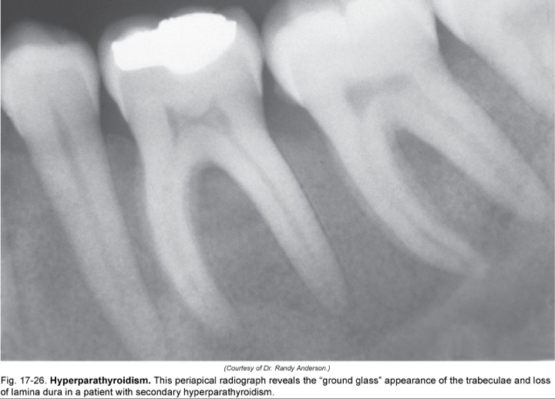
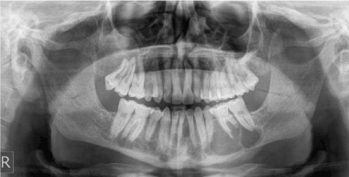
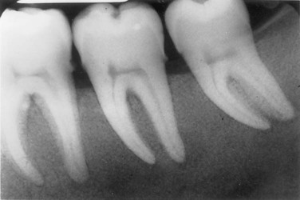
Hormonal bone diseases
Hyperparathyroidism
Radiographic features:
Osseous lesions appear first as general radiolucency as compared with those of normal bone.
Later sharply defined oval or round radiolucent area develop, which may be lobulated.
Radiographic picture of the jaw bones shows the ground glass pattern, which result from the decrease in the trabecular density and blurring of the normal trabecular pattern.
Lamina dura around the teeth is partially lost.
Advanced cases the roots of the teeth show resorption with subsequent exfoliation of teeth.

Slide 19
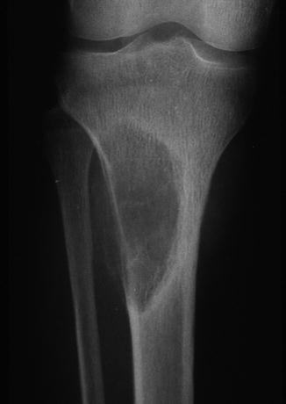
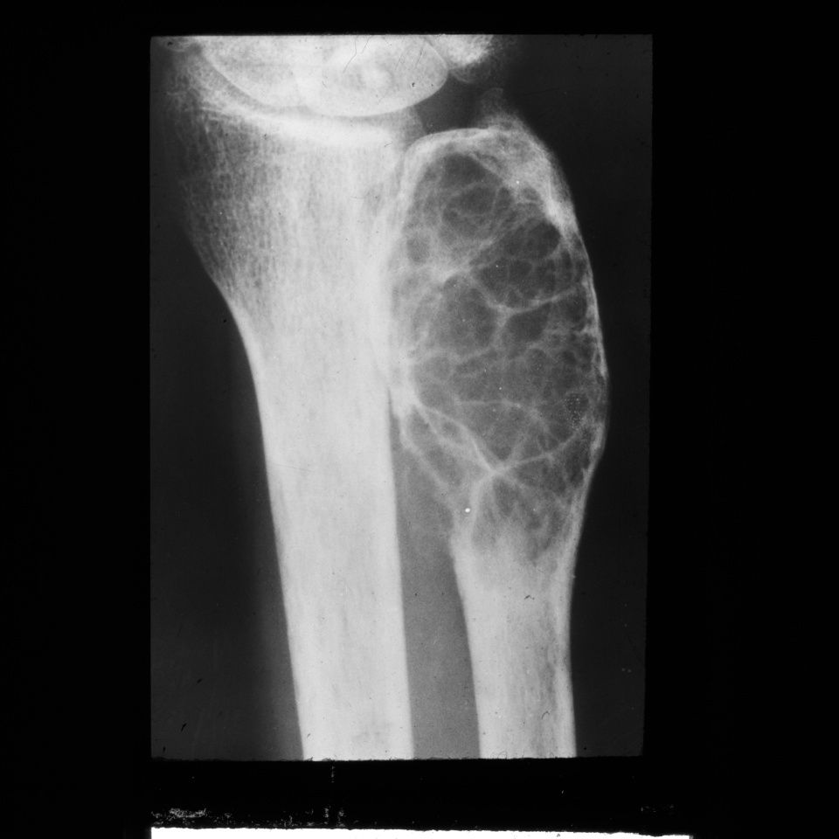
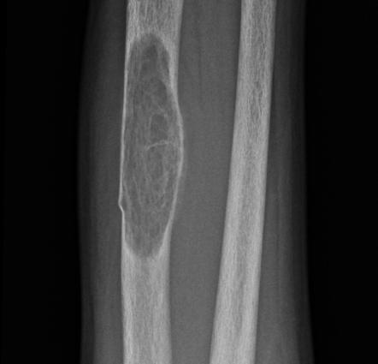
Hormonal bone diseases
Hyperparathyroidism
Laboratory investigations:
Increased level of serum calcium may reach 16-17 mg / dl (normal level 9-11 mg/dl).
Increased serum alkaline phosphatase.
Increased PTH level.
Low serum phosphorous.
Macroscopical features:
Brown tumor of hyperparathyroidism forms a mass that expands and perforates the cortex.

Slide 20
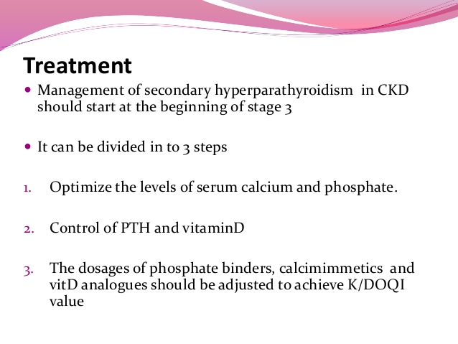
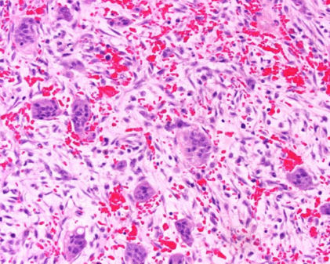
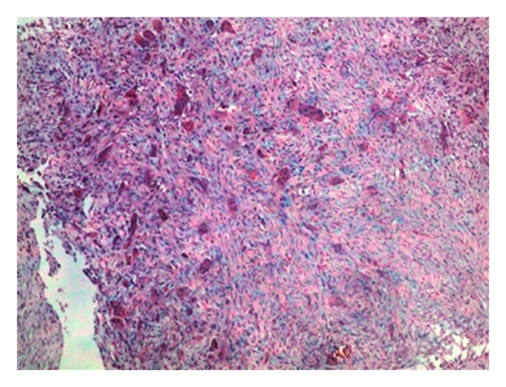
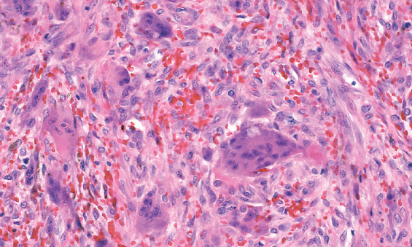
Hormonal bone diseases
Hyperparathyroidism
Histological features:
In areas of resorption, some islands of osteoid are seen lined by osteoblasts.
Fibrosis of marrow spaces and fibroblasts replaced the resorbed trabeculae.
Areas of recent and old hemorrhage with much hemosiderin are seen.
As this disease develops it becomes characterized by:
Fibroblast proliferation in a loose pattern.
Numerous capillaries and endothelial lined spaces.
Extravasated RBCs with yellow and brown hemosiderin.
Numerous multinucleated giant cells.

Slide 21
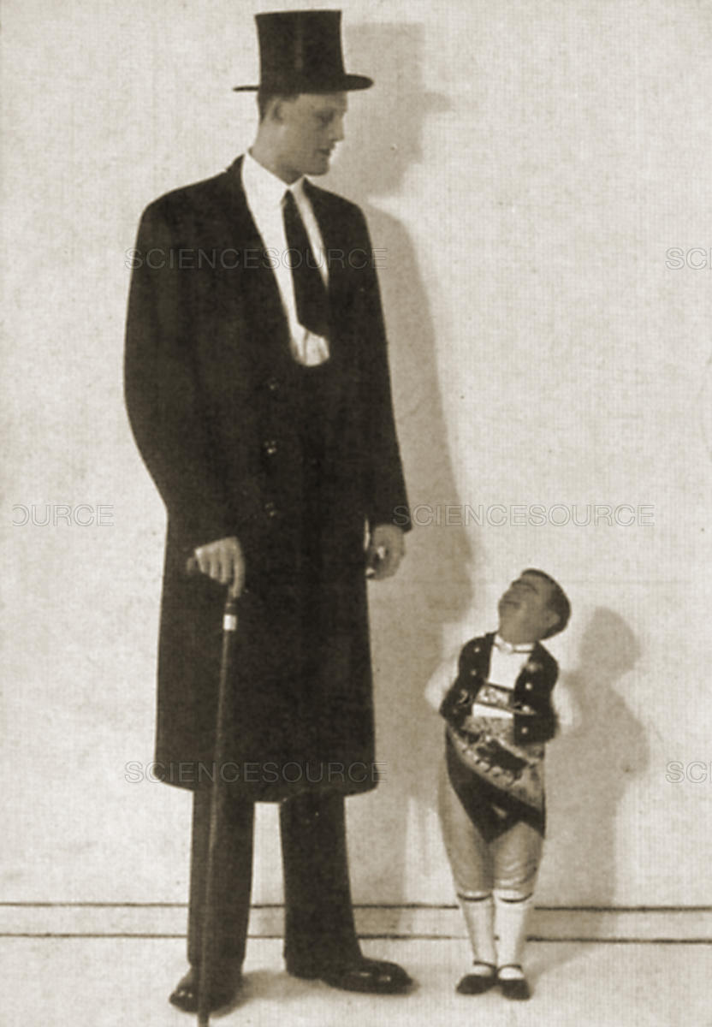
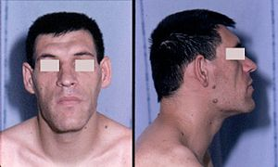
Hormonal bone diseases
Gigantism and acromegaly
Both results from over production of pituitary growth hormone usually due to an adenoma of the anterior lobe of pituitary gland.
Before the fusion of the epiphyses, over production of growth hormone gives rise to the overgrowth of the whole skeleton; gigantism.
After fusion of the epiphysis, overproduction of growth hormone gives rise to acromegaly.

Slide 22
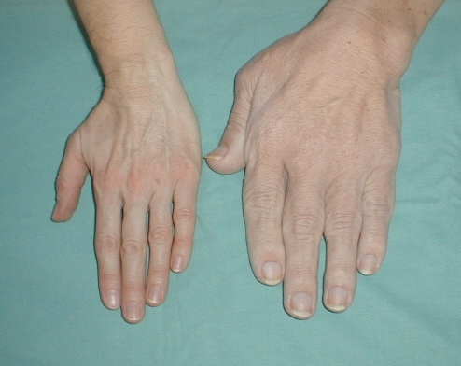
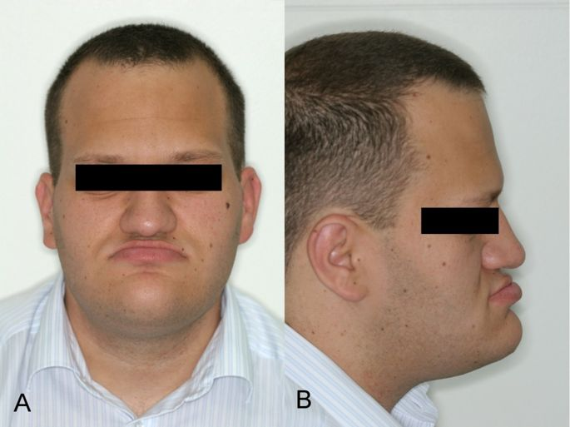
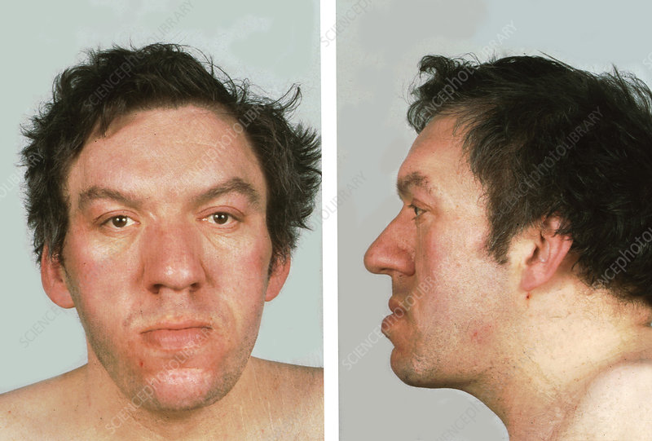
Hormonal bone diseases
Gigantism and acromegaly
Clinical features:
Continuous growth of the mandibular condyle, causing prognathism.
Thickening of the facial bone and soft tissue such as lip and nose.
Macroglossia may result in teeth spacing and diastma formation.
Over growth of hands and feet.

Slide 23
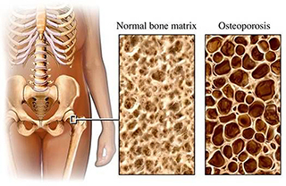
Hormonal bone diseases
Osteoporosis
Osteoporosis is defined as decrease in bone density (bone mass per unit volume) of normally mineralized bone, resulting in thinning and increased porosity of the bone cortices and trabeculae.
Risk factors:
Post-menopausal women due to estrogen deficiency. Sometimes in males due to androgen deficiency.
Increase prevalence with age.
Smoking, alcohol, steroid or anticonvulsant medications.
Lack of physical exercise.
Cushing syndrome, occurs either due to adenoma, carcinoma of adrenal glands.
Thyrotoxicosis and primary hyperparathyroidism.

Slide 24
Hormonal bone diseases
Osteoporosis
Pathogenesis:
Bone turnover and remodeling occurs throughout life.
In the growing person, the total bone mass increases with skeletal growth as bone formation exceeds bone resorption.
Bone mass then remains constant for several years during skeletal maturity, when bone formation and bone resorption are nearly equal.
The bone mass then begins to decline after the age of 40 to 50 at a faster rate in women than in men, as bone resorption exceeds bone formation.
Sex hormone deficiency is a major factor associated with osteoporosis.
Deficiency of estrogens, osteoclastic activity predominates, resulting in an increased resorption and loss of bone mass.
Osteoporotic bone is of normal composition but reduced in quantity.

Slide 25
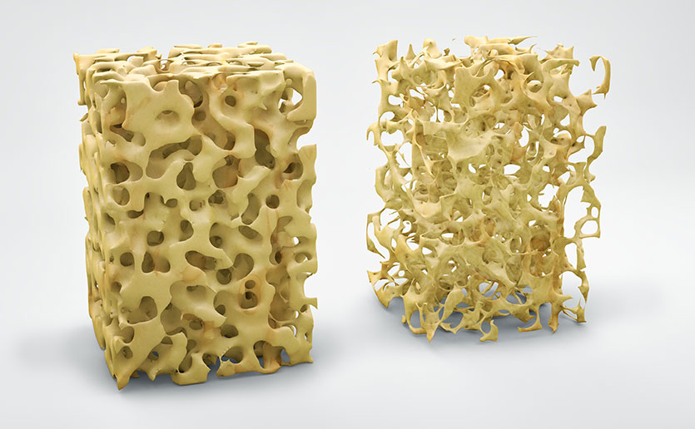
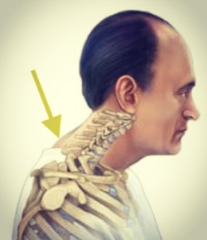
Hormonal bone diseases
Osteoporosis
Clinical features:
Bone pain. A silent risk factor of bone fracture (hip, spine and wrist).
Osteopenia is a descriptive term for a loss of bone density observed radiographically.
Excessive bone loss produces thinning and increased porosity of the trabecular bone of the axial skeleton (vertebrae, ribs and pelvis).
Endosteal resorption of the cortical bone resulting in the enlargement of the medullary cavity without a corresponding change in outer diameter of bone.
Dowager’s hump results when the vertebral bodies, particularly in the thoraco-lumbar region, may be weakened by micro-fractures and collapse anteriorly, resulting in compression fractures and wedging of the vertebrae, a loss of stature and kyphotic deformity of the spine.

Slide 26
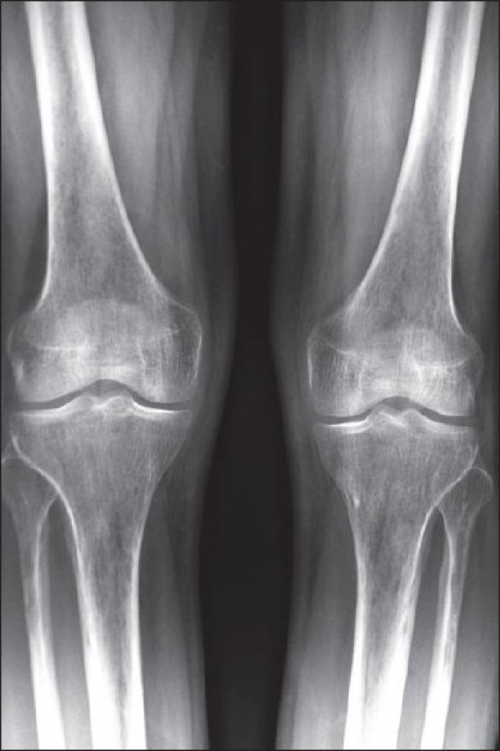



Hormonal bone diseases
Osteoporosis
Clinical features:
Jaws are involved, but the condition is asymptomatic, sometimes pathological fracture occurs.
In edentulous patients, total disappearance of the alveolar ridge results.
Radiographic features:
Increased radiolucency of bone and their cortex.
There are more marrow spaces in the cancellous bone in association with thin trabeculae.

Slide 27



