Slide 1
BONE DISEASES
Dr. Ahmed M. Attay

Slide 2
Reactive bone diseases

Slide 3
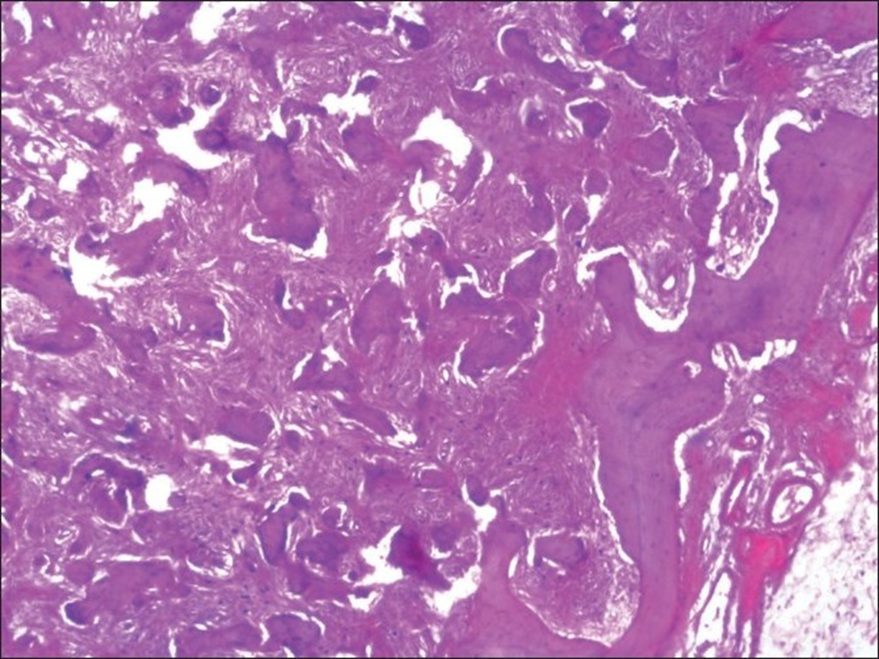
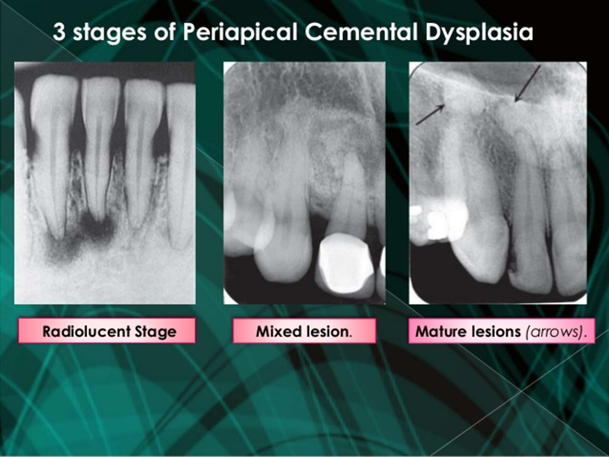
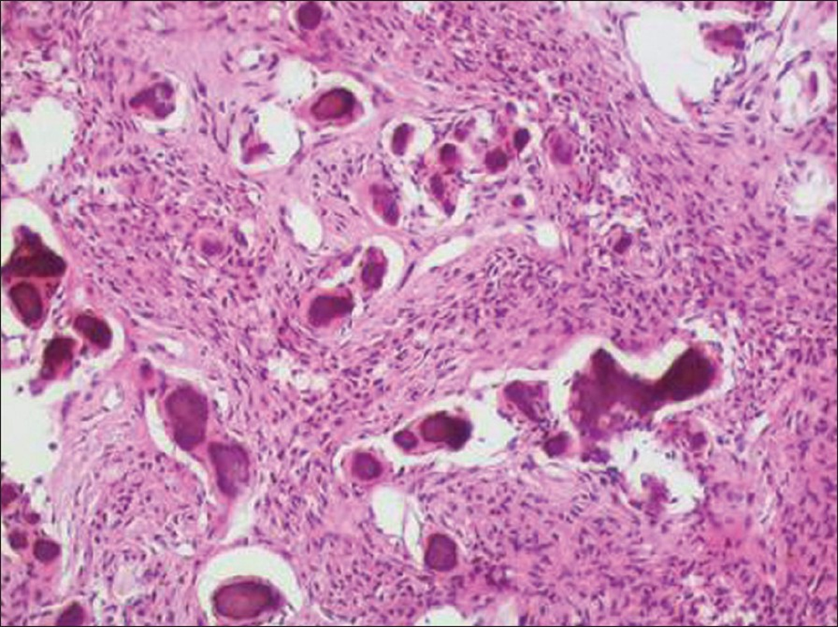
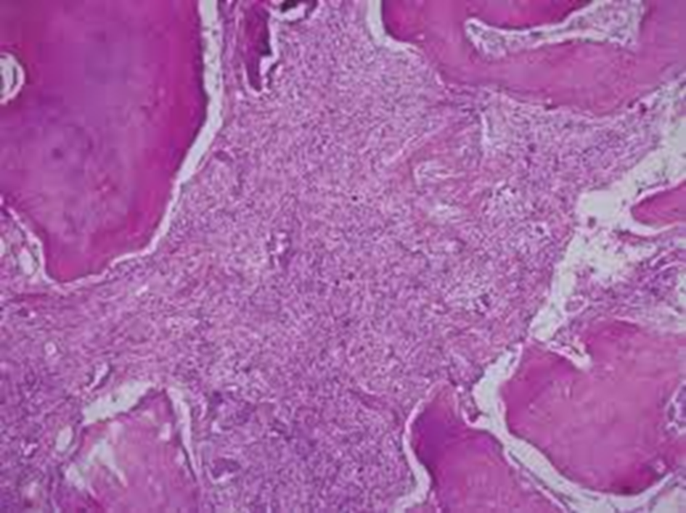
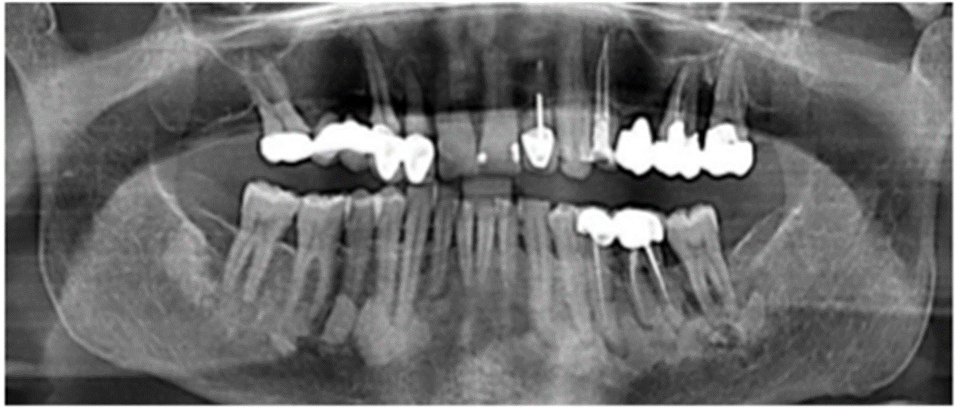
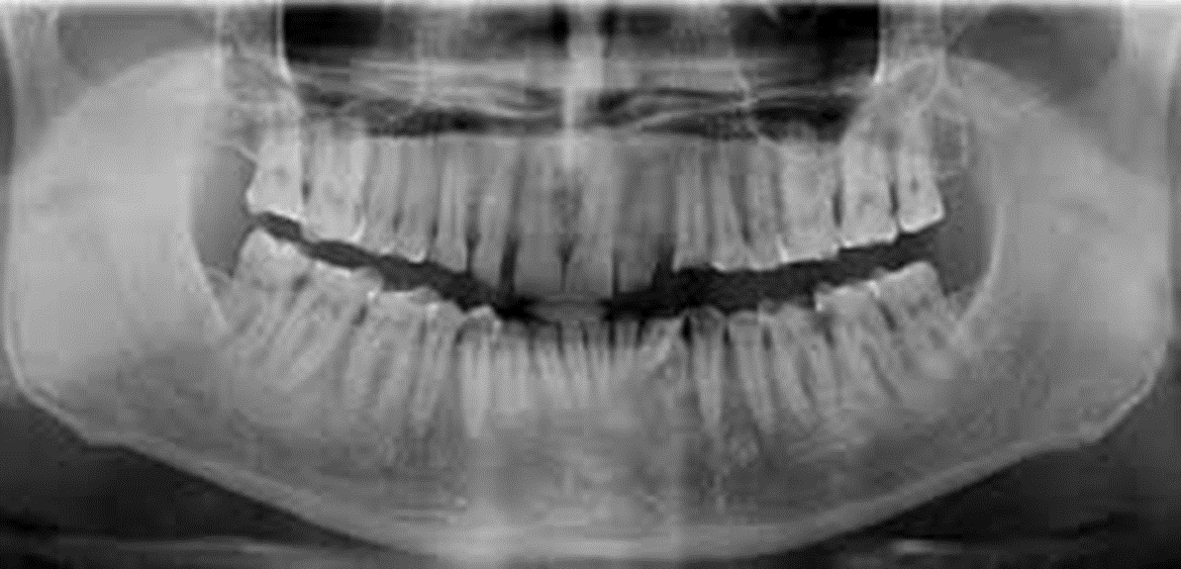
Reactive bone diseases
Cemento-osseous dysplasias
Cemento ossifying fibroma.
Periapical cemental dysplasia.
Florid cemento-osseous dysplasia (gigantiform cementoma).

Slide 4
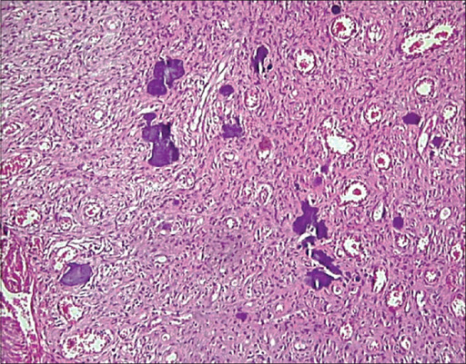

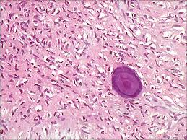
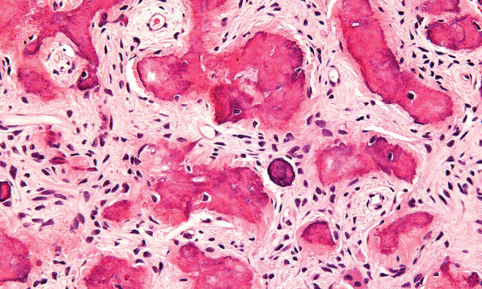
Reactive bone diseases
Ossifying fibroma
(cementifying fibroma, cemento-ossifying fibroma)

Slide 5
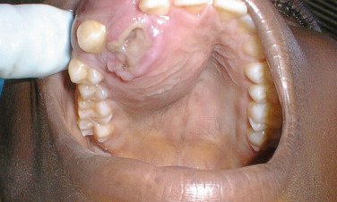
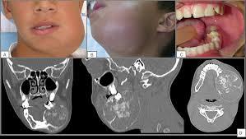
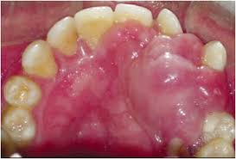
Reactive bone diseases
Juvenile ossifying fibroma
Juvenile ossifying fibroma (JOF) is uncommon lesion of bone. It is differentiated from ossifying fibroma on the basis of age incidence, site, predilection and clinical behavior.
Histologically, the distinction from ossifying fibroma is not so clear.
Clinical features:
Common in patients younger than 15 years of age.
Sex incidence is equal in both males and females.
Maxilla is involved more commonly.
Rapid growth. In such cases, pain and paresthesia may be noted.
Cortical expansion and facial asymmetry is seen with jaw lesions.
Orbital and sinus involvement may cause exophthalmus, proptosis and nasal obstruction.

Slide 6
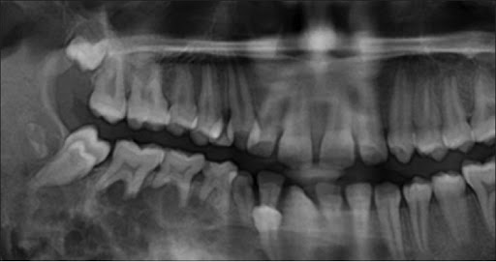
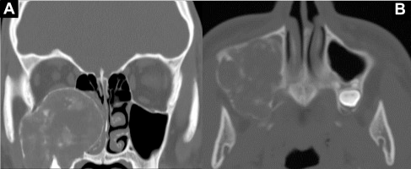
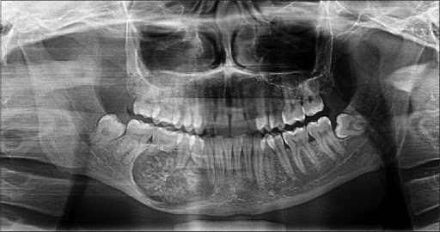
Reactive bone diseases
Juvenile ossifying fibroma
Radiographic features:
It appears as radiolucent or mixed radiopaque-radiolucent depending on amount of calcified material present within the tumor.
Lesion may be well demarcated or may show invasion into surrounding bone.

Slide 7
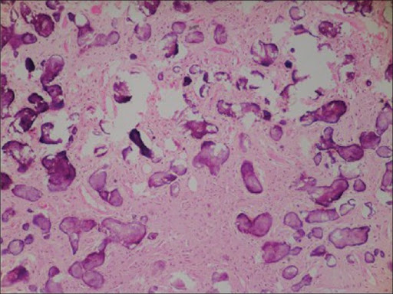
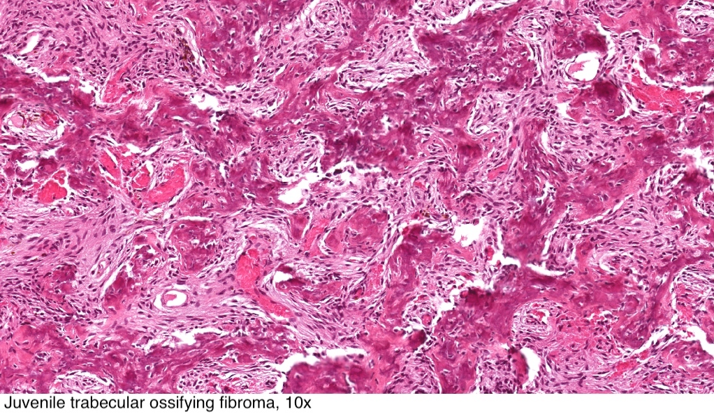
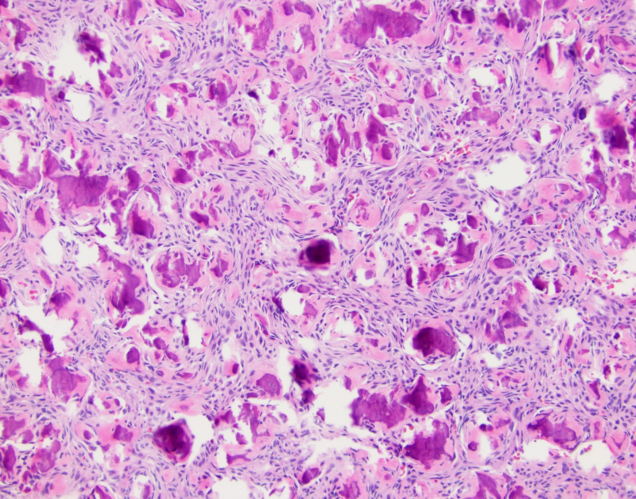
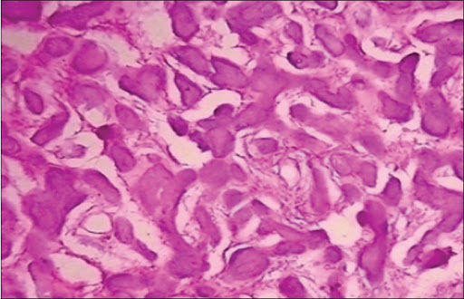
Reactive bone diseases
Juvenile ossifying fibroma
Histological features:
2 patterns are recognized:
a. Trabecular JOF.
b. Psammomatoid JOF.
Both patterns of JOF are well circumscribed but not encapsulated.
They are composed of fibro-cellular connective tissue, with areas of hemorrhage and occasional multinucleated giant cells.
They differ in the mineralized component:
In trabecular JOF, shows irregular strands of osteoid lined by plump osteoblasts.
In psammomatoid JOF, the mineralized material is composed of concentric, lamellated and spherical ossicles.

Slide 8

Note
The following are considered as fibro-osseous lesions:
1. Fibrous dysplasia:
a. Monostotic fibrous dysplasia.
b. Polyostotic fibrous dysplasia.
2. Cemento-osseous dysplasias:
a. Periapical cemental dysplasia.
b. Florid cemento-osseous dysplasia (Gigantiform cementoma).
c. Focal cemento-osseous dysplasia.
3. Cemento-ossifying fibroma.
4. Cherubism.

