Slide 1
Today’s topics

Slide 2
PHYSIOLOGY OF SPERM
I- SPERM CAPACITATION
Definition:
It is the ability of the sperm to penetrate zona pellucida of follicle and fertilize the ovum due destruction of macromolecule called decapacitation factor.
Site:
Female genitalia of mammals only.
Time:
Few hours after semen deposition, during estrous phase due to due to high level of gonadotropins and estrogen hormone.

Slide 3
Mechanism:
- Testicular sperm is exposed to decapacitation factor found in seminal plasma and originated from vesicular gland and epididymis.
- Decapacitation factor is macromolecule of glycoprotein stable at heat 65^{O} C/30 min or precipitated by 50% ethyl.
- Female uterus secrets capacitation promoting factors such as steroid binding albumin, lipoprotein, proteolytic and glycolytic enzymes.
- Capacitation promoting factors stimulate destabilization of cell membrane of sperm acrosomal head by increasing influx of Ca⁺⁺ and increase intracellular cAMP increasing motility and capacitation.

Slide 4
- There is a synergetic capacitation factor called fertilization promoting peptide (FPP) secreted by prostate gland, this factor act as decapacitation factor in high concentration (in male reproductive system) while; in low concentration as in female genitalia where it diluted by secretion, it acts as capacitation factor.
- Capacitation can be done in vitro by ultracentrifugation or using 50% ethyl.
- Capacitation is species specific.

Slide 5
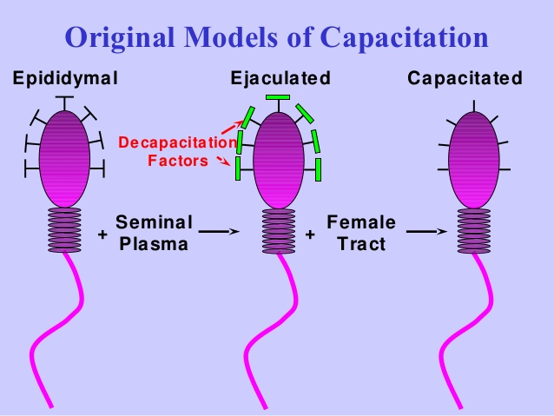

Slide 6
II- Acrosomal reaction
Definition:
It is specific reaction occur in acrosomal head of the sperm to release acrosomal content and facilitate fusion, penetrate and fertilization of oocyte.
Site: Ampulla of oviduct.
Factors enhance AR
Concentration of sperm.
Sperm motility.
Chemotaxic materials such as 1- malic acid.
Acrosomal head sperm contains species specific glycoprotein receptors for specific substances on zona pellucida to attract sperm to oocyte.

Slide 7
Mechanism:
1. Attraction phase
Directly after capacitation, sperm undergoes hyperactivity and its flagellum pushes it toward the ovum.
Attraction also synergetic by chemotaxic substances and specific glycoprotein receptors.
2. Penetration phase
Oocyte surrounded by two layers, Z. pellucida and Z. granulosa which composed from corona radiate and cumulus oophorous.
When the head of the sperm penetrates corona radiate, it releases hyalouronidase enzyme to digest cumulus cells which bind with each other by jelly-like material from hyaluronic acid.
Proteolytic zona lysine is proteolytic enzyme has been formed by perforation of apical body and finger-like projections between acrosomes and nucleus.

Slide 8
3. Fusion phase
During penetration , sperms loss their cell membrane and loss their acrosomal content to reach vitelline membrane creating channels inside vitelline membrane.
Plasma membrane of the ovum engulfing plasma membrane of the sperm which loses its content into ovum cytoplasm leading to fusion of the sperm and ovum.
4. Zona reaction phase
It is alteration in structure of zonal pellucida catalyzed by proteases to block penetration for more sperms. This reaction induced by:
Hardness of zona pellucida by addition of more concret materials to prevent penetration by other sperms.
Destruction of sperm receptors on zona pellucida so, sperms can’t bind with it.

Slide 9
5. Egg activation phase
It is metabolic and physical changes to increase intracellular Ca⁺⁺ concentration, this stimulated by phospholipase C to complete 2nd meiotic division forming zygote.

Slide 10
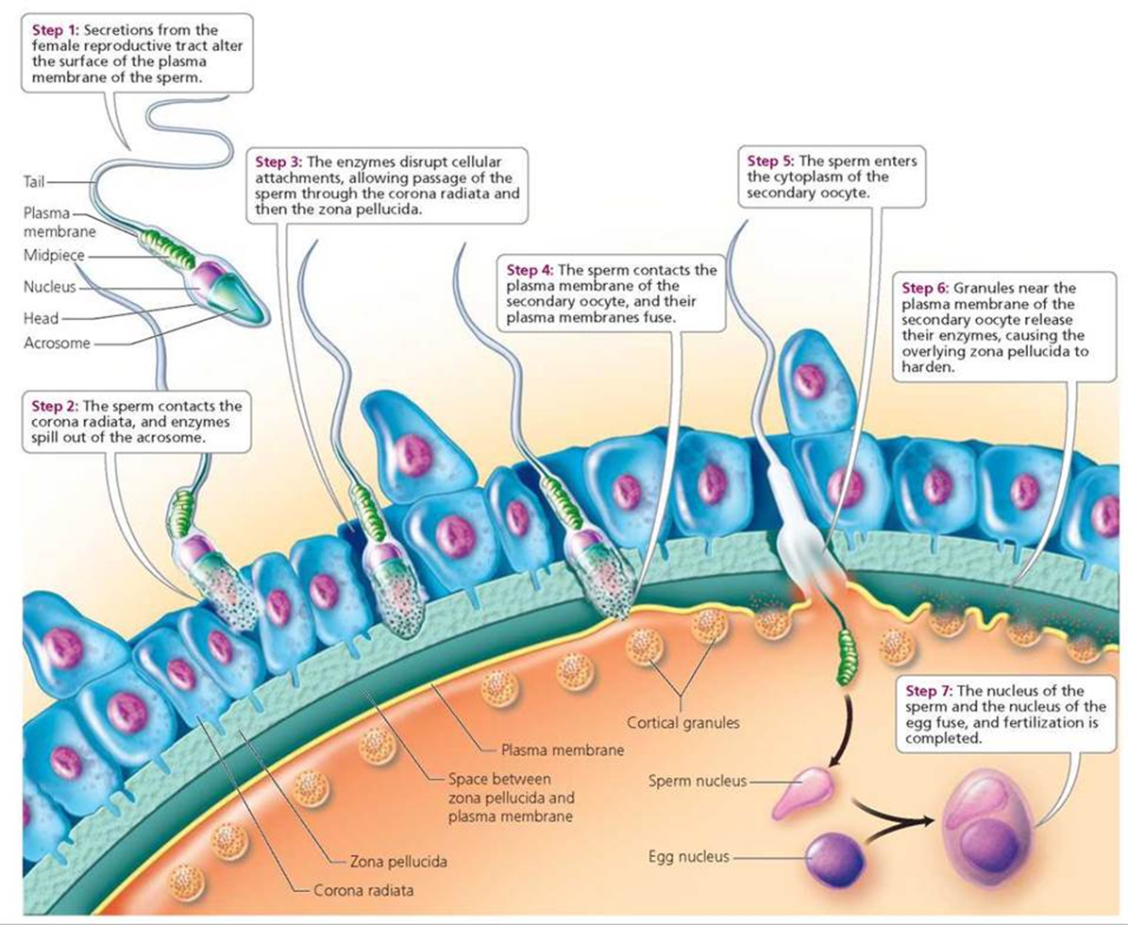

Slide 11
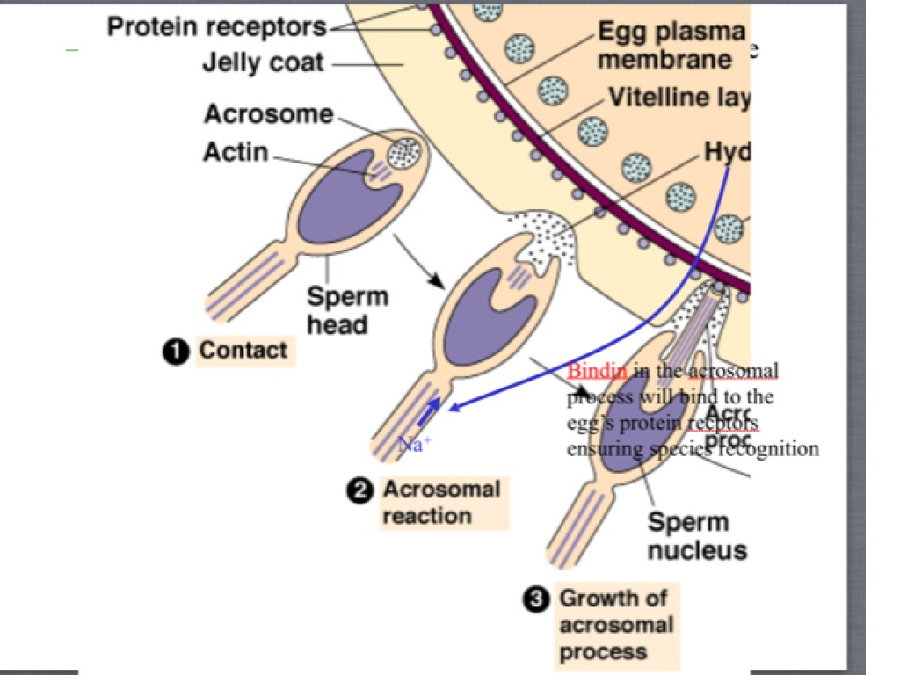

Slide 12
PHYSIOLOGY OF FEMALE REPRODUCTION
DR/ Hassan Ahmed
B.V.Sc, M.D, Ph.D
South Valley University

Slide 13
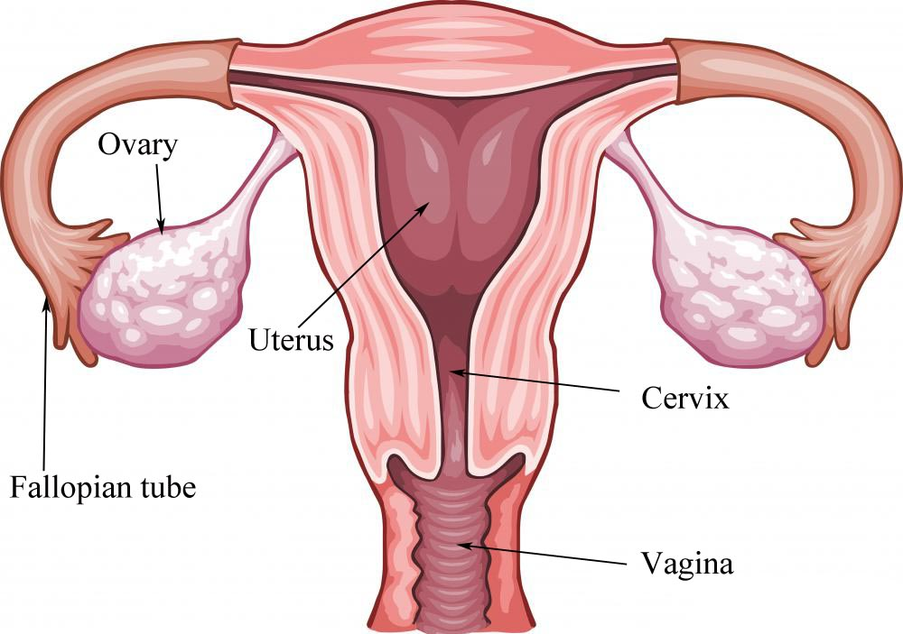

Slide 14
ESTROUS CYCLE
It is rhythmic sexual behavior pattern characterized by physical and hormonal events associated with folliculogenesis, ovulation, leutinization and luteolysis in an adult female animal.

Slide 15
STAGES OF ESTROUS
1- Proestrus
Ovarian changes
Primary follicle: primary oocyte (selective development) surrounded by single and thin layer cuboidal epithelial.
Secondary follicle
Surrounded by multi layers of polyhedral cells, zona layer and antrum without theca layer.
Hormonal changes
Increase FSH.RH, FSH
Level of progesterone vey low

Slide 16
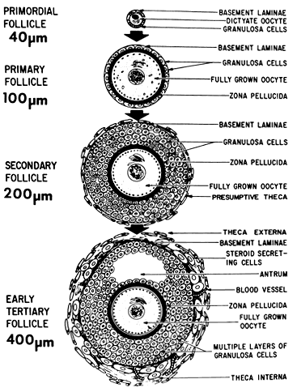

Slide 17
2- Estrus
Ovarian changes
Graafian follicle:
Antrum:
Granulosa cell layer:
Layer of stratified follicular epithelial cell lining antral cavity.
Cumulus oophorus:
Collection of cells around corona radiata.
Play an important role in amino acid transportation, steroid biosynthesis and regulation of oocyte gene transcription.

Slide 18
Theca interna:
More cellular and vascular and less fibrous tissue.
Secrets testosterone hormone which converted by granulosa cells to estradiol which in role converted by aromatase enzyme into estrogen.
Theca externa:
Composed of high amount of fibrous tissue and low cellular and vascular.

Slide 21
Ovulation:
Definition
It is rupture of graffian follicle and discharge the ovum with its corona radiata cells as well as follicular fluid into fallopian tube.
Types of ovulation
A- Spontaneous
B- Induced

Slide 22
Mechanism
Spontaneous ovulation
Endosmotic theory
High level of estrogen leading to concentration of NaCL in antral fluid increasing osmotic pressure followed by exudation of fluid from surrounded tissue to antrum; this increasing intrafollicular pressure on follicular wall ending with rupture and ovulation.

Slide 23
Hormonal theory
LH surge:
LH stimulates release estrogen hormone which causing hyperemia and vasodilatation and exudation of plasma from blood to antral fluid increasing intrafollicular pressure ending with rupture and ovulation.
LH enhances collagenase found in follicular fluid, these proteolytic enzymes have following action:
Loosen cumulus oophorus from membrane granulosa.
Lysis of CT in theca externa.

Slide 24
LH causes contraction of SMF present in theca externa leading to its shrinkage, rupture and ovulation.
Prostaglandin:
Oxytocin hormone:
Bradikinin
It is local hormone found in follicular fluid of bovine, woman and rabbit at ovulation.
It is found in inactive form, it activated by fallopian tube secretion result in relaxation of SMF in fallopian tube creating negative pressure helps in suction and release of ovum from its corona radiate.

Slide 26
Hormonal changes
Estrogen increase as G. follicle increase.
LH level increase (LH surge)
3- Metestrus phase
Ovarian changes
Site of ovulation or follicular cavity filled with blood forming corpus haemorrhagicum,
In cow and buffalo ovulation takes place during early Metestrus, post-estral bleeding or metrorrhagia.
Hormonal changes
levels of LH and estrogen hormones decline.

Slide 27
4- Dietestrus phase
Ovarian changes
Hyperplasia and hypertrophy of granulosa and theca cells which filled with yellow lipid inclusions called lutein cells (CL).
Lutein cells invaded by network of capillaries start to produce progesterone hormone.
Hormonal changes
levels of Progesterone H. increase
FSH gradually increase.

Slide 28
LUTEOLYSIS
It is involution or regression of CL of estrous cycle or pregnancy after parturition. Involution caused by:
Oxytocin hormone
It causes degenerative changes in CL.
Stimulates release thyroid stimulating hormone (TSH) which stimulates vasoconstriction of luteal blood vessels.
Enhances formation of CT in CL.
Prostaglandin (PGF2α)
It is local hormone secreted by uterus under control of parasympathetic nervous system.
It leading to degeneration of luteal cells and decline of CL.

Slide 29
HORMONES CONTROL FEMALE REPRODUCTION
1- Pituitary GnH
2- Placental GnH:
PMS
From endometrial cup
Appear in blood at 40th – 140th days of pregnancy and reaches its peak at 60th – 110th days of pregnancy.
It is mainly FSH like action and has traces of LH like action.

Slide 30
hCG
From chrionic villi of pregnant woman
Appear in urine at few weeks after pregnancy and reaches its peak at 50th days of pregnancy.
It is mainly LH like action and has traces of FH like action.
3- Menopausal GnH
4- Female sex steroids:
Estrogen
Progesterone
Inhibin

Slide 31
Estrogen H
Site of secretion
Mature graafian follicle from theca interna and zona granulosa cells.
Zona reticularis of adrenal cortex in both male and female.
CL secrets small amount.
In male secreted by Leydig cells.
Placenta of some species such as woman, mare and guinea pig

Slide 32
Function
It has estrous inducing capacity.
Responsible for appearance of secondary sex characters in female.
Responsible for signs of estrous cycle (internal and external signs).
On mammary gland:
Stimulates development of duct system.
Stimulates secretion of prolactin hormone which initiates milk production.
It has synergetic effect with progesterone hormone on mammary gland.

Slide 33
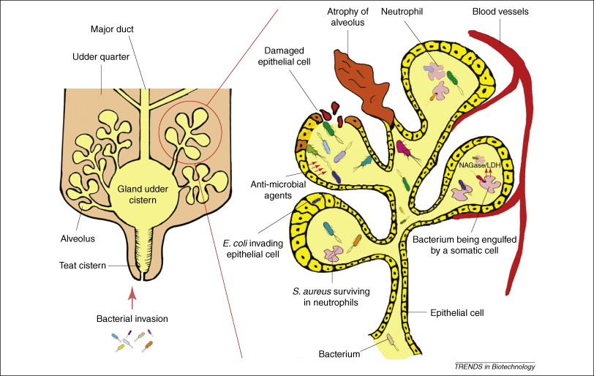

Slide 34
At parturition:
Increases contraction of uterine muscles help in expulsion of fetus.
Increases loosing of pelvic symphysis and relaxation of intrapubic ligaments.
On Endocrine system:
Low dose of estrogen stimulates release of TSH and ACTH while, high dose inhibits TSH secretion.
On minerals:
Increases ferroxidase enzyme responsible for iron absorption.
Helps in deposition of Ca⁺⁺ (calcification).
In mammals, it associated with hypocalcemia while, in birds it associated with hypercalcemia.
Inhibits growth of bone by ossification of epiphyseal line.

Slide 35
It has carcinogenic effect in the presence of genetic factors.
In ruminants, it has anabolic effect on protein leading to increase weight gain and growth in the same time; it stimulates secretion of growth hormone.

Slide 36
Progesterone H.
Site of secretion:
Corpus luteum.
Theca externa of graafian follicle.
Zona reticularis of adrenal cortex in both male and female.
Placenta of some species such as woman, monkey, mare and guinea pig in second half of pregnancy.

Slide 37
Function
Low amount of progesterone has synergetic effect on estrogen while, high amount inhibits follicular growth and ovulation due to inhibition FSH and LH secretion.
Responsible for pregnancy by calming of uterus through increasing Mg⁺⁺ concentration which has narcotic effect.
Stimulates growth of uterus and increase secretory activity producing uterine milk which considered the main nutrition for implanted ovum.
Decreases water content of uterus and oviduct making them flappy.
Responsible for implantation of fertilized ovum and placenta formation.

Slide 38
Help in development of lobuloalveolar system of mammary gland.
It has anabolic effect as it stimulates retention of water, salts and nitrogen causing true growth.
Induces mucification of vaginal discharge leading to formation of cervical plug.

Slide 39
5- Other hormones
Prostaglandins
Oxytocin
Bradikinin

