Slide 1
Commercial Fish Types in Egypt Prof. Dr. Fahim Shaltout Professor of Meat Hygiene Faculty of Veterinary Medicine Professor Benha University, Egypt email: fahimshaltout@hotmail.com

Slide 2
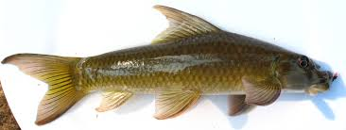
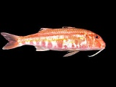
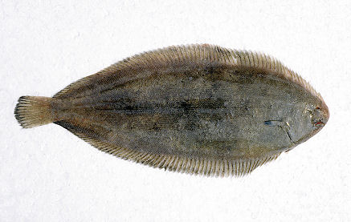
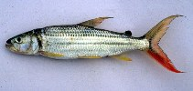
Labeo niloticus
Nile Lebeo
Mullus barbatus
Hydrocynus
Solea vulgaris

Slide 3
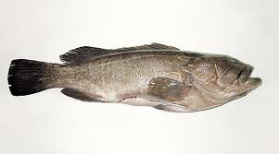
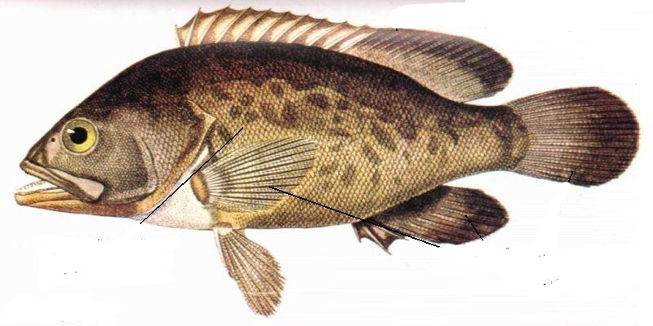
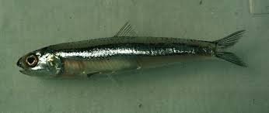
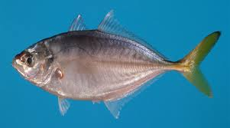
Epinephelus aeneus
Encrasicholina punctifer
Alepes djedaba

Slide 4
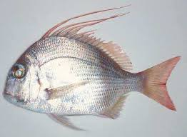
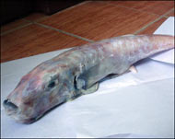
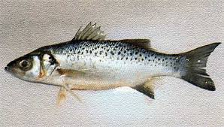
Pagrus pagrus
Rabbit Fish
Dicentrarchus punctatus

Slide 5
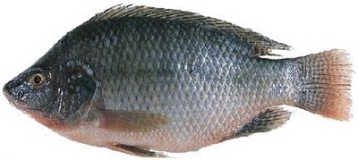
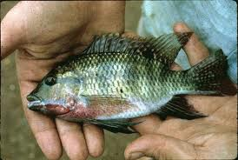
Oreochromis niloticus
Zilli Tilapia

Slide 6
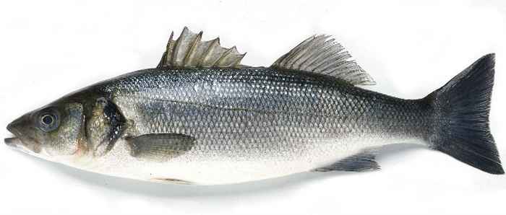
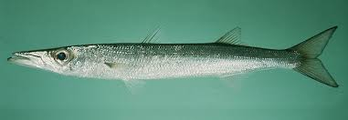
Dicentrarchus labrax
Sphyraena barracuda

Slide 7
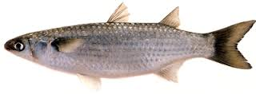
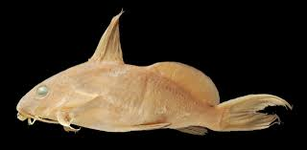
Mugil cephalus
Synodontis schall

Slide 8
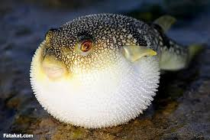
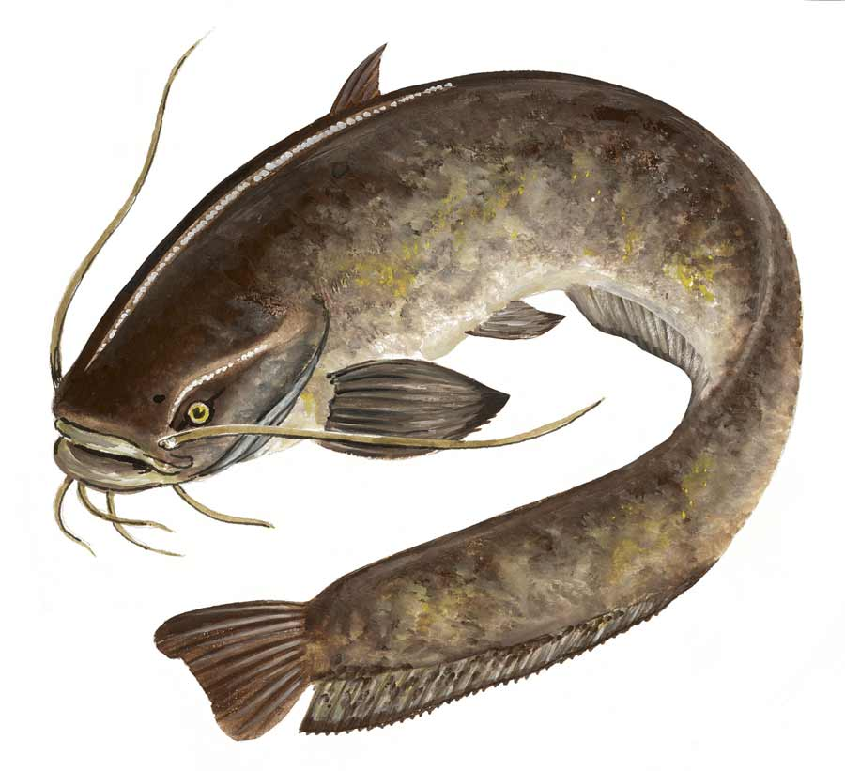
Tetraodon Fahaka
Clarias lazerea

Slide 9
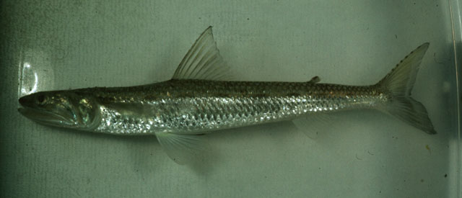
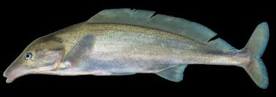
Saurida undosquamis
Mormyrus Niloticus

Slide 10
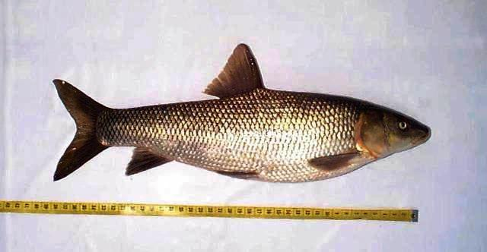
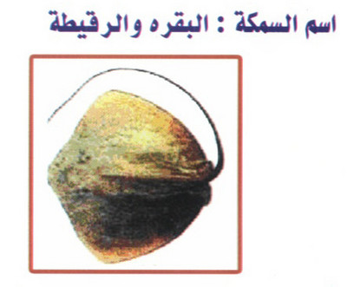
Barbus bynni
Rays

Slide 11
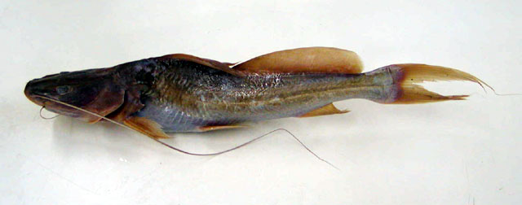
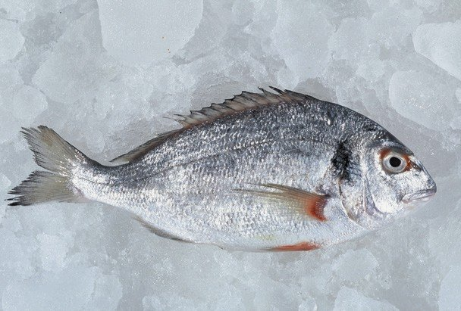
Bagrus bajad
Chrysopherus

Slide 12
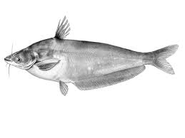
Salmon
Schilbe mystus

Slide 13
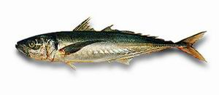
Ctenopharyngodon idella
Grass Carb
Trachurus indicus

Slide 14
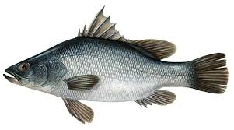
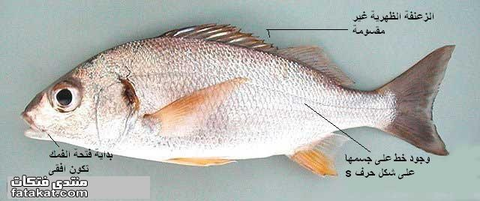
Lates niloticus
Argyrosomus regius

Slide 15
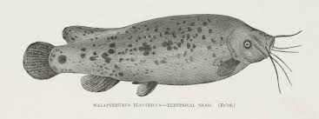
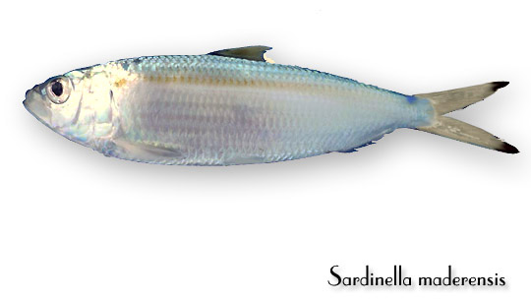
Malapterurus electricus

Slide 16
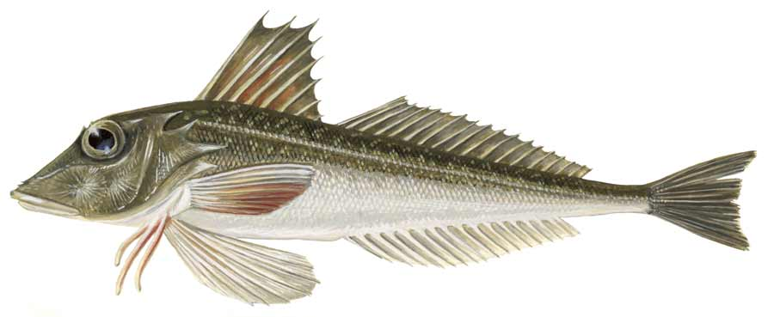
Eutrigla gurnardus

Slide 17
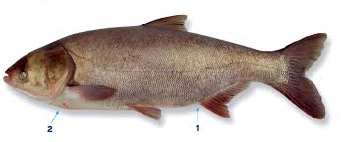
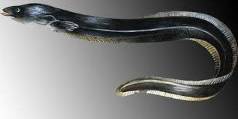

Slide 18
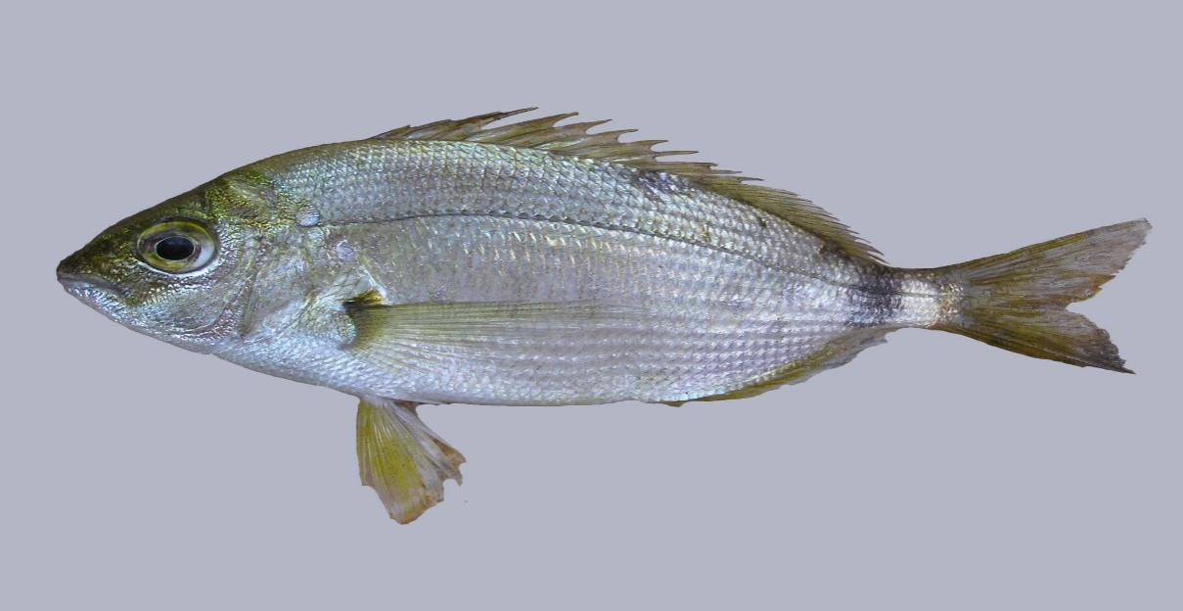
Diplodus annularis
Euthynnus affinis

Slide 19
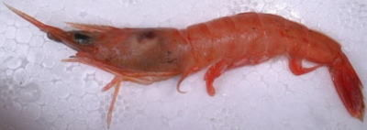
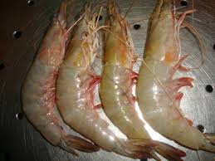
Trachypenaeus curvirostris
Penaeus semisulcatus
Metapenaeus stebbingi

Slide 20
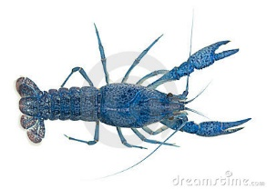
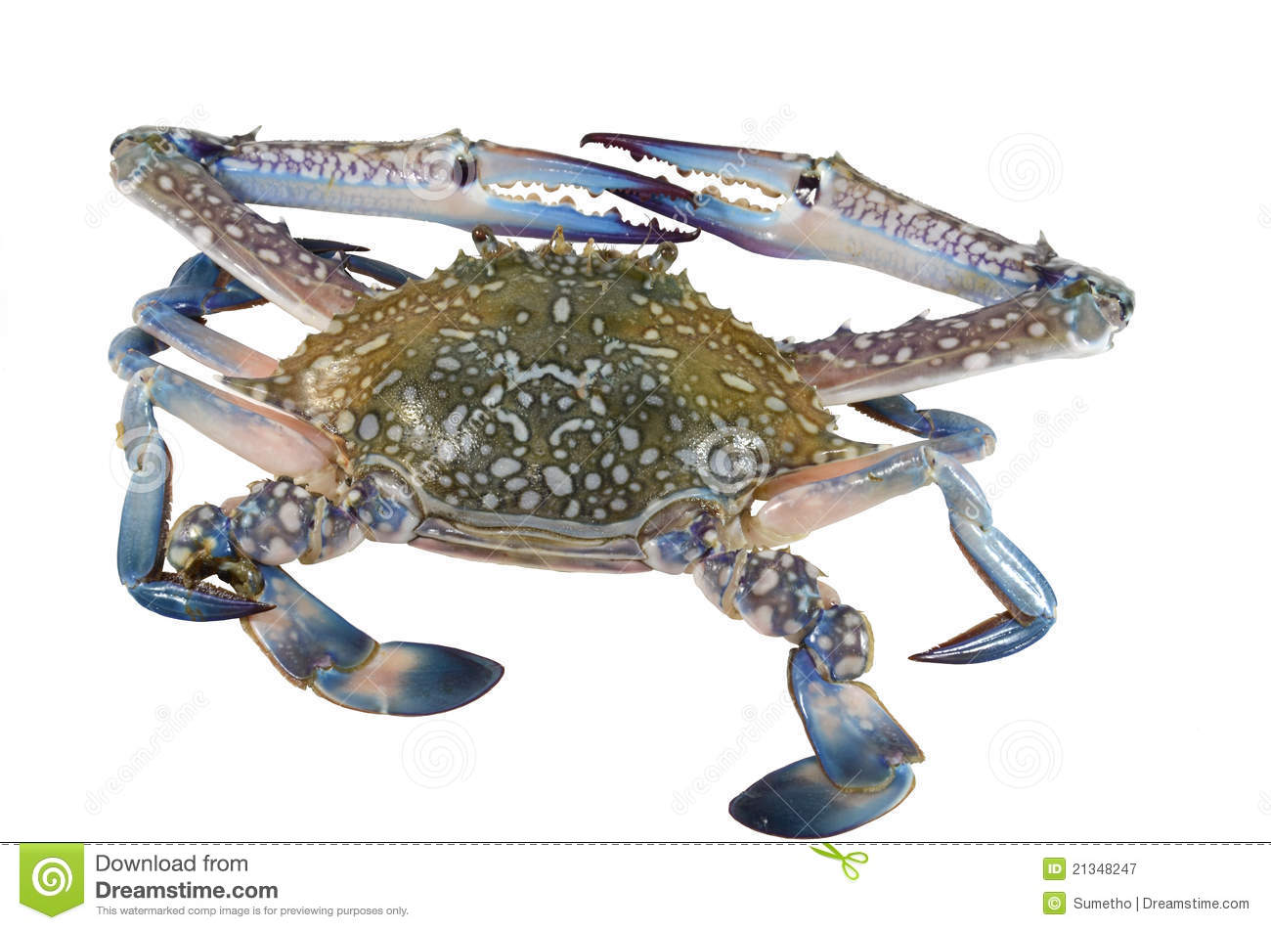
Cray Fish
Portunus pelagicus

