Slide 1
Department of parasitology Practical sections of parasitology
7th Week
24-3-2020

Slide 2
Order: Acarina
(ticks and mites)
Sub-order:
Ixodidea
Family:
Ixodidae
(Hard ticks)
Family:
Argasidae
(Soft ticks)
Sub-order: Sarcoptiforms
Family:
Sarcoptidae
Class: Arachnida
Phylum: Arthropoda
Family:
Psoroptidae
Specie:
Sarcoptes. scabiei
Specie:
Psoroptes. equi
Ticks
القراد
Mites
العثة

Slide 3
Ticks
Larva
Adult
3 pairs of legs
4 pairs of legs
Hard tick
Female partially covered by Scutum
Soft tick
Male Scutum cover all the body
Adult
mammalited & no scutum
Hard tick
Soft tick

Slide 4
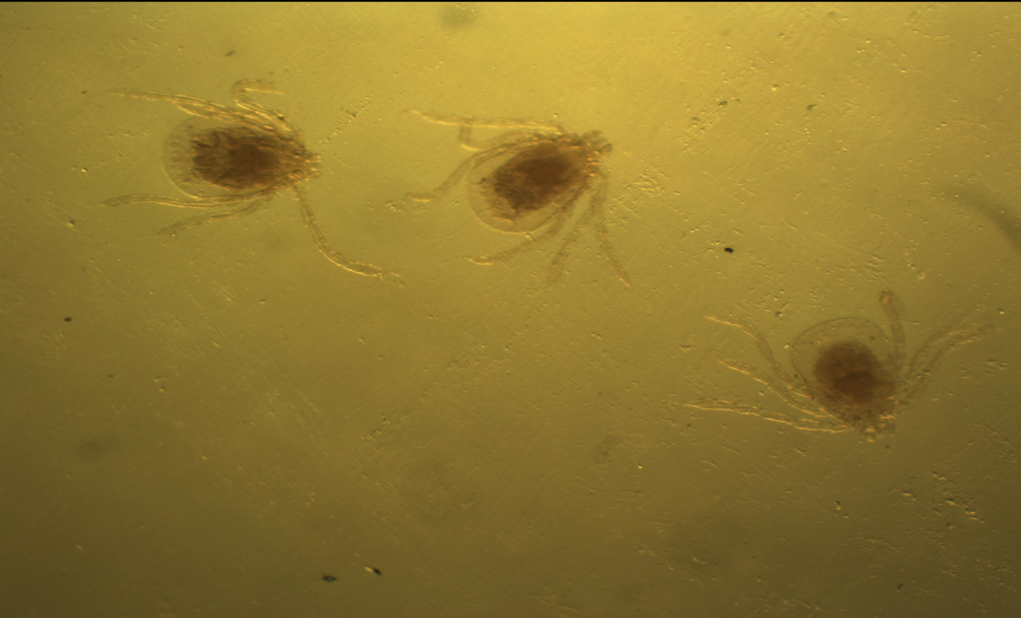
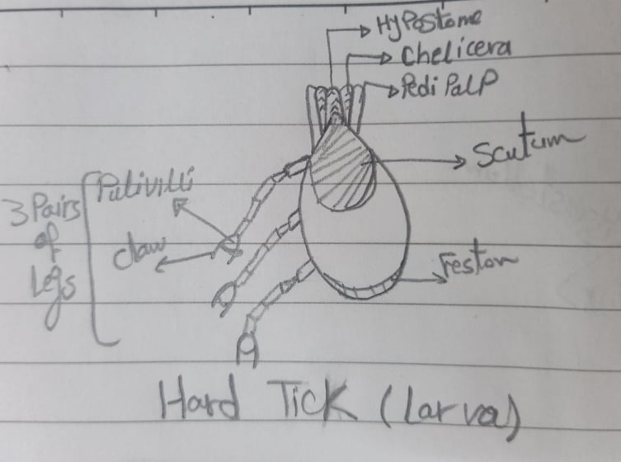
1-Hard tick (larva)
* Characterized by:-
Small in size &oval in shape.
Mouth parts protruded anteriorly.
Larva have 3 pairs of legs with pulivilli .
Scutum cover the dorsal third of the body.

Slide 5
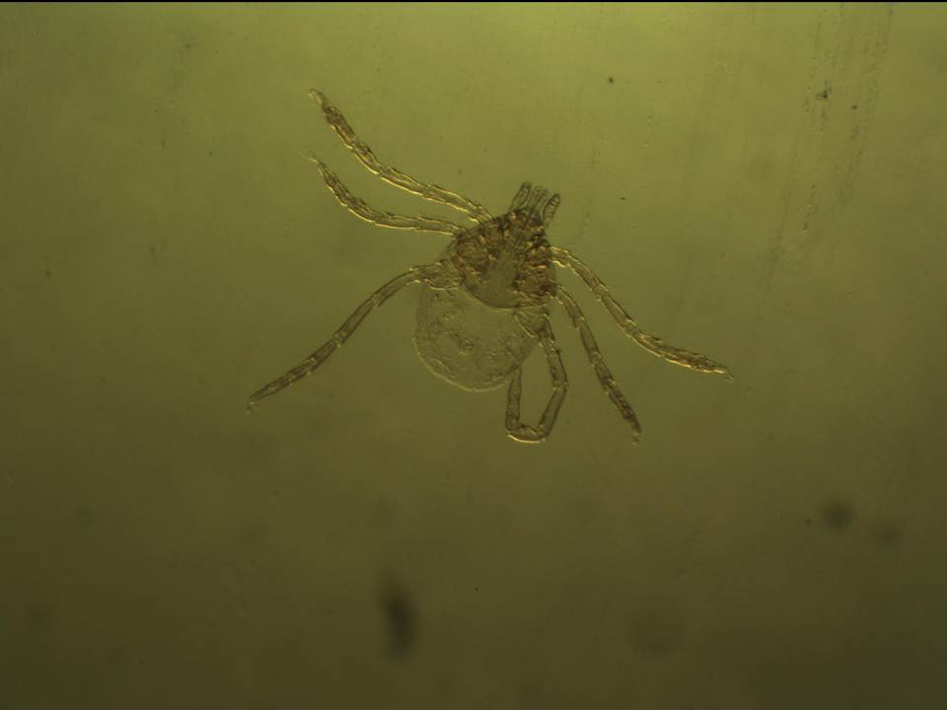
Mouth parts
Scutum
oval in shape
3 pairs of Legs
Feston

Slide 6
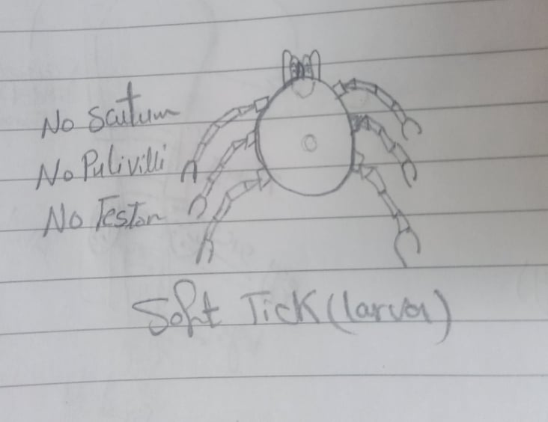
2-Soft tick (larva)
* Similar to hard tick but;
Round in shape.
There is no Scutum ,no pulivilli ,no feston .

Slide 7
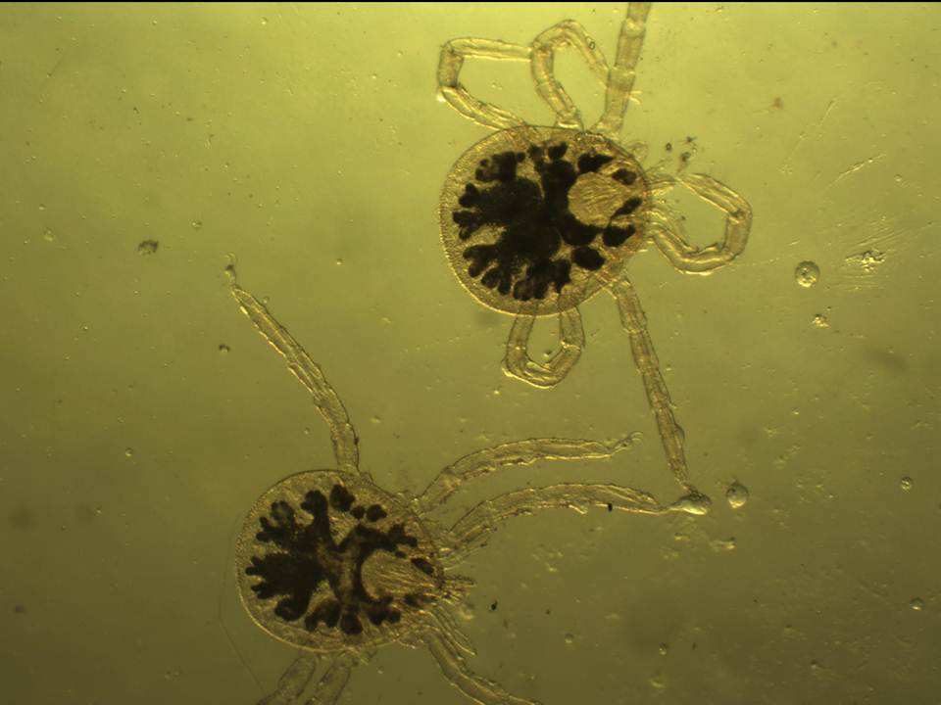
Round in shape
Blood meal

Slide 8
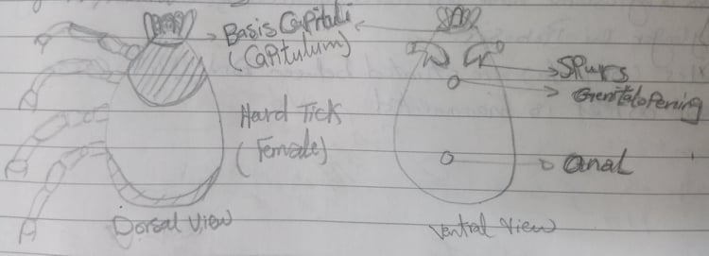
3-Hard tick (Female)
* Characterized by:-
oval in shape & flattened dorsoventrally.
Mouth parts are carried on the capitulum protruded anteriorly & posterior is festoned.
The dorsal surface is partially covered by Scutum.
4 pairs of legs with pulivilli .
Anal opening in the middle of the posterior half ventrally.

Slide 9
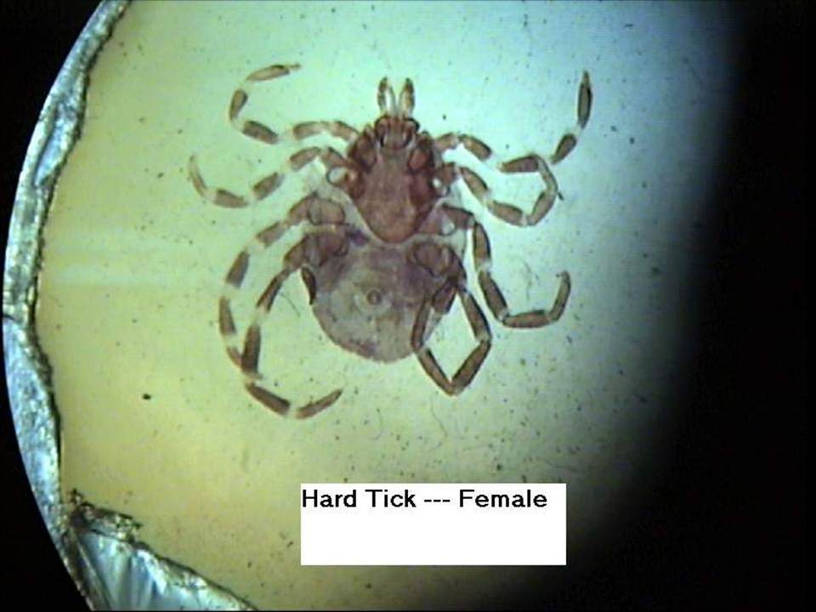
Scutum
Mouth parts
4 pairs of Legs

Slide 10
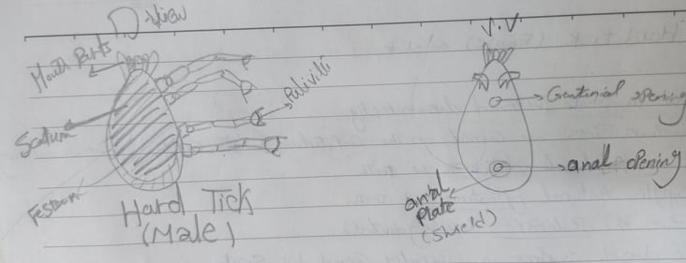
4-Hard tick (Male)
* Similar to female but; smaller in size
The Scutum cover all the body.
Eye located on the lateral marginal.
Have 4 pairs of legs with pulivilli .

Slide 11
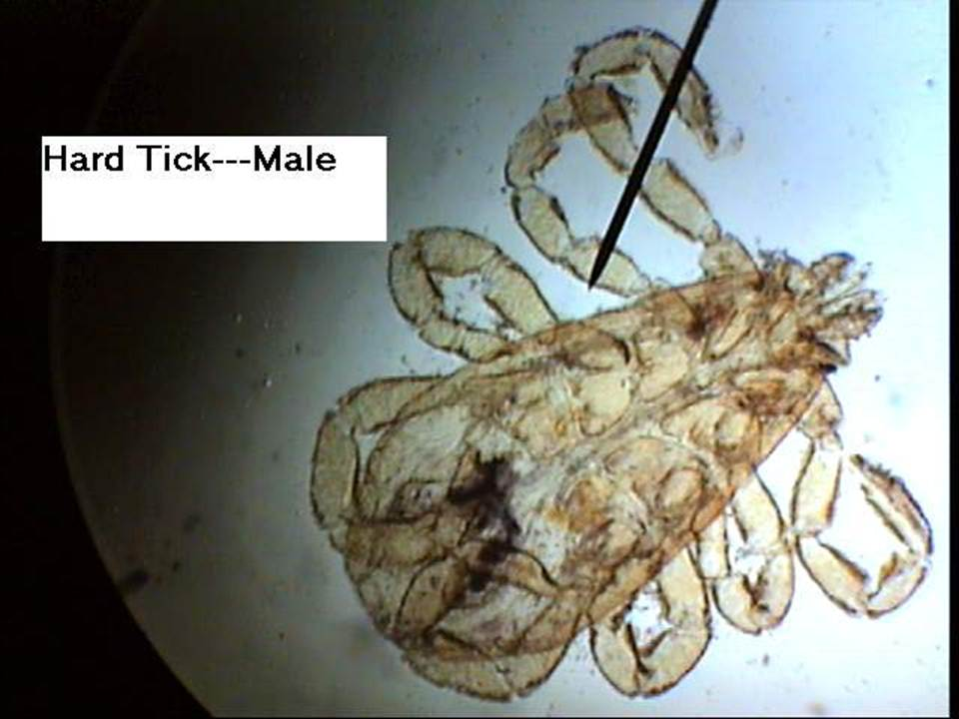
4 pairs of Legs
Scutum

Slide 12
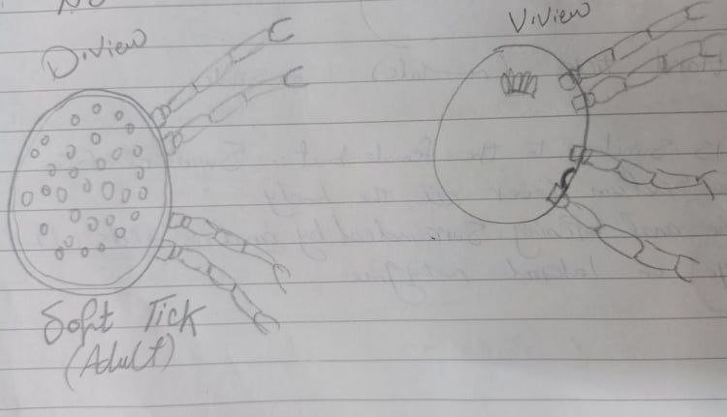
5-Soft tick (Adult)
* Characterized by:-
Disc or Round in shape & Mouth parts not protruded.
The dorsal aspect is mammalited & no scutum .
Have 4 pairs of legs .

Slide 13
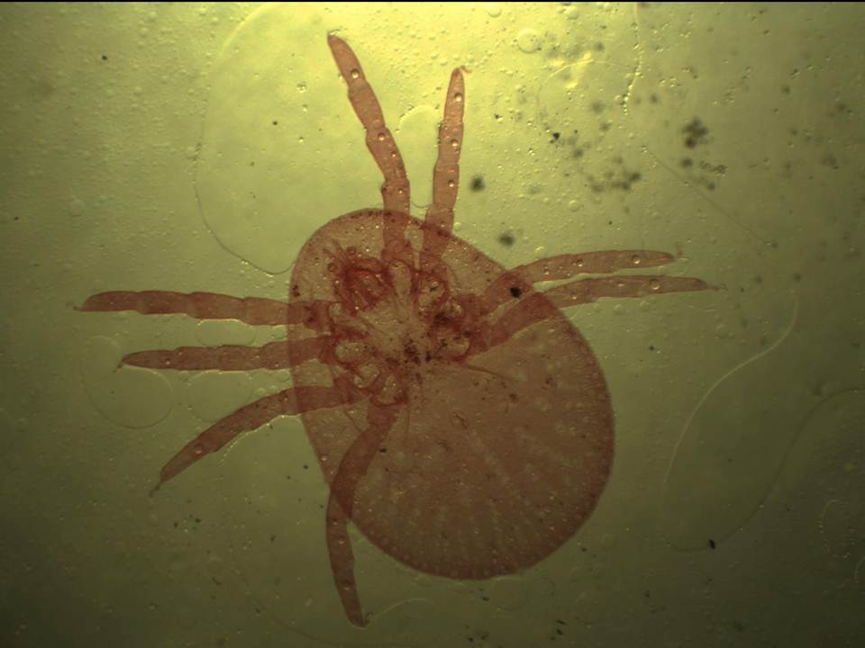
Mouth parts not protruded
The dorsal surface is mammalited & no scutum
4 pairs of legs

Slide 14
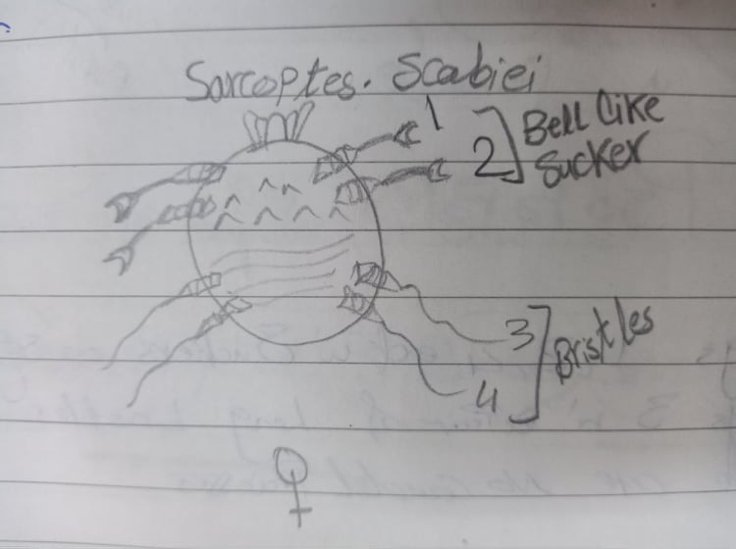
6-Sarcoptes .scabiei (Female)
* Characterized by:-
It is round in shape & Transparent in colour.
Mouth parts protruded anteriorly.
On dorsal surface there are transverse ridges and triangular scales(spines).
They have 4 pairs of short & stumpy legs.
* Legs numbers 1 & 2 end with suckers (bell shaped).
* Legs numbers 3 & 4 in females end with bristles.

Slide 15
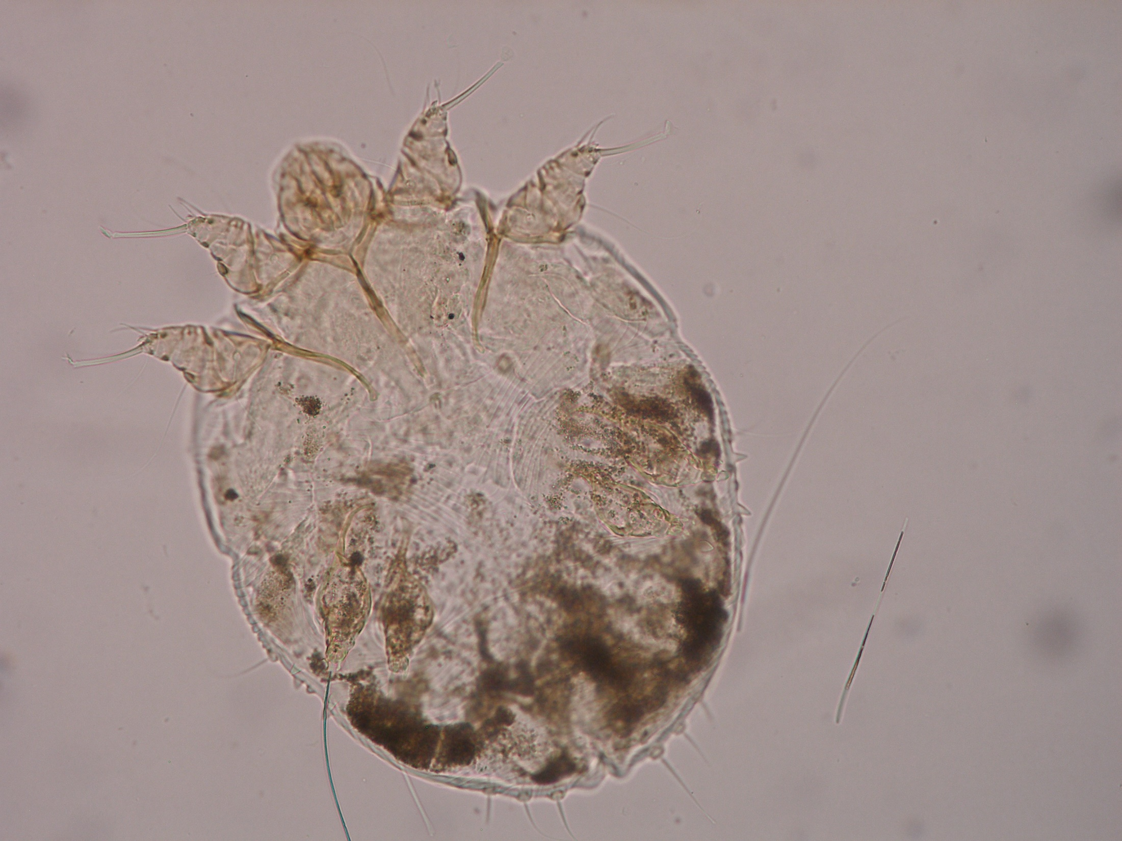
Mouth parts
Legs no. 1 & 2 end with suckers (bell shaped).
Legs no. 3 & 4 end with bristles.
bristles

Slide 16
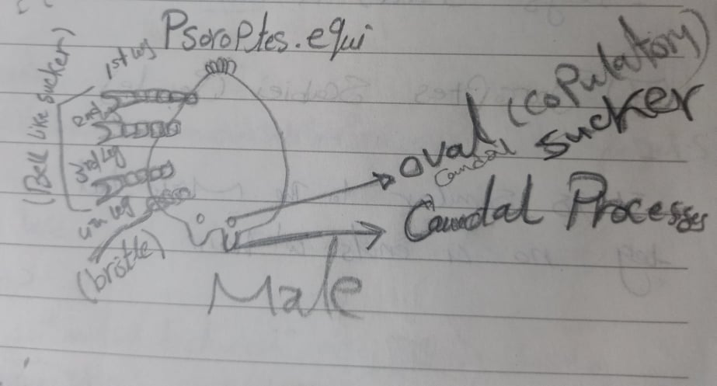
7-Psoroptes .equi (Male)
* Characterized by:-
It is oval in shape.
The legs are long.
*Legs 1 , 2 & 3 end with (bell-shaped) suckers.
*Leg No. 4 of males is short & end with bristles.
Male has 1 pair of caudal copulatory oval sucker on the posterior end of the abdomen & behind them 1 pair of caudal processes (bilobed abdomen).

Slide 17
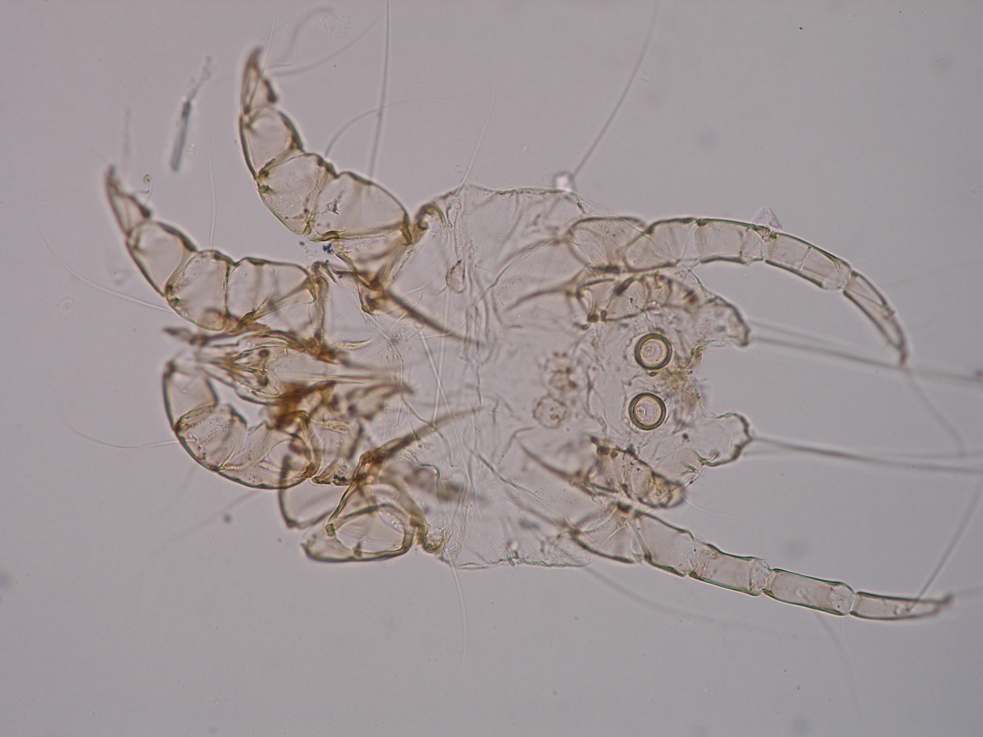
copulatory (oval) sucker
caudal processes
Leg No. 4 is short

