Slide 1
Bacteriological examination of water
Fifth year students
21*3*2020

Slide 2
Detection of the extent of fecal pollution
Detection of coliform group
Detection of fecal streptococci
Detection of Colstridium welchii

Slide 3
Detection of Coliform group
Presuptive coliform test (Most probable number)
Ejkman test (differrntial test)

Slide 4
Presumtive coliform test(Most probable number)
MPN is most commonly applied for quality testing of water to ensure whether the water is safe or not in terms of bacteria present in it. A group of bacteria commonly referred as fecal coliforms act as an indicator for fecal contamination of water.
.

Slide 5
Principle
Water to be tested is diluted serially and inoculated in lactose broth, coliforms if present in water utilize the lactose present in the medium to produce acid and gas . The presence of acid is indicated by color change of the medium and the presence of gas is detected as gas bubbles collected in the inverted durham tube present in the medium. The number of total coliforms is determined by counting the number of tubes giving positive reaction (i.e both color change and gas production) and comparing the pattern of positive results (the number of tubes showing growth at each dilution) with standard statistical tables

Slide 6
MPN test is performed in 3 steps
Presumptive test
Confirmatory test
Completed test

Slide 7
Presumptive test
Requirements :
Medium: Lactose broth or Mac Conkey Broth or Lauryl tryptose (lactose) broth
Glasswares: Test tubes of various capacities (20ml, 10ml, 5ml), Durham tube
Others: Sterile pipettes
Preparation of the Medium
Prepare medium (either mac conkey broth or Lactose broth)in single and double strength concentration.
:Dispense the double strength medium in 5tubes (10ml in each tube) and single strength medium in 10 tubes (10 ml in each tube)and add an durham tube in inverted position.

Slide 8
Procedure of the test

Slide 9
Take 5 tubes of double strength and 10 tubes of single strength for each water sample to be tested.
Using a sterile pipette add 10 ml of water to 5 tubes containing 10 ml double strength medium.
Similarly add 1 ml of water to 5 tubes containing 10 ml single strength strength medium and 0.1 ml water to remaining 5 tubes containing 10 ml single strength medium.
Incubate all the tubes at 37°C for 24 hrs. If no tubes appear positive re-incubate up to 48 hrs.
Compare the number of tubes giving positive reaction to a standard chart and record the number of bacteria present in it.
For example: a water sample tested shows a result of 3–2–1 (3 × 10 ml positive, 2 × 1 ml positive, 1 × 0.1 ml positive) gives an MPN value of 17, i.e. the water sample contains an estimated 17 coliforms per 100 ml

Slide 10
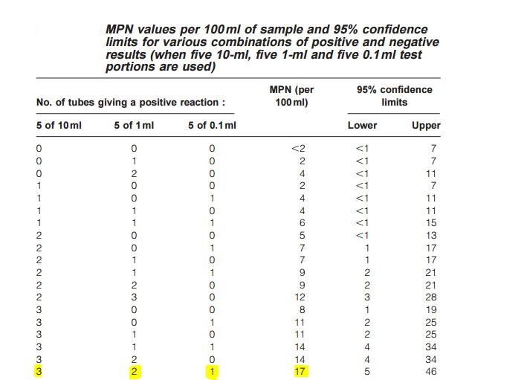

Slide 11
2. Confirmed test:
Some microrganisms other than coliforms also produce acid and gas from lactose fermentation. In order to confirm the presence of coliform, confirmatory test is done.
From each of the fermentation tubes with positive results transfer one loopful of medium to3 ml lactose-broth or brilliant green lactose fermentation tube
Incubate the inoculated lactose-broth fermentation tubes at 37°C and inspect gas formation after 24 ± 2 hours. If no gas production is seen,further incubate up to maximum of 48 ±3 hours to check gas production
The formation of gas in lactose broth indicates the presence of a member of the coliform group in the sample examined.

Slide 12
3. Completed test:
Since some of the positive results from the confirmatory test may be false, it is desirable to do completed tests. For this inoculum from each positive tube of the confirmatory test is streaked on a plate of EMB or Endo agar. Coliforms produce colonies with greenish metallic sheen

Slide 13
Ejkman test
For the differrntiation between typical and atypical coliform bacteria , sub-culturing the positive presumptive cultures into fresh tubes containing 5 ml MacConkey bile salt broth with durham tubes and incubating them for 24 to 48 hr in a thermostatically controlled water bath at 44∙C.
If acid and gas are produced this indicates that the coliform bacteria are of typical type

Slide 14
Sanitary classification of water based on coliform bacteria
class | Quality | E.Coli count/100ml | Presumpitive coliform count/100ml
1 | Highly satisfactory | 0 | 0
2 | satisfactory | 0 | 1-3
3 | suspecious | 0 | 4-10
4 | unsatisfactory | 1 or more | More than 10

Slide 15
Detection of fecal streptococci
The same method that adobted for coliform.
MPN of fecal streptococci by using azide dextrose broth. Incubation is performed at 37C for 48hr.
The tubes examined for the presence of turbidity

Slide 16
Detection of Colstridium welchii
Presence of spores of Cl. Welchii in water indicate old fecal pollution.
Inoculation of multiple portions of water previously heated at 75C for 10 minutes to destroy non spore forming organisms into differential reinforced colstridial medium(DRCM) in screw capped bottles. Then incubated at 37C for 48hr.
Positive reaction will shown by blackening of the medium
Loopful from each positive bottle should be subcultured into tube of litmus milk . The tubes incubated at 37C for 48hr . Cl.welchii will produce stromy clot in which milk acidified and coagulated and the clot distributed by gas.

Slide 17
Thank you

