Slide 1
Bacteriological examination of water
Fifth year students
14/3/2020

Slide 2
The bacteriological examination of water sample consists of:
Determination of total bacterial count
Determination of total fungal count
Determination of extent of fecal pollution
Detection of potentially pathogenic microorganisms

Slide 3
Total bacterial count
The numbers of living organisms in water samples as well as the saline of collected swabs were counted using standard pour plate method (Cruickshank et al. 1980)
The original collected water samples were thoroughly shaken several times , ten fold serial dilutions were aseptically prepared from the collected water samples : 1ml of each final dilution was aseptically transferred into double sterile petri dishes over which 10ml sterile standard plate count agar previously melted and cooled at 45∙C were aseptically poured and thoroughly mixed with saline suspensions.
The plates were incubated after full solidification at 37∙C for 48 hours. A control agar plate was similarly incubated.
Plates showed colonies ranged from 30-300 colonies were selected and counted using digital colony counter.

Slide 4
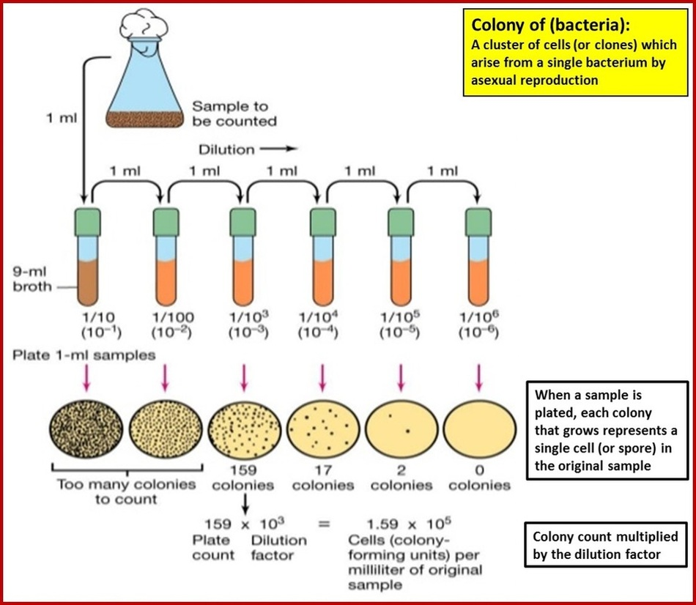
Total bacterial count

Slide 5
Total bacterial count
The number of non pathogenic bacteria present in water must not exceed than 100 organism in 1ml of water
Sometimes. The total bacterial count of water sample is very low and water unfit for consumption due to presence of pathogenic bacteria.

Slide 6
Total fungal count
The same technique as previously mentioned in total bacterial count except:
Media used is 10 ml Sabouraud՚s dextrose agar
Incubation at 22∙C for 3-5 days
P.H. should be acidic 3-3.5

Slide 7

Thank you

