Slide 1
Claw or digit amputation

Slide 2
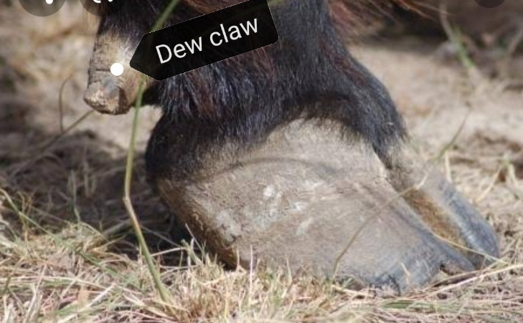
NB/ the bovine foot is composed of four digits, two are functional digits and two are nonfunctional digits (dew claws).

Slide 3
Definition/ surgical excision of the affected digit or claw
It is performed in all animals to increase survival rate of the animals except in horse (no hoof no horse).

Slide 4
Indications/ for treatment of irreversible lesions as:
1/infectious arthritis of the interphalangeal joint.
2/luxation or dislocation of the interphalangeal joint.
3/osteitis and osteomyelitis of the middle or distal phalanx.
4/compound comminuted fractures of the middle or distal phalanx.
5/septic tenosynovitis.
6/necrosis of the insertion of the deep digital flexor tendon.
7/ abscessiation and necrosis of the digital cushion.
8/ incurable foot rot and septic pododermatits.

Slide 5
Sites of operation (types of amputation)/ there are three types of amputation:
1/disarticulation/ at the pastern joint.
2/low amputation/ at the middle of second phalanx.
3/high amputation/ at the junction between the middle and distal third of the proximal phalanx.

Slide 6
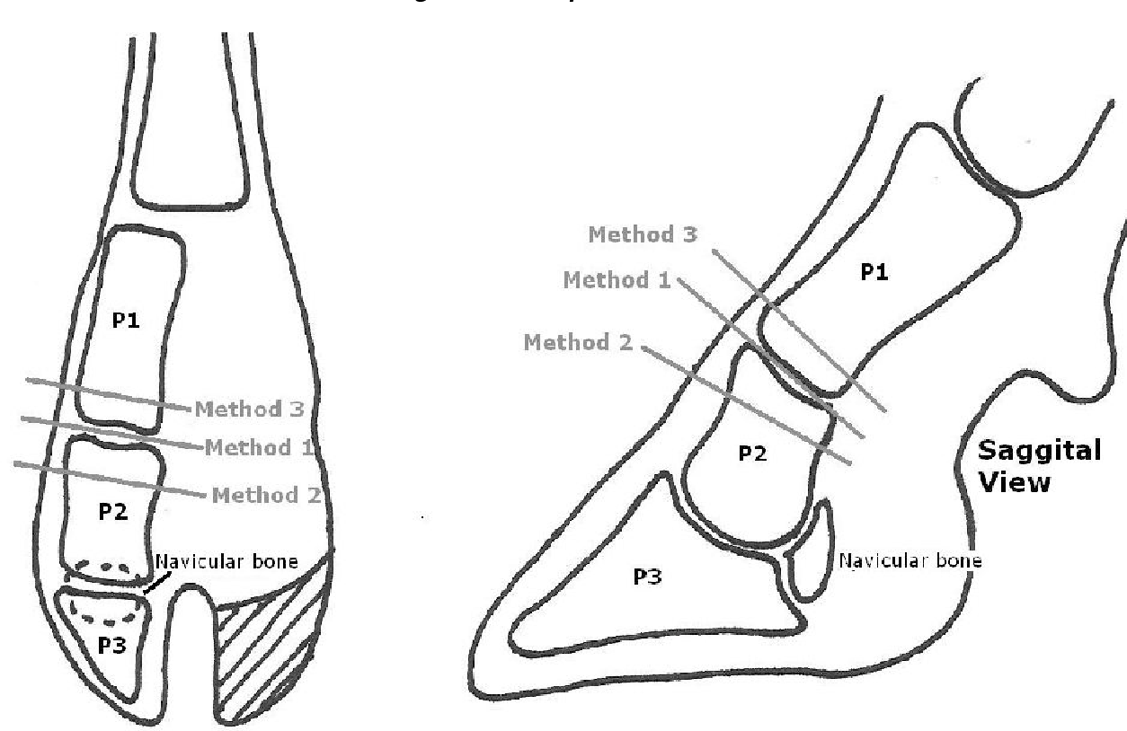

Slide 7
Anaesthesia/ it is performed under effect one of the following:
1/tranquilizer and ring block above fetlock joint using lidocaine 2%.
2/intravenous regional analgesia (application of tourniquet below the carpus or tarsus then injection 10:30 ml lidocaine 2% intravenously below the tourniquet).

Slide 8
Surgical preparation/
Lateral recumbency of the animal with the affected claw upper most.
Removal of debris from claw and interdigital space.
Clipping of hair from midmetacarpal or midmetatarsal region distally till the claw.
Scrubbing by antiseptic solution.

Slide 9
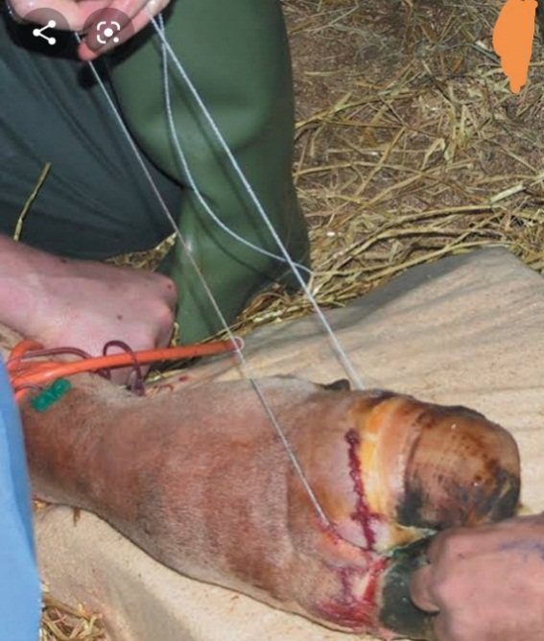
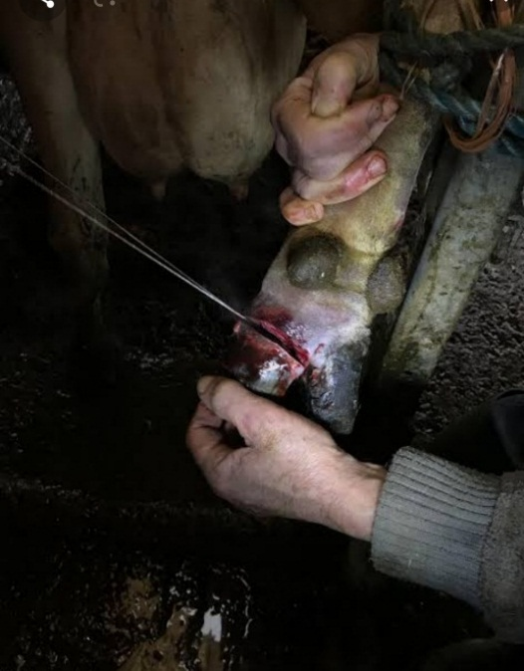
Technique of the operation/
Skin incision is made along abaxial and axial surface of the coronary band, then vertical incisions are made cranially and caudally.
Dissection of the skin to free it from underlying digit.
Then amputation is performed by using of obstetric wire (high amputation or law amputation or disarticulation).

Slide 10
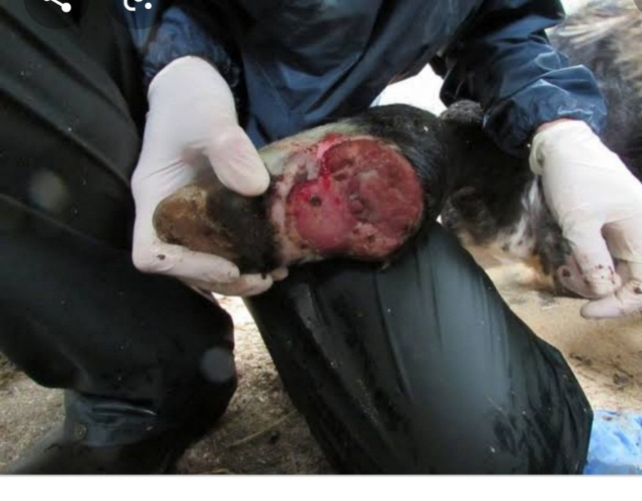
Once the digit has been removed the interdigital fat and necrotic tissue are removed and blood vessels are legated.

Slide 11
Skin flap can be sutured to cover the wound or trimming of the skin and allow drainage and granulation of the wound (heeling by second intension).
The tourniquet is released slowly.
Application of local antibiotic at surgical site

Slide 12
Postoperative management/
Application of bandage to prevent contamination and reduce haemorrhage, change bandage every 48 hours and keep it until wound healing completely.
Keep the animal in clean dry area until complete healing of the wound.
Systemic antibiotic and anti-inflammatory.

Slide 13
Digit amputation is contraindicated in the following cases:
1/affection involvement of both digits of the same foot.
2/sepsis of the fetlock joint.
3/heavy bull or cow.

