Slide 1
Skin scraping

Slide 2
It is a routine technique used for diagnosis ectoparasites in different species of animals.
Used mainly for diagnosis mange and ring worm.
Contact (direct and in direct )
Sampling :
A. Direct method: The skin scrapings are placed on clean and dry glass slide with one drop 10% potasium hydroxide.. Heating…then cover it with cover slide.. . Examine under low power of microscope. .

Slide 3
B. Heat method:
in a clean test tube add skin scrape with equal volume of 10% KOH ,heating the mixture on a flame ,cooling at room temperature, centrifuge the mixture at 1500 rpm for 5 minutes then discard supernatant and take the sample from sediment apply on a glass slide followed by covering by a cover slide finally examine under microscope under low power

Slide 4
C. Digestion and concentration method :
in a clean flask or test tube add skin scrape with 5% KOH (1:10) , heating the mixture on a flame with covering to obtain completely digestion and concentration ,cooling at room temperature, centrifuge the mixture at 1500 rpm for 5 minutes discard supernatant, add equal volume of distalled water and centrifuge again for 5 minutes discard supernatant and examine the sediment under low power of microscope .

Slide 5
N.B : if the sample appear negative you can discard supernatant but re suspend sediment with saturated sucrose solution ,centrifuge at 1500rpm for 5 minutes , examine the top of the mixture microscopically.

Slide 6
C. diagnosis of ring worm:
Causes ?????
World wide
Zoonotic diseases
Case history
Clinical observation
Skin scraping
Wood ’ s Light Examination

Slide 7
Fungal culture:
“Gold standard” for diagnosis. _ Choose hairs that fluoresce under Wood’s lamp if possible.
N.B STERALIZATION WITH ALCOHOL
Sampling methods:
Pluck hairs from the periphery of an alopecic area.
Brush hair coat with a sterile toothbrush. On Dermatophyte test media( sabaroud dextrose agar media ) 5-7days
dermatophytes change media color , examine inoculated media daily. Microscopic examination of the growth for microconidia and macroconidia necessary to confirm pathogenic dermatophyte .

Slide 8
Microsporum canis

Slide 9
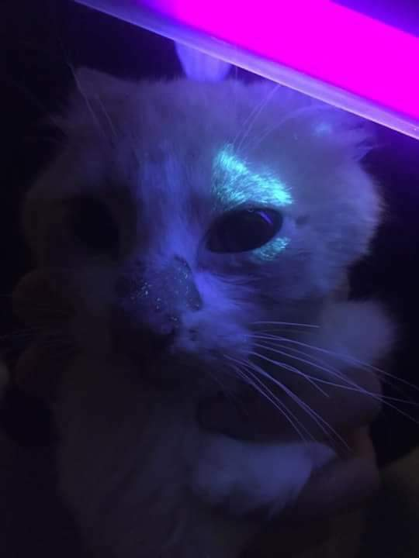
Wood ’ s light examination of a cat with dermatophytosis showing positive fluorescence results.

Slide 10
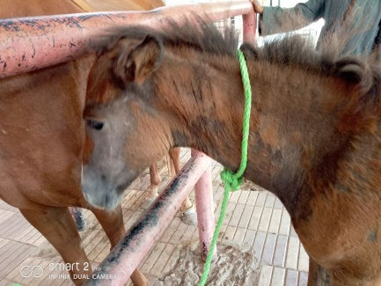
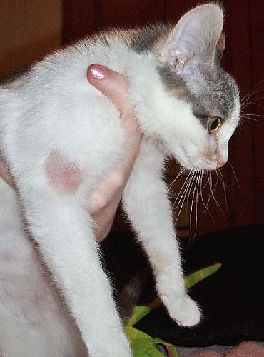

Slide 11
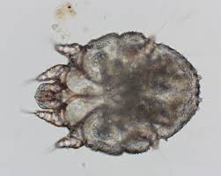
Sarcoptic mange

Slide 12
Mange in bull

Slide 13
White top surface, cotton or wool consistency

Slide 14
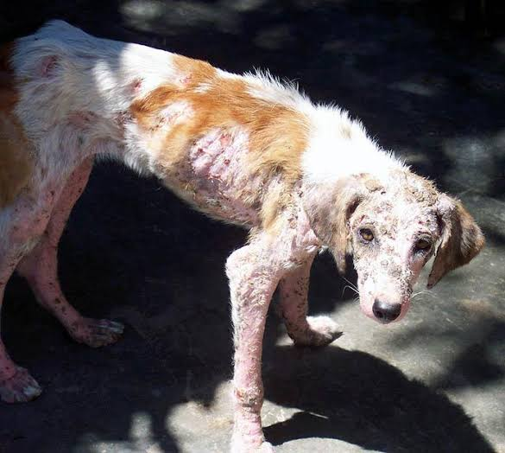
Discuss ???

Slide 15
Thank you very much

