Slide 1
Semen
definition

Slide 2
Semen
It’s the milky secretion of testicles, prostate and seminal vesicles.
Sperms are produced in the tests by spermatogenesis which needs FSH for initiation and high local testosterone for maintenance .
Each sperm consist of head, middle piece and tail

Slide 3
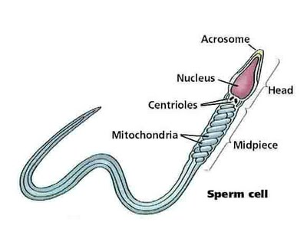
Head
Contain the nucleus which contain haploid number of the chromosomes .
Acrosome:-which contain peptidase and hyalouranidase enzymes which are important for penetration and fertilization of the ovum

Slide 4
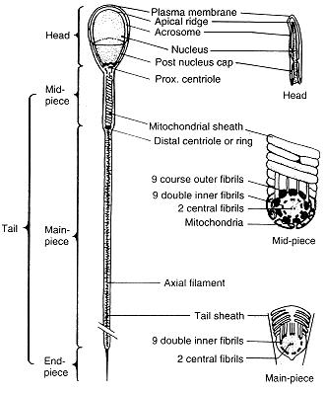
Middle piece(neck)
Contain mitochondria for energy production

Slide 5
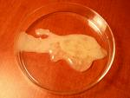
Tail
It contain a protein similar to myosin fibrils .
Its responsible for sperm motility.

Slide 6
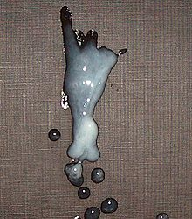
Characteristics of semen 1-colour
Its milky whitish.
2-volume.
3-5 ML .
3-Number.
60-120 Million\ml
The lower normal limit is 10 million\ml
-oligospermia:-sperm count below 10 M\ml.
-Azospermia:-no sperm just seminal plasma.

Slide 7
4-Specific gravity
1028.
5-PH.
7.2-8.
6- shape
Normally 80% must of normal shape and only 10-20% abnormal

Slide 8
7-motility
Its foreword progressive movement
It can reach the oviduct with in 30-60M after copulation.
The normal motility:-70-90% in the 1st H.
50-70% in the 2nd H
40-60% in the 3rd H
The lower normal limit is 40% motile

Slide 9
8-viscosity
It is viscous it clots rapidly due to presence of fibrinogen and coagulase enzyme and then liquefies with in one hour due to presence of fibrinolysin from prostate.
Increase viscosity may be a cause of male infertility.

Slide 10
Chemical constituent of semen
A-carbohydrates:-
1-fructose:-normal level is 150-650mg\dl
It is the main sugar in semen it used as a nutrient for sperms and essential for its activity and viability.
It decrease in testosterone deficiency (impotence) and so fructose % used as fertility test.
2-citric acid and vit. C

Slide 11
B-protein
1-fibrinogen:-cause rapid clotting of semen after ejaculation.
2-fibrinolysin:-liquefy the clotted semen with in 20-60 M after ejaculation.
3-spermine &spermidine :-they are polyamines secreted by the prostate they give the characteristic odour of semen.
4-enzymes:-acid phosphatase ,atpase ,coagulase and hyaluronidase.

Slide 12
C-lipid
1-prostaglandins:-produced by prostate and cause uterine contraction to help the uptake of semen by uterus.
2-phospholipids
3-cholesterol

Slide 13
D-minerals
1-zinc:-its very important mineral in semen it inhibits testicular proteolytic enzymes so decrease of zinc activate this enzymes lead to testicular destruction and sterility .
2- Ca-Mg-K.
3-phosphate and bicarbonate buffer.
-Vit. C & ergothionine as antioxidant

Slide 14
Abnormalities
Aspermia: absence of semen
Azoospermia: absence of sperm
Oligospermia: low semen volume
Oligozoospermia: low sperm count
Asthenozoospermia: poor sperm motility
Teratozoospermia: sperm carry more morphological defects than usual

