Slide 1
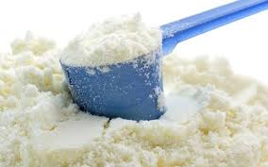
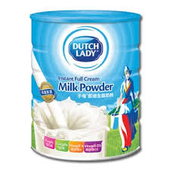
Milk powder
Def. :it is product of milk resulting from Complete removal of water from milk

Slide 2
Sampling
1-from bulk
The sample collected from different places by using dry sterile spoon after making thoroughly mixing of the content ,then transfer the sample to wide mouth jar

Slide 3
2-from can
One or more un opened cans are collected as a random sample
Before opening it ,the can should be washed by warm water and soap

Slide 4
Preparation of sample: by Reconstitution of milk powder
In test tube add:
1 part M.P + 7 part D.W
At temp.20c in case of M.P prepared by spray method
At temp.85c in case of M.P prepared by roller method

Slide 5
Skim milk powder :30gm +300 ml D.W
Whole milk powder :37 gm +300 ml D.W
N.B) whole milk give (powder milk )more than skim milk

Slide 6
Physical examination
As canned milk

Slide 7
Chemical examination
Fat %:
Gerber method :in clean milk butyrometer add
8 ml reconstituted M.P +3ml D.W heated at 70c then complete as milk
Rose gottlieb method
1gm M.P +8ml D.W heated , then boiling these content till lumps disappear
Complete as milk

Slide 8
Protein % :
T.S % and moisture % :

Slide 9
Solubility of M.P
by 2 methods
1- rapid method 2- standard method

Slide 10
1- rapid method
In clean dry test tube add
10ml D.W ,then sprinkle milk powder on the surface of water without shaking
Result :
Milk solution without sediment :good soluble M.P
Clear solution with sediment :bad soluble M.P

Slide 11
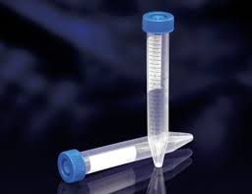
2- Standard method
in clean dry beaker add
20gm M.P
200 ml D.W mixing for 5 minutes
Take 25 ml from this solution in special caliberated centrifuge tube

Slide 12
Centrifugation at 3000 rpm for 15 min till formation of 3 layer (cream ,supernatant ,sediment)
Remove cream and supernatant fluid ,but leave the sediment
Add 25ml D.W to sediment ,shaking
Complete the content till 50 ml
Recentrifugation for 15min at 3000 r.p.m
Complete as before……….

Slide 13
Result
Acc. to the amount of sediment
If large amount sediment :bad soluble M.P
If small amount sediment :good soluble M.P

Slide 14
Adulteration of milk powder
detection of starch in M.P
It can be detected by :
1- taste
2- microscopic examination
3-chemical examination

Slide 15
1-taste
The starch has characterstic taste which differ from taste of M.P

Slide 16
2-Microscopic examination
Add drop of re constituted milk powder over clean ,dry glass slide and cover it by cover slide
Leave it to dry
Examine it under microscope
Result
Normally M.P has no starch granules

Slide 17
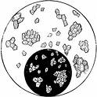
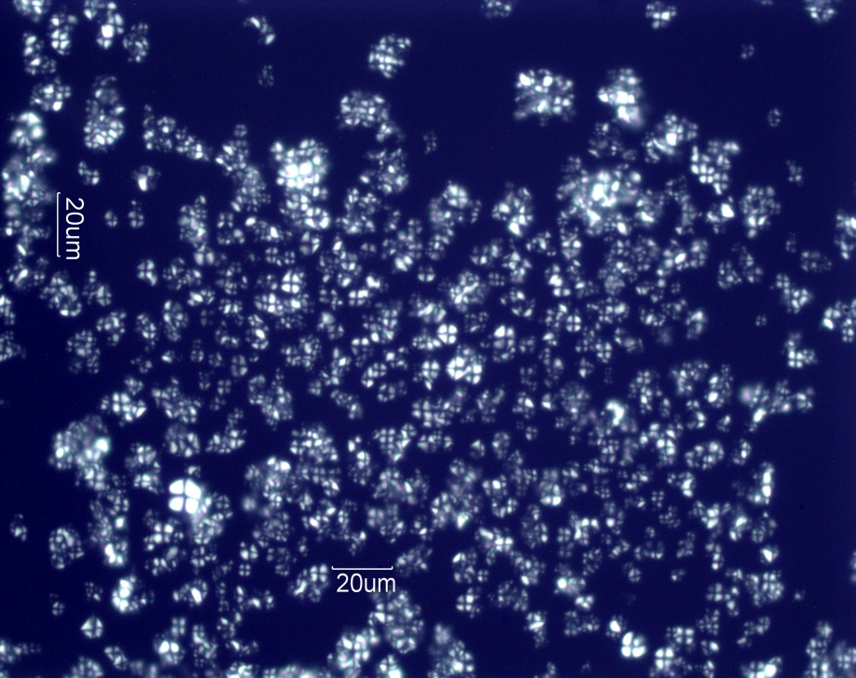
1-Rice starch :cocci arranged in clusters

Slide 18
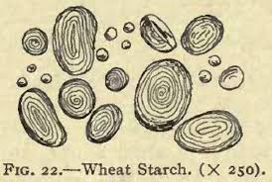
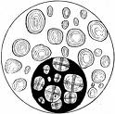
2-Wheat starch

Slide 19
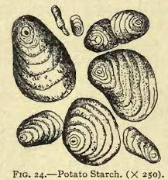
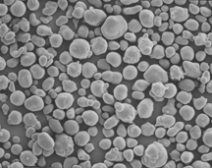
3-Potato starch

Slide 20
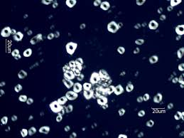
4-Maize starch (corn )

Slide 21
3- Chemical examination
In clean dry test tube add :
1part of M.P + 7 part D.W mixing
Put it in water bath for few minutes
Then add drops of iodine
Result
If appear blue color +ve for starch

Slide 23
Sanitary test
Acidity % :
in clean dry beaker add
2,5gm M.P +20ml D.W +1ml Ph.ph
Titrate against NaOH N\9 till appearnce of faint pink color end point record R
Calculation
Acidity % = R\20 Acidity degree = R x 5

Slide 24
Sediment test
In clean dry beaker add
50gm M.P +500 ml D.W Shaking
Filter the content through cotton wool pad disc
Result
Disc is dried and compared with standard disc to determine grade of milk powder

Slide 27
Microbiological examination
1-All equipment should be sterile
2-take the sample under complete aseptic condition
preparation of the sample
10gm M.P +90ml D.W Mixing 1\10
Complete ten fold serial dilution till 1\1000000

Slide 29
Make different bacteriological examination
1-T.B.C by standard method
2-coliform count
3-enterococci
4-yeast , mold
5-lipolytic and proteolytic m.os
6-pathogenic m.os as food poisning (s.aureus)

