Slide 1
Stereoisomerism 2
Dr/ omniya sayed zaky

Slide 2
Molecule asymmetry without the presence of asymmetry carbon atom
1-biphenyl derivatives :-
These compound own their asymmetry to restricted rotation about single bond
2-allenes :- C=C=C
Asymmetry due to the presence of cumulated تكدس double bond
3-Spirans :-
Spiranes owe their asymmetry to the presence of the spiran type of ring systems

Slide 3
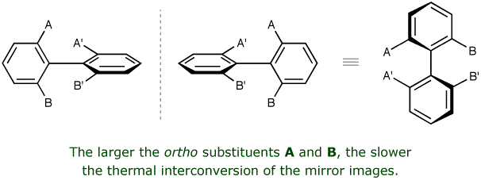
1-biphenyl derivatives
Atropisomers are stereoisomers arising because of hindered rotation about a single bond. The word atropisomer ( meaning "without turn"

Slide 4
Optical activity in biphenyl derivatives
Optical activity cannot be explain in the basis of planer molecule
The interference of ortho substituent prevent the planarity of the molecule by prevent free rotation of nuclei about the C-C bond

Slide 5
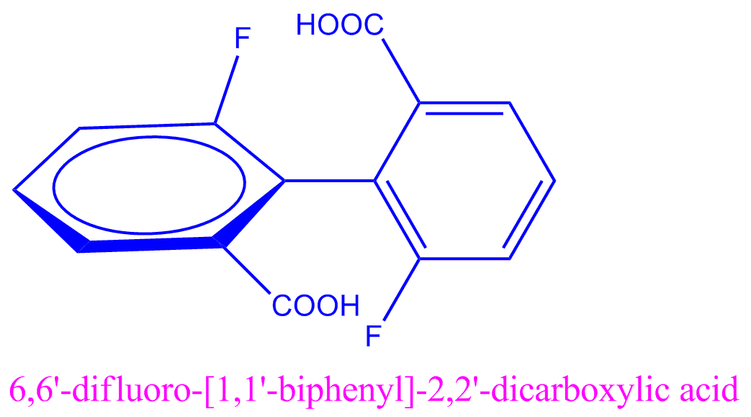
So there are two reason to become biphenyl optically active :
1-The presence of O-substituents bulk enough to restrict free rotation and stabilize the non-planer conformation
2-Each phenyl group should be unsymmetrical substituted , So the result isomer willl be mirror image and have equal and opposite optical rotation

Slide 6
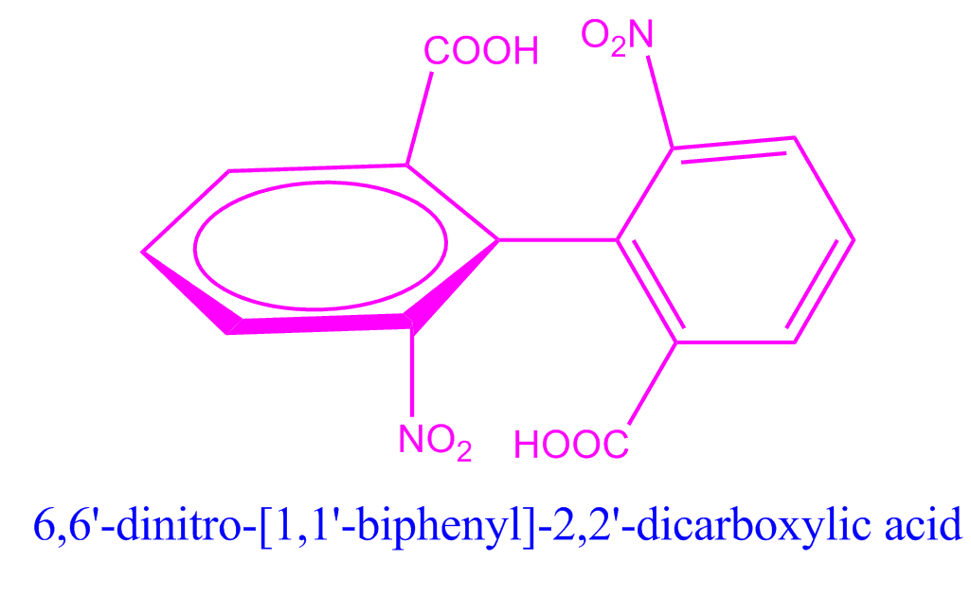
Example
* 6,6'-Dinitrodiphenic acid
The compound is optically active and rotation is restricted about single bond and non-planar conformation

Slide 7
example

Slide 8
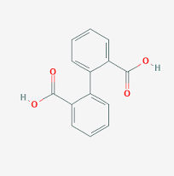
example
2,2-diphenic acid
It is unsymmetrical substituent ,but rotation not restricted due to small hydrogen so :- It is Optically inactive

Slide 9
The rotation to be restricted
** the substituent must bulky enough with one another and this happen when it have definite size
So the ability of compound to exist in non-planer optically active must be displayed in diphenyl derivative in with the sum of van der waals radii of o-substituted not less than 2.90 A

Slide 10
Example
If R = fluorine atom ( 1.39A° radius )
F +F = 1.39+1.39= 2.7 ˂ 2.90
So the compound is optically inactive
Because the fluore atom not bulk enough to prevent the rotation about single bond

Slide 11
example
If R= OCH3 group (1.45 A°)
OCH3 +OCH3 = 1.45+1.45 = 2.90
So the compound is optically active
If R= Cl atom (1.69 A°)
Cl +Cl =1.69 +1.69 = 3.30 ˃ 2.90
So the compound is optically active

Slide 12
Note
Optical active compound must not contain three or four substituent to prevent the rotation in O- position
But if two or one substituent is bulk enough and even hydrogen in the ortho position prevent him from rotation we can obtain " atropisomerism "

Slide 13
Example But easily racemised ( mirror image )

Slide 14
Example
3-bromodiphenyl-2-trimethyl arsonium iodide
The restriction of rotation is enough so it optical activity but less for optical stability ( because the trimethyl arsonium group is large enough so it is optically acive but racemised readily )

Slide 15
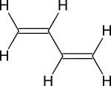
Allene
An allene is a compound in which one carbon atom has double bonds with each of its two adjacent carbon centres. Allenes are classified as polyenes with cumulated dienes

Slide 16
Dienes can be divided into three classes, depending on the relative location of the double bonds
Cumulated dienes have the double bonds sharing a common atom. The result is more specifically called an allene.
Conjugated dienes have conjugated double bonds separated by one single bond. Conjugated dienes are more stable than other dienes because of resonance.

Slide 17
Unconjugated dienes have the double bonds separated by two or more single bonds. They are usually less stable than isomeric conjugated dienes. This can also be known as an isolated diene.

Slide 18
Stereoisomer in allenes
Each carbon atom connected with two different group So it consider optically active
Each carbon connected with the same group So it consider optically inactive

Slide 19
example
1,3-diphenylallene 1,3-ditetrabutylallene
2,3-pentadiene 1,3-diphenyl-1,3-dinaphthylallene

Slide 20
Note
If the number of double bond is even it consider allene ( optical isomer )
If it is odd it consider ( geometrical isomer )

