Slide 1
Geomagnetic method
3rd year geophysical students
Course: Applied Geophysics G344
5-6 Lectures
Dr. Abdelhady Elakrby

Slide 2
History of Magnetics
2nd Century BC: Chinese used lodestone (rock rich in magnetite) for direction finding.
12th Century AD: Magnetic compass in use in Europe.
1600: First scientific analysis of Earth’s magnetic field by William Gilbert in book De Magnete.
1640: First use of magnetic measurements to locate iron ore deposits in Sweden.
1870: Development of instrumentation for rapid, accurate measurement of magnetic field by Thalén and Tiberg.
1915: Development of balance magnetometer by Adolf Schmidt.
WWII: Rapid development of magnetic surveying technology for mine and submarine detection.
1960s: Sensitive optical absorption magnetometers allow airborne magnetics surveying.
1970s: Development of magnetic gradiometers to measure field difference between two sensors.

Slide 3
Magnetics Surveying
Introduction
Magnetics surveys measure the magnitude and orientation of the Earth’s magnetic field.
Magnetic field at Earth’s surface depends on field generated in Earth’s core, magnetic mineral content of surface materials, and remnant magnetization of surface rocks.
Magnetic susceptibility, κ, is physical parameter to which magnetic surveys are sensitive.

Slide 4
Applications
Location of metal objects: Pipes, cables, military ordnance.
Mapping near-surface: Archeological sites, concealed mine shafts, igneous intrusions.
Mineral Exploration: Identification of metalliferous deposits, for example massive sulphides
Geological Bedrock Mapping: Identification of faults and geological boundaries, especially beneath sediment cover.

Slide 5
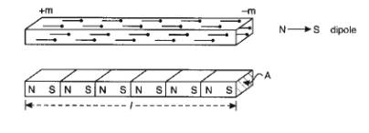
Induced Magnetization and Magnetic Susceptibility
Orbital motions of electrons around atoms’ nucleus constitute circular electric currents, causing atoms to behave like magnets.
Intensity of Magnetization J
A body placed in a magnetic field can become magnetised as atoms and molecules align. Net external field as if bar magnet.
Magnetic Susceptibility k
For low magnetic fields, magnetization J is proportional to the magnetising field H:
J = k H
where k is called the magnetic susceptibility.
Susceptibility is fundamental rock parameter of magnetics prospecting.
Magnetic response of rocks determined by amounts and susceptibilities of constituent minerals.

Slide 6
Total Magnetic Field B
The Total Magnetic Field B represents the sum of the magnetizing field strength and the magnetization of the medium:
B = μ₀(H + J) = μ₀(H + κ H) = μ_{r}μ₀ H = μ H
where μ₀ is magnetic permeability of free space (4π x10⁻⁷ H/m)
μ_{r} is relative magnetic permeability
μ is absolute magnetic permeability
Clearly, μ_{r} = μ / μ₀
B is also called the magnetic flux density or magnetic induction.
Magnitude of B represents "closeness" of flux lines. Direction of B along flux lines.
Magnetic field measured in volt. s /m² = weber/m² = teslas (T) in SI units.
μ measured in weber/ (amp.m) = henry/m (H/m)
In c.g.s system, magnetic flux measured in gauss or gamma 1 γ = 10⁻⁵ gauss = 1 nT.
In geophysics, magnetic fields are small and measured in nT. Earth’s magnetic field varies between 20,000 to 60,000 nT.

Slide 7
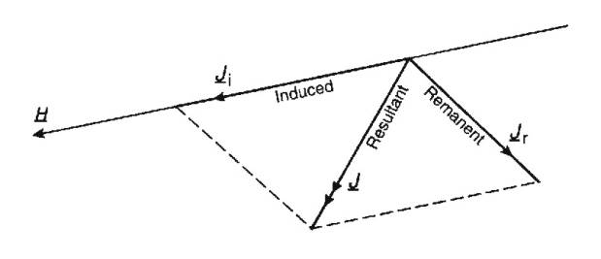
Induced and Remnant Magnetisation
Induced Magnetisation
Induced Magnetisation J_{i} is produced within a rock in response to an applied external magnetic field.
Remnant Magnetisation
Magnetic field may exist within rock even in absence of external field due to permanently magnetic particles. This is remnant or permanent magnetization.
Interpretation of magnetic data complicated as magnetic field due to a subsurface body results from combined effect of two vector magnetizations that may have different magnitudes and directions.

Slide 8
Diamagnetism and Paramagnetism
All atoms have a magnetic moment due to orbit of electrons around nucleus and spin of elections moment (i.e. behave like a small bar magnet).
According to quantum theory, two electrons can exist in same electron shell if they have opposite spins. Magnetic moment of paired electrons will cancel out
In most materials, no overall magnetisation exists in absence of external field, because the magnetic moments of adjacent atoms are randomly distributed and cancel.
Diamagnetism
In a diamagnetic material such as halite, all electron shells are complete and no unpaired electrons exist.
In an external magnetic field, electrons orbit to produce a weak magnetic field that opposes applied field.
Magnetic susceptibility is weak and negative.
Paramagnetism
In minerals such as olivine, unpaired electrons in incomplete electron shells produce unbalanced magnetic moments.
In an external field, magnetic moments align themselves in same direction, producing a weak magnetic field aligned with external.
Magnetic susceptibility is weak and positive, but usually an order of magnitude stronger than in diamagnetic materials.

Slide 9
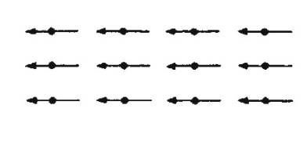
Ferromagnetism
In metals such as cobalt, nickel and iron, unpaired electrons are coupled magnetically due to strong interaction between adjacent atoms and overlap of electron orbits.
Groups of atoms that couple together magnetically are called magnetic domains, around 1 micron in size.
Magnetic domains can be oriented to produce a spontaneous magnetic field in absence of external field.
Magnetic susceptibility is large, but depends on temperature and strength of applied field. All domains oriented in same direction.
Ferromagnetism disappears if material heated to Curie Temperature, T_{C}, as inter-atomic coupling restricted and domains cannot exist.
Behaves as paramagnetic above Cure temperature.

Slide 10
Magnetic Domains
Unmagnetized Domains
Each domain possesses a random magnetic field orientation.
Induced Non-Permanent Ferromagnetism
Domains aligned with external field grow at expense of others as external magnetic field increases.
Induced Permanent Ferromagnetism
Electrons in domains rotate to align with external field as it increases.

Slide 11
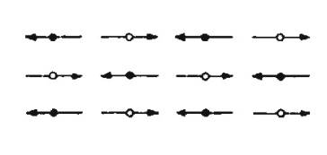
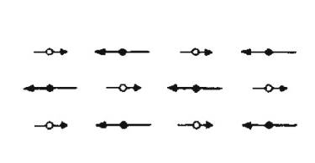
Antiferromagnetism and Ferrimagnetism
Antiferromagnetism
In minerals such as hematite, magnetic domains form, but are aligned in antiparallel fashion.
* Magnetic fields cancel out, but crystal lattice defects cause small net field in response to applied external field.
* Magnetic susceptibilities are large and positive.
Ferrimagnetism
In minerals such as magnetite, titanomagnetite, and ilmenite, magnetic domains are antiparallel, but of unequal magnitude.
* Net magnetization produced with applied external field.
* Magnetic susceptibilities are very large and positive.
* Domains can be permanently aligned, producing spontaneous magnetisation that exists after removal of external field.
* Ferrimagnetism disappears above Cure temperature.

Slide 12
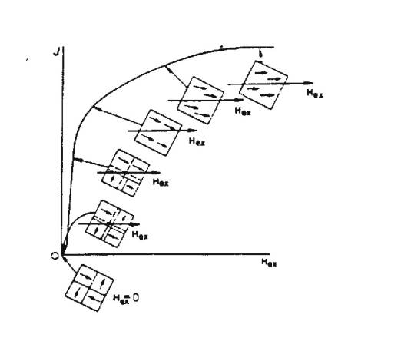
Magnetization of Ferromagnetic Materials
Magnetization
For an unmagnetized material with magnetic domains in absence of external magnetic field H, domain orientation related to crystal axes and magnetization cancels out.
When external field H is applied, domains reorient themselves in discrete steps to parallel H.
Point is reached where no further increase in magnetization, as all domains aligned with external field H. Material is saturated.

Slide 13
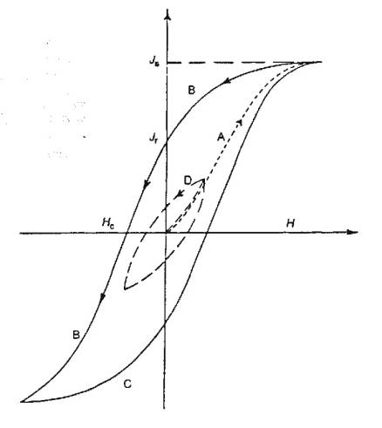
Hysteresis Loop in Magnetisation
After magnetisation, ferro/ferri-magnetic material retains magnetisation when H decreased to zero,
Remnant magnetisation can be removed by external reversing magnetic field.
Magnitude of reversed magnetic field H_{C} , the coercivity, needed to eliminate remnant magnetisation is measure of its "hardness" or permanence.
Same process can be applied in reverse to return to full positive magnetisation. This process is called a hysteresis loop.
Note: Small loop is hysteresis without saturation.

Slide 14
Curie Temperature
Cure temperature is temperature at which mineral loses its ferromagnetic behaviour, and any permanent magnetisation is lost.
Cure temperature varies with mineral:
Titanomagnetite 100-200º C
Titanomaghemite 150-450º C
Magnetite 550-580º C
Hematite 650-680º C
Curie temperature is below melting point of rock.
In rock such as granite, there will be multiple Curie temperatures for the different minerals present.
Low-Temperature Oxidation
Oxidation at less than 300º C, tends to increase Curie temperature, as titanomagnetite oxidese towards hematite.
Intensity of magnetisation also reduced.
Oxidation can affect expected magnetic response of certain rocks.

Slide 15
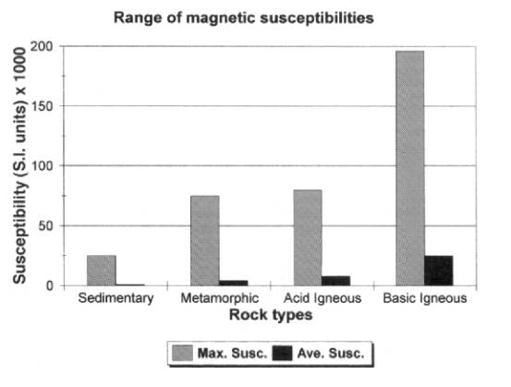
Magnetic Susceptibilities of Rocks and Minerals
Magnetic susceptibility κ is the physical parameter of magnetics surveying (equivalent to density in gravity).
Rocks with significant concentrations of ferri/ferro-magnetic minerals have highest susceptibilities:
Ultramafic rocks highest 95,000 – 200,000
Mafic rocks high 550 – 122,000
Felsic rocks low 40-52,000
Metamorphic low 0-73,000
Sedimentary very low 0-360

Slide 16
Primary Remnant Magnetization
Rocks can become permanently magnetized in the Earth’s magnetic field,.
It is this that permits tracing past plate motions and locating magnetic ores.
Primary remnant magnetization refers to permanent magnetization created during formation of a rock.
Thermal Remnant Magnetisation (TRM)
TRM acquired when a rock cools through the Curie temperature, e.g. colling of volcanic rock.
At Curie temperature, ferro/ferri-magnetic minerals become magnetised in direction of Earth’s magnetic field at that time.
TRM usually greater than induced magnetisation from present day field.
Detrital Remnant Magnetisation (DRM)
DRM acquired when fine magnetic particles settle during formation of sedimentary rock, e.g. formation of clays
Settling particles are oriented by Earth’s magnetic field at that time.
DRM << TRM

Slide 17
Secondary Remnant Magnetization
Secondary remnant magnetization refers to magnetization acquired later in a rock’s history by alteration processes.
Chemical Remnant Magnetization (CRM)
CRM acquired in situ when magnetic minerals grow or are chemically altered to another form below Curie temperature, e.g. growth of iron oxide in sandstone.
Most common in sedimentary and metamorphic rocks.
Viscous Remnant Magnetization (VRM)
VRM produced by long exposure to ambient field in uniform environment.
Buildup of VRM logarithmic with time.

Slide 18
Königsberger Ratio
Remnant magnetization (Jr)may be much greater than that induced by Earth’s field today (Ji), e.g. with TRM.
Königsberger Ratio Q is measure of ratio of intensity of remnant to induced magnetization:
Q ~ 30-50 for rapidly quenched volcanic rocks
Q ~10 for volcanic rocks in general
Q~1 for slowly crystallised igneous anmd thermally metamorphosed continental rocks
Q<1 in sedimentary and metamorphic rocks when iron not present

Slide 19
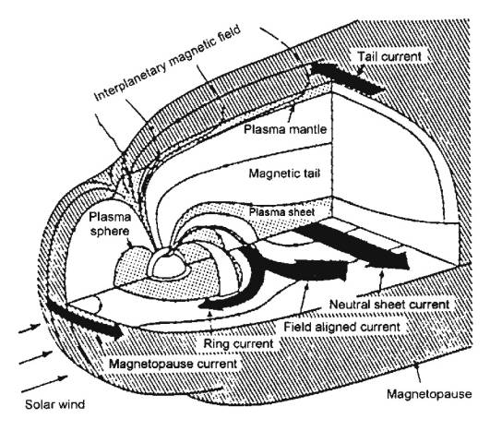
Earth’s Distant Magnetic Field
Near the Earth’s surface: magnetic field originates largely from currents flowing in the liquid outer core, and the magnetization of surface rocks.
Away from the surface: magnetic field is affected by currents caused by the movement of charged particles associated with Van Allen radiation belts.
Some of these charged particles are responsible for the Aurora Borealis near the poles.
At great distance: the magnetic field is due to charged particles from the sun, the solar wind.

Slide 20
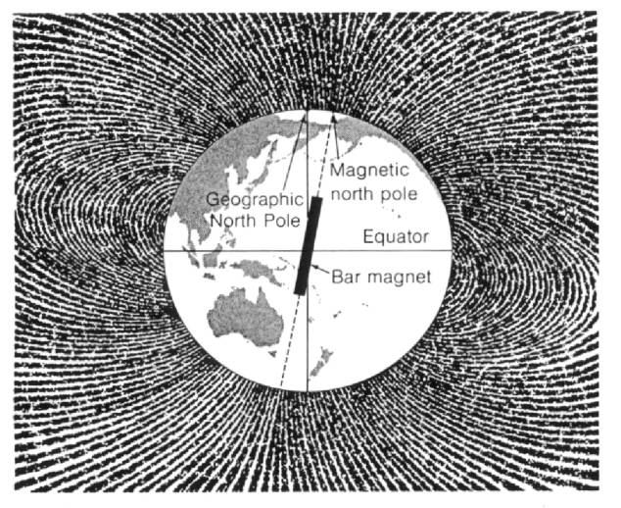
Earth’s Dipole Field
Earth’s magnetic field roughly appears as if it originated from a large bar magnet located at the center of the Earth oriented at 11.5º to the axis of rotation.

Slide 21
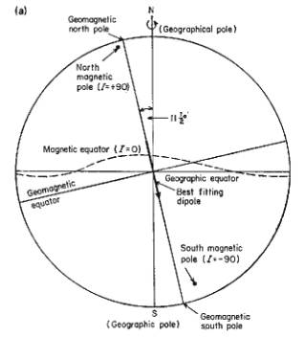
Earth’s Magnetic Field
Geomagnetic Pole: the position on Earth’s surface intersected by the axis of the dipole that fits best the Earth’s magnetic field.
o North: Hayes Peninsula in northern Greenland
o South: Vostok research station in Antarctica
Magnetic Pole (or Dip Pole): the position where the magnetic field is vertical
o North: North of Bathurst Island in Canadian Arctic
o South: 150 km offshore off Adelie coast of Antarctica
Geomagnetic and Magnetic Poles differ slightly because Earth’s magnetic field is not quite a dipole.

Slide 22
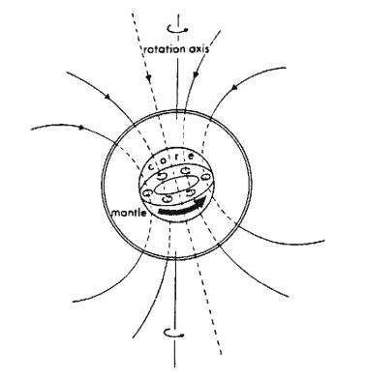
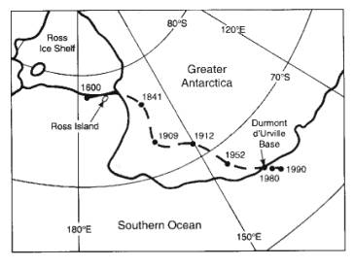
Generation of Earth’s Magnetic Field
Exact mechanism responsible for generation of Earth’s magnetic field is not known.
Believed to be associated with electrical eddy currents induced within the liquid outer core by its slow internal convection.
Secular Variation: Magnetic field is slowly changing due to core processes, e.g. location of south magnetic pole:

Slide 23
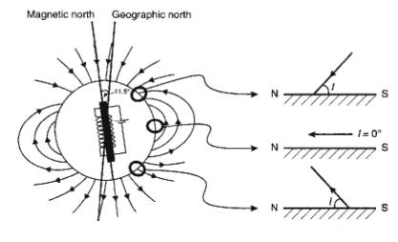
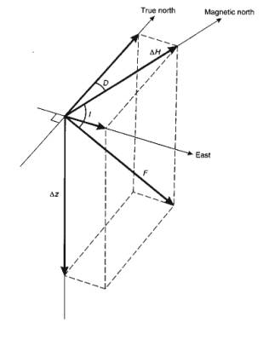
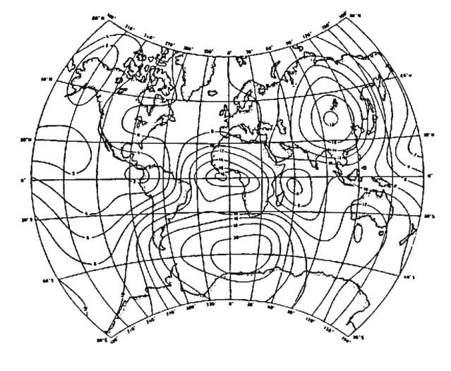
Description of Earth’s Magnetic Field
A compass needle free to move in 3-D will point along the magnetic field, i.e. it will point down where field points into Earth.
Geomagnetic field can be described by the declination D, the inclination I, and total field vector F.
Can calculate (magnetic) latitude, l, from inclination:
Earth’s Non-Dipolar Field
90% of Earth’s magnetic field can be represented by a dipole.
Difference between the actual magnetic field and that of the best-fitting dipole is called the non-dipolar field.
Features in non-dipolar field with magnitudes of 20,000 nT extending for 1000s km.
Non-dipolar field can be represented as 8-12 small dipoles locate radially close to liquid core, simulate cores eddy currents.

Slide 24
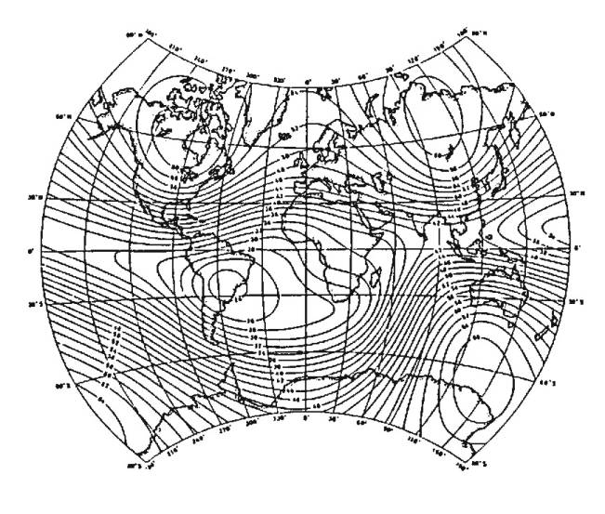
International Geomagnetic Reference Field
Geomagnetic field can be represented mathematically, and international standard is called International Geomagnetic Reference Field (IGRF).
Total field is recalculated every 5 years because of secular variation. Year of calculation is called the epoch.
Total field intensity of the IGRF epoch 1980:
* A true dipole field would have two maxima,
but Earth’s magnetic field actually has four.
* IGRF excludes effects of near-surface rocks.

Slide 25
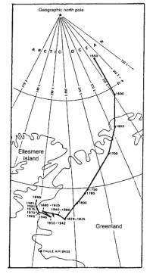
Variations in Earth’s Magnetic Field
Geomagnetic Reversals
Earth’s magnetic field flips polarity unpredictably on geological time scale due to sudden changes in fluid motions in core.
Secular Variations
Observations of Earth’s magnetic field made over 400 years show a
gradual change in position of the magnetic pole.
Due to slow movement of eddy currents in Earth’s core.
Diurnal Variations
Daily changes in field due to changes in currents of charged particles in ionosphere.
Changes are smooth and average around 50 nT.
Magnetic Storms
Short term disturbances in magnetic field associated with sun spot activity and streams of charged particles from sun.
Can be up to 1000 nT in magnitude, and make magnetic surveying impossible.

Slide 26
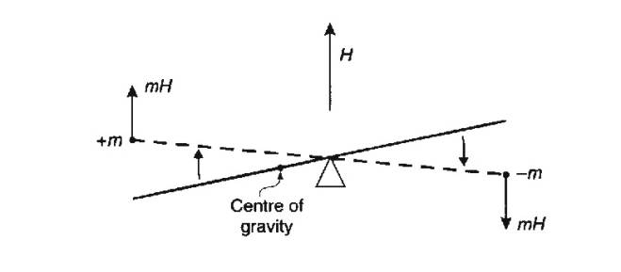
Instrumentation
There are many different types of magnetometers in use today for varrying purposes. For enviromental and engineering investigations the current standards are generally proton procession and cesium vapor. The magnetometer type reflects the physical process by which the magnetic field is measured.
Torsion and Balance Magnetometers (Obsolete)
Magnetometers measure the total magnetic field F_{T} or the horizontal and/or vertical components of magnetic field, F_{H} and F_{Z} respectively.
First magnetometers devised in1640 essentially comprised:
a magnetic needle suspended on a wire (Torsion type), or
a magnetic needle balanced on a pivot (Balance type)
Needle oriented in direction of magnetic field at station location.
Adolf Schmidt Variometer
Magnetic beam asymmetrically balanced on agate knife edge, and zeroed at base station.
Different magnetic field at another station caused displacement of beam, which was measured using collimating telescope.
* Had to be oriented perpendicular to magnetic meridien to remove
horizontal component of Earth’s field. (Use compass?)
* Calibrated to read vertical magnetic field component.

Slide 27
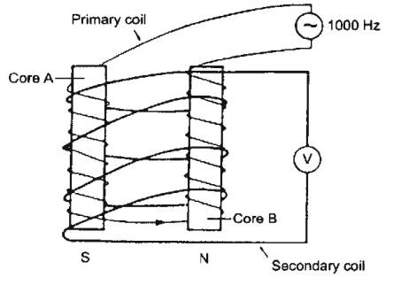
Fluxgate Magnetometer
Measures component of magnetic field parallel to cores with accuracy of 1-10 nT.
Comprises two parallel cores of high μ ferromagnetic material.
Primary coil wound on two cores in series in opposite directions. Secondary coils also wound, but in opposite direction to primary.
Operation of Fluxgate Magnetometer
An alternating current at 50-1000 Hz is passed through primary coils,
producing magnetic field that drives each core to saturation through a
Magnetization hysteresis loop.
* With no external magnetic field, cores saturate every half cycle.
Voltages induced in secondary coils have opposite polarity as coils
wound in opposite directions. So zero net voltage.
In Earth's magnetic field, component of field parallel to cores causes one core
to saturate before the other, and voltages in secondary coils do not cancel.

Slide 28
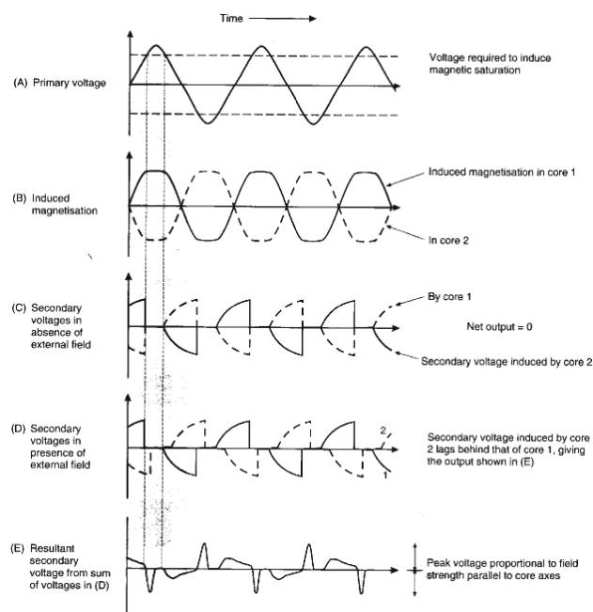
Operation of Fluxgate Magnetometer
An alternating current at 50-1000 Hz is passed through primary coils, producing magnetic field that drives each core to saturation through a magnetization hysteresis loop.
With no external magnetic field, cores saturate every half cycle.
Voltages induced in secondary coils have opposite polarity as coils wound in opposite directions. So zero net voltage.
In Earth's magnetic field, component of field parallel to cores causes one core to saturate before the other, and voltages in secondary coils do not cancel.
Principle of Operation of Fluxgate Magnetometer
Principle behind operation is Faraday’s Law of Induction
(twice)
Voltage induced in secondary coil proportional to magnetic
field generated in ferromagnetic core.
When core saturated, magnetic field does not change, and
no voltage is induced in secondary coil.

Slide 29
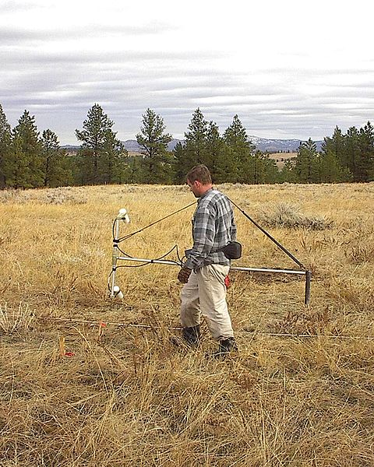
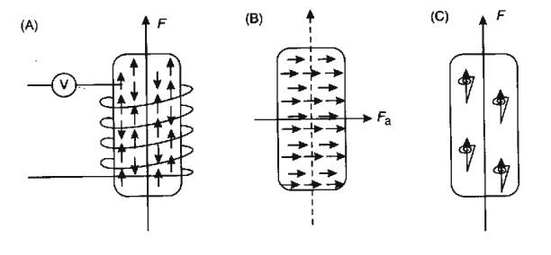
Proton Precession Magnetometer
Uses sensor consisting of bottle of proton-rich liquid, usually water or kerosene, wrapped with wire coil.
Protons have a net magnetic moment, and so are oriented by Earth’s magnetic field or an applied field.
Measures precession as protons reorient to Earth’s field.
Precession frequency proportional to total field strength.
As sensor bottle 15 cm long, accuracy of measurement is reduced in areas of
high magnetic field gradient.
Measures total field strength, so instrument orientation not important, unlike fluxgate.
Overhauser Effect adds electron-rich fluid to enhance polarisation effect, and increase
accuracy.
Two sensors indicate a gradiometer
Principle of Operation of Proton Magnetometer
A. In ambient field, majority of protons aligned parallel to field, remainder
antiparallel.
B) Current in coil generates strong magnetic field at right angles to Earth’s
field, causing all protons to align.
C.When current turned off protons precess back to orientation of Earth’s
field.
Protons are charged particles, and create magnetic field, which alternates
as proton precesses.
Current induces alternating voltage in coil at precession frequency.
C.Measuring frequency of current in coil gives magnitude of Earth’s total magnetic field as it is proportional to
precession frequency.
Measuring current frequency to 0.004 Hz gives field to ±0.1nT.

Slide 30
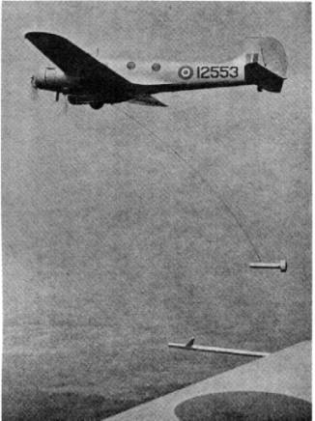
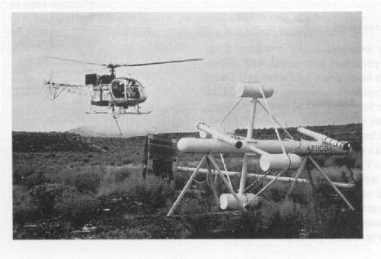
Airborne and Seaborne Magnetometers
Proton precession magnetometers are used extensively in marine and airborne surveys:
At sea: sensor bottle is towed in a "fish" 2-3 ship’s length astern to remove it from magnetic field of ship
In air: sensor is towed 30 m behind aircraft or placed in a "stinger" on nose, tail or
wingtip.
Often active compensation for magnetic effect of aircraft is calculated.
Advantage: Aeromag is rapid, cost-effective method for covering large areas.
Magnetic Gradiometers
Gradiometers use two sensors separated by fixed distance to measure gradient of the Earth’s
magnetic field:
In airborne work, separation is 2-5 m for stinger, up to 30 m for bird.
In ground work, separations of 0.5 m are common.
Example of 3-axis gradiometer system:
Advantages:
No correction for diurnal variation required as measurement is difference off two
magnetic sensors.
Vertical gradient measurements emphasise shallow anomalies and suppress long
wavelength features.

Slide 31
Magnetic Surveying - Data Acquisition
Ground Surveys
Ground magnetic measurements are usually made with portable instruments at regular intervals along more or less straight and parallel lines that cover the survey area. Often the interval between measurement locations (stations) along the lines is less than the spacing between lines.
Ideally lines should be perpendicular to strike, with a few along strike tie-lines.
Establish base-station to monitor diurnal variations every 0.5-1.0 hours.
Avoid readings near metal objects such as railway tracks, cars...
Avoid wearing metal objects, such as watch, geological hammer.
Data recording methods will vary with the purpose of the survey and the amount of noise present. Methods include taking three readings and averaging the results, taking three readings within a meter of the station and either recording each or recording the average. Some magnetometers can apply either of these methods and even do the averaging internally. An experienced field geophysicist will specify which technique is required for a given survey. In either case, the time of the reading is also recorded unless the magnetometer stores the readings and times internally.

Slide 32
Items to be recorded in the field book for magnetics include:
a) Station location, including locations of lines with respect to permanent landmarks or surveyed points.
b) Magnetic field and/or gradient reading.
c) Time.
d) Nearby sources of potential interference.
The experienced magnetics operator will be alert for the possible occurrence of the following:
1. Excessive gradients may be beyond the magnetometer's ability to make a stable measurement. Modern magnetometers give a quality factor for the reading. Multiple measurements at a station, minor adjustments of the station location and other adjustments of technique may be necessary to produce repeatable, representative data.
2. Nearby metal objects may cause interference. Some items, such as automobiles, are obvious, but some subtle interference will be recognized only by the imaginative and observant magnetics operator. Old buried curbs and foundations, buried cans and bottles, power lines, fences, and other hidden factors can greatly affect magnetic readings.

Slide 33
Airborne Surveys
Estimate line spacing to avoid significant signal aliasing for aircraft height.
Approximate rule of thumb for maximum line spacing for particular application:
Note that h is flight height above magnetic basement, not Earth’s surface.
Reduction of Magnetic Survey Data
Magnetics data reduction is usually simpler than with gravity, comprising:
1. Diurnal Correction
2. Geomagnetic Correction
3. Elevation/Terrain Correction (occasionally)
Diurnal Variation
Similar to tidal correction in gravity
Reading is recorded at base station during survey, and then corrections applied to survey data.

Slide 34
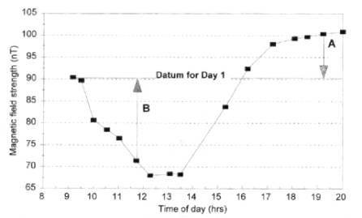
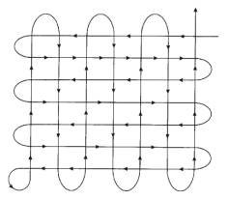
The base-station memory magnetometer, when used, is set up every
day prior to collection of the magnetic data. Ideally the base station
is placed at least 100 m from any large metal objects or traveled
roads and at least 500 m from any power lines when feasible. The
base station location must be very well described in the field book,
as others may have to later locate it based on the written description.
As the base may vary by 10 to 25 nT or more from day to day, this correction ensures that another person using the same base station and the same asserted value will get the same readings at a field point to within the accuracy of the instrument. This procedure is always good technique but is often neglected by persons interested in only very large anomalies (> 500 nT, etc.).
Difficult to return to base station in airborne work: possible to estimate diurnal
correction from line intersections especially with additional tie lines

Slide 35
Geomagnetic Correction
Similar to latitude correction in gravity: Earth’s total magnetic field varies from 25,000 nT at equator to 69,000 nT at poles
Three possible correction methods:
1) Subtraction of IGRF: Earth’s theoretical magnetic field is removed from survey data by subtracting IGRF
2) Linear approximation to IGRF: Earth’s field is approximated by linear variation across survey area, and subtracted:
For example, in UK IGRF is approximated by 2.13 nT/km north, and 0.26 nT/km west.
3. Regional correction: With large surveys, regional trend can be estimated and removed to leave residual anomaly, as with gravity data.
Terrain Correction
There are no elevation corrections (equivalent to Free-air and Bouguer corrections) with magnetic data as gradient is only 0.035 nT/m at poles, 0.015 nT/m at equator.
Terrain corrections can be applied, but are complicated. Require estimate of ground susceptibility, and topography.

Slide 36
Waiting me in
7-8 lectures in Geoelectric method
&
9-10 lectures in Seismic method

