Slide 1
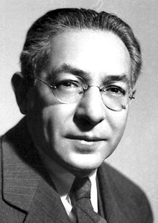

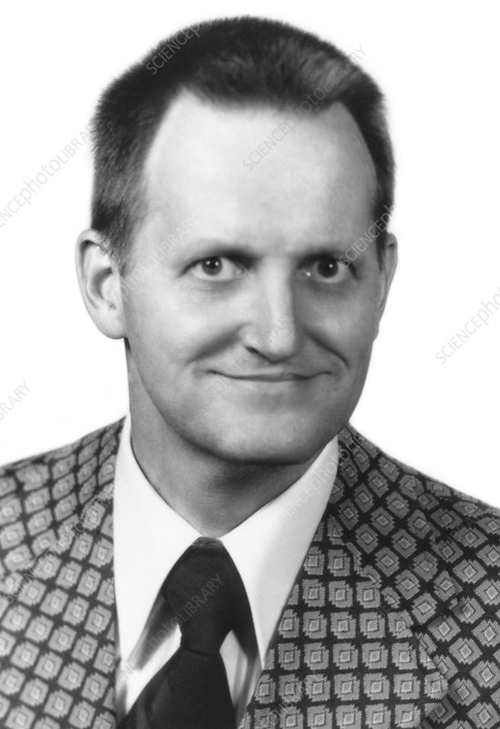
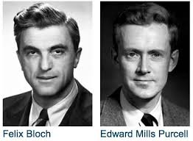

NMR History
1937 Rabi predicts and observes nuclear magnetic resonance
1946 Bloch, Purcell first nuclear magnetic resonance of bulk sample
1953 Overhauser NOE (nuclear Overhauser effect)
1966 Ernst, Anderson Fourier transform NMR
1975 Jeener, Ernst 2D NMR
1984 Nicholson NMR metabolomics
1985 Wüthrich first solution structure of a small protein (BPTI)
from NOE derived distance restraints

Slide 2
NMR History
1987 3D NMR + ¹³C, ¹⁵N isotope labeling of recombinant proteins (resolution)
1990 pulsed field gradients (artifact suppression)
1996/7 residual dipolar couplings (RDC) from partial alignment in liquid crystalline media TROSY (molecular weight > 100 kDa)
2000s Dynamic nuclear polarisation (DNP) to enhance NMR sensitivity

Slide 3
NMR History
Nobel prizes
1944 Physics Rabi (Columbia)
1952 Physics Bloch (Stanford), Purcell (Harvard)
1991 Chemistry Ernst (ETH)
2002 Chemistry Wüthrich (ETH)
2003 Medicine Lauterbur (University of Illinois in Urbana ),
Mansfield (University of Nottingham)

Slide 4
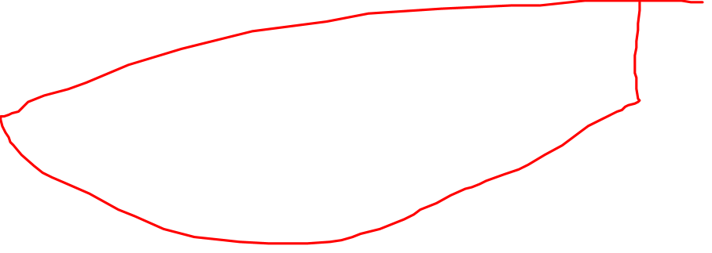
The physics of nuclear magnetic resonance
The magnetization of nuclei
A proton has a spin, and thus the electrical charge of the proton also moves.
A moving electrical charge is an electrical current, and this is accompanied by a magnetic field.
Thus, the proton has its own magnetic field and it can be seen as a little bar magnet.

Slide 5
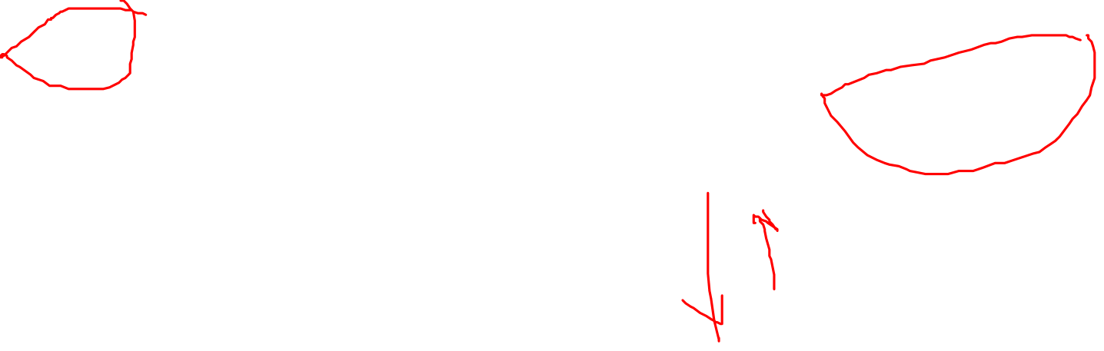
What happens to the protons, when we put them into an external magnetic field?
The protons - being little magnets - align themselves in the external magnetic field like a compass needle in the magnetic field of the earth.
However, there is an important difference.
For the compass needle there is only one way to align itself with the magnetic field, for the protons however, there are two.
The protons may align with their South and North poles in the direction of the external field, parallel to it.
Or they may point exactly in the complete opposite direction, anti-parallel.

Slide 6
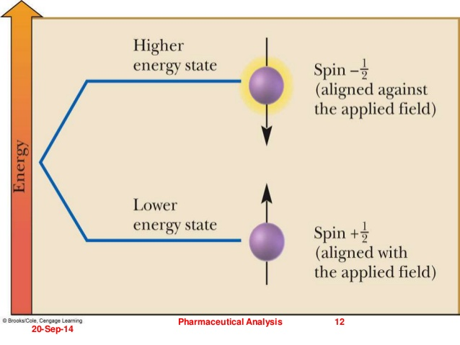
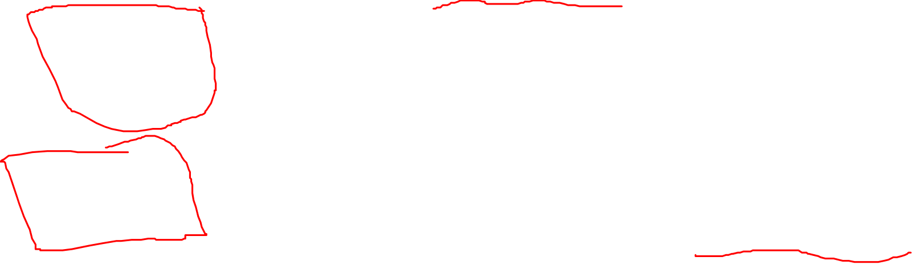
These types of alignment are on different energy levels.
To explain this; a man can align himself parallel to the magnetic field of the earth i.e. walk on his feet, or he can align himself anti-parallel, in the opposite direction.
Both states are on different energy levels, i.e. need different amounts of energy. Walking on one's feet is undoubtedly less exhausting, takes less energy than walking on one's hands.

Slide 7
Naturally the preferred state of alignment is the one that needs less energy.
So more protons are on the lower energy level, parallel to the external magnetic field (walk on their feet).
The difference in number is, however, very small and depends on the strength of the applied magnetic field.
To get a rough idea: for about 10 million protons "walking on their hands", there are about 10 000 007 "walking on their feet" (the difference "007" is probably easy to remember).
It may be obvious at this point already, that for NMR the mobile protons are important.

Slide 8
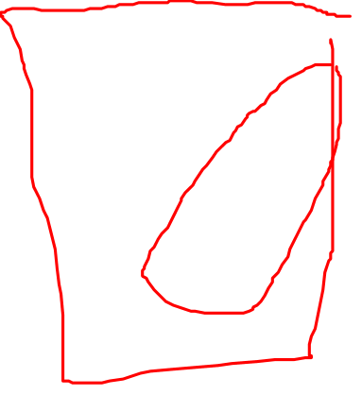
Let us take a closer look at these protons
We will see that the protons do not just lay there, aligned parallel or anti-parallel to the magnetic field lines.
Instead, they move around in a certain way. The type of movement is called precession

Slide 9
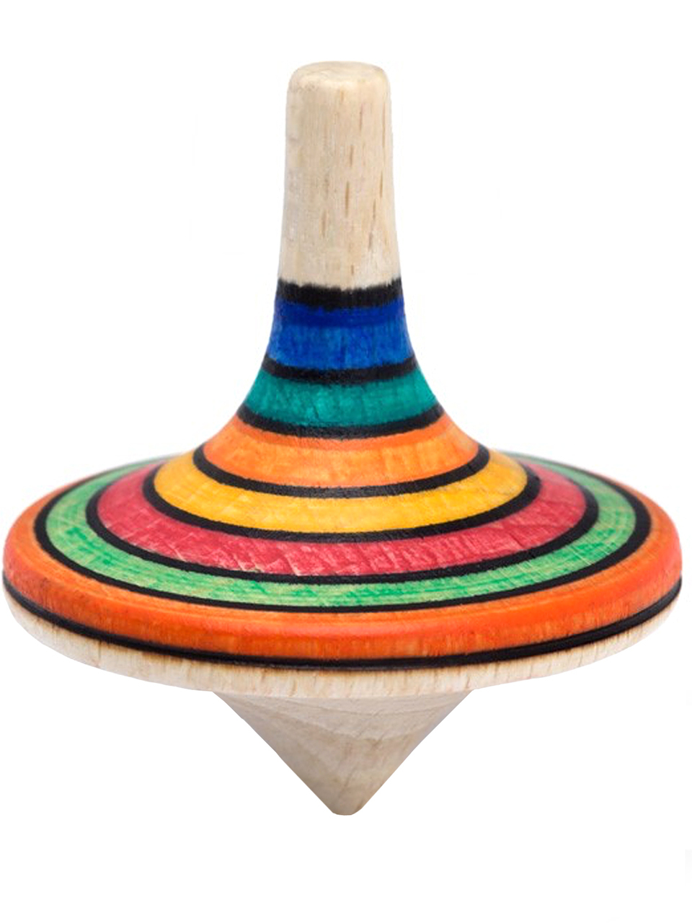
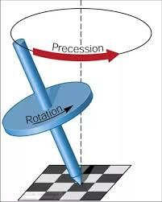
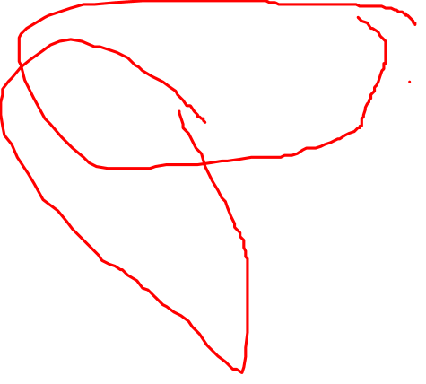
What type of movement is "precession"?
Just imagine a spinning top.
When you hit it, it starts to "wobble" or tumble around. It does not, however, fall over.
During this precession, the axis of the spinning top circles forming a cone shape.
It is hard to draw such a precessing proton, as this is a very fast movement as we will see below

Slide 10
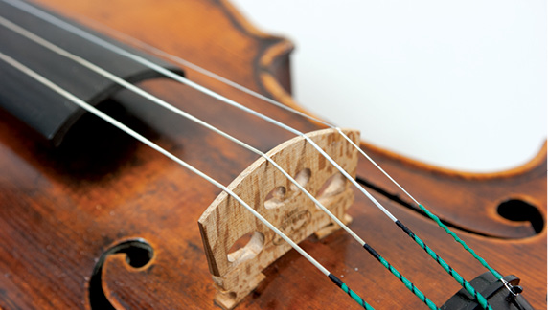
It is important to know how fast the protons precess.
This speed can be measured as precession frequency, that is, how many times the protons precess per second.
This precession frequency is not constant.
It depends upon the strength of the magnetic field, in which the protons are placed. The stronger the magnetic field, the faster the precession rate and the higher the precession frequency.
This is like a violin string: the stronger the force exerted upon the string, the higher its frequency.

Slide 11
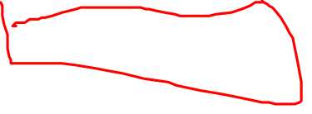
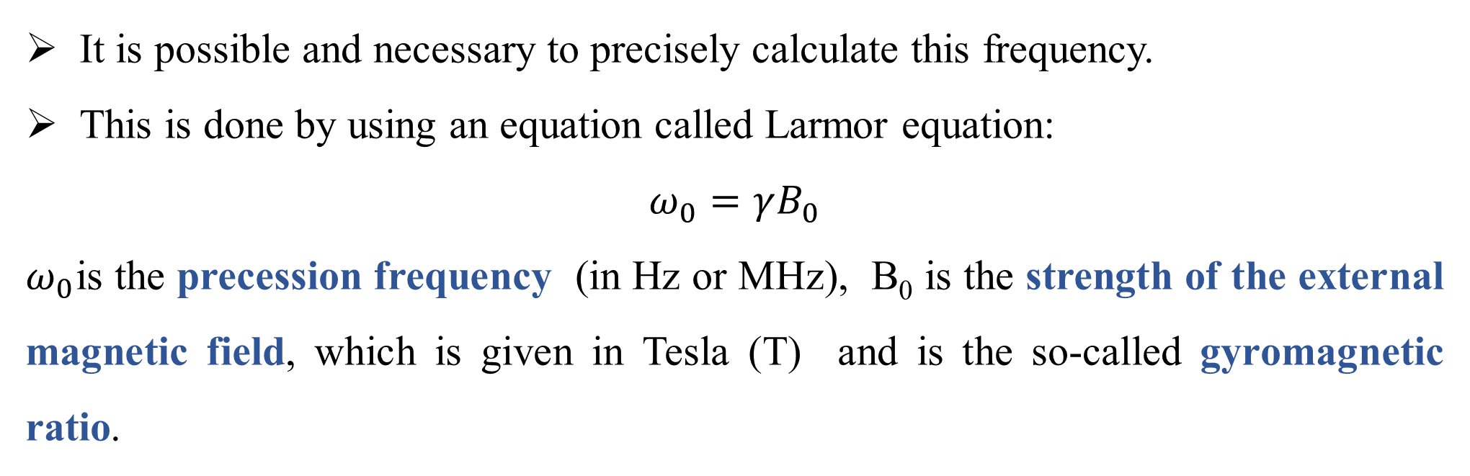
It is possible and necessary to precisely calculate this frequency.
This is done by using an equation called Larmor equation:
$$ω_{0}=γB_{0}$$
$ω_{0}$is the precession frequency (in Hz or MHz), B₀ is the strength of the external magnetic field, which is given in Tesla (T) and is the so-called gyromagnetic ratio.
The equation states that the precession frequency becomes higher when the magnetic field strength increases.
The exact relationship is determined by the gyro-magnetic ratio This gyro-magnetic ratio is different for different materials (e.g. the value for protons is (42.5 MHz/T). It can be compared to an exchange rate, which is different for different currencies.

Slide 12
Time to take a break however, let us briefly review, what we have read up to now:
Protons have a positive electrical charge, which is constantly moving, because the protons possess a spin.
This moving electrical charge is nothing more than an electrical current, and the latter always induces a magnetic field.
every proton has its little magnetic field, and can thus be seen as a little bar magnet.
When we put an atom in a magnet, the protons, being little magnets, align with the external magnetic field. They do this in two ways: parallel and anti-parallel. The state that needs less energy is preferred, and so there are a few more protons "walking on their feet" than "on their hands".

Slide 13
The protons precess along the field lines of the magnetic field, just like a spinning top that precesses along the field lines of the magnetic field of earth.
The precession frequency can be calculated by the Larmor equation and is higher in stronger magnetic fields.
Why is this precession frequency important?
It has something to do with the resonance in magnetic resonance imaging. But to understand this will take a few more minutes.

Slide 14
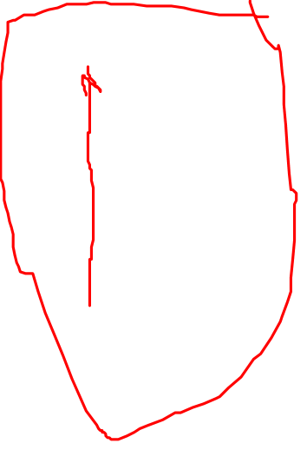
Introducing the coordinate system
To make communication (and drawing of illustrations) easier, let us start using a coordinate system like we know from school. As you see, the z-axis runs in the direction of the magnetic field lines, and thus can represent them. So, we can stop drawing the external magnet in all other illustrations.

Slide 15
There we have 9 protons pointing up, precessing parallel to the external magnetic field lines, and 5 protons pointing down, precessing anti-parallel to the external magnetic field.
The result is very important; the magnetic forces in the opposing directions cancel each other out, like two persons pulling at the opposite ends of a rope.
Finally, for every proton pointing down, there is one pointing up, cancelling its magnetic effects.
But as we have read: there-are more protons pointing up than down, and the magnetic forces of these protons are not cancelled by others. So we are left – in effect - with some protons (4 in our example) pointing up

Slide 16
However, not only magnetic forces pointing up and down can cancel or neutralize each other. As the protons that are left pointing up, precess, there may be one pointing to the right, when there is another one pointing to the left; or for one pointing to the front, there is one pointing backwards, and so on (the corresponding protons are marked A and A', B and B' for example)

Slide 17
This means that the opposing magnetic forces of the remaining protons cancel each other out in these directions.
This is true for all but one direction, the direction of the z-axis, along the external magnetic field.
In this direction, the single vectors, the single magnetic forces add up, like people pulling on the same end of a rope.
What we end up with in effect is a magnetic vector in the direction of the external magnetic field (the arrow on the z-axis ); and this vector is a sum vector made up by adding the magnetic vectors of the protons pointing upwards.

Slide 18
To illustrate this:

Slide 19
imagine that you are standing on a boat, floating down a river. You have a water hose in your hand and squirt water into the river. For somebody who is watching you from the shore, it is impossible to tell how much water you pour out (this shall be how much new magnetization is added in the old direction).
However, when you point the water hose to the shore, change the direction of the new magnetic field, then the water may perhaps be directly picked up and measured by an impartial observer on the shore.
What we should learn from this is: magnetization along or, better, longitudinal to the external magnetic field cannot be measured directly. For this we need a magnetization which is not longitudinal, but transversal to the external magnetic field.

Slide 20
Time to take a break . . .
but before you walk off, just read the short summary. And when you come back, start out with the summary again.
Protons have a positive charge and possess a spin. Due to this, they have a magnetic field and can be seen as little bar magnets.
When we put them into a strong external magnetic field, they align with it, some parallel (pointing up), some anti-parallel (pointing down).
The protons do not just lay there, but precess around the magnetic field lines. And the stronger the magnetic field, the higher the precession frequency, a relationship that is mathematically described in the Larmor equation.

Slide 21
Anti-parallel and parallel protons can cancel each other's forces out. But as there are more parallel protons on the lower energy level ("pointing up"), we are left with some protons, the magnetic forces of which are not cancelled. All of these protons pointing up, add up their forces in the direction of the external magnetic field. And so, when we put the atom in the NMR magnet, it has his own magnetic field, which is longitudinal to the external field of the NMR machine's magnet. Because it is longitudinal however, it cannot be measured directly.

Slide 22
What happens after we put the atoms into the magnet?
We send in a radio wave.
The term radio wave is used to describe an electromagnetic wave, that is in the frequency range of the waves which you receive in your radio.
What we actually send into the atoms is not a wave of long duration, but a short burst of some electromagnetic wave, which is called a radio frequency (RF) pulse.

Slide 23
The purpose of this RF pulse is to disturb the protons, which are peacefully precessing in alignment with the external magnetic field. Not every RF pulse disturbs the alignment of the protons. For this, we need a special RF pulse, one that can exchange energy with the protons.
This is as if someone were looking at you. You may not notice it, because there is no exchange of energy, so you do not change your position/alignment. However, if someone were to pound you in the stomach, exchange energy with you, your alignment would be disturbed. And this may explain why we need a certain RF pulse that can exchange energy with the protons to change their alignment.

Slide 24
But when can an RF pulse exchange energy with the protons?
For this it must have the same frequency; the same "speed" as the protons.
Just imagine that you are driving down a race track in your car, and someone in the lane next to you wants to hand you a couple of sandwiches, i.e. exchange energy with you.

Slide 25
Energy transfer is possible when both cars have the same speed, move around the racetrack with the same frequency
With differences in speed/ frequency less or no energy transfer is possible.

Slide 26
What speed, or better, what frequency did the protons have?
They had their precession frequency which can be calculated by the Larmor equation .
So the Larmor equation gives us the necessary frequency of the RF pulse to send in.
Only when the RF pulse and the protons have the same frequency, can protons pick up some energy from the radio wave, a phenomenon called resonance (this is where the "resonance" in magnetic resonance comes from).

Slide 27
The term resonance can be illustrated by the use of tuning forks.
Imagine that you are in a room with different kinds of tuning forks, tuned e.g. to a, e, and d.
Somebody enters the room with a tuning fork with "a"-frequency, that was struck to emit sound.
From all the tuning forks in the room, all of a sudden, the other "a" forks, and only those, pick up energy, start to vibrate and to emit sound, they show a phenomenon called resonance.

Slide 28
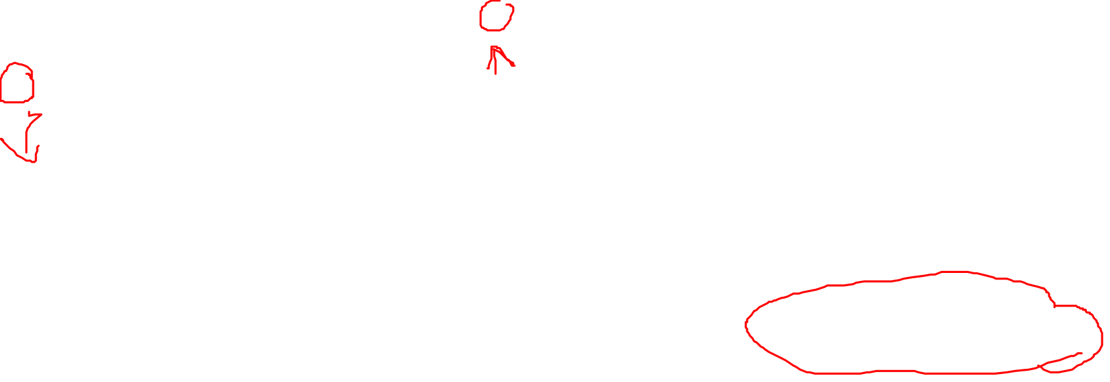
What happens with the protons, when they are exposed to this RF-pulse?
Some of them pick up energy and go from a lower to a higher energy level.
Some, which were walking on their feet, start walking on their hands. And this has some effect on the atom's magnetization.
Let us assume that from the net sum of 6 protons pointing up, after the RF pulse is sent in 2 point down.
The result is that these 2 protons cancel out the magnetic forces of the same number of protons, that point up.
In effect, then, the magnetization in longitudinal direction decreases from 6 to 2.

Slide 29
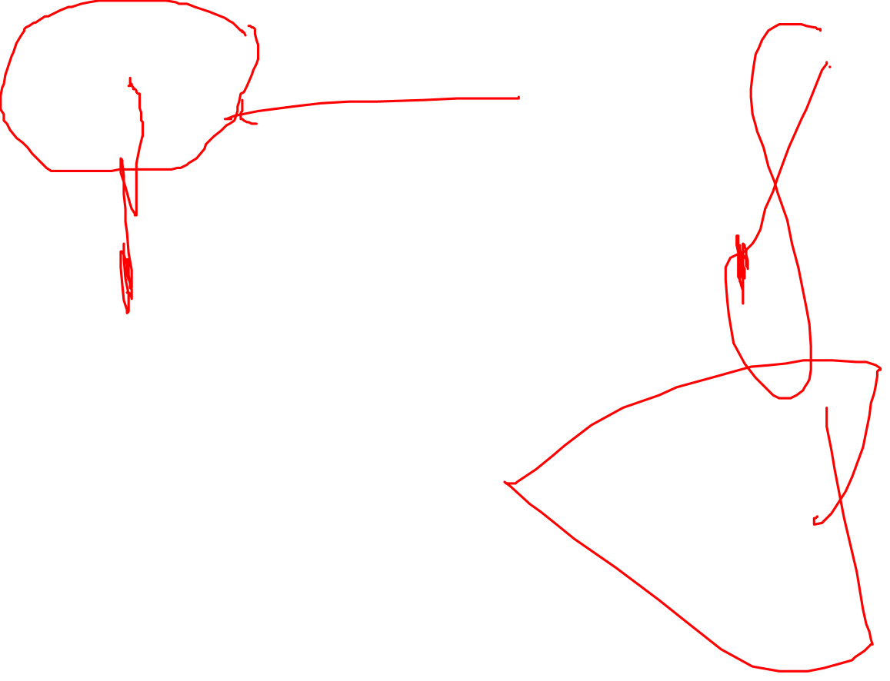

Slide 30
But something else happens.
Do you remember what drawings of radio waves look like?
They resemble a whip, and the RF pulse also has a whip-like action: it gets the precessing protons in synch and this has another important effect.

Slide 31
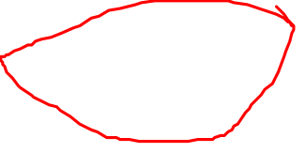
When the protons randomly point left/right, back/forth and so on, they also cancel their magnetic forces in these directions.
Due to the RF pulse, the protons do not point in random directions anymore, but move in step, in synch - they are "in phase".
They now point in the same direction at the same time, and thus their magnetic vectors add up in this direction.
This results in a magnetic vector pointing to the side to which the precessing protons point, and this is in a transverse direction.
This is why it is called transversal magnetization.

Slide 32
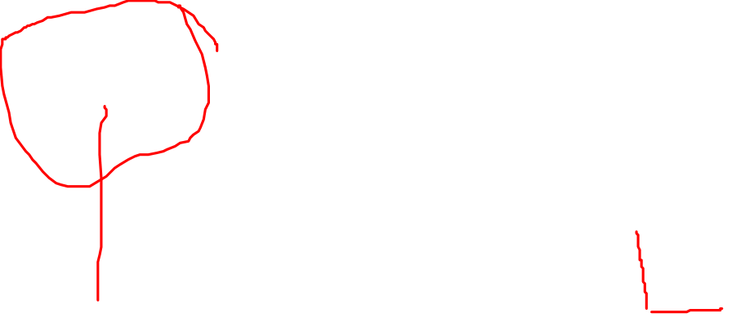

Slide 33
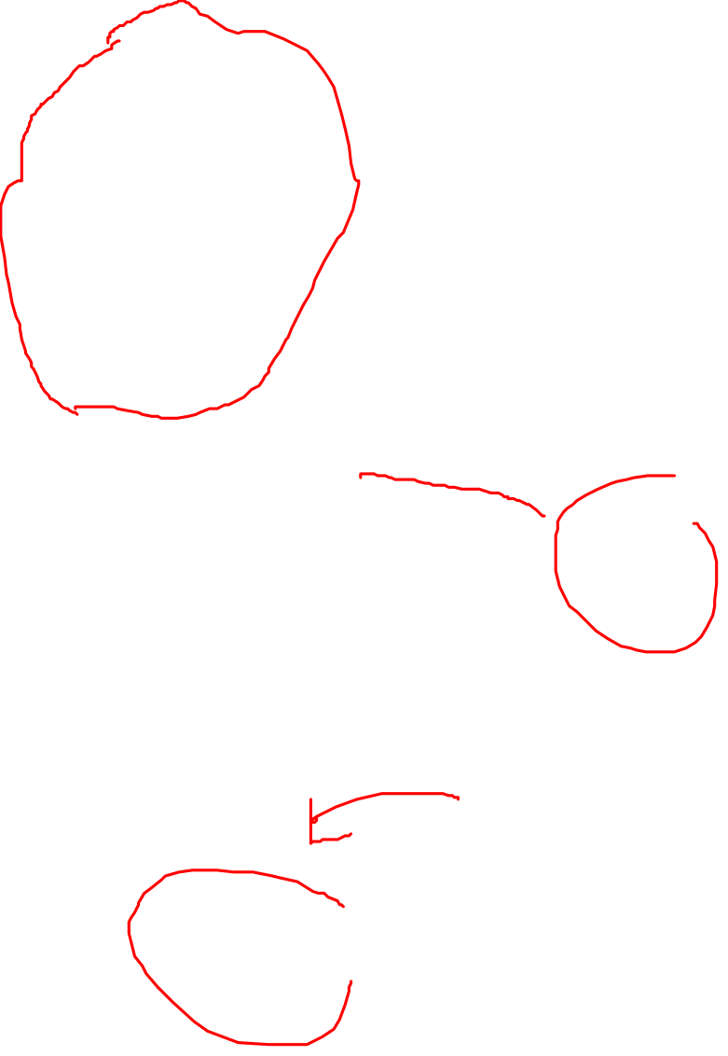
The situation can be compared to a ship: think about the passengers being distributed randomly all over the floor, the ship then is in a normal position.
Then have all passengers walk in equal step around the railing; what happens?
The ship is leaning towards the side where the people are, a new force is established, and becomes visible.
So the RF pulse causes a transversal magnetization. This newly established magnetic vector naturally does not stand still, but moves in line with the precessing protons, and thus with the precession frequency.

Slide 34

So - what were the new things that we have learned?
When we put the atoms in the NMR machine, the protons line up parallel or anti-parallel to the machines magnetic field.
A magnetic field in the atoms, longitudinal to the external field results.
Sending in an RF pulse that has the same frequency as the precession frequency of the protons causes two effects:
Some protons pick up energy, start to walk on their hands, and thus decrease the amount of longitudinal magnetization.

Slide 35

The protons get in synch, start to precess in phase. Their vectors now also add up in a direction transverse to the external magnetic field, and thus a transversal magnetization is established.
In summary:
The RF pulse causes longitudinal magnetization to decrease, and establishes a new transversal magnetization

