Slide 1
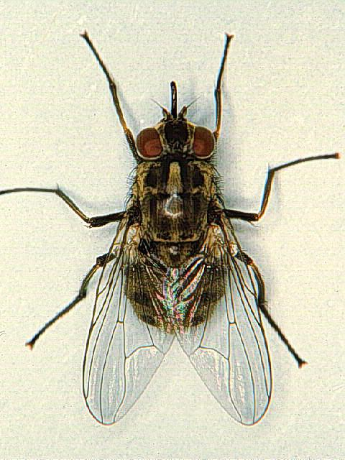
Stomoxys calcitrans
General chracters :
1 – Adult :
Size : 7 – 10 mm
Colour : grey
Head :
Antenna : aristate
Arista : simple hairs on dorsal side only
Proboscis : biting (piercing and sucking) – rigid not retractile
The labium is grooved dorsally to enclose the epipharynx and hypopharynx (all enter the wound during biting )
Maxillary palps : 1 segment – short
Thorax :
4 longitudinal dark strips
Wings : open 1st posterior cell ( the 4th vein bends making an obtuse angle to reach the apex away from the 3rd vein
Abdomen :
4 segments – dark round spots

Slide 2
2 – Egg :
Bannana shaped , creamy white , laid in patches
Breading places horse dung
3 – Larva :
Tapering anterior and posterior ends
Posterior sopiracles : triangular
4 – Pupa :
Barrel – shaped
5 – Medical importance :
A- Direct mechanical transmission of blood parasites as trypanosomes
B- Accidental mayasis
6 – Control :
A- sanitary disposal of manure
B- application of insecticides

Slide 3
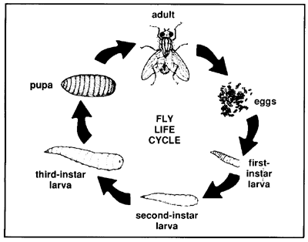
Life cycle :

Slide 4
Glossina palpalis
Glossina morsitans

Slide 5
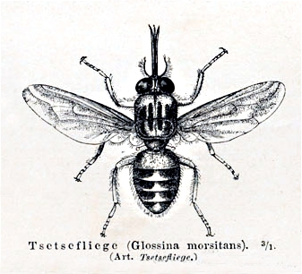

Slide 6
Glossina palpalis , Glossina morsitans
General characters :
1 – Adult :
Size : 10 – 15 mm
Colour : Glossina palpalis (black) Glossina morsitans (brown)
Head :
Antenna : aristate – 3rd seg. bent dorsally and tapering
Arista : branching hairs on dorsal side only
Proboscis : biting (piercing and sucking) blood – rigid
The labium is grooved dorsally to enclose the epipharynx and hypopharynx (all enter the wound during biting)
Maxillary palps : as long as the proboscis
Thorax :
The 4th vein makes a double curve giving a cleaver – shaped discal cell between it and the 5th vein
At rest wings are folded over the abdomen (Scissor like)
Abdomen: 8 segments , black with median pale strip in G. palpalis brown with yellow transverse bands in G. morsitans

Slide 7
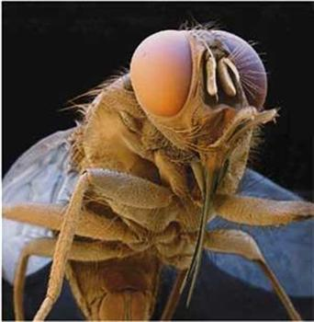

Slide 8
2 – Egg : Larviparous - 1 larva at a time
Breeding places : G. palpalis : soil (shaded water side )
G. morsitan : soil (open land)
3 – Larva : Cylindrical with 2 posterior knobs
4 – Pupa : Barrel – shaped with 2 posterior knobs
5 – Medical importance :Vectors of trypanosomes :
A- Nagana in animal
B- Sleeping sickness in man
Glossina palpalis transmit Trypanosoma gambiense
Glossina morsitans transmit Trypanosoma rhodesiense
6 – Control :
A- change nature of breeding places
B- manual collection of pupae
C- application of insecticides

Slide 9
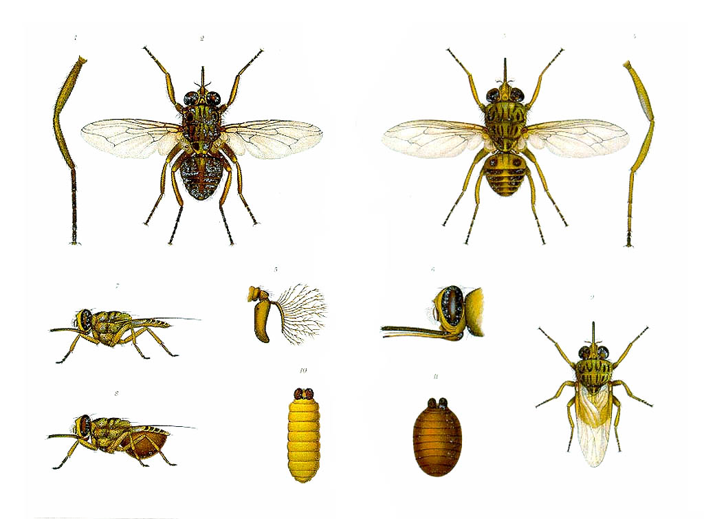

Slide 10
Human trypanosomiasis

Slide 11
Human trypanosomiasis :
Is a parasitic disease caused by Trypanosoma gambiense
and Trypanosoma rhodesiense and transmitted by the tsetse fly
Symptoms :
Fever , headache , joint pains and anemia as the parasites enter through both the blood and lymph systems
When the parasite passes through the blood-brain barrier the disease enter a neurgogical phase and the sleep cycle is disturbed progressing into death if untreated

Slide 12
