Slide 1
Myiasis

Slide 2
Myiasis is an animal or human disease caused by parasitic dipterous fly larvae feeding on the hosts living tissue
Some flies may lay eggs in open wounds
Other larvae may invade unbroken skin or enter the body through nose or ears
Others may be swallowed if the eggs are deposed on food

Slide 3
Classification of myiasis :
1 – According to the habit of the fly :
1- Specific myiasis : These are obligatory tissue parasites
larvae develop only in living tissues, so the flies
oviposit or larviposit in or near living tissues
Examples :
1-Family : Oestridae ( Oestrus , Hypoderma , Dermatobia )
Lay eggs on some insect which when visits man and bites him the eggs hatch and larvae penetrate the skin
2-Gastrophillus
3-Cordylobia( lay eggs on ground or cloth , larvae penetrate unbroken skin)
4-some species of Chrysomia or Wohlfahrtia ( larvae donot penetrate unbroken skin but wounded or diseased tissues

Slide 4
2– Semi–specific myiasis : these are oblgatory feeders on decayed matter
but may attack tissues facultatively attracted by
diseased tissues or wounds odour
Examples :
Family : Calliphoridae

Slide 5
3- Accidental myiasis : Larvae may accidentally get in the tissues
as eggs deposed accidentally on food
Examples :
Musca , Stomoxys

Slide 6
2 – According to habitat ( type of tissue invaded ) :
1- Intesstinal : Musca , Calliphora , Lucilia
2- Gastric : Eristalis
3- Urogenital : Fannia
4- Cutaneous : Dermatobia , Cordylobia , Family : Calliphoridae
5- Ocular : Oestrus , Wohlfahrtia and Sarcophaga
6- Nasopharyngeal : Wohlfahrtia and Sarcophaga

Slide 7
Diagnosis : Finding larvae in the lesion
These are identified by the characteristic posterior
spiracles
Living larvae may be reared to adult for identification
Treatment : Forcible or surgical removal of larvae

Slide 8
Order : Siphonaptera

Slide 9
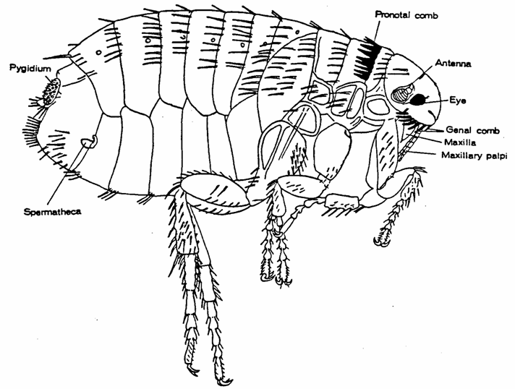
General characters of Order : Siphonaptera
( Bilaterally compressed – Covered with stiff hairs directed backwardly –
Strong legs to help in jumping – Complete metamorphosis )
1- Adult :
Size : 2-3 mm
Body is divided into head,thorax and abd.
Head : round or angular and carries :
2 simple eyes (may be absent)
Post cephalic hairs (one or more)
2 short 3-segmented antenna behind eyes
Genal comb in some species
Proboscis : piercing and sucking in male and female
Thorax : composed of 3 segments and carries :
Legs : 3 pairs of strong legs particulary the coxa and femur
Pronotal comb on the posterior border of the 1st thoracic seg. In some sp.
Mesopleural suture may be present

Slide 10
