Slide 1
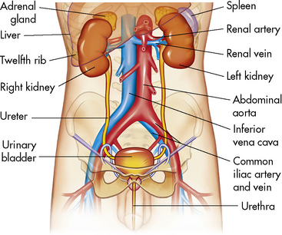
Physiology of Renal System

Slide 2
Functions of Renal Tubules
The loop of Henel
Functions:
Reabsorption of 15% H2O (in descending limb only it is passive)
Reabsorption of 25% NaCl (in ascending limb it is active)
Absorption of Ca ⁺² ions from thick ascending limb (medullary nephrons NOT under PTH control)

Slide 3
Functions of Renal Tubules
Distal tubules & collecting ducts:
Functions:
Reabsorption of Na & secretion of H ⁺ & K ⁺ under aldosterone control
Absorption of Ca ⁺ ions under PTH control)
Reabsorption of H2O under ADH control
Generation of new bicarbonate

Slide 4
Na⁺ Reabsorption
An active process occurs on the basolateral membrane (Na+/K+ ATPase)
The amount of Na + reabsorped from PCT (65%) & loop of Henle (25%) is kept constant.
The reabsorption of the remaining 10% by DCT & CD is controlled by:
Aldosterone hormone: that is secreted from adrenal cortex and encourage Na + reabsorption from DCT & CD
Atrial natriuretic peptide: that is secreted by myocardial cells of atria and inhibit Na + reabsorption from CD

Slide 5
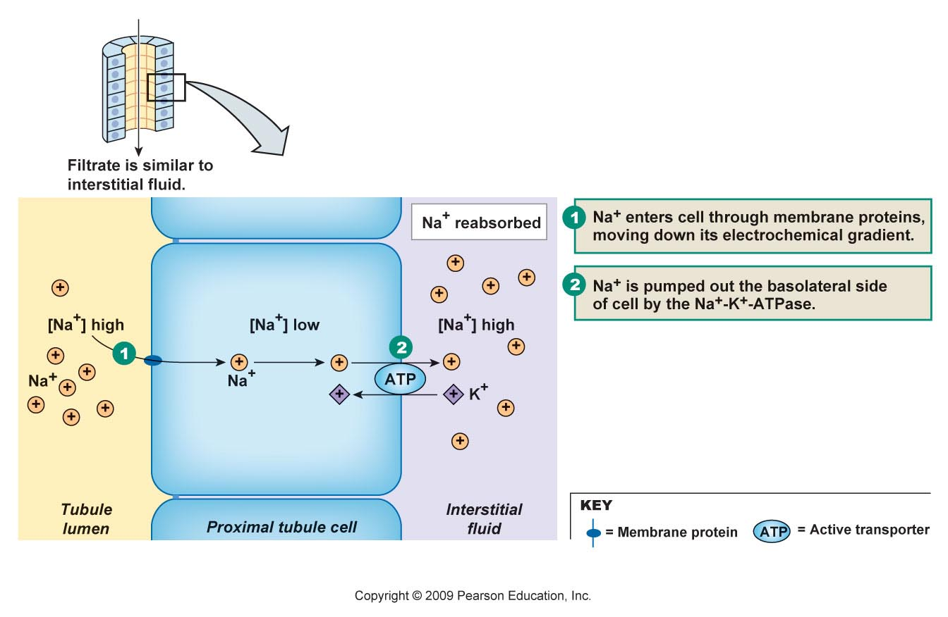
Na⁺ Reabsorption

Slide 6
Water Reabsorption
I. Obligatory: occurs regardless water content of the body
65 % is reabsorped from PCT & 15 % from descending loop of Henle
II. The remaining 20% is reabsorped from DCT & CD under control of ADH

Slide 7
III. Tubular Secretion
Tubular secretion is the movement of material from the peritubular capillaries and interstitial space into the nephron tubules
Secretion occurs via diffusion and transcellular mediated transport.
Enables further removal of unwanted substances

Slide 8
III. Tubular Secretion
H ⁺ & K ⁺ are the most important substances secreted in the tubules.
Other important substances secreted are metabolites such as choline and creatinine and chemicals such as penicillin.
Active transport is required for the movement of the substances from the blood to the cell or out of the cell and into the tubular lumen.

