Slide 1
Ischemic Heart Diseases

Slide 2
Antianginal Drugs
Ischaemic heart disease
Ischaemic or ischemic heart disease or myocardial ischaemia, is a disease characterized by ischaemia (reduced blood supply) of the heart muscle, usually due to coronary artery disease (atherosclerosis of the coronary arteries
Ischaemic heart disease include:
1-Angina pectoris
2-myocardial infarction
Angina pectoris
An imbalance between the supply of oxygen and the myocardial demand resulting in myocardial ischaemia.
The imbalance between oxygen delivery an d utilization may result from a spasm of the vascular smooth muscle or from obstruction of blood vessels caused by atherosclerotic lesions.
Angina is characterized by a sudden, severe pressing substernal pain radiating to the left arm.

Slide 3
Types of angina
1- Classic or atherosclerotic exercise or angina of effort or stable angina.
Classic angina is caused due to atheromatous obstruction of the large coronary vessels. In classic angina, the imbalance occurs when the myocardial oxygen requirement increases, as during exercise, and coronary blood flow does not increase proportionately. The resulting ischemia usually leads to pain.
In stable, pain is typically relieved by rest.
Classic angina is therefore "angina of effort." (In some individuals, the ischemia is not always accompanied by pain, resulting in "silent" ischemia.)
2- Variant or vasospastic or Prinzmetal's angina
Variant angina (Prinzmetal’s angina) almost always occurs during periods of rest, usually at night. The cause is a spasm of a coronary artery. Prinzmetal's angina is unrelieved by rest but usually disappears in about 5 minutes.

Slide 4
3- Unstable angina
- Due to spasm and partial obstruction of coronaries.
Unstable angina, one of the acute coronary syndromes that includes heart attack, is characterized by a change in the pattern of angina episodes, occurring 1) more frequently, 2) at rest, 3) and/or not responding to treatment.
In most cases, formation of labile non-occlusive thrombi at the site of a fissured or ulcerated plaque is the mechanism for reduction in flow. The course and the prognosis of unstable angina are variable, but this subset of acute coronary syndrome is associated with a high risk of myocardial infarction and death.
Myocardial Infarction
Myocardial infarction (MI) is the death of myocardial cells that occurs following prolonged oxygen deprivation.. Myocardial cells begin to die.
a common cause of an MI is the rupture of an atherosclerotic plaque from one of the coronary arteries, and the subsequent obstruction of blood flow
Plaque is made up of low density lipoprotein (LDL), macrophages, smooth muscle cells, platelets, and other substances.
It may narrow the lumen of a blood vessel and restrict blood flow. Plaque rupture can induce the formation of thrombus (blood clot) and block blood flow. This will result in ischemic stroke or heart attack

Slide 5
Formation of foam cells
The first stage in the development of atherosclerosis is the formation of foam cells (macrophages with ingested oxidized LDL).
The process begins with trap of LDL in the intima, which lies just below the endothelium (the monolayer of cells lining the arterial wall).
Formation of plaque
As atherosclerosis progresses,
T lymphocytes, platelets and smooth muscle cells also join foam cells, expanding the plaque size.
This involves cytokines to activate T lymphocytes and growth
factors to promote proliferation of smooth muscle cells.
Platelets can also release cytokines and growth factors to enhance migration and proliferation of smooth muscle cells.
During this stage, a fibrous cap is formed to separate the plaque from the lumen
Thrombosis
Thrombosis (formation of thrombus) arises from plaque rupture. Macrophages may release metalloproteinases and other proteolytic enzymes to degrade fibrous cap, making it susceptible to rupture. Plaque rupture activates platelets, leading to formation of blood clots at the site of lesion.

Slide 6
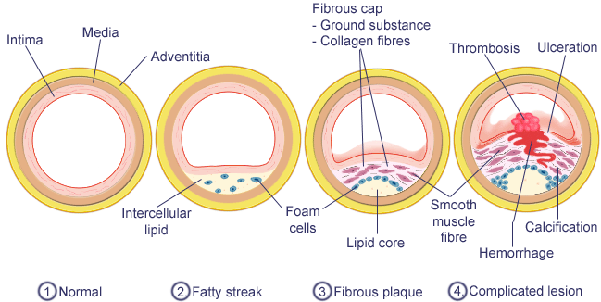

Slide 7
The Lipid Hypothesis
and components of the plaque
Smooth muscle cells
Cholesterol crystals
Collagen
Foam cells
Diagrammatic representation of an atheromatous plaque
showing outer cap containing collagen and smooth muscle
cells, and inner core containing foam cells and extracellular
cholesterol crystals.

Slide 8
Response – to – Injury
Hypothesis
Cholesteryl
ester
Monocycle
Foam
cells
LDL
Endothelial
injury
Platelets

Slide 9
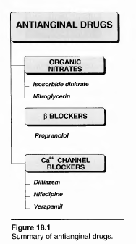
Antianginal drugs
Three classes of drugs are effective, either alone or in combination, in treating patients with stable angina: nitrates, β -blockers, and calcium channel- blockers.

Slide 10
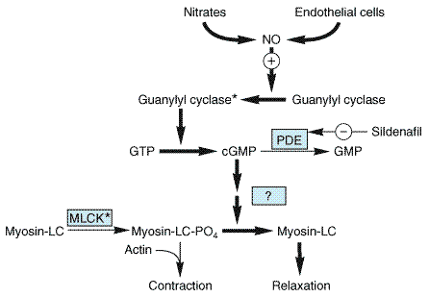
l)
A- ORGANIC NITRATES Organic nitrates (and nitrites) are simple nitric and nitrous acid esters of alcohols. They differ in their volatility; for example, isosorbide dinitrate is solid at room temperature, nitroglycerin is only moderately volatile, whereas amyl nitrate is extremely volatile. These compounds cause a rapid reduction in myocardial oxygen demand followed byrapid relief of symptoms. They are effective in stable and unstable angina, as well as Prinzmetal's or variant angina pectoris.
NO is released by effect of Mitochondrial aldahyde dehydrogenase (MALD) on nitroglycerin
Mechanisms of action: The organic nitrates, such as nitroglycerin are thought to relax vascular smooth muscle by their intracellular conversion to nitrite ions and then to nitric oxide (NO), which in turn activates guanylate cyclase and increases the cells' cyclic GMP. Elevated cGMP ultimately leads to dephosphorylation of the myosin light chain, resulting in vascular smooth muscle relaxation (Figure 18.2).

Slide 11
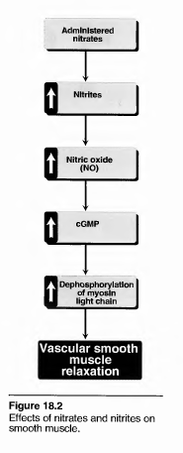
Effects on cardiovascular system:
1-It causes dilation of the large veins, resulting in pooling of blood in the veins. This diminishes preload (venous return to the heart), and reduces the work of the At therapeutic doses, nitroglycerin has major effects. Heart (main mechanism)
2- It decreased afterlaod due to vasodilatation of arteries.
3-Nitroglycerin dilates the epicardial and collateral blood vessel, providing increased blood perfusion to the heart muscle. Nitroglycerin causes a decrease in myocardial oxygen consumption because of decreased cardiac work

Slide 12
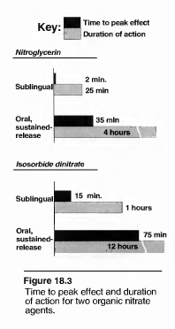
Pharmacokinetics:
The time to onset of action varies from one minute for nitroglycerin to more than one hour for isosorbide mononitrate (Figure 18.3). Significant first-pass metabolism of nitroglycerin occurs in the liver. Therefore, it is common to give the drug either sublingually and amyl nitrite by inhalation (ampoule) used in emergencyor via a transdermal patch (used in nocturnal angina) .

Slide 13
Adverse effects:
The most common adverse effect of nitroglycerin, as well as the other nitrates, is headache. Thirty to sixty percent of patients receiving intermittent nitrate therapy with long-acting agents develop headaches. High doses of organic nitrates can also cause postural hypotension, pulsating headache, facial flushing, and tachycardia.
Tolerance:
If nitrates are given continuously the intensity of the effect soon declines. This is the main limitation to chronic nitrate therapy. The mechanism of this rapid development tolerance is not clearly understood. However, it is proposed due to:
1-Impaired biotransformation of NG to its active principle – NO (or a NO-related species) due to oxidation of MALDH enzyme by NO
2-Neurohormonal activation, causing sympathetic activation and release of vasoconstrictors such as endothelin and angiotensin II, which counteract the vasodilation induced by NG (reflex mechanism )
3-The oxidative stress hypothesis
It can be overcome by provision of a daily "nitrate-free interval" to restore sensitivity to the drug. This interval is typically 6 to 8 hours, usually at night because there is decreased demand on the heart at that time. If the drug is given 3 times daily the last dose should be at 6 p.m.
To avoid tolerance to long term nitrate therapy, regimens should be tailored to provide a 10- to 12-hour nitrate-free interval when possible. Or by long acting isosorbide monohydrate

Slide 14
B. Isosorbide dinitrate Isosorbide dinitrate
is an orally active nitrate (Figure 18.3). The drug is not readily metabolized by the liver or smooth muscle and has a lower potency than nitroglycerin in relaxng vascular smooth muscle.
Il) β-ADRENERGIC BLOCKERS
The β -adrenergic blocking agents suppress the activation of the heart by blocking β-receptors.
They also reduce the work of the heart by decreasing cardiac output and causing a slight decrease in blood pressure.
Propranolol is the prototype of this class of compounds, but other β -blockers, such as metoprolol and atenolol are equally effective.
However, agents with intrinsic sympathomimetic activity (for example, pindolol and acebutolol) are less effective and should be avoided.
The β -blockers reduce the frequency and severity of angina attacks.
These agents are particularly useful in the treatment of patients with myocardial infarction.
They are, however, contraindicated in patients with diabetes, peripheral vascular disease, or chronic obstructive pulmonary disease.
The β -blockers are not useful in prinzmetal or variant angina, but they may worse the conditions. This because when the β-receptor in coronary arteries are blocked there will be unopposed effect of catecholamine acting on α-receptors and increases coronary resistance.

Slide 15
lll) CALCIUM CHANNEL BLOCKERS
The calcium channel blockers inhibit the entrance of calcium into cardiac and smooth muscle cells of the coronary and systemic arterial beds. All calcium channel blockers are therefore vasodilators that cause a decrease in smooth muscle tone and vascular resistance. At clinical doses, these agents affect primarily the resistance of vascular smooth muscle and the myocardium. [Note: Verapamil mainly affects the myocardium, whereas nifedipine exerts a greater effect on smooth mus- cle in the peripheral vasculature.
1- Nifedipine:
Nifedipine functions mainly as an arteriolar vasodilator. This drug has minimal effect on cardiac conduction or heart rate. Nifedipine is administered orally and has a short half-life (about 4 hours requiring multiple dosing. The vasodilation effect of nifedipine is useful in the treatment of variant angina caused by spontaneous coronary spasm.
Nifedipine can cause flushing, headache, hypotension, and peripheral edema as side effects of its vasodilation activity. The drug may cause reflex tachycardia if peripheral vasodilation is marked resulting in a substantial decrease in blood pressure.

Slide 16
2- Verapamil
Verapamfl slows cardiac conduction directly and thus decreases heart rate and oxygen demand. Verapamil causes greater negative inotropic effects than does nifedipine, but it is a weaker vasodilator.
Verapamil is contraindicated in patients with preexisting depressed cardiac function or AV conduction abnormalities. It also causes constipation.
Verapamil should be used with caution in digitalized patients, since it increases digoxin levels.
3-. Diltiazem
Diltiazem has cardiovascular effects that are similar to those of verapamil. It reduces the heart rate, although to a lesser extent than verapamil, and also decreases blood pressure. In addition, diltiazem can relieve coronary artery spasm and is therefore particularly useful in patients with variant angina. The incidence of adverse side effects is low.

Slide 17
Therapeutic uses
1- Angina pectoris
In exertional angina Ca++ channel blockers are effective in reducing the frequency and severity of anginal attacks. This could result from an increase in coronary blood flow due to coronary dilation and decrease in myocardial oxygen demand secondary to decrease BP, HR and contractility.
In some patients the drugs of dihydropyridine class may aggravate anginal symptoms due to the reflex tachycardia.
Concurrent therapy with beta –adrenegic –blockers is more effective than either agent alone .
It is advisable however, not to combine verapamil or diltizem with beta-blockers for the fear of AV-block, severe bradycardia or heart failure.
In prinzmetal angina Ca++ channel blockers are the agents of choice of dihydropyridine Nifedipine due to their selectivity on coronary arteries.
2- Supraventricular dysrhythmia
3- Hypertension
lll) Antiplatlets drugs (Aspirin)
Small dose of aspirin 75-150 mg to inhibit platelets aggregation

Slide 18
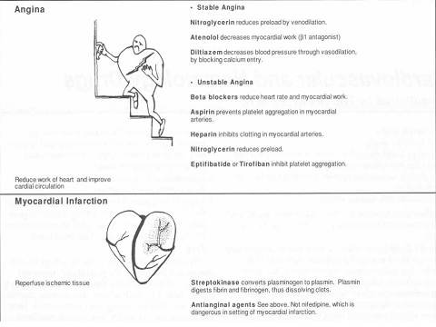

Slide 20
Antidysrhythmic Drugs
Cardiac arrhythmias
It is alterations in heart rate or rhythm and arise from alteration in impulse generation or conduction.
It result from alterations in the orderly sequence of depolarization followed by repolarization in the heart.
Arrhythmias are caused by a disruption of the normal electrical conduction system of the heart.
The clinical implications of disordered cardiac activation range from asymptomatic palpitations to lethal arrhythmia.
The electrial impulse that signals your heart to contract in a synchronized way begins in the sinoatrial node (SA node). This node is your heart's natural pacemaker.
Normally, the four chambers of the heart (two atria and two ventricles) contract in a very specific, coordinated way.
The signal leaves the SA node and travels through the two upper chambers (atria). Then the signal passes through another node (the AV node), and finally, through the lower chambers (ventricles).
This path enables the chambers to contract in a coordinated fashion

Slide 21
The arrhythmias are conceptually simple--dysfunctions cause abnormalities in impulse formation and conduction in the myocardium. However, in the clinic, arrhythmias present as a complex family of disorders that show a variety of symptoms. For example, cardiac arrhythmias may cause the heart
(1) to beat too slowly (sinus bradycardia)
(2) to beat too rapidly (sinus or ventricular tachycardia, atrial or ventricular premature depolarization, atrial flutter);
(3) to respond to impulses originating from sites other than the SA node.
: Atrial flutter: Well-organized (regular) but overly rapid contractions of the atrium of the heart (usually at a rate of 250-350 per minute.).
Flutter refers to a rapid vibration or pulsation..
Atrial Fibrillation is the most common type of irregular heartbeat (around 250 beat per minute
. It is a very fast heartbeat of the two top chambers of the heart causing them to beat about four times faster than normal. The impulses are sent to the ventricles in an irregular pattern
Atrial Fibrillation is one of the most common risk factors for stroke.
The difference between flutter and fibrillation is that flutter is well organized while fibrillation is not. Atrial flutter is a serious and potentially unstable rhythm of the heart.

Slide 22
Electrophysiology of Normal Cardiac Rhythm
The electrical impulse that triggers a normal cardiac contraction originates at regular intervals in the sinoatrial node (Figure17- 1), usually at a frequency of 60–100 beats per minute. This impulse
spreads rapidly through the atria and enters the atrioventricular node, which is normally the only conduction pathway between the atria and ventricles.
Conduction through the atrioventricular node
is slow, requiring about 0.15 s. (This delay provides time for atrial contraction to propel blood into the ventricles.)
The impulse then propagates over the His-Purkinje system and invades all parts of the ventricles.
Ventricular activation is complete in less than 0.1 s; therefore, contraction of all of the ventricular muscle is synchronous and hemodynamically effective.

Slide 23
Electrophysiology of the heart different waveforms for each of the specialized cells
Schematic representation of the heart and normal cardiac electrical activity (intracellular
recordings from areas indicated and ECG). Sinoatrial node, atrioventricular node, and Purkinje cells display pacemaker activity (phase 4 depolarization). The ECG is the body surface manifestation of the depolarization and repolarization waves of the heart.
The P wave is generated by atrial depolarization,
the QRS by ventricular muscle depolarization, and the
T wave by ventricular repolarization.
Thus, the PR interval is a measure of conduction time from atrium to ventricle,
the QRS duration indicates the time required for all of the ventricular cells to be activated (ie, the intraventricular conduction time).
The QT interval reflects the duration of the ventricular action potential.

Slide 24
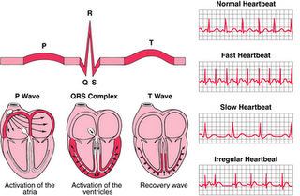
Electrophysiology of the heart

Slide 25
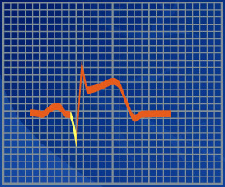
Deep Q wave
Only diagnostic change of myocardial infarction

