Slide 1
CNS Acting Drugs

Slide 2
Introduction to the Pharmacology of CNS Drugs
REVIEW OF BASIC NEUROSCIENCE
The functional unit of the central nervous system (CNS) is the neuron, and most neuropharmacological agents have the neuron as their primary site of action.
CNS
neurons are capable of transmitting information to and receiving information from other neurons and peripheral end organs, such as muscle cells, glandular cells, and specialized receptors, for example, those involved with, temperature sensing, and so on.
The depolarization associated with an action potential results in the calcium-facilitated release of a specific chemical substance at the synapse between two neurons.
This chemical substance or neurotransmitter is released, diffuses across the synaptic cleft, and interacts with the membrane of the second neuron to initiate
a local change in the ionic composition and a local altered potential difference in the second neuron.

Slide 3
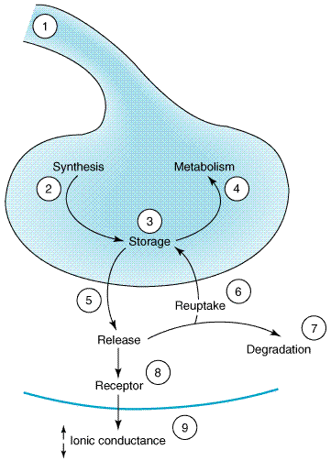
Fig 1 Sites of drug action. Schematic drawing of steps at which drugs can alter synaptic transmission. 1) Action potential in presynaptic fiber; (2) synthesis of transmitter; (3) storage; (4) metabolism; (5) release; (6) reuptake; (7) degradation; (8) receptor for the transmitter; (9) receptor-induced increase or decrease in ionic conductance.

Slide 4
Types of CNS receptors
1- ionotropic receptors, also called Ligand-gated channels, are opened by the binding of neurotransmitters to the channel. The receptor is formed of subunits, and the channel is an integral part of the receptor complex. These channels are insensitive or only weakly sensitive to membrane potential. Activation of these channels typically results in a brief (a few milliseconds to tens of milliseconds) opening of the channel. Ligand-gated channels are responsible for fast synaptic transmission typical of hierarchical pathways in the CNS.
2-metabotropic receptors. Metabotropic receptors mediated via G proteins, modulate voltage-gated channels. This interaction can occur entirely
within the membrane and is referred to as a membrane delimited pathway .

Slide 5
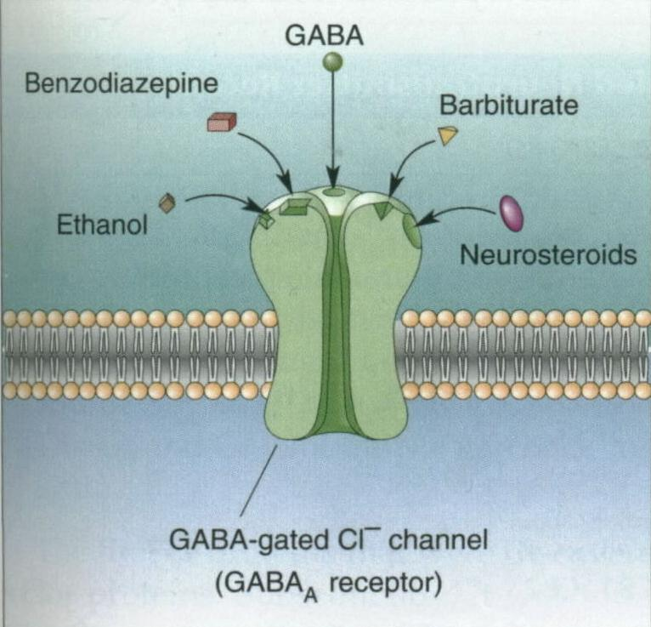
Central Neurotransmitters
1-Amino Acid
a-Inhibitory 1-Amino Acid
A large number of amino acids serve as neurotransmitters
in the mammalian CNS. -Aminobutyric Acid
i-Gama Aminobutyric acid (GABA) is the major inhibitory neurotransmitter in the mammalian
Two types of GABA receptors have been identified in mammals, a GABAa- and a GABAb-receptor.
a) The GABAa-receptor (postsynaptic receptor), when coupled with GABA, induces a shift in membrane permeability, primarily to chloride ions, causing hyperpolarization of the neuron. In addition to the GABAa-receptor, benzodiazepine and barbiturate binding sites and the chloride ionophore (chloride channel). A number of drugs are thought to exert their CNS effect by altering GABAa-receptor activity. The 1,4- benzodiazepines, -carbolines, barbiturates, alcohols and general anesthetics appear to facilitate GABA transmission by interacting at this macromolecular complex.

Slide 6
b) The GABAb-receptor (presynaptic receptor), in contrast, is not modulated by benzodiazepines is not linked to chloride movement, and is not nearly as well characterized as is the GABAa-receptor. The GABAb-receptor is coupled to K+ channels. and is activated by the antispastic agent baclofen.
ii-Glycine
Glycine is another inhibitory CNS neurotransmitter.
Whereas GABA is located primarily in the brain, glycine is found predominantly in the ventral horn of the spinal cord.
Glycine acts on its own receptor which is similar to GABAa
Relatively few drugs are known to interact with glycine; the best-known example is the convulsant agent strychnine, which appears to be a relatively specific antagonist of glycine.
Excitatory Amino Acid
Glutamate and Aspartic Acid
These two excitatory amino acids are widely
distributed throughout the mammalian CNS. Their administration
leads to rapid depolarization of neurons and an increase in firing rate.). The best-characterized receptor is known as the a-a-NMDA (N-methyl-Daspartate) receptor
Exposure of NMDA to glutamate can leads to increased Ca++ and Na++ ion influx.
NAMDA antagonist can be used in treatment of epilepsy.

Slide 7
2-Acetylcholine
Both muscrinic and nicotinic exist in CNS
Most of Ach is mediated by muscarinic receptor
ACh is an excitatory neurotransmitter in the mammalian CNS. There is good evidence that ACh (among other neurotransmitters) is decreased in certain cognitive disorders, such as Alzheimer’s disease . Thus anticholinestrase can be used in treatment of dementia Alzheimer
3-Dopamine
1- Nigrostriatal projection linking to substantia nigra involved in motor functon----antiparkinsonism.
2- Mesolimbic projection involved in behavior effect-----Antipsychotic.
3- Tuber infundibular is linking to the hypothalamus involved in in the control of prolactin.
A number of dopamine receptors have been identified, and they fall into two categories: D1-like and D2-like.
All dopamine receptors are metabotropic. Dopamine generally exerts a slow inhibitory action on CNS neurons. This action has been best characterized on dopamine-containing substantia nigra neurons, where D2 receptor activation opens potassium channels.
D2-recptors have been implicated in the pathophsiology of schizophrnia, parkinsonism, CTZ activation.
Some drugs that act as dopamine agonist is bromocriptine.

Slide 8
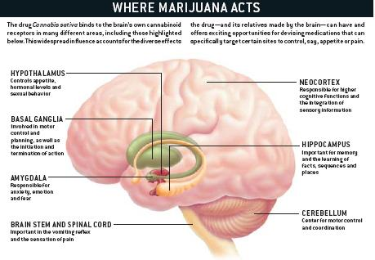

Slide 9
4-Norepinephrine
Most central noradrenergic neurons are located in the nucleus locus ceruleus of the pons and in neurons of the reticular formation. Fibers from these nuclei innervate a large number of cortical, subcortical, and spinomedullary
fields. Many functions have been ascribed to the central noradrenergic neurons, including a role in affective disorders in learning and memory, and in sleep–wake cycle regulation.The mammalia CNS contains both - and -adrenoceptors.
5-Epinephrine
Epinephrine is found only in very low concentrations in the mammalian CNS, and it is unlikely to play a major role as a neurotransmitter.
6-Histamine
Histamine occurs in the brain, particularly in certain
hypothalamic neurons, and evidence is strong that histamine
is a neurotransmitter.
Possible roles for histamine in the regulation of food and water intake, thermoregulation, hormone release, and sleep have been suggested

Slide 10
7-Serotonin
-Serotonin (5-hydroxytryptamine, or 5HT) is present in the brain as well as in the periphery.
-In humans, about 90% of the total serotonin in the body is in enterochromaffin cells in the gastrointestinal tract; the remain in 10% occurs primarily in the platelets and brain.
Synthesis and Fate
Dietary tryptophan is the source of the formation of serotonin. Enzymes and cofactors necessary for serotonin synthesis are present in both the enterochromaffin cells of the gastrointestinal tract and neurons in the brain. Tryptophan is initially hydroxylated to form 5- hydroxytryptophan.
Actions and Site of Actions
. Current evidence indicates that serotonin is involved in
the regulation of several aspects of behavior, including sleep, pain perception depression, sexual activity, and aggressiveness.
Some of the most important antidepressant agents are believed to prevent the reuptake of serotonin.
Serotonin also may be involved in temperature regulation and in the hypothalamic control of the release of pituitary hormones.
In addition, it is a precursor for the synthesis of melatonin, a hormone that influences endocrine activity presumably by an action within the hypothalamus

Slide 11
Anxiolytic and Hypnotic Drugs
- Anxiety is an unpleasant state of tension, apprehension, or fear that seems to arise from an unknown source. Disorders involving anxiety are the most common mental disturbances. The symptoms of severe anxiety are similar to those of fear (such as, tachycadia, sweating, palpitations) and involve sympathetic activation.
- Episodes of mild anxiety are common life experiences and do not warrant treatment.
- However, the symptoms of severe, chronic anxiety may be treated with antianxiety drugs (sometimes called anxiolytic or minor tranquilizers), and/or some form of psycho- or behavioral therapy.
- Since all of the antianxiety drugs also cause some sedation, the same drugs often function clinically as both anxiolytic and hypnotic (sleep-inducing) agents. Figure 9.1 summarizes the anxiolytic and hypnotic agents.

Slide 12
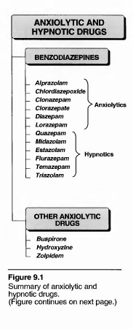
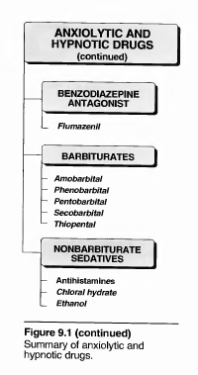

Slide 13
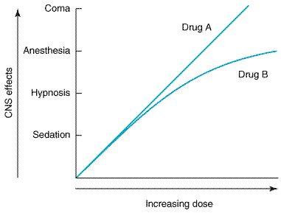
Requirments for good Sedative -hypnotic
An effective sedative (anxiolytic) agent should reduce anxiety and exert a calming effect. The
degree of central nervous system depression caused by a sedative should be the minimum consistent with therapeutic efficacy. A hypnotic drug should produce drowsiness and encourage the onset and maintenance of a state of sleep. Hypnotic effects involve more pronounced depression of the central nervous system than sedation, and this can be achieved with most drugs in this class simply by increasing the dose. Graded dose-dependent depression of central nervous system function is a characteristic of sedative-hypnotics. However, individual drugs differ in the relationship between the dose and the degree of central nervous system depression. Two examples of such dose-response relationships are shown in Figure 22–1. The linear slope for drug A is typical of many of the older sedative-hypnotics, including the barbiturates and alcohols. With such drugs, an increase in dose above that needed for hypnosis may lead to a state of general anesthesia. At still higher doses, sedative-hypnotics may depress respiratory and vasomotor centers in the medulla, leading to coma and death. Deviations from a linear dose-response relationship, as shown for drug B, will require proportionately greater dosage increments in order to achieve central nervous system depression
more profound than hypnosis.
Fig 22-1Dose-response curves for two hypothetical sedative-hypnotics.

Slide 14
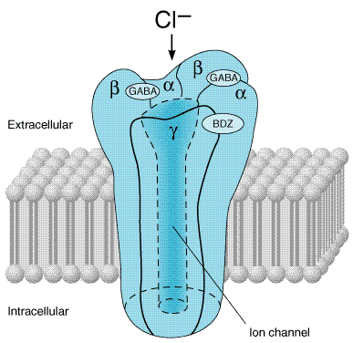
BENZODIAZEPINES
Benzodiazepines are the most widely used anxiolytic drugs. They have largely replaced barbiturates and meprobamate in the treatment of anxiety
Mode of action
Binding of 7-aminobutyric acid (GABA) to its receptor on the cell membrane triggers an opening of a chloride channel, which leads to an increase in chloride conductance (Figure 9.3).
The influx of chloride ions results in enhanced hyperpolarization and further inhibition of neuronal firing and inhibits the formation of action potentials.
Benzodiazepines bind to specific, high affinity sites on the cell membrane, which are separate from but adjacent to the receptor for GABA.
The benzodiazepine receptors are found only in the central nervous system (CNS), and their location parallels that of the GABA neurons.

Slide 15
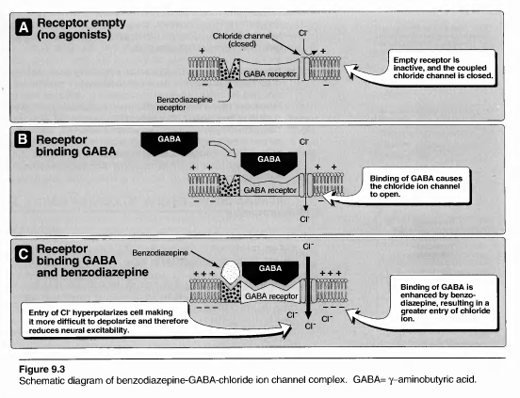

Slide 16
Benzodiazepine Receptor Ligands
types of ligand-
benzodiazepine receptor interactions have been reported:
Agonists facilitate GABA actions, and this occurs at multiple BZ receptor sites in the case of the benzodiazepines. The nonbenzodiazepines zolpidem and zaleplon are selective agonists at the BZ1 receptor subtype. Endogenous agonist ligands for the BZ receptors have been proposed, since benzodiazepine-like chemicals have been isolated from brain tissue of animals never exposed to these drugs.
(2) Antagonists are typified by the synthetic benzodiazepine derivative flumazenil, which blocks the actions of benzodiazepines and zolpidem but does not antagonize the actions of barbiturates, meprobamate, or ethanol.

Slide 17
Pharmacological actions
1- Reduction of anxiety: At low doses, the benzodiazepines are anxiolytic. They are thought to reduce anxiety by selectively inhibiting neuronal circuits in the limbic system of the brain.
2- Sedative and hypnotic actions: All of the benzodiazepines used to treat anxiety have some sedative properties. At higher doses, certain benzodiazepines produce hypnosis (artificially-produced sleep).
3. Anticonvulsant: Several of the benzodiazepines have anticonvulsant activity and are used to treat epilepsy and other seizure disorders. Muscle relaxant: The benzodiazepines relax the spasticity of skeletal muscle, probably by increasing presynaptic inhibition in the spinal cord.
4-Effects on Respiration and Cardiovascular Function
normal doses of sedative-hypnotics may cause cardiovascular depression, probably as a result of actions on the medullary vasomotor centers.

Slide 18
C. Therapeutic uses
The individual benzodiazepines show small differences in their relative anxiolytic, anticonvulsant, and sedative properties. However, the duration of action varies widely among this group, and pharmacokinetic considerations are often important in choice of drug.
1-Anxiety disorders:
The benzodiazepines are useful in treating the anxiety that accompanies some forms of depression and schizophrenia.
The longer acting agents such as diazepam are often preferred in those patients with anxiety that may require treatment for prolonged periods of time.
The antianxiety effects of the benzodiazepines are less subject to tolerance than the sedative and hypnotic effects.
2- Muscular disorders: Diazepam is useful in the treatment of skeletal muscle spasms such as occur in muscle strain, and in treating spasticity from degenerative disorders, such as multiple sclerosis and cerebral palsy.

Slide 19
3-Seizures:
Clonazepam is useful in the chronic treatment of epilepsy, whereas diazepam is the drug of choice in terminating grand mal epileptic seizures and status epilepticus.
Chlordiazepoxide clorazepate diazepam, and oxazepam [ox A ze pam] are use- ful in the acute treatment of alcohol withdrawal.
4-Sleep disorders:
Not all of the benzodiazepines are useful as hypnotic agents, although all have sedative or calming effects.
Temazepam:
Triazolam: This benzodiazepine has a relatively short duration of action and is therefore used to induce sleep in patients with recurring insomnia.

Slide 20
E. Adverse effects.
Drowsiness and confusion: These effects are the two most common side effects of the benzodiazepines. Ataxia occurs at high doses and precludes activities that require fine motor coordination, such as driving an automobile.
Cognitive impairment (decreased Io0g-term recall and acquisition of new knowledge) can occur with use of benzodiazepines. Triazolam, the benzodiazepine with the most rapid elimination, often shows a rapid development of tolerance, early morning insomnia and daytime anxiety, along with amnesia and confusion.
F- Dependence
Psychological and physical dependence on benzodiazepines can develop if high doses of the drug are given over a prolonged period. Abrupt discontinuation of the benzodiazepines results in withdrawal symptoms, including confusion, anxiety, agitation, restlessness, insomnia, and tension.

Slide 21
Precautions: Use benzodiazepines cautiously in treating patients with liver disease. They potentiate alcohol and other CNS depressants. As a result, a drug overdose is seldom lethal, unless other central depressants, such as alcohol, are taken concurrently.

Slide 22
OTHER ANXIOLYTIC AND HYPNOTIC AGENTS
A- Buspirone
- Buspirone is useful in the treatment of generalized anxiety disorders and has an efficacy comparable to the benzodiazepines.
-The actions of buspirone appear to be mediated by serotonin (5-HT1A) receptors as partial agonist, although other receptors could be involved, since buspirone displays some affinity for DA2 dopamine receptors and 5-HT2 serotonin receptors. The mode of action thus differs from that of the benzodiazepines.
Buspirone lacks anticonvulsant and muscle-relaxant properties of the benzodiazepines and causes only minimal sedation.
adverse effects
headaches, dizziness, nervousness, and lightheadness. Sedation and psychomotor and cognitive dysfunction are minimal, and dependence is unlikely.
Buspirone has the disadvantage of a slow onset of action. Figure 9.6 compares some of the common adverse effects of buspirone and the benzodiazepine, alprazolam.

Slide 23
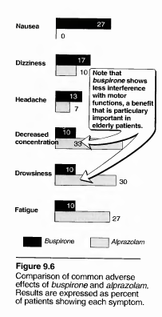

Slide 24
B- Zolpidem
Although the hypnotic zolpidem is not a benzodiazepine, it acts on a subset of the benzodiazepine receptor family. Zolpidem has no anticonvulsant or muscle relaxing properties. It shows no withdrawal effects, exhibits minimal rebound insomnia and little or no tolerance occurs with prolonged use.
Adverse effects of zolpidem include-
nightmares, agitation, headache, gastrointestinal upset, dizziness, and drowsiness.
BENZODIAZEPINE ANTAGONIST
-Flumazenil is a GABA receptor antagonist that can rapidly reverse the effects of benzodiazepines.
-The drug is available by IV administration only.
-Onset is rapid but duration is short, with a half-life of about one hour.
-Frequent administration may be necessary to maintain reversal of a long-acting benzodiazepine.
-Adverse effects
Administration of flumazenil may precipitate withdrawal in dependent patients or may cause seizures if a benzodiazepine is used to control seizure activity. Dizziness, nausea, vomiting, and agitation are the most common side effects.

Slide 25
Barbiturates
The barbiturates were formerly the mainstay of treatment used to sedate the patient or to induce and maintain sleep. Today, they have been largely replaced by the benzodiazepines, mainly because barbiturates induce tolerance, drug-metabolizing enzymes, physical dependence, and very severe withdrawal symptoms.
Advantages of Benzodiazepines over Barbiturates
1- Better therapeutic index
2- wide margin of safety
3- Less liability of dependence or addiction.
4- less depressant effect on respiratory sys.
5- have no enzyme inducers

Slide 26
Mode of action
Barbiturates are thought to interfere with sodium and potassium transport across cell membranes..
1-Barbiturates also potentiate GABA action on chloride entry into the neuron, although they do not bind at the benzodiazepine receptor.Barbiturates also facilitate the actions of GABA at multiple sites in the central nervous system, but—
2-in contrast to benzodiazepines—they appear to increase the duration of the GABA-gated chloride channel openings.
3-At high concentrations, the barbiturates may also be GABA-mimetic, directly activating chloride channels. These effects involve a binding site or sites distinct from the benzodiazepine binding sites.
4- Barbiturates are less selective in their actions than benzodiazepines, since they also depress the actions of excitatory neurotransmitters (eg, glutamic acid) and exert nonsynaptic membrane effects in parallel with their effects on GABA neurotransmission. This multiplicity of sites of action of barbiturates may be the basis for their ability to induce full surgical anesthesia and for their more pronounced central depressant effects (which result in their low margin of safety) compared to benzodiazepines

Slide 27
Actions Barbiturates are classified according to their duration of action (Figure 9.7). For example, thiopental which acts within seconds and has a duration of action of about 30 minutes, is used in the intravenous induction of anesthesia. By contrast, phenobarbital which has a duration of action greater than a day, is useful in the treatment of seizures. Pentobarbital secobarbital and amobarbital are short-acting barbiturates, which are effective as sedative and hypnotic.

Slide 28
Depression of CNS:
At low doses, the barbiturates produce seda- tion (calming effect, reducing excitement). At higher doses, the drugs cause hypnosis, followed by anesthesia (loss of feeling or sensation), and finally coma and death..
Respiratory depression:
Barbiturates suppress the hypoxic and chemoreceptor response to CO2, and overdosage is followed by respiratory depression and death.
. Enzyme induction:
Barbiturates induce P-450 microsomal enzymes in the liver Therefore, chronic barbiturate administration diminishes the action of many drugs that are dependent on P-450 metabolism to reduce their concentration.

Slide 29
Therapeutic uses
Anesthesia: Selection of a barbiturate is strongly influenced by the desired duration of- action. The ultra-short-acting barbiturates, such as thiopental, are used intravenously to induce anesthesia.
-Anticonvulsant: Phenobarbital is used in long-term management of tonic-clonic seizures, status epilepticus, and eclampsia. Phenobarbital has been regarded as the drug of choice for treatment of young children with recurrent febrile seizures..
-Anxiety: Barbiturates have been used as mild sedatives to relieve anxiety, nervous tension, and insomnia. Most have been replaced by the benzodiazepines.
Pharmacokinetics Barbiturates
are absorbed orally and distributed widely throughout the body. All barbiturates redistribute in the body from the brain areas, to skeletal muscle, and finally to adipose tissue. This movement is important in causing the short duration of action of thiopental and similar short-acting derivatives.

Slide 30
E. Adverse effects
1-CNS:
Barbiturates cause drowsiness, impaired concentration, and mental and physical sluggishness.
2-Drug hangover:
Hypnotic doses of barbiturates produce a feeling of tiredness well after the patient awakes. This drug hangover leads to impaired ability to function normally for many hours after waking. Occasionally, nausea and dizziness occur.
3-Precautions:
As noted previously, barbiturates induce the P-450 system and therefore may decrease the effect of drugs that are metabolized by these hepatic enzymes. Barbiturates increase porphyrin synthesis, and are contraindicated in patients with acute intermittent porphyria.
4-Addiction:
Abrupt withdrawal from barbiturates may cause tremors, anxiety, weakness, restlessness, nausea and vomiting, seizures, delirium, and cardiac arrest. Withdrawal is much more severe than that associated with opiates and can result in death.

Slide 31
Poisoning: Barbiturate poisoning has been a leading cause of death among drug overdoses for many decades. Severe depression of respiration is coupled with central cardiovascular depression, and results in a shock-like condition with shallow, infrequent breathing.
Treatment includes artificial respiration and purging the stomach of its contents if the drug has been recently taken. Hemodialysis may be necessary if large quantities have been taken. Alkalinization of the urine often aids in the elimination of phenobarbital.

