Slide 1
Department of Histology
Faculty of Medicine
Assiut university
EPITHELIAL TISSUE
Prof. Amal Taha
2019-2020

Slide 2
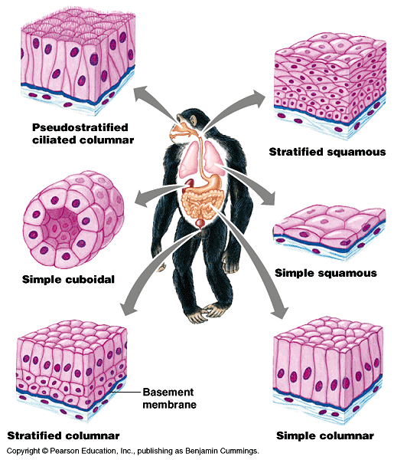
EPITHELIAL TISSUE
Genaral Characteristics:
1. It is formed of crowded cells with minimal intercellular substance.
2. It rests on a basement membrane & underlying connective tissue.
3. It is avascular (=nonvascularized).
4. It is rich in nerve endings.
5. It has a high power of regeneration.
6. It forms:
a- sheets covering all surfaces &lining all cavities in the body (covering &lining epithelium)
b- clusters of cells forming glands (glandular epithelium)
c- modified structures acting as sensory receptors (sensory epithelium)

Slide 3
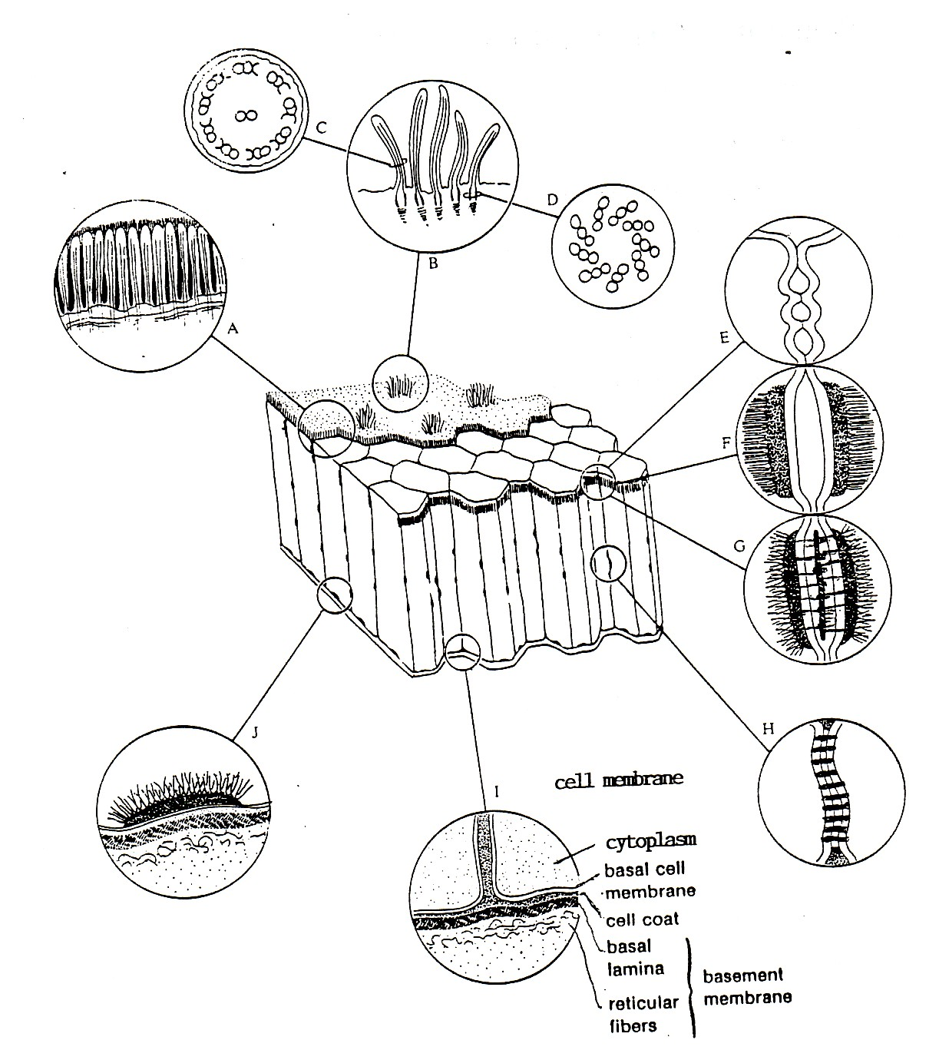
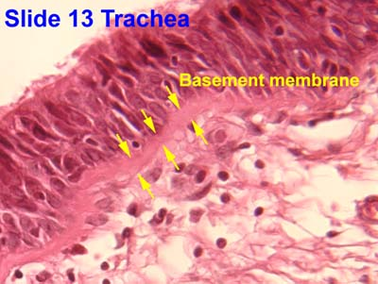
Basement Membrane
It is the layer thet sparates the epithelium from the underlying connective tissue.
By LM, it appears as a thin layer & can be stained with PAS & silver.
By EM, it is formed of:
1. Cell coat of epithelial cells.
2. Basal lamina: is a homogenous layer composed of glycoproteins.
3. A layer of reticular fibers.
Function:
1- acts as a barrier against diffusion of macromolecules.
2- support for the epithelial layer.

Slide 4
Covering & Lining
Epithelium
Simple Epithelium
Formed of one layer of cells
1- simple squamous ep.
2- simple cuboidal ep.
3- simple columnar ep.
4- pseudostratified columnar ep.
Stratified Epithelium
Formed of more than one
layer of cells
1- stratified squamous ep.
2- stratified columnar ep.
3- transitional ep.

Slide 5
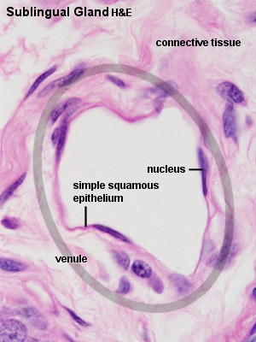
Covering & Lining Epithelium
I- Simple Epithelium
1. Simple squamous epithelium:
Formed of one layer of flat cells with flat nuclei.
Site: lining blood vessels &all body cavities.

Slide 6
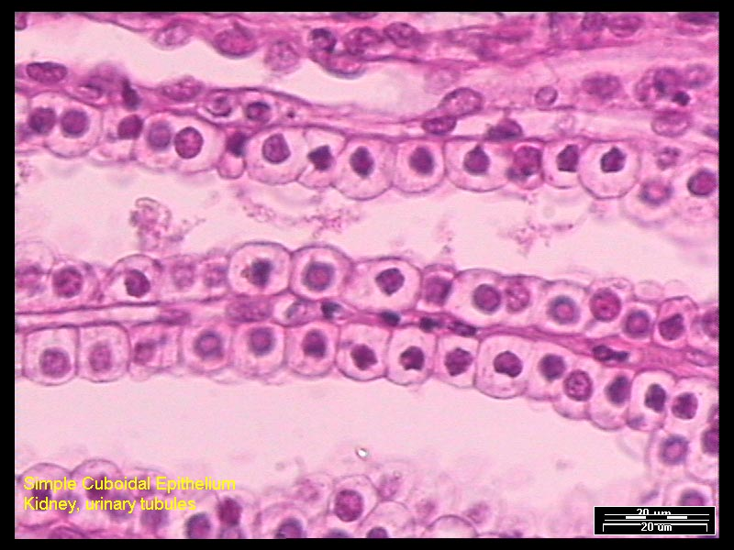
2. Simple Cuboidal epithelium:
Formed of one layer of cubical cells with central rounded nuclei.
Site: lining renal tubules &thyroid follicles.

Slide 7
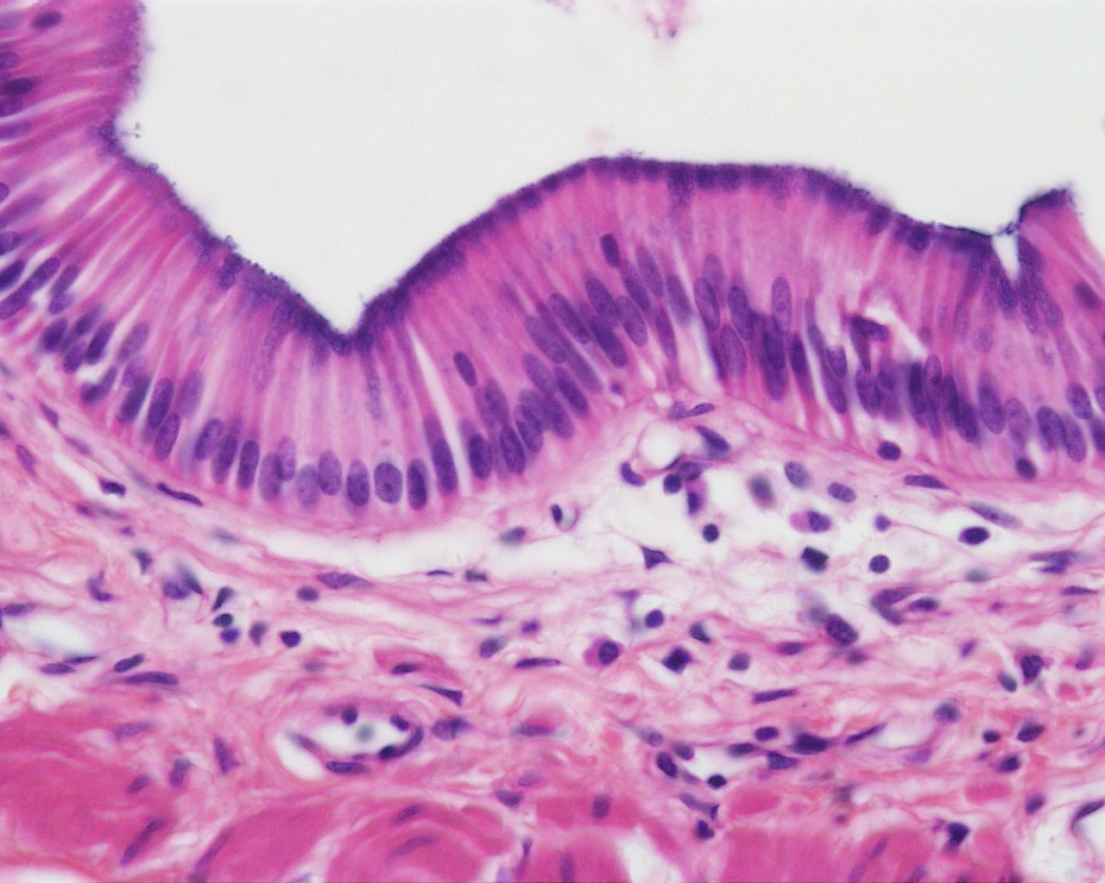
3. Simple Columnar epithelium:
Formed of one layer of tall cells with oval basal nuclei.
Site: lining the stomach, the intestines & gall bladder.

Slide 8
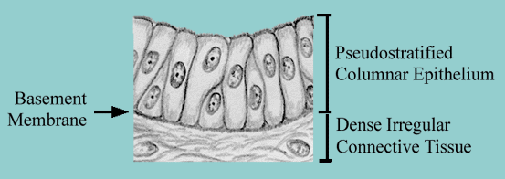
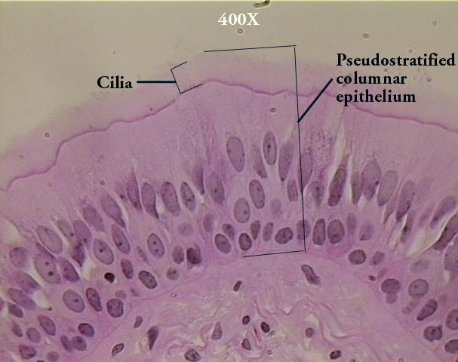
4. Pseudostratified Columnar epithelium
Formed of one layer of cells. Some cells are tall & reach the surface of the epithelium and others are too short to reach the surface but all the cells rest on the basement membrane. The epithelium appears falsely stratified.
Site: lining the trachea (pseudostratified columnar ciliated ep.)

Slide 9
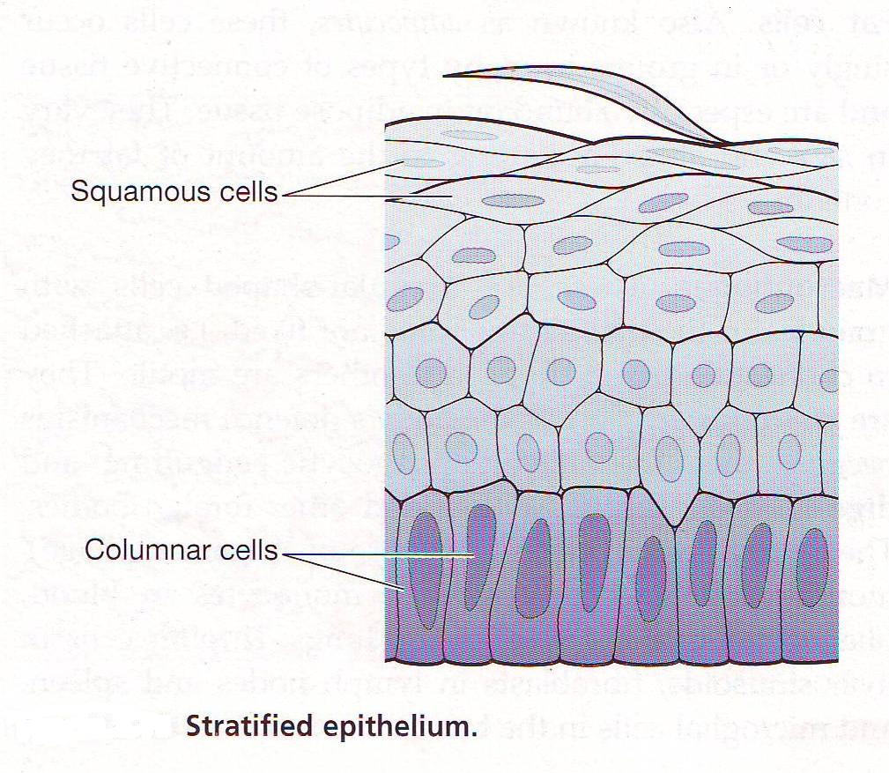
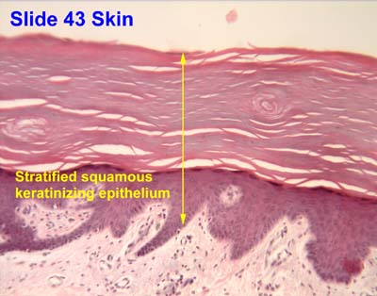
II- Stratified Epithelium
1- Stratified Squamous Epithelium:
Structure: Formed of several layers of cells. The basal cells are columnar, the following layers are polyhedral, the superficial cells are flattened squamous.
Site: It has two types:
1. Stratified squamous non keratinized: lining the oral cavity & the oesophagus.
2 Stratified squamous keratinized: covers the skin

Slide 10
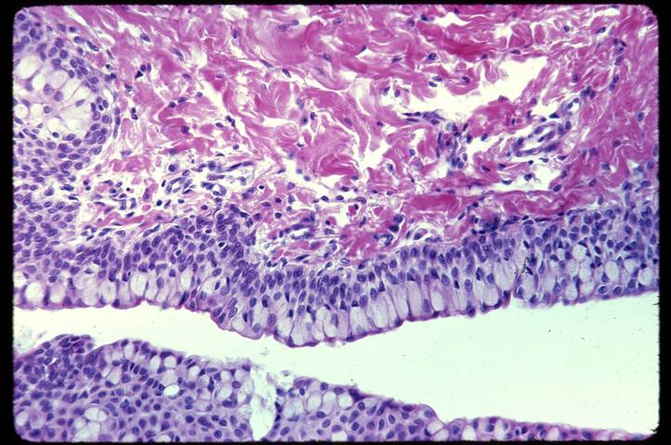
2. Stratified Columnar Epithelium:
Structure: Formed of several layers of cells. The basal cells are columnar, the following layers are polyhedral, the superficial cells are tall columnar.
Site: lining large ducts of glands.

Slide 11
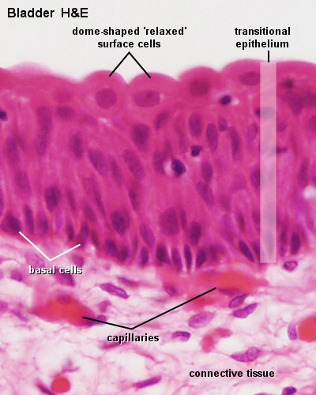
3. Transitional Epithelium:
Means that the epithelium can change its form.
Site: It lines organs which can expand greatly like the urinary bladder.
Structure:
a- When the epithelium is stretched (as in full bladder), it is similar to a stratified squamous non keratinized type.
b- When the epithelium is relaxed (as in empty bladder): The basal cells are short columnar, the intermediate cells are polyhedral and the superficial cells are large rounded with convex upper surfaces &have one or two nuclei.

Slide 12
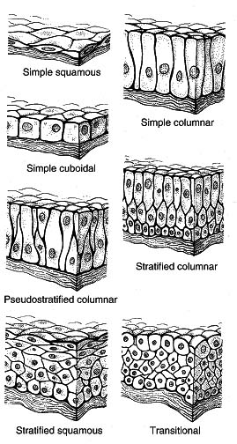
Covering & Lining Epithelium

Slide 13
Glandular Epithelium
Classification of Glandular Epithelium:
There are several ways of classification of glandular epithelium:
According to presence or absence of ducts:
1. Exocrine glands: have ducts that carry their secretion to the surface of the epithelium, e.g. salivary glands.
2. Endocrine glands: are ductless glands. They secrete hormones directly into blood, e.g. pituitary gland.

Slide 14
Exocrine glands: are further classified according to:
a- the nature of secretion into:
1. Serous glands secrete watery secretion rich in enzymes e.g. pancreas.
2. Mucous glands secrete viscid mucous secretion e.g. esophageal glands.
3. Muco-serous glands: secrete mucous &serous secretion e.g. submandibular salivary gland.

Slide 15
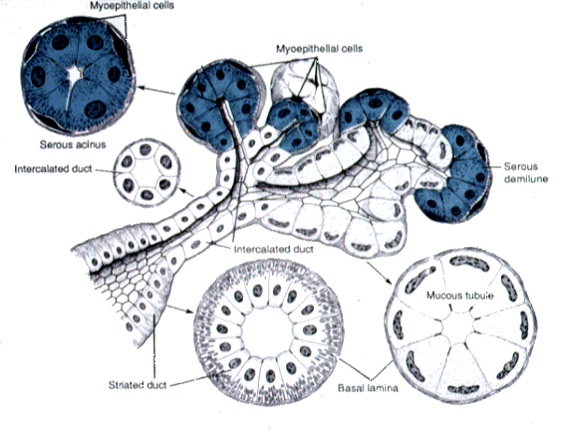
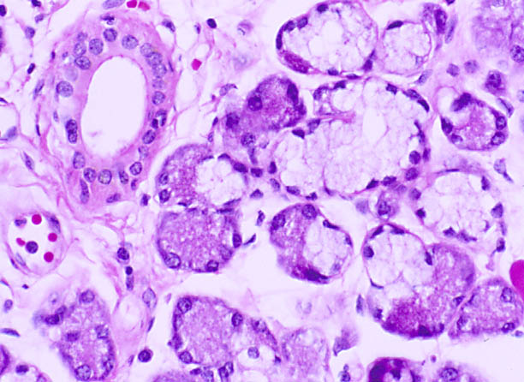
Exocrine glands according to the nature of secretion

Slide 16
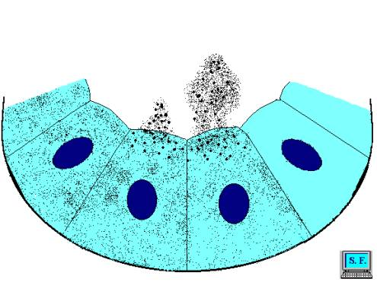
b- the mode of secretion:
1. Merocrine glands: The secretion leaves the cell by exocytosis & the cell membrane is left intact. No part of the cell is lost e.g. salivary glands.

Slide 17
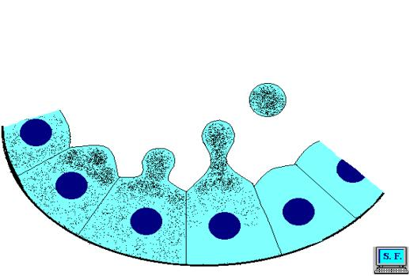
2. Apocrine glands: During secretion, there is loss of the apical part of the cell e.g. apocrine sweat glands.

Slide 18
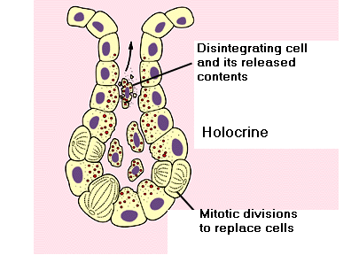
3. Holocrine glands: The cells after being full of secretion, they burst &become totally included in the secretion e.g. sebaceous glands.

Slide 19
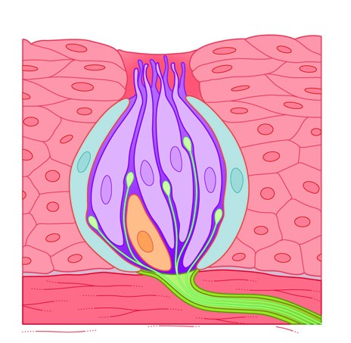
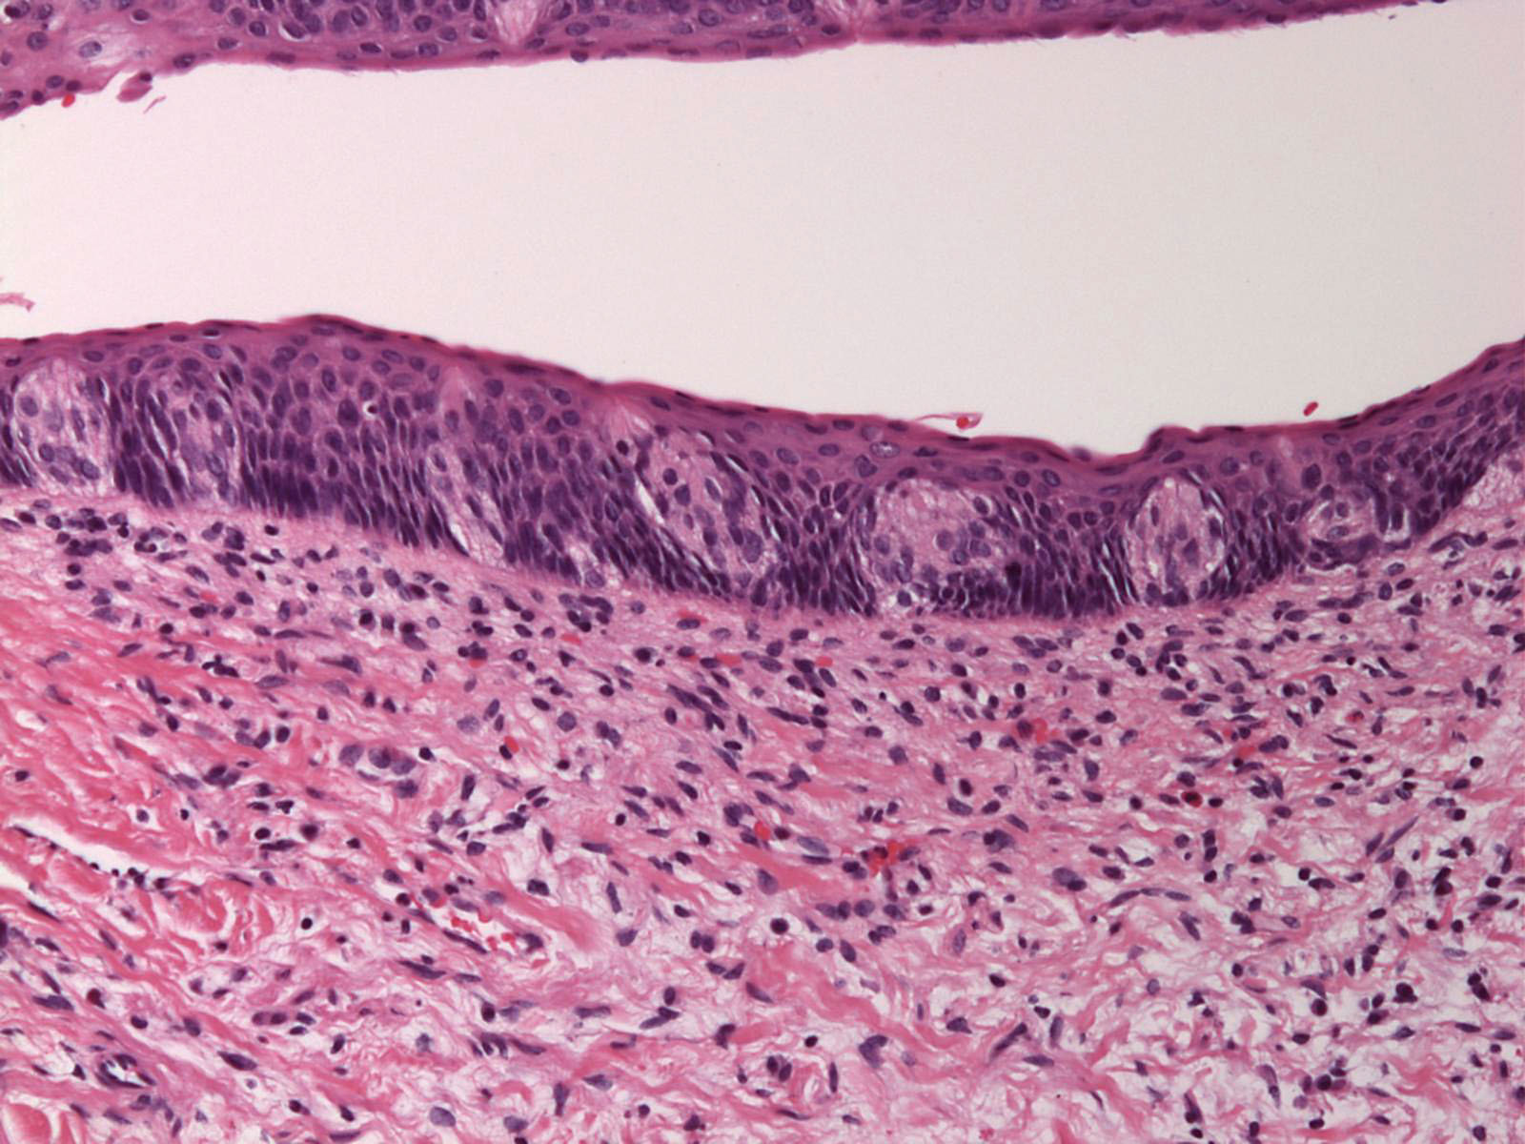
Sensory Epithelium
(Neuro-Epithelium)
It is epithelial tissue modified to act as a receptor.
Structure: formed of three types of cells:
1. sensory cells.
2. supporting cells.
3. basal cells.
Site:
-taste buds in the tongue.
-olfactory epithelium in the nose

Slide 20

Thank you

