Slide 1
Carbohydrates

Slide 2
NON REDUCING DISACCHARIDES
These disaccharides, have a glycosidic linkage between both anomeric centers, therefore, they don’t contain a functional carbonyl group and do not reduce Fehling’s solution, form osazone or undergo mutarotation in solution.

Slide 3
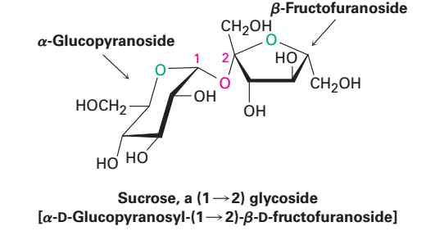
Sucrose
1,2-α-D-glucopyranosyl-β-D-fructofuranoside
Sugar, Cane sugar, Beet sugar.
Occurrence:
Occurs in juices of seeds, leaves, fruits and flowers, in cane sugar, and beet sugar.

Slide 4
Structure
It is a non-reducing sugar, hence the reducing groups are involved it the glycosidic linkage.
On hydrolysis by an acid or by an enzyme invertase of yeast, sucrose yields equimolecular quantities of the pyranose form of D-glucose and D-fructose.
The mixture formed is known as invert sugar and the process is called inversion, since the optical rotation changes from dextro to the levo- rotation during the hydrolysis process.

Slide 5
The enzymatic hydrolysis for sucrose by α-glycosidase and not by β-glycosidase supported the α-glycosidic configuration.
Uses
In syrups as demulcent and nutrient.
In sufficient concentration in aqueous solution, it is bacterostatic and preservative.
Masks disagreeable taste in tablets and pills.

Slide 6
Trehalose
Occurrence:
Trehalose is a disaccharide found in yeasts, fungi, sea urchins (قنافذ), and algae.
It is a nonreducing sugar and does not found in plants.
It is widely distributed in yeasts, moulds and fungi as these are not contain chlorophyll, they do not form starch but store trehalose as a reserve food supply.
Properties:
1- It has a sweet taste and high specific rotation (+197).
2- It is difficult to be hydrolyzed by acids.
3-It is hydrolyzed by specific enzyme trehalase which occurs in certain yeast species, moulds and fungi.

Slide 7
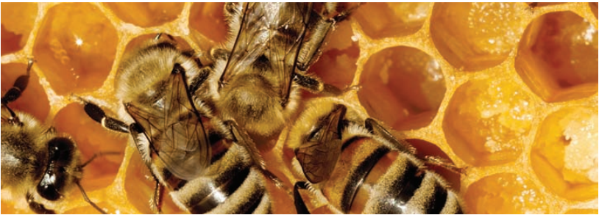
HONEY
Source
Sugar secretions are collected in honeycomb by honey bees.
Chemical composition:
Honey consists chiefly of dextrose and levulose (70-80%) with small amounts of water, sucrose (2-10%), dextrin, wax, proteins, volatile oils, minerals, acids and coloring and flavoring components, it contains vitamin B₁, B₂, C, nicotinic acid and formic acid.

Slide 8
Uses:
1- As demulcent, sweetener in cough mixture.
2- As a fragrance ingredient and humectant, also a biological additive in shampoos, face, body and hand creams and lotions.
3- It has been reported to have antimicrobial activity.

Slide 9
TRISACCHARIDES
They may be considered as two disaccharides combined in one molecule with a central sugar residue.
They include both reducing and non-reducing types and may occur in plants as the sugar part of certain plant glycosides or in the free state.
The reducing type usually found in plant glycosides e.g. Mannotriose.
The non-reducing trisaccharides have the molecular formula C₁₈ H₃₂ O₁₆ e.g. Raffinose.

Slide 10
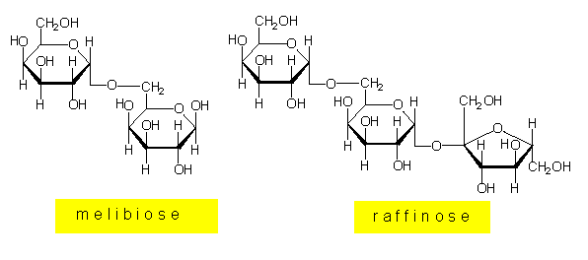
RAFFINOSE : Melitose, melitriose
α-D-galactopyranosyl-1,6-α-D-glucopyranosyl-1,2-β-D-fructofuranoside.
Raffinose comprises melibiose and sucrose with the central glucose residue.
Occurrence:
It occurs in small quantities in sugar beet (بنجر) and appreciable quantities in cotton seed and soybean.
It is commonly recovered from the mother liquor (molasses) during sucrose crystallization.

Slide 11
TETRASACCHARIDES
Stachyose
α-D-galactose- 1,6-α- D-galactose-1,6-α-D-glucose- 1,2-β-D-fructose
Occurrence
It occurs in soybean with raffinose.
Structure
Complete hydrolysis yield one molecule of D-fructose, one molecule of D-glucose and two molecules of D-galactose.
Accordingly, stachyose is composed of raffinose containing an added galactose unit.

Slide 12
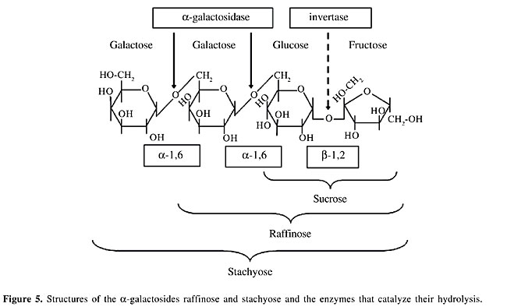
Stachyose

Slide 13
POLYSACCHARIDES
Polysaccharides have two main functions:
Sugar acetals
Homosides
Homosaccharides
Heterosaccharides
Heterosides
Food reserve
Structural elements
Built up of one kind of monosaccharides.
Having the glycosidic linkage between sugar portions.
Built up of several kinds of monosaccharides and sugar derivatives.
Glycosidic compounds
Having the glycosidic linkage between sugar portion and non sugar portion e.g. glycosides.

Slide 14
A- Homosaccharides
I- Glucosans
1- Starch
It is the first visible product of photosynthesis.
Occurs in the storage organs (seeds, tubers and roots) as the reserve food material in the form of granules.
It is obtained from a variety of plant source, including zea maize, wheat, potato and rice.
Chemical composition:
Starch consists of two components which differ in the physical properties commonly known as amylose and amylopectin.

Slide 15
Amylose
It is the inner layer of the granule and forms about 25% of the whole starch and this proportion varies according to the plant.
It is more water soluble, forming less viscous solution, and is responsible for the blue iodine reaction of the starch.
It consists of linear chain molecules of about 250-300 glucopyranose residues linked by α- 1,4 -glycosidic linkages which tend to cause the molecule to assume a helical conformation with six glucose residues per turn of the helix and is hydrolyzed by amylase into maltose.

Slide 16
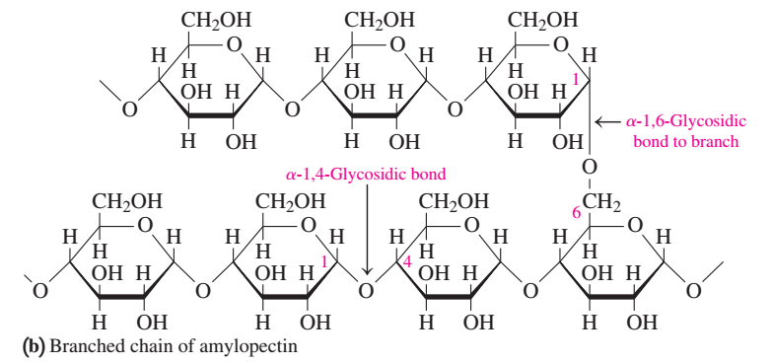
1- Starch
Amylose
Amylopectin

Slide 17
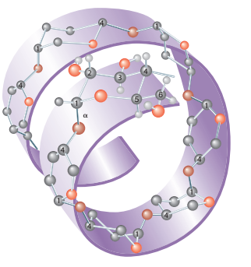
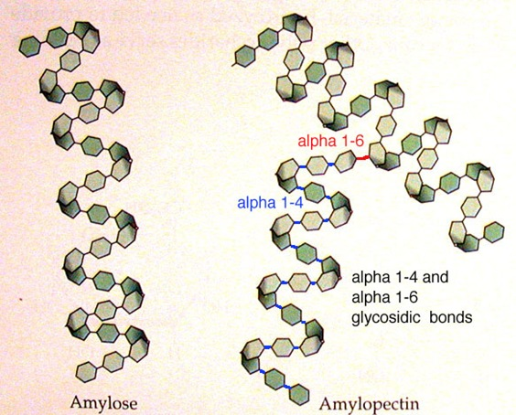
1- Starch

Slide 18
Amylopectin
It constitutes the outer layer of the granule, gives bluish-red or violet color with iodine solution.
It consists of branched chains of about 1000 glucose units or more, most of which are connected with α- 1,4 -linkage but the branches are linked at 6- position.
Amylopectin is hydrolyzed by amylase to give maltose and the rest is resistant high molecular weight residue named dextrin, which is the stubs of the branches (i.e 1,6-linkages) as a product of incomplete hydrolysis.

Slide 19
Hydrolysis of starch by mineral acids results in the ultimate production of glucose.
The change in the coarse of hydrolysis can conveniently be traced with iodine colour reaction which changes successively.
Starch gives blue, dextrin gives purple or reddish brown and glucose gives no colour.
Uses :
1- Its adsorbent properties make it an ideal dusting powder.
2- It has the ability to swell in water so, it is used as disintegrant.
3- Antidote for iodine poisoning.
4- Starting material from which liquid glucose, dextrose, dextrin are obtained.

Slide 20
Characteristics of Amylose and Amylopectin

Slide 21
Heta starch (Hydroxy ethyl starch)
Is a semi synthetic product, it consists of about 90% amylopectin and seven to eight hydroxy ethylene substituents are present for each 10 glucose units.
Uses :
A 6% solution of heta starch is used as plasma expander for treatment of shock caused by hemorrhage, burns, surgery or other trauma.
The molecules with molecular weight less than 50,000 are eliminated rapidly by renal excretion.

Slide 22
Heta starch (Hydroxy ethyl starch)

Slide 23
2- Dextrin
White, amorsphous powder which is incompletely soluble in cold water, but freely soluble in hot water.
It is obtained by enzymatic degradation and incomplete hydrolysis of starch.
The degradation product vary in the molecular weight in the following decreasing order, amylodextrin, erythrodextrin and achrodextrin.
The color produced with iodine changes from blue to red to colorless.
When starch is heated with a steam at 180 - 200°C yellow dextrin or British gum results.

Slide 24
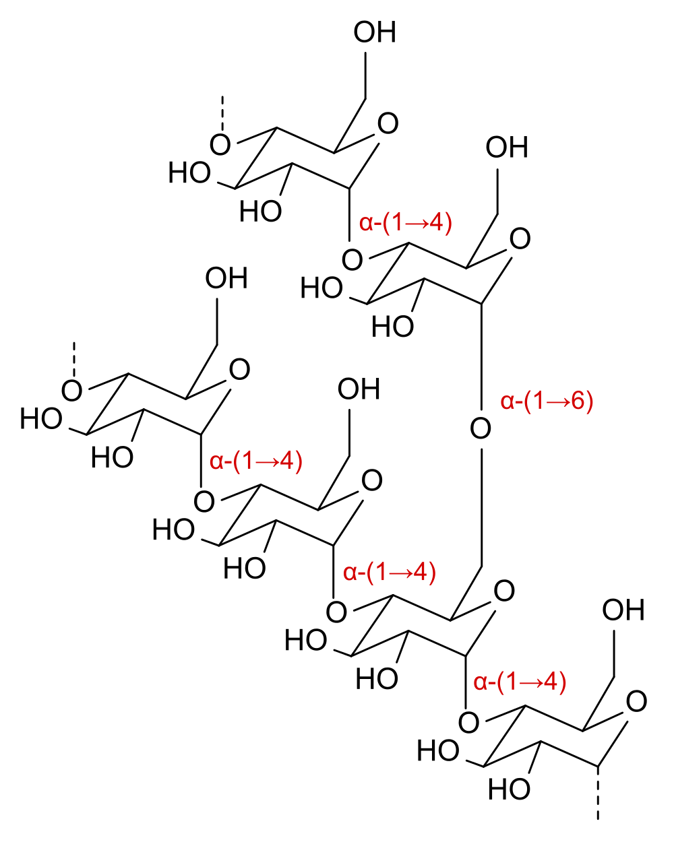
White dextrin is formed when starch is moistened with a very diluted mineral acids and heated at 110°C.
Pure dextrin does not reduce Fehling's solution, but commercial dextrin contains always maltose and certain amount of free glucose, therefore, reduces Fehling's solution.
Uses
1- It is used as a source of readily digestible carbohydrates for infants and adults.
2- It is also used as substitute for natural gums or adhesive for sizing cloths and paper.

Slide 25
3- Cellulose
It is the most abundant carbohydrate in the earth and is the structural polysaccharide in plants.
It is unbranched polymer with glucosyl residues, joined together in β (1-4) linkages.
Cellulose from different sources varies in molecular weight and the number of glucose units lies in the range of 2500 - 14,000.
Cellulose microfibrils are tightly packed aggregates of cellulose molecules which are chemically inert, insoluble and possess significant mechanical strength.

Slide 26
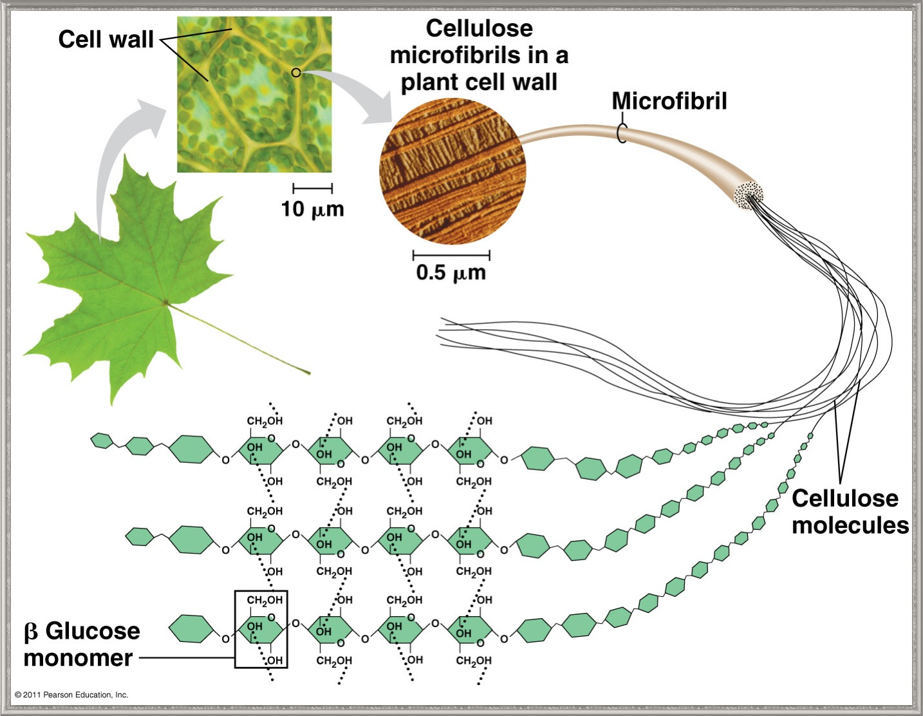
3- Cellulose

Slide 27
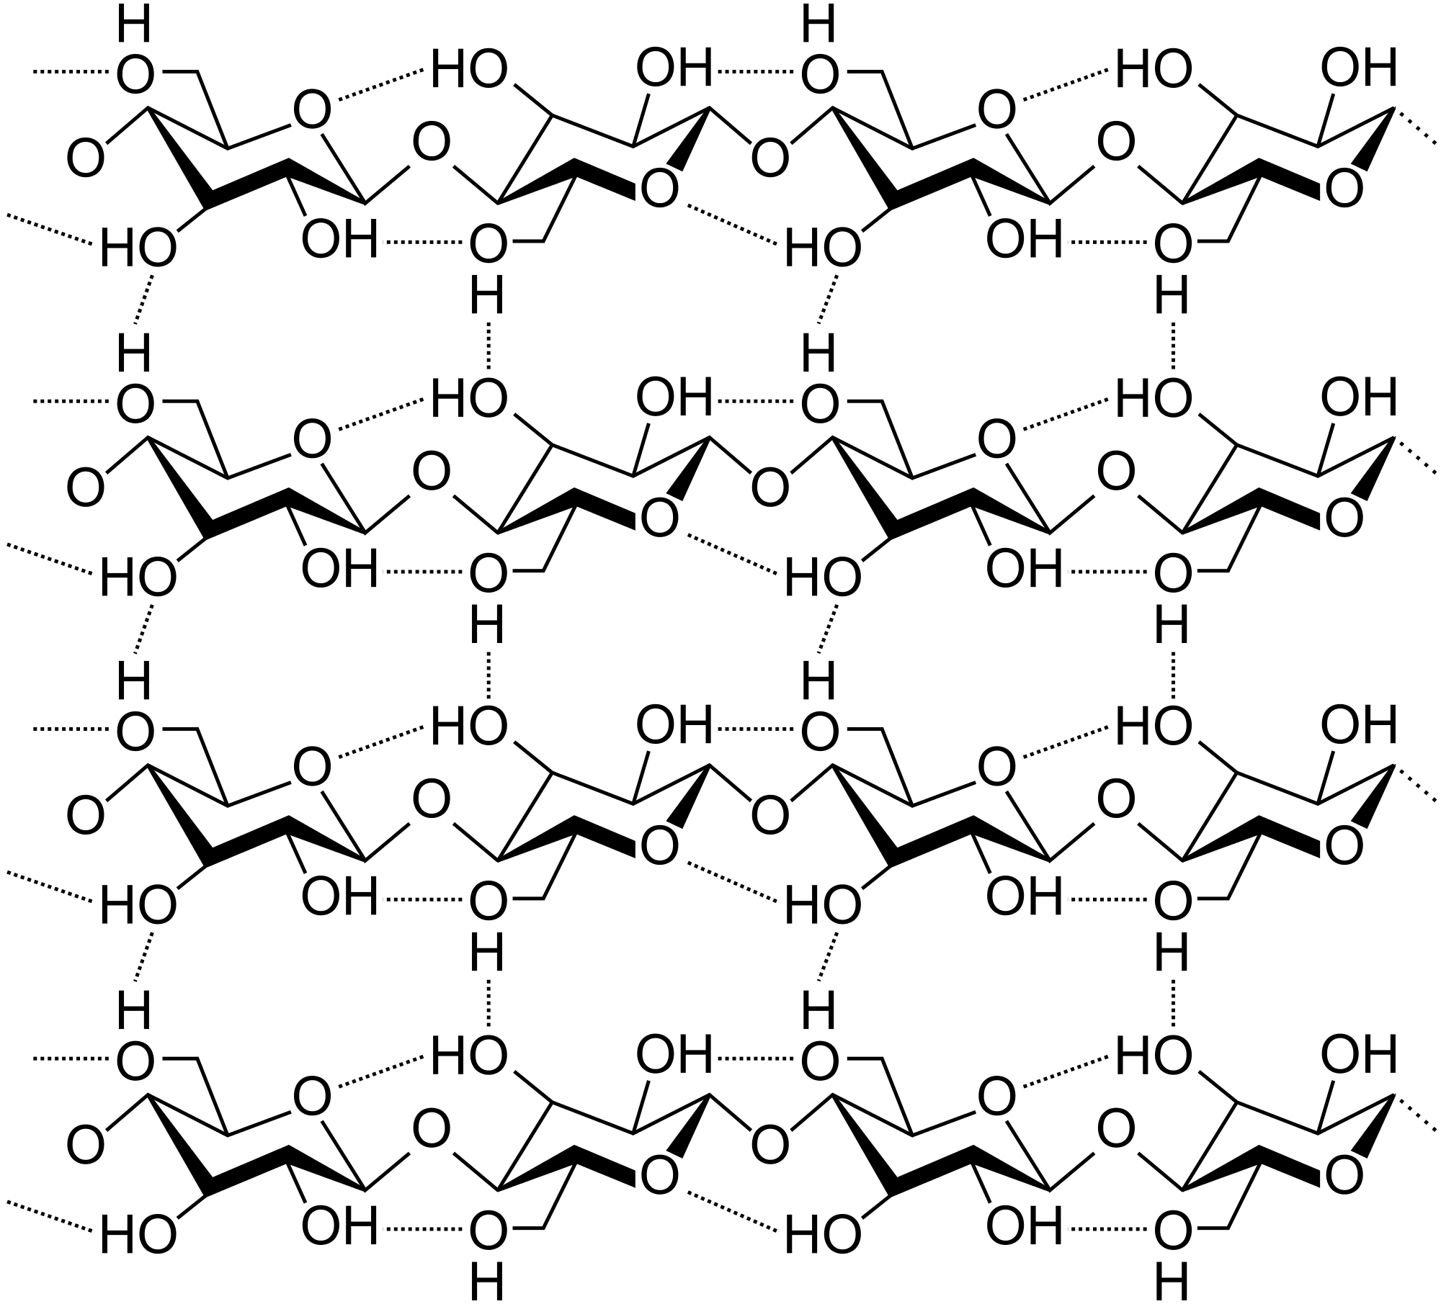
3- Cellulose
Because of its β -linkages, the preferred conformation of cellulose is the one in which the ring oxygen of one residue forms a hydrogen bond with the C-3 hydroxyl group of the next residue.

Slide 28
Fourty or more individual cellulose molecules that aggregated to form microfibrils are held together by intermolecular hydrogen bonds. •
In human, cellulose is not digested in small intestine but is digested in large intestine to varying degrees by the microflora to yield short chain fatty acids, hydrogen, CO₂ and methane. •
Undigested cellulose forms a part of the indigestible components of the diet known as dietary fiber.
Dietary fiber consists of cellulose and other polysaccharides (hemicellulose, pectins, gums and alginates) and a non-polysaccharide compound; lignin.
These different types of dietary fiber are derived from the cell wall and the sap components of plant cells.

Slide 29
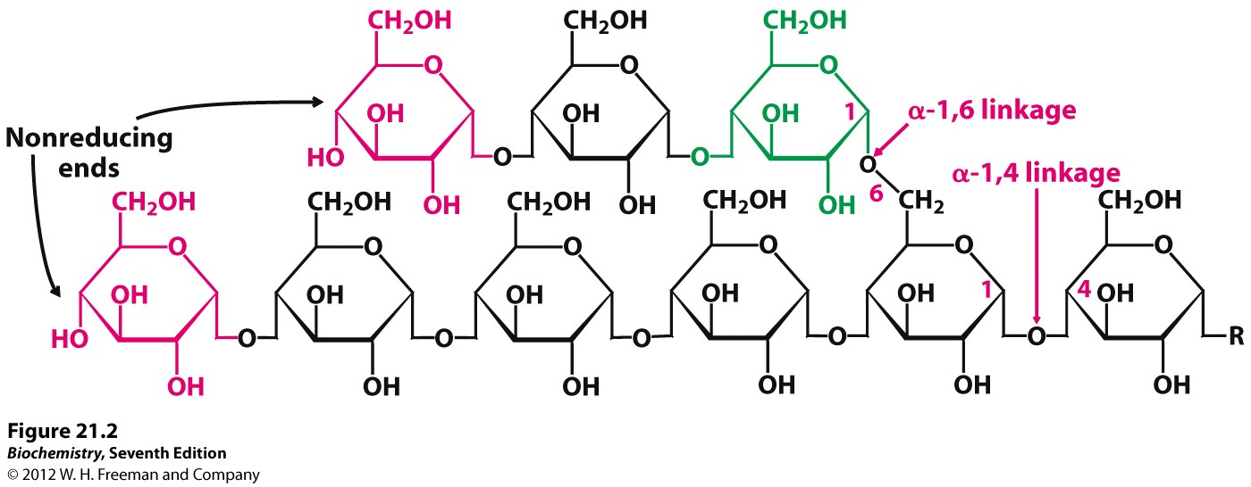
4- Glycogen
This polysaccharide in known as animal starch and is stored in this form specially in the liver and in muscles. •
The functional roles of glycogen in these two tissues are quite different.
In muscles, glycogen serves as energy reserve mostly for contraction, where in liver, glycogen supplies glucose to other tissue, via blood circulatory system.

