Slide 1
Glycosides

Slide 2
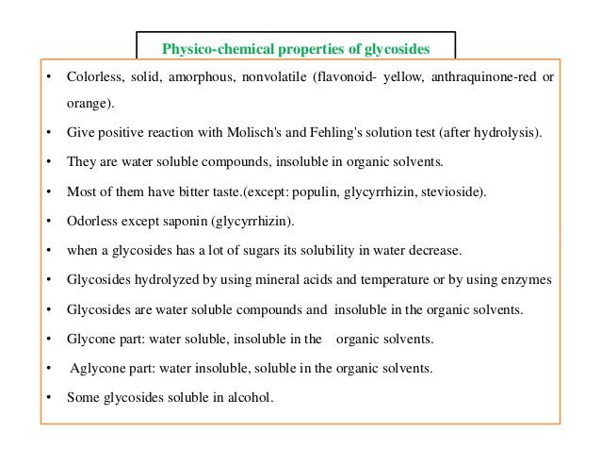

Slide 4
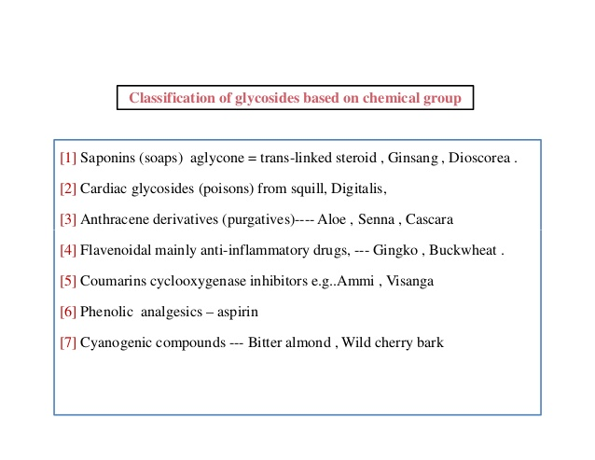

Slide 7
1. Saponin glycosides

Slide 8
A group of plant glycosides known as saponins share in varying degrees, two common characteristics:
(a) They foam in aqueous solution.
(b)They cause haemolysis of red blood cells.
The aglycones of the saponins are collectively referred to as Sapogenins. The more poisonous saponins are often called Sapotoxins.

Slide 9
Plant materials containing saponins have long been used in many parts of the world for their detergent properties for example, in Europe, the root of Saponaria officinalis (Fam. Caryophyllaceae) and in South America, the bark of Quillaia saponaria (Fam. Rosaceae). Such plants contain a high percentage of the glycosides known as saponins (Latin Sapo, means Soap) which are characterized by their property of producing a frothing aqueous solution.

Slide 10
Properties:
Saponins form colloidal solution in water (hydrophilic colloids) which froths upon shaking. These substances modify and lower the surface tension and therefore foam when shaken. This has led to their use to increase the foaming of beer.
Practical industrial applications of saponins include their use in cleaning industrial equipment and fine fabrics and as powerful emulsifiers of certain resins, fats and fixed oils.

Slide 11
In general, they have a bitter, acrid taste and drugs containing them are usually sternutatory (causing or producing sneezing) and irritating to the mucous membranes of eyes and nose.
Characteristic for all saponins is their ability to cause haemolysis of red blood corpuscles and to destroy them. When injected into the blood stream, they are highly toxic.
When taken by mouth, Saponins are comparatively harmless, being not absorbed from the intestinal tract. Sarsaparilla, for example, is rich in saponins but is widely used in the preparation of non­alcoholic beverages.

Slide 12
Saponins are toxic especially to cold-blooded animals e.g. frogs. Many are used as fish-poisons.
The actual cause of the haemolysis:
The red blood cells carry sterols in their membranes, and when brought into contact with saponins, the sterols of the RBCs are precipitated and the colloidal chemical properties of the membrane are so altered as to give hemoglobin passage to the surrounding medium.
Saponins have a high molecular weight and their isolation in a state of purity presents some difficulties.

Slide 13
Structure of Saponins:
According to the structure of the aglycone or sapogenin, two kinds of saponin are recognized:
The steroidal type (commonly tetracyclic triterpenoids, C-27).
The triterpenoid type (pentacyclic triterpenoids, C-30).
Both of these have a glycosidal linkage at C-3 and have a common biosynthetic origin via mevalonic acid and isoprene units.

Slide 15
A. Steroidal saponins
The steroidal saponins are less widely distributed in nature than the pentacyclic triterpenoid type.
Steroidal saponins are of great pharmaceutical importance because of their relationship to compounds such as the sex hormones, cortisone, diuretic steroids, vitamin D and the cardiac glycosides.
Examples: Diosgenin (Dioscorea sylvatica), Sarsapogenin (Smilax sp.).

Slide 16
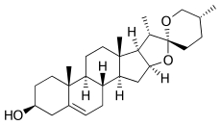
Diosgenin,
phytosteroid sapogenin, present in detectable amounts in Trigonella
Costus speciosus,
Diosgenin is a precursor for several hormones

Slide 17
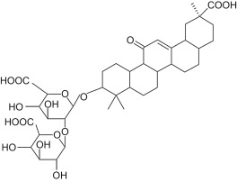
B. Triterpenoid saponins
Glycyrrhizin
(or glycyrrhizic acid or glycyrrhizinic acid) is the chief sweet-tasting constituent of Glycyrrhiza glabra (liquorice) root. Structurally, it is a saponin used as an emulsifier and gel-forming agent in foodstuffs and cosmetics.

Slide 18
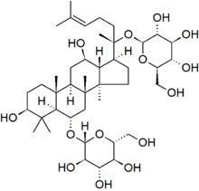
Ginsing saponins,, (Ginsenosides) Ginsenosides are saponins, which are the major pharmacologically active components of ginseng root.
Pharmacological effects of ginseng have been demonstrated in cancer, diabetes mellitus, cardiovascular system, immune system and central nervous system including anti-stress and anti-oxidant activity

Slide 19
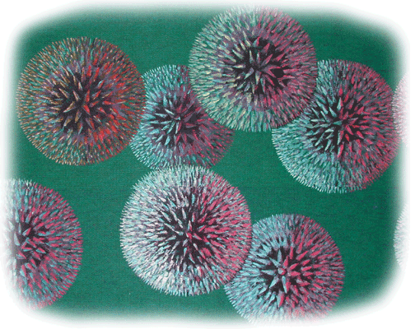
2- Cardiac glycosides

Slide 20
Steroidal cardioactive glycosides
Cardiac glycosides are a group of natural products characterized by their specific effect on myocardial contraction and atrioventricular conduction.
In large doses they are toxic and bring about cardiac arrest in systole, but in lower doses they are important drugs in the treatment of congestive heart failure.
They have a diuretic activity. Since, the improved circulation tends to improve renal secretion, which relieves the edema often associated with heart failure.

Slide 21
Distribution in nature
Cardiac glycosides occur in small amounts in the seeds, leaves, stems, roots or barks of plants of wide geographical distribution, particularly of the Fam. Apocyanaceae (e.g. seeds of Strophanthus, roots of Apocynum and fruits of Acokanthera); others are found in the Scrophulariaceae (e.g. leaves of Digitalis sp.), Liliaceae (e.g. scales of the bulbs of Urginea and Convallaria), and Ranunculaceae (Adonis).
Cardiac glycosides are also found in animals only in exceptional cases: Bufadienolides occur in toads (Bufo).

Slide 22
 Structure of cardiac glycosides
The structure comprise a steroidal aglycone of the (C₂₃) cardenolide type or of the (C₂₄) bufadienolide type, and a sugar moiety, most often an oligosaccharide.

Slide 23
A. Structure of the aglycones
All of the aglycones have in common the classic, tetracyclic, steroidal nucleus.
Also common to all the aglycones is the presence of a hydroxyl group (3β secondary alcohol).
All of the aglycones have a β constituent at C-17: an α,β-unsaturated lactone.

Slide 24
The size of the lactone ring distinguishes two groups of aglycones: the C23 cardenolides with an α,β-unsaturated γ-lactone (= butenolide) and the C24 bufadienolides with a di-unsaturated δ-lactone (= pentadienolide).

Slide 25
B. Structure of the sugar moiety
The sugar moiety is generally linked to the aglycone through the hydroxyl group at C-3.
The majority of the saccharides found in cardiac glycosides are highly specific:
2,6-dideoxyhexoses, e.g. D-digitoxose
6-deoxyhexoses, e.g. L-rhamnose
6-deoxy-3-methylhexoses, e.g. D-digitalose

Slide 26
 Color reactions
They can be due to the sugars or to the aglycone:
Color reactions of the sugars.
-Keller-Kiliani test.
Dry 5 ml of the above extract on a water bath, and dissolve the residue in 3 ml of concentrated acetic acid. Add 1 drop of conc. sulphuric acid gradually. A reddish brown ring forms at the interface, the upper acetic acid layer soon turns bluish green.

Slide 27
Color reactions of the aglycones (steroidal nucleus)
These are positive with any compound containing a steroidal nucleus including cardenolides or bufadienolide
Liebermann's test
To 2 ml of the test solution, 10 drops of Anhydrous Sodium Sulfate was added and mixed well. To this 5 ml of soln, concentrated sulphuric acid was added from the sides of the test tube, appearance of greenish blue colour

Slide 28
Color reactions of the aglycones (lactone ring).
These are characteristic for lactone ring:
Kedde's test
Dry 5 ml of the above extract on a water bath, and dissolve the residue in 2 ml of alcoholic Kedde Reagent (3,5- dinitrobenzoic acid) and 1 ml of NaOH solution. The reaction mixture immediately turns purple-violet, which colour disappears after a few min.

Slide 29
Pharmacological properties
Cardiac glycosides increase the force and speed of contraction of the heart. In patients with cardiac insufficiency, this positive inotropic effect translates into an increase in cardiac output, an increase in cardiac work capacity without any increase in oxygen consumption, a decrease in heart rate, and, indirectly, a decrease in arterial resistance.
Mechanism of action
The glycosides are thought to act at the membrane level, by inhibition of the Na-K ATPase, which would result in an increase of the intracellular calcium ion concentration.

Slide 30
Examples of Cardinolides
Digitalis glycosides
Several species of Digitalis yield pharmacologically active principles. The most important of these species are Digitalis purpurea and Digitalis lanata.
Digitalis purpurea folium (Red foxglove leaves)
0.15% − 0.4% total cardenolides, ∼ 30 glycosides Purpurea glycosides A and B (∼60%), digitoxin (∼12%), gitoxin (∼10%) and gitaloxin (∼10%).
Digitalis lanata folium (White foxglove leaves)
0.5% − 1.5% total cardenolides, ∼ 60 glycosides Lanatosides A and C (∼50%), lanatosides B, D, E as well as digoxin and digitoxin.

Slide 31
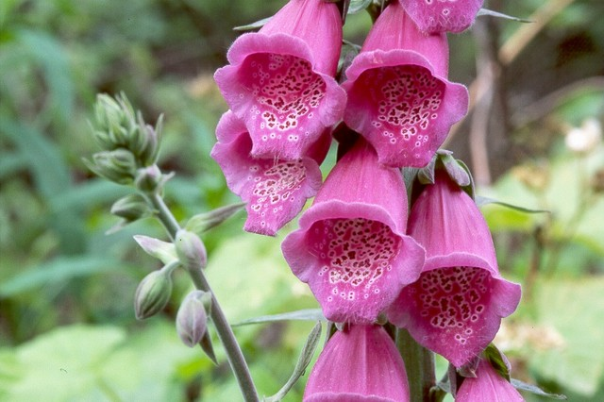
Digitalis purpurea

Slide 32
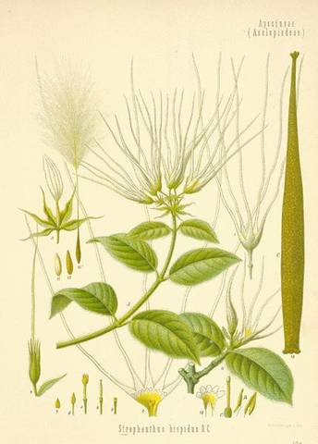
Strophanthus glycosides
e.g. Strophanthus kombe
The principle glycosides are:
K-strophanthoside
K-strophanthin-β
Cymarin

Slide 34
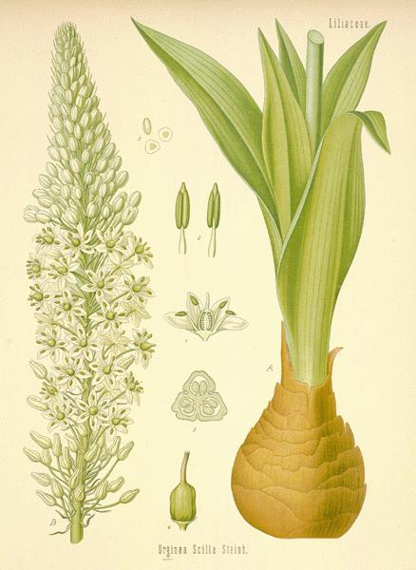
Examples of Bufadienolides
Squill glycosides
Urginea maritima (L.)
0.1% − 2.4% total bufadienolides, ∼15 glycosides
White variety: average 0.2%-0.4%
proscillaridin A, scillaren A, glucoscillaren A (aglycone: scillarenin)
scilliphaeoside, scilliglaucoside
Red variety: < 0.1%
scilliroside and glucoscilliroside (aglycone: scillirosidin); proscillaridin A and scillaren A as in the white variety

Slide 35
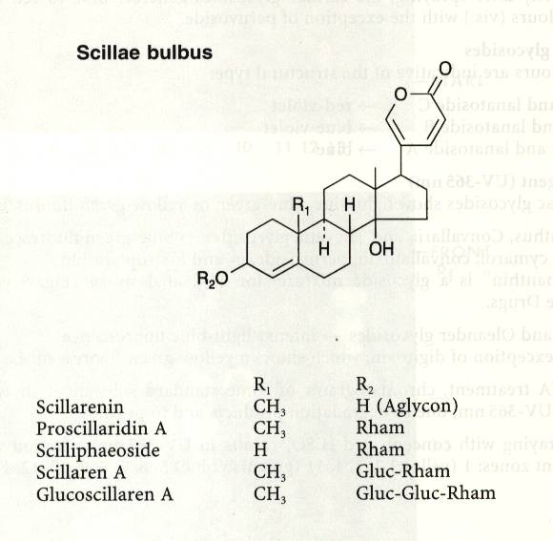

Slide 36
Pharmacological properties of squill
White squill:
it is an expectorant, but it also possesses emetic, cardiotonic (proscillaridin A), and diuretic properties.
Red squill:
it is used as a rat poison (scilliroside), because rodents lack the vomiting reflex, which makes red squill particularly lethal to these animals.

