Slide 2
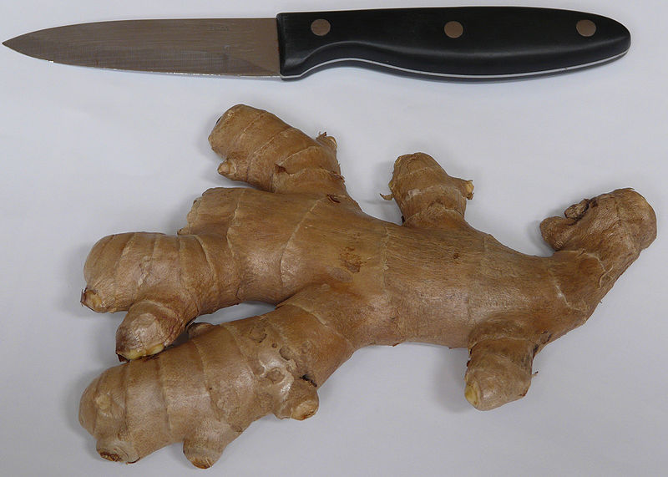
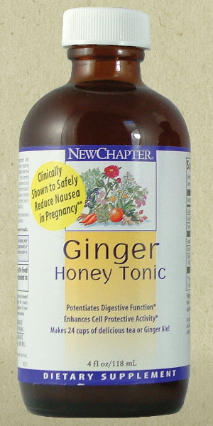
Official rhizomes
Ginger الزنجبيل
Origin: The dried tuberous roots (rhizomes) of Zingiber officinale,
Family: Zingiberacea
Odour: Characteristic sweet aromatic,
Taste: Pungent.
boiling with 2% solution of potash.
The characteristic odor and flavor of ginger is caused by a mixture of volatile oils: zingerone, shogaols and gingerols, that compose one to three percent of the weight of fresh ginger.

Slide 3
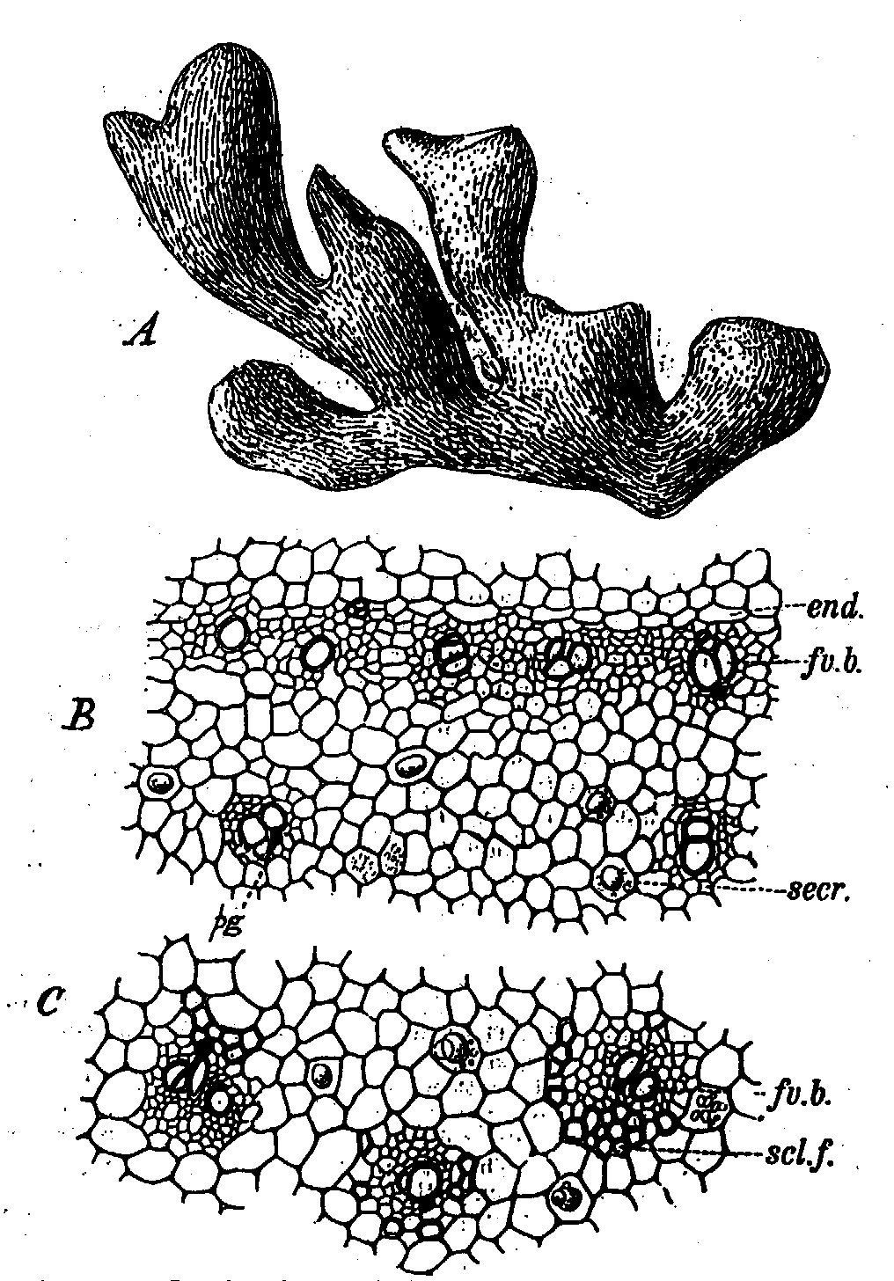
Microscopical characters:
- The cortex.
- The endodermis.
- The vascular bundles.
- Pericycle.
- Stele.

Slide 4
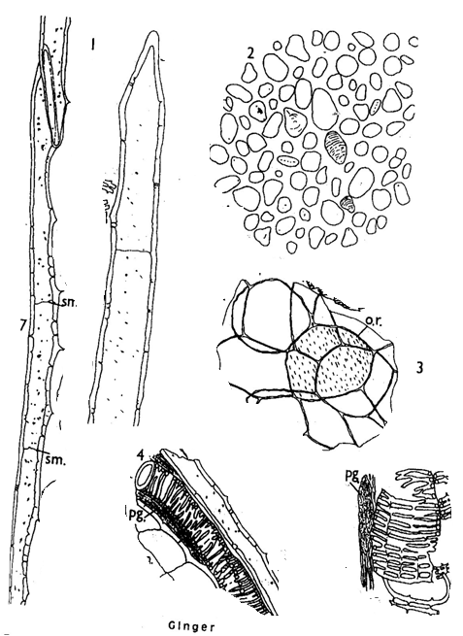
Powder:
Yellowish white in colour with agreable aromatic odour and pungent taste, microscopically it is characterized by:
1. Non lignified septated fibers with oblique slit-like pits.
2. Starch granules simple, ovoid or sack-shaped and have eccentric hilum and faint transverse striations (scitaminaceous starch).
3. Yellowish brown oleo resin masses.
4. Non lignified spiral, scalariform and reticulate xylem vessels

Slide 5
Active constituents:
Ginger contains about 1-2% volatile oil which mixture of over than 50 constituents. Main constituents are sesquiterpenoids: zingiberene as the main component. Small amounts of other sesquiterpenoids (β-sesquiphellandrene, bisabolene and farnesene) and a small monoterpenoid fraction (β-phelladrene, cineol, and citral).
uses
The Jamaica ginger; a stimulant and carminative, frequently for dyspepsia and colic.
Mask the taste of medicines.
Ginger is on the FDA's "generally recognized as safe".
Arthritis, blood thinning and cholesterol lowering properties.

Slide 6
Folk remedy for colds.
Diarrhea
Ginger is active against diarrhea which is the leading cause of infant death.
Zingerone is likely to be the active constituent against enterotoxigenic Escherichia coli heat-labile enterotoxin-induced diarrhea.
Nausea
Ginger is effective in treating nausea caused by seasickness, morning sickness and chemotherapy.
In laboratory animals, the gingerols increase the motility of the gastrointestinal tract and have analgesic, sedative, antipyretic and antibacterial properties.
Ginger oil has been shown to prevent skin cancer in mice and a study demonstrated that gingerols can kill ovarian cancer cells.

Slide 7
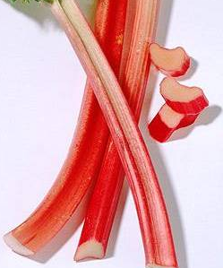
Rhubarb الراوند
Origin:
Rhubarb is the peeled and dried rhizomes and big roots of Rheum palmatum L., Rheum officinale or other Rheum species (hybrids of these two species or mixture of them) except Rheum rhaponticum, Family Polygonaceae.
Collection and preparation:
The rhizomes decorticated, the large rhizomes are cut either longitudinally or transeversely. Then dried in the shade or sometimes dried by the heat of fires.

Slide 8
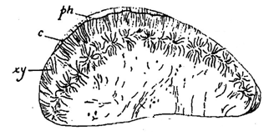
Macroscopical characters
at the periphery of pith, cambium tissue is developed, which produces numerous concentric bundles having phloem towards the centre and radiating xylem externally. ” Star Spots”
phloem
cambium
radiate wood
The small size (2-5 mm) continuous ring of star spots; identifies R. palmatum, while R. officinale has larger star-spots which are irregularly distributed.

Slide 9
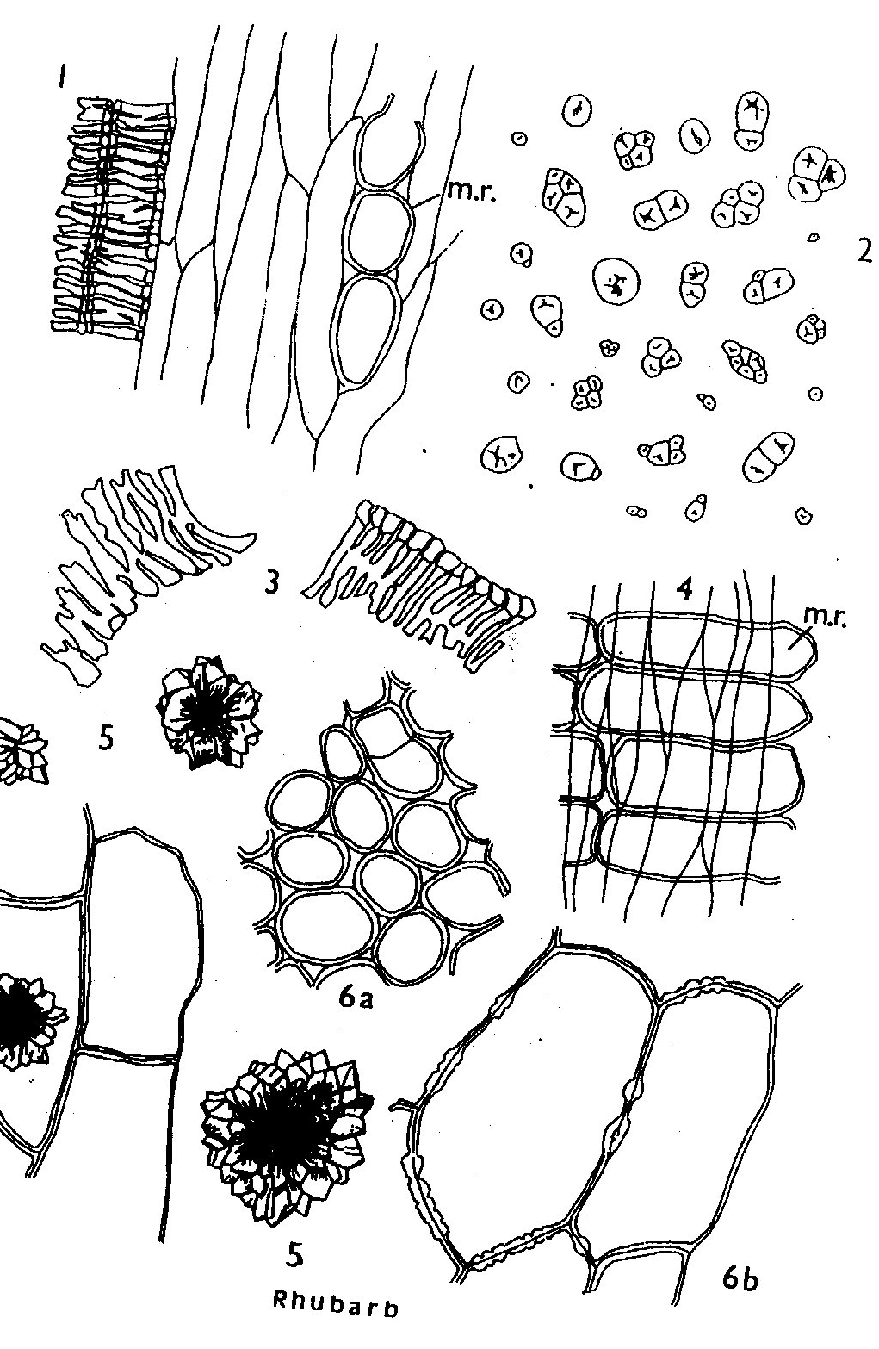
Microscopical characters:
Powder is yellowish-brown to reddish-brown, charcteristic odour and bitter astringent taste.
Parenchymatous cells contain large clusters.
Xylem; reticulated but non-lignified.
Yellow masses in the cells of the medullary rays, soluble in water and gives reddish-pink with ammonium hydroxide solution.

Slide 10
Active constituents:
I- Rhubarb contains anthraquinones:
1- With carboxyl groups e.g. rhein and its glycoside gluco-rhein
2- Without carboxyl group e.g. chrysophanol, aloe-emedin, emodin and physcion (free anthraquinones) and their glycosides.
3-Anthrone or dianthrones of chrysophanol or emodin or aloe-emodin,
sennosides A and B (dianthrone glucosides of rhein) and the oxalates of
these (sennosides E and F).
II- Astringent compounds such as glucogallin, free gallic acid, epicatechin
gallate and catechin.

Slide 11
Chemical tests:
Test for anthraquinone derivatives???
Test for rhaponticin :
UV shows brown colour or blue fluorescence.
Uses:
In small doses used as bitter stomachic and intestinal astringent.
In large doses it causes purgation, which is followed by an astringent effect !!!!.

Slide 12
Substitutes and Adulterants:
Chinese rhapontic rhubarb:
It consists of untrimmed pieces sometimes split longitudinally. The centre may be hollow.
Star spots are present as a diffuse ring.
It contains mainly rhaponticin ?.
English rhubarb:
R. officinale: Resemble the Chinese rhubarb but it’s more spongy, star spots fewer and more scattered and has the same active constituents.
R. rhaponticum: It shows circles of isolated star spots and shows no emodin, aloe-emodin or rhein. It contains mainly rhaponticin.

Slide 13
Rhaponticin
Stillbenoid glucoside
It has beneficial effect on diabetic mice
In vitro results suggest that it may have relation to
Alzheimer disease
Also it has estrogenic activity

