Slide 1
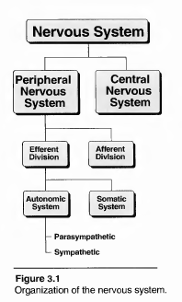

The Autonomic Nervous System
INTRODUCTION TO THE NERVOUS SYSTEM
The nervous system is divided into two anatomical divisions, the central nervous system (CNS), which is composed of the brain and spinal cord, and the peripheral nervous system, which includes neurons located out- side the brain and spinal cord, that is, any nerves that enter or leave the CNS (Figure 3.1).
The peripheral nervous system can be further divided into the efferent division, whose neurons carry signals away from the brain and spinal cord to the peripheral tissues, and the afferent division, whose neurons bring information from the periphery to the CNS.

Slide 2
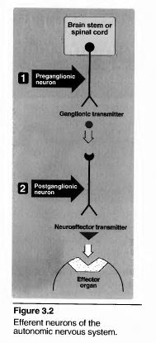
Functional divisions within the nervous system.
The efferent portion of the peripheral nervous system can be further divided into two major functional subdivisions,
i- The somatic
ii- Autonomic systems (see Figure 3.1).
The somatic efferents are involved in voluntarily controlled functions such as contraction of the skeletal muscles in locomotion.
The autonomic system functions involuntarily to regulate the everyday needs and requirements of the body with- out the conscious participation of the mind. It is composed primarily of visceral motor (efferent) neurons that innervate smooth muscle of the viscera, cardiac muscle, vasculature and the exocrine glands.

Slide 3
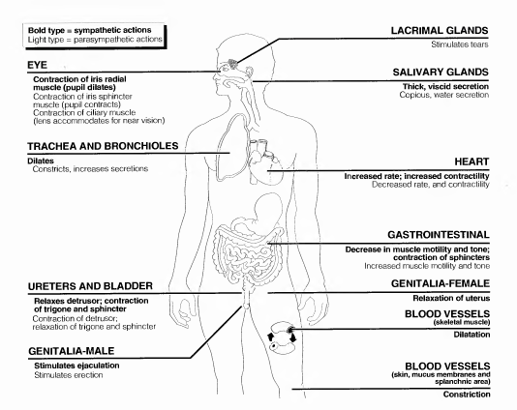

Slide 4
. Functions of the sympathetic system
1- Effects of stimulation of the sympathetic division:
increase heart rate and blood pressure, to mobilize energy stores of the body.
increase blood flow to skeletal muscles and heart while diverting flow from the skin and internal organs.
Sympathetic stimulation also results in dilation of the pupils and the bronchioles (Figure 3.3).
. 2-Fight or flight response:
The changes experienced by the body during emergencies have been referred to as the "fight or flight" response (Figure 3.4)..
Functions of the parasympathetic system:
The parasympathetic division maintains essential bodily functions, such as digestive processes and elimination of wastes, and is required for life

Slide 5


Autonomic NS
Symapathatic
Fight and flight
parasympathatic
Rest and digest

Slide 6
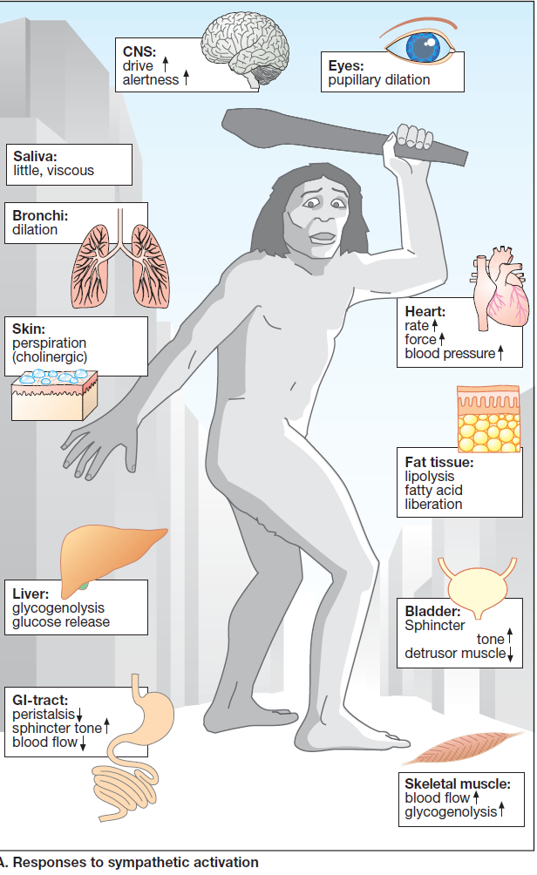
Sympathatic-Parasympathatic

Slide 7
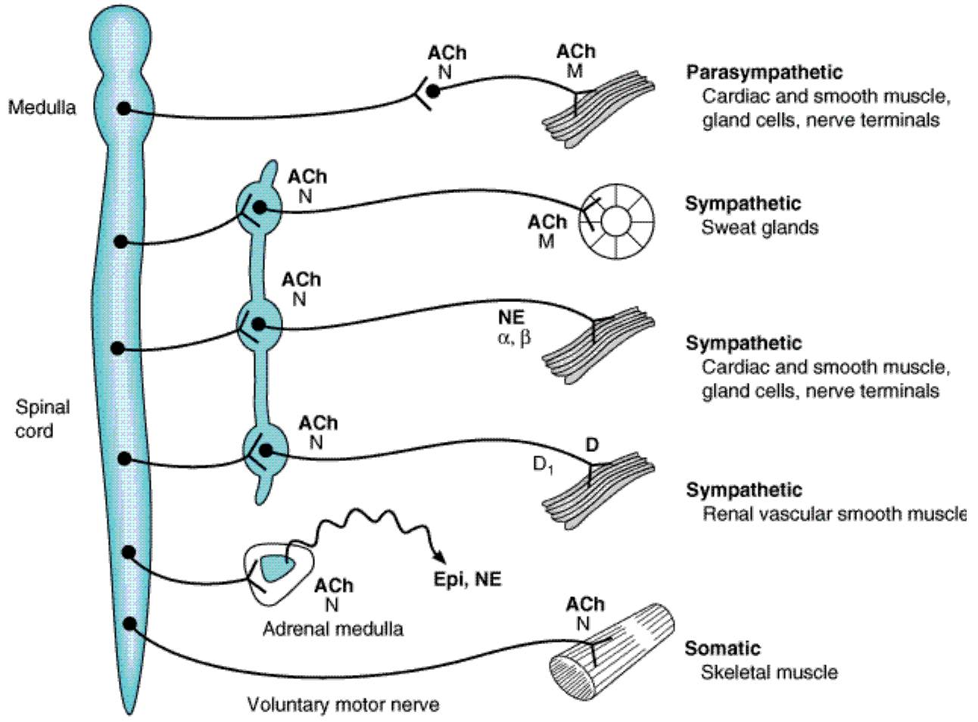
Schematic diagram comparing some anatomic and neurotransmitter features of autonomic and
somatic motor nerves. Only the primary transmitter substances are shown. Parasympathetic
ganglia are not shown because most are in or near the wall of the organ innervated. Note that some sympathetic postganglionic fibers release acetylcholine or dopamine rather than norepinephrine.
The adrenal medulla, a modified sympathetic ganglion, receives sympathetic preganglionic fibers and releases epinephrine and norepinephrine into the blood. (ACh, acetylcholine; D, dopamine;
Epi, epinephrine; NE, norepinephrine; N, nicotinic receptors; M, muscarinic receptors.)

Slide 8
Types of neurotransmitters:
Acetylcholine:
The autonomic nerve fibers can be classified into two groups based on the chemical nature of the neurotransmitter released. If transmission is mediated by acetylcholine, the neuron is termed cholinergic.
b. Norepinephrine and epinephrine:
If norepinephrine or epinephrine is the transmitter, the fiber is called adrenergic (adrenaline being another name for epinephrine). In the sympathetic system, norepinephrine mediates the transmission of nerve impulses from autonomic postganglionic nerves to effector organs.

Slide 11
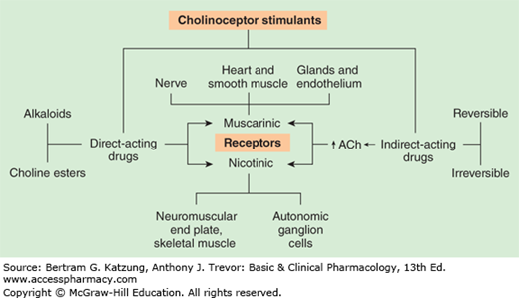
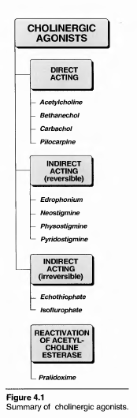
Cholinergic Agonists

Slide 12
Neurotransmission at cholinergic neurons
Neurotransmission in cholinergic neurons involves six steps. The first four, synthesis, storage, release and binding of the acetylcholine to a receptor, are followed by the fifth step, degradation of the neurotransmitter in the synaptic gap (that is, the space between the nerve endings and adjacent receptors located on nerves or effector organs), and the sixth step, the recycling of choline (Figure 4.3).
Synthesis of acetylcholine:
Choline is transported from the extracellular fluid into the cytoplasm of the cholinergic neuron by a carrier system that cotransports sodium and can be inhibited by the drug hemicholinium.
2. Storage of acetylcholine in vesicles: The acetylcholine is pack- aged into vesicles by an active transport process coupled to the efflux of protons.

Slide 13
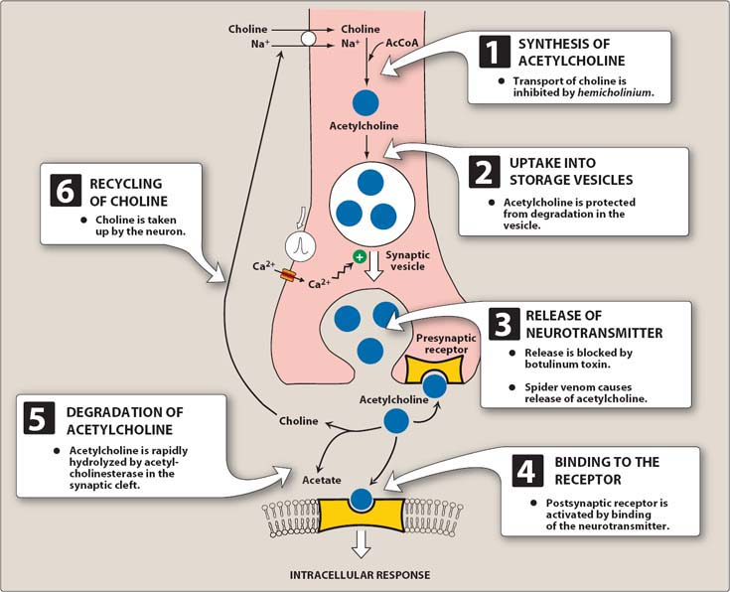
Release of acetylcholine:
When an action potential propagated by the action of voltage-sensitive sodium channels arrives at a nerve ending, voltage-sensitive calcium channels in the presynaptic membrane open, causing an increase in the concentration of intracellular calcium. Elevated calcium levels promote the fusion of synaptic vesicles with the cell membrane and release of acetylcholine into the synapse. This release is blocked by botulinum toxin.
Figure 4.3

Slide 14
III. CHOLINERGIC RECEPTORS (CHOLINOCEPTORS)
Two families of cholinoceptors, designated muscarinic and nicotinic receptors, can be distinguished from each other on the basis of their different affinities for agents that mimic the action of acetylcholine (cholinomimetic agents).
A. Muscarinic receptors
several subclasses of muscarinic receptors have been pharmacologically distinguished as M1, M2, M3, M4, and M5.
Pharmacological actions | Locations | Receptor
CNS excitation Gastric acid secretion | CNS gastric parietal cells | M1 (Neuronal) Excitatory
Cardiac inhibition (Bradycardia) | Heart | M2 (Cardiac) Inhibitory
Secretion of glands Smooth muscle contraction Vasodilatation (via nitric oxide) | Exocrine glands Smooth muscles Vascular endothelium | M3 (Exocrine) Excitatory
memory, arousal, attention and | CNS | M4 & M5

Slide 15
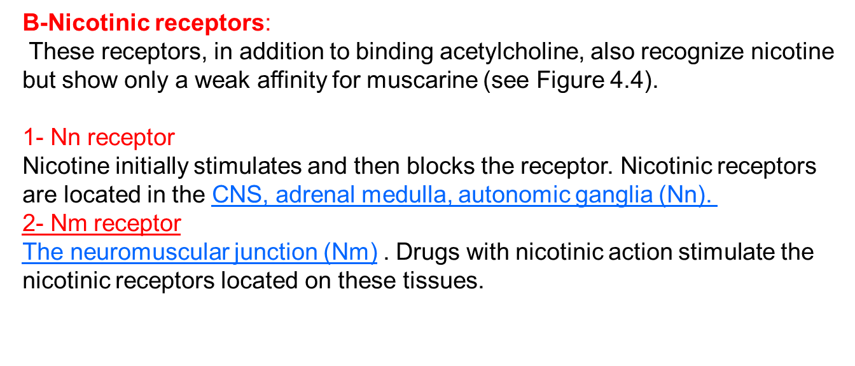
Mechanisms of Acetylcholine Muscarinic receptor
A number of different molecular mechanisms transmit the signal generated by acetylcholine occupation of the receptor. For example, when the M1 or M3 receptors are activated, the receptor undergoes a con- formational change and
interacts with a G protein, which in turn activates phospholipase C. while M2 receptor mediates Activation of potassium channels

Slide 16
Classification of parasympathomimetic
1. DIRECT-ACTING CHOLINERGIC AGONISTS
Cholinergic agonists mimic the effects of acetylcholine by binding directly to cholinoceptors. These agents are synthetic esters of choline,
such as carbachol and bethanechol, methacholine, or naturally occurring alkaloids, such as pilocarpine and Muscarine.
Direct parasympathmimetic
*Choline ester *Alkaloid
acetyl choline muscarine
Methacholine pilocarpine
carbacol arecoline
bethanechol

Slide 17
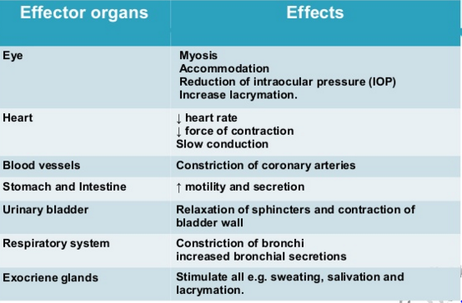
1.Direct parasympathmimetic muscarinic action of Ach

Slide 18
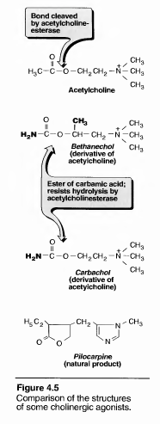
A-Acetylcholine
Acetylcholine is a quarternary ammonium com- pound, it is therapeutically of no importance because of its multiplicity of actions and its rapid inactivation by acetylcholinesterase.
Acetylcholine has both muscarinic and nicotinic activity. Its actions include:
1. Decrease in heart rate and cardiac output: The actions of acetylcholine on the heart mimic the effects of vagal stimulation. For example, acetylcholine, if injected intravenously, produces a brief decrease in cardiac rate

Slide 19
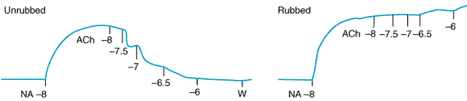
2. Decrease in blood pressure:
Injection of acetylcholine causes vasodilation and the lowering of blood pressure. Although no innervation of the vasculature by the parasympathetic system exists, there are cholinergic receptors on the blood vessels that respond by causing vasodilation. The vasodilation is due to an acetylcholine-induced rise in intracellular Ca++--caused by the phosphatidylinositol system--that results in the formation of nitric oxide (NO) from arginine in endothelial cells. 2 [Note: NO is also known as endothelium-derived relaxing factor (EDRF). Atropine blocks these muscarinic receptors and prevents acetylcholine from producing vasodilation.
Activation of endothelial cell muscarinic receptors by acetylcholine releases endothelium-derivedrelaxing factor (nitric oxide) (EDRF [NO]), which causes relaxation of vascular smooth muscle precontracted with norepinephrine. Removal of the endothelium by rubbing eliminates the relaxant effect and reveals contraction caused by direct action of acetylcholine on vascular smooth muscle.

Slide 21
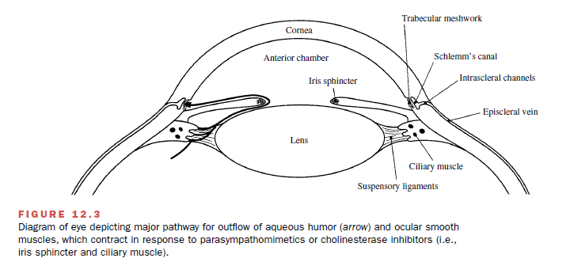
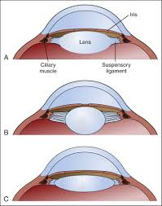
. Other actions:
A- In the gastrointestinal tract, acetylcholine increases salivary secretion, and stimulates intestinal secretions and motility.
B- Bronchiolar secretions are also stimulated.
C- In the genitourinary tract, the tone of the detrusor urinae muscle is increased.
D- In the eye,
acetylcholine is involved in
1- stimulating ciliary muscle contraction for near vision and in the constriction of the (pupillae sphincter muscle, causing miosis (marked constriction of the pupil).(Fig 7
2- Decrease the intraocular pressure.

Slide 22
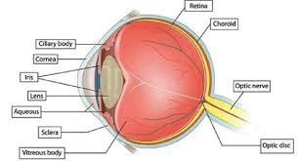
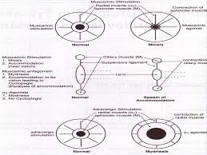
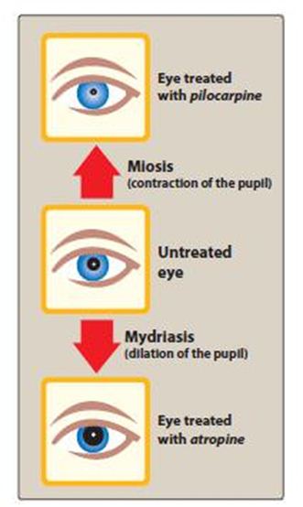
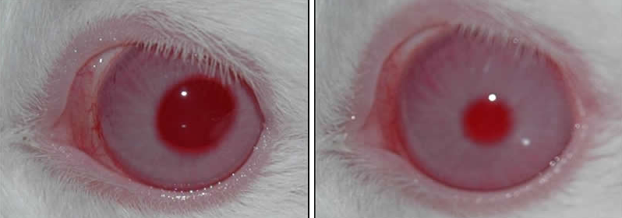

Slide 23
