Slide 1
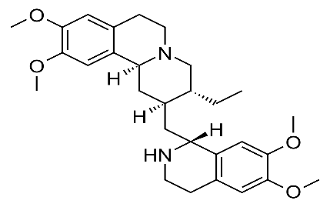

Determination of total Ipecacuanha alkaloids
The total alkaloids of Ipecacuanha are extracted and determined volumetrically by adding a known volume of standard acid to the purified alkaloidal residue and back titrating the excess acid with standard alkali. The percentage of alkaloids is calculated as emetine from the volume of standard acid consumed in the reaction.

Slide 2
Procedure:
5 ml extract
20 ml water
5 ml 1 N H2SO4
20 ml CHCl₃
reject CHCl₃
Aqueous layer
5 ml 1 N H2SO4
20 ml CHCl₃
Shake well and reject CHCl₃

Slide 3
٭Mix aciduc solutions, alkaline with conc ammonia
(litmus paper)
Add 30, 30,30ml
CHCl₃
Distill of CHCl₃
Wash with 20 ml water
(residue)

Slide 4
Dissolve the residue in 10 ml 0.1N H2SO4 , dilute with 25 ml of distilled water and back titrate the excess acid with 0.1N NaOH using 3-40drops of methyl red indicator. The color changes from red to yellow (end point).
Calculate the percentage of total alkaloid as hyoscyamine in the sample of the drug.
1 ml 0.1 H₂SO₄ = 0.02403 g of total alkaloids calculated as emetine.
% of total alkaloids = (10 – E.P.) X 0.02403 X 100 /5 = % w/v calculated as
emetine

Slide 5
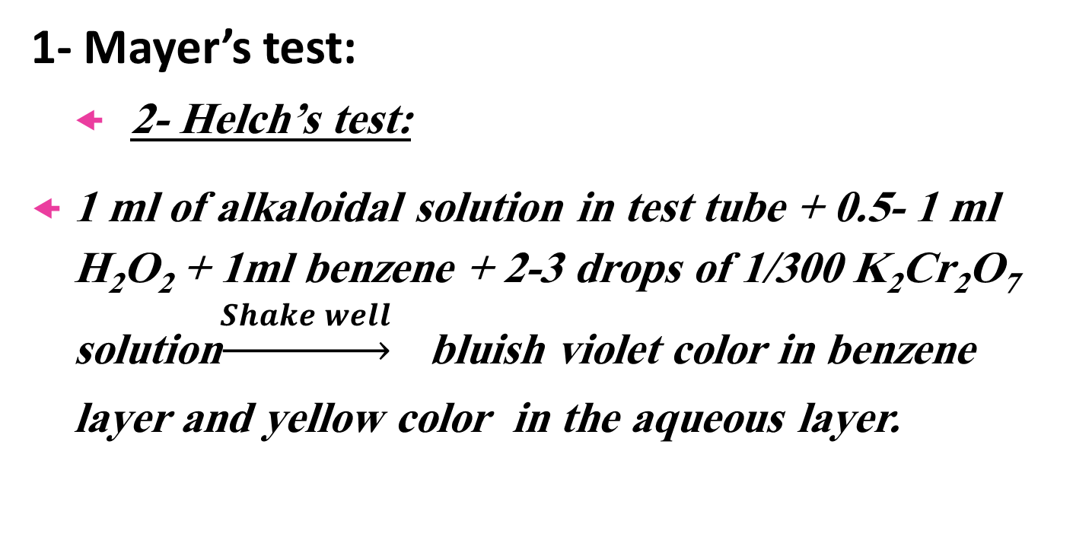
Identification of alkaloids Pilocarpine
1- Mayer’s test:
2- Helch’s test:
1 ml of alkaloidal solution in test tube + 0.5- 1 ml H₂O₂ + 1ml benzene + 2-3 drops of 1/300 K₂Cr₂O₇ solution$\underset{→}{\begin{aligned}Shake well \\ \end{aligned}}$ bluish violet color in benzene layer and yellow color in the aqueous layer.

Slide 6

6- Identification of alkaloids
(Ephedrine, Caffeine & theobromine)

Slide 7
Identification of alkaloids
(Ephedrine, Caffeine & theobromine)
1- Mayer’s test:
0.5 ml alkaloidal soln.
Few drops of Mayer’s reagent
No creamy white ppt.
Mayer’s negative alkaloids

Slide 8
Identification of alkaloids
(Ephedrine, Caffeine & theobromine)
2- Copper sulfate test:
Ephedrine
1 ml ephedrine soln.
3 drops 5% CuSO₄ soln.
2 drops 20% NaOH soln.
Purple color
Shake with 1 ml Chloroform
Purple color in organic layer and blue in aqueous layer

Slide 9
Identification of alkaloids
(Ephedrine, Caffeine & theobromine)
3- Murexide test (caffeine & theobromine) :
Add 2-5 drops of conc. HCl
+
few crystals of potassium chlorate
Evaporate to dryness on W.B.
1 ml alkaloid soln.
(caffeine or theobromine)
Heat on W.B.
Invert over conc. ammonia
Continue heating on W.B.
Crimson red color
Yellow colour
Violet color destroyed with 10% NaOH in case of caffeine but not destroyed in case of theobromine

