Slide 1
Carbohydrate Phytochemistry

Slide 2
Identification of Monosaccharides
(glucose & fructose)
1- Molisch’s test:
1ml of the sugar soln.
2-3 drops alc.α-naphthol
1ml conc. H₂SO₄ dropwise on the wall
Purple ring in the junction between 2 layers.
This test gives positive result with all carbohydrates.

Slide 3
Identification of Monosaccharides
(Glucose & Fructose)
2- Fehling’s test:
1ml sugar soln.
1ml Fehling’s A
1ml Fehling’s B
heat on water bath
Reddish brown ppt. of Cu₂O
This test gives a positive result with reducing sugars (Monosaccharides and reducing disaccharides)

Slide 4
Identification of Monosaccharides
(glucose & fructose)
3- Barfoed’s test:
Heat on boiling W.B. for 5 min.
1ml sugar soln.
1ml Barfoed’s reagent
Reddish brown ppt. of Cu₂O at the bottom of the test tube
This test gives a positive result with both glucose and fructose (both are monosaccharides)
what about disaccharides?

Slide 5
Identification of Monosaccharides
(glucose & fructose)
4- Ozazone test:
5ml sugar soln.
0.5g Phenylhydrazine HCl
1g Sodium acetate
Heat on W.B. for 15 min.
Yellow ppt. on hot, when examined under microscope shows tufts of needles.
Both glucose and fructose give the same ozazone
Why?

Slide 6
Identification of disaccharide
Disaccharides includes:
1) Sucrose.
2) Lactose .
3) Maltose.
1) Sucrose
Physical characters:
White crystalline , sweet taste , soluble in water and insoluble in alcohol.

Slide 7
Test for identity:
Molisch’test: Positive( Purple ring at the junction between the two layers)
Reduction of Fehling’s soln. : Negative
( No redprecipitate)…………..Why?!
Special test:
Resorcinol test:
Few crystals of resorcin
Heat
Deep red color
2ml 25% HCl
Sugar soln.

Slide 8
2) Lactose:
Physical characters:
White crystalline , slightly sweet , soluble in water and insoluble in alcohol.
Tests for identity:
Molisch’s test: Positive
Reduction of Fehling’s soln. : Positive (Red precipitate)
Reduction of Barfoed’s soln. : Red precipitate after more than 5 mins.
Osazone test : It gives characteristic crystals in the form of tufts of needles after heating for 45 mins on cold.

Slide 9
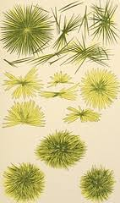
3)Maltose:
Physical characters:
White crystalline , slightly sweet , soluble in water and insoluble in alcohol.
Tests for identity:
Molisch’s test : Positive.
Reduction of Fehling’s soln.:Positive.
Reduction of Barfoed’s soln.: Red precipitate after more than 5 mins.
Osazone : It gives crystals of osazone in the form of radiating plates or broad needles after heating for 45 mins on cold.

Slide 10
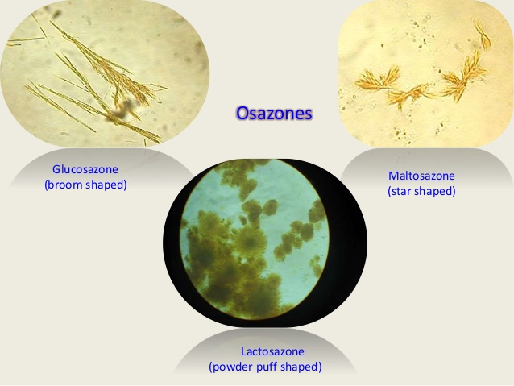

Slide 11
Identification of Monosaccharides
(glucose & fructose)
5- Resorcin (Selwianoff’s) test:
2ml sugar soln.
2ml 12%HCl
Few crystals of resorcin
Heat on W.B
Deep red colour
This test gives a positive result with fructose but not with glucose.

Slide 12
Identification of Polysaccharides
(Starch, Gum Acacia, Gum tragacanth & Agar-agar)
1- Fehling’s test:
1ml sugar soln.
1ml Fehling’s A
1ml Fehling’s B
heat on water bath
No reddish brown ppt.
Non-reducing carbohydrate

Slide 13
Identification of Polysaccharides
(Starch, Gum Acacia, Gum tragacanth & Agar-agar)
2- Test with N/50 I₂ soln. :
2 ml of the carbohydrate soln. (shake)
N/50 I₂ soln. (amount?)
Starch Blue colour
Gum tragacanth Olive green colour
Agar-agar Brick red particles
Gum acacia No change in I₂ colour

Slide 14
Identification of Polysaccharides
(Starch, Gum Acacia, Gum tragacanth & Agar-agar)
3- Benzidine test (oxidase test) :
2 ml of gum acacia soln. (shake)
Few drops 10% H₂O₂ soln.
1-2 drops of benzidine
Blue colour
This test is specific for gum acacia

Slide 15
Identification of Polysaccharides
(Starch, Gum Acacia, Gum tragacanth & Agar-agar)
4- BaCl₂ Test (test for sulfate ions) (Agar-Agar):
3 ml of the Agar-agar soln. (shake)
3 ml of dil. HCl
Put in W.B. for 30 min.
Neutralize, Few drops of BaCl₂ soln.
White turbidity or ppt. of BaSO₄

Slide 16
Identification of Polysaccharides
(Starch, Gum Acacia, Gum tragacanth & Agar-agar)
5- Hydrolysis then Fehling’s (confirmatory test):
3 ml of the carbohydrate soln. (shake)
3 ml of dil. HCl
Put in W.B. for 30 min.
Neutralize with sodium bicarbonate
Carry out Fehling’s test
Reddish brown ppt. of Cu₂O

Slide 17
Thank you

