Slide 1
Pharmacognosy 4
GENERAL

Slide 2
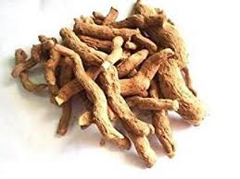
Rauwolfia Root Indian Snake Root

Slide 3
Origin :
The dried roots and rhizomes of
Rauwolfia serpentina
Fam : Apocyanaceae

Slide 4
Morphology
Condition :dried pieces of roots and rhizomes .
Shape : subcylindrical or slightly tapering , tortouos , rarely branched .
Colour : dull and grayish brown .
Taste : bitter .
Odour : odourless .
Branching : unbranched .
Rootlets : present not numerous and are usually broken off .
Direction of growth : horizontal .
Surface : grayish brown with longtudinal wrinkles .
Fracture and texture : short

Slide 5
Microscopical examination
The root
Cork : 2-7 alternating bands of smaller suberized cells in 1-7 layers & larger lignified cells in 1-3 layers .
Phelloderm : parenchymatous contain starch granules prisms .
Phloem : narrow with scattered sieve tissues
Xylem :wholly lignified with 3-6 annual rings , 2ry xylem formed of vessels ,tracheids , fibers and wood parenchyma .

Slide 6
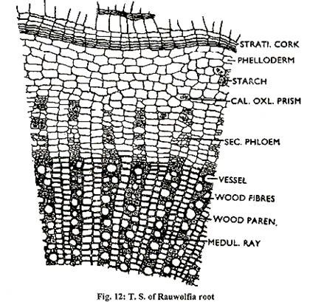

Slide 7
The rhizome
Differs in having :
Pericycle : showing unlignified fibers with elongated ovoid enlargement .
Pith : parenchymatous

Slide 8
T .S in rhizome
Cork
Phelloderm
Pericyclic fiber
Pericycle
Phloem
Xylem

Slide 9
Cork : 2-7 alternating bands

Slide 10
unlignified
Pericyclic fiber

Slide 12
Xylem
Pith

Slide 13
Microscopical exmination of the powder
Starch granules : simple , spherical with eccentric fissure hilum .
cork : brown polygonal cells, some are strongly lignified while others are non-lignified .
Xylem fibers : irregular in shape , thickened and lignified .
Pericyclic fibers : large unlignified show ovoid enlargement at one end .
Prisms of ca-oxalate .

Slide 14
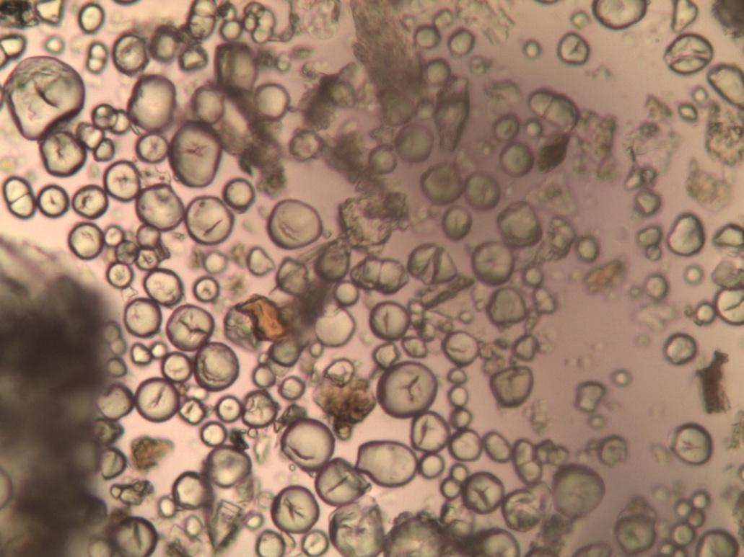
Starch granules

Slide 15
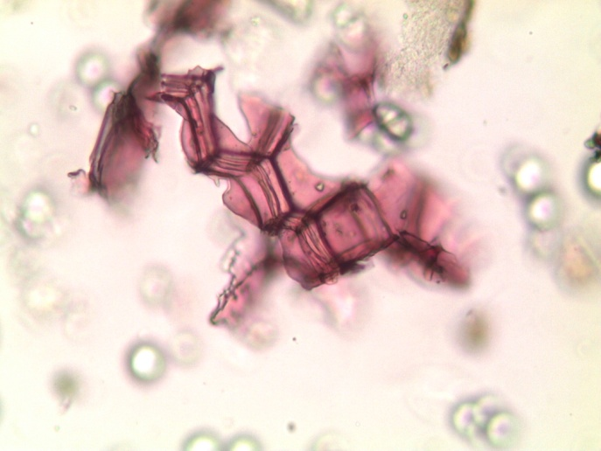
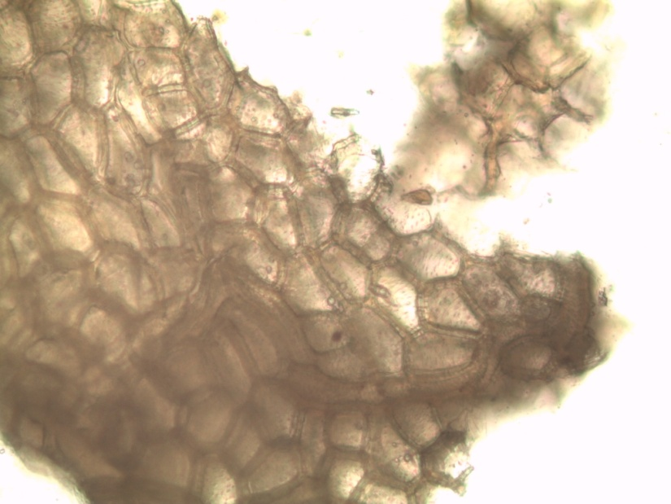
cork

Slide 16
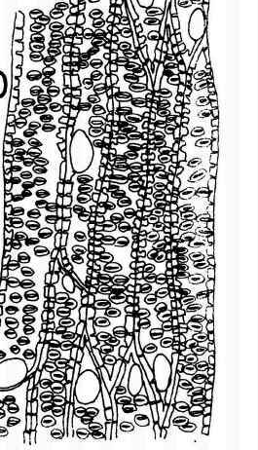
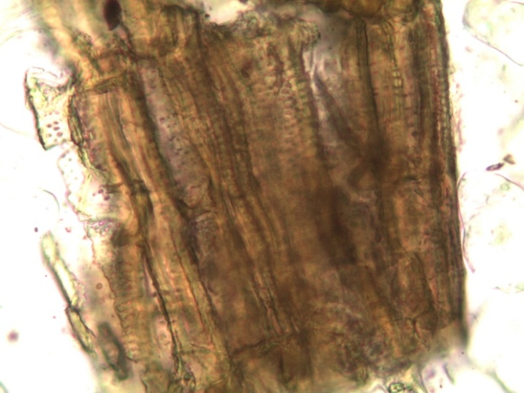
Xylem fibers and trachieds

Slide 17
Pericyclic fibers

