Slide 1
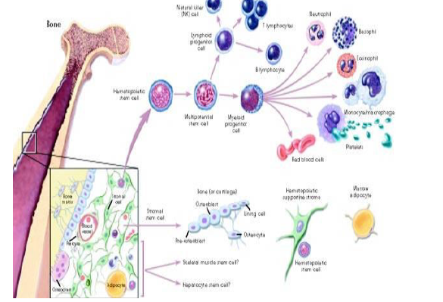
Stem cells

Slide 2
Definition
Cells that can divide to produce either cells like themselves (selfrenewal), or cells of one or several specific differentiated types.
Characters of different stem cells
1-They are capable of dividing and renewing themselves for long periods (proliferation).
2-Unspecialized.
3-They can give rise to specialized cell types (differentiation).

Slide 3
Types of Stem cells
Progenitor stem cells (Unipotant):
terminally differentiated progeny consist of a single cell type only.
Epidermal stem cells keratinocytes.
Spermatogonial stem cells spermatozoa.

Slide 4
2. Multipotent stem cells:
those which can give rise to several terminally differentiated cell types constituting a specific tissue or organ
I. Skin stem cells epidermal cells, sebaceous glands and hair follicles.
II. Haematopoietic stem cells blood cells (erythrocytes, lymphocytes, antibody-producing cells and so on).
III. Neural stem cells all the cell types in the nervous system, including glia (sheath cells), and the many different types of neurons.

Slide 5
Importance of progenitor & multipotent stem cells :
Progenitor & Multipotent stem cells may persist through out life:
In foetus, these stem cells are essential to the formation of tissues and organs.
In the adult, they replenish tissues whose cells have a limited life span. skin stem cells, intestinal stem cells and haematopoietic stem cells. In the absence of stem cells various tissues would wear out and we would die.

Slide 6
3. Pluripotent stem cells:
are able to give rise to all different cell types in vitro.
Isolated from primordial germ cells in the foetus, are called: embryonic germ cells ("EG cells").
Or,misolated from the inner cell mass of a blastocyst-stage embryo are called: embryonic stem cells ("ES cells”).
N.B. Pluripotent stem cells do not occur naturally in the body.

Slide 7
Sources of stem cells
Adult stem cells:
Mammals appear to contain some 20 major types of somatic stem cells that can generate liver, pancreas, bone and cartilage but they are rather difficult to find and isolate.
Neural stem cells is limited since they are located in the brain
Haematopoietic stem cells are present in the blood, but their harvesting requires stimulatory treatment of the donor’s bone marrow

Slide 8
Adult stem cell differentiation:
Normal differentiation pathways to form the specialized cell types of the tissue in which they reside.
Trans-differentiation or plasticity pathways to form specialized cell types of other tissues.

Slide 9
Where are adult stem cells found and what do they normally do?
Many organs and tissues.
very small number.
They may remain quiescent (non-dividing) for many years until they are activated by disease or tissue injury.
e.g. Brain, bone marrow, peripheral blood, blood vessels, skeletal muscle, skin and liver

Slide 10
2. Stem cells of foetal origin:
Haematopoietic stem cells can be retrieved from the umbilical cord blood.
Foetal tissue obtained after pregnancy termination can be used to derive:
a) Multipotent stem cells like neural stem cells which can be isolated from foetal neural tissue and multiplied in culture, though they have a limited life span.
b) Pluripotent EG cells isolated from the primordial germ cells of the foetus.

Slide 11
3. Stem cells of embryonic origin:
Pluripotent ES cells are derived from an embryo at the blastocyst stage.
Embryos could be produced either by in vitro fertilisation (IVF) or by transfer of an adult nucleus to an enucleated egg cell or oocyte (somatic cell nuclear transfer – SCNT).

Slide 12
Human embryonic development
At 2 to 3 days after fertilization: Totipotent capable of developing into a complete organism or differentiating into any of its cells or tissues
At 4 to 5 days after fertilization: morula stage unspecialized but can not develop into a complete organism.
At 5 to7 days after fertilisation (blastocyst stage), differentiated into:
a) Hollow appears in the centre of the morula (blastocoel).
b) Outer cells will constitute the tissues around the foetus including the placenta (trophoblast).
c) Inner cells (20 to 30 cells) will give rise to the foetus itself as well as to some of the surrounding tissues (blastocyst).

Slide 13
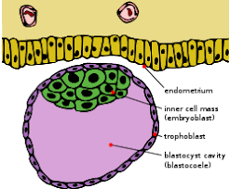

Slide 14
Similarities and differences between embryonic and adult stem cells
Embryonic stem cells | Adult stem cells
pluripotent | multipotent
Stable can be undergo many cell division. | Less stable capacity foe selfrenewal is limited.
Easy to obtain. | Difficult to isolate
Could cause transplant rejection by immune system. | Could not cause transplant rejection by immune system for patient’s own cells.

Slide 15
What laboratory tests are used to identify embryonic stem cells?
1. Growing and subculturing the stem cells for many months remain undifferentiated.
2. Surface markers : Oct-4 protein.
3. Examining the chromosomes under a microscope.

Slide 16
Potential applications of stem cells
1. Basic developmental biology: to understand the causes of birth defects, infertility and pregnancy loss. It could also be useful to give a better understanding of normal and abnormal human development.
2. Studies of human diseases on animal models.
3. Culturing specific differentiated cell lines to be used for pharmacology studies and toxicology testing.
4. Use of stem cells in gene therapy: Stem cells could be used as vectors for the delivery of gene therapy. One current application in clinical trials is the use of haematopoietic stem cells genetically modified to make them resistant to the HIV (virus responsible for AIDS).

Slide 17
5. Production of specific cell lines for therapeutic transplantation "Cell based therapies": damaged tissues. For instance, the aim would be to produce cardiac muscle cells to be used to alleviate ischaemic heart disease, pancreatic islet cells for treatment of diabetes (juvenile onset diabetes mellitus), liver cells for hepatitis, neural cells for degenerative brain diseases such as Alzheimer's & Parkinson’s disease, and perhaps even cells for treating some forms of cancer.
The use of human stem cells could open the way to a new "regenerative medicine".

