Slide 1
Biochemistry and clinical enzymology-I

Slide 2
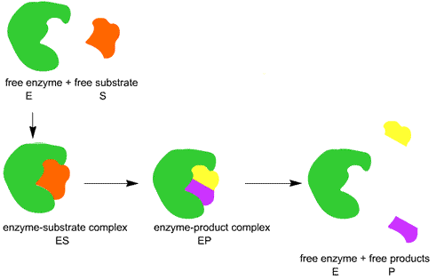
Definition
Enzymes are proteins that act as catalysts for chemical reactions in the body.
Substrate is the substance upon which the enzyme acts.

Slide 3
Enzyme Components
Enzymes are chemically classified into:-
Simple protein enzymes:-Which consists only of protein.
Conjugated protein enzymes ( Holozymes or Holoenzymes):- which consist of :-
Protein part:- called apoenzyme.
Non-protein part which is either :-
Loosely attached (i.e., non-covalently) to apoenzyme and called Coenzyme or Cofactor. Or
Firmly attached (i.e., covalently) to apoenzyme and called Prosthetic group.

Slide 4
Table showing the differences between components of holoenzyme:-
 | Apoenzyme | Coenzyme | Prosthetic Group | Cofactor
Nature | Protein | non-protein | non-protein | non-protein
Examples | All enzymes | NAD, FAD, TPP, ATP, UTP | E.g. tryptophan oxygenase iron-Heme | Mg2+, Ca2+ Cu2+, Mn2+
Attachment to the apoenzyme |  | Loose | Firmly | Loose
Heat stability | labile | Stable | Stable | Stable
MW | Large | Small | Small | Small
Determine substrate specificity | Yes | No | No | No
Determine chemical nature of the reaction | Yes | Yes | Yes | Yes

Slide 5
Basic Reactions and Classes of Enzymes
The Enzyme Commission has divided the basic reaction types and the enzymes catalyzing them into six broad numbered classes:
(1) Oxidoreductases.
(2) Transferases.
(3) Hydrolases.
(4) Lyases.
(5) Isomerases
(6) Ligases.

Slide 6
Functional sites of enzyme system
1- Catalytic (active site):-
It is the site on the enzyme surface that catalyzes the chemical reaction i.e. carries out the chemical reaction .
2- Substrate binding site:-
It is the site on the enzyme surface at which the substrate specifically binds.
Both sites :-
Either separated by large or small distance or combined into one site.
They are either:-
Rigid model " Lock & key model": No changes in their shape after binding of the substrate .
Flexible model " Induced fit model": After binding of substrate , it induce conformational changes in their shapes to induce proper fitting of the enzyme- substrate complex.

Slide 7
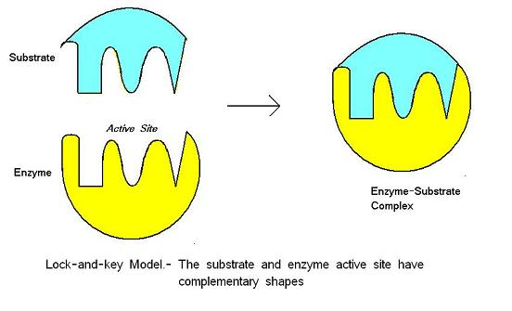
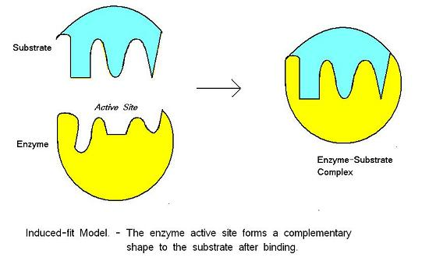

Slide 8
3. Allosteric site:-
Allosteric means other site ( from the greek word "allos") . It is site on the enzyme surface other than the catalytic and substrate binding site to which allosteric effector binds.
Enzymes regulated by allosteric effector are called allosteric enzymes.
Allosteric effector(regulatory molecule) is a low molecular weight substance with no or little structural similarities to the substrate and may be end product of enzyme catalyzed reaction & leads to one of the following effects:-
A)- Conformational changes mainly in catalytic site , leading to increase the rate of enzyme catalyzed reaction i.e. increase enzyme activity resulting in decreased Km.
And called Allosteric activator or " feed back activator" or " positive allosteric effector".

Slide 9
B)- Conformational changes mainly in catalytic site , leading to decrease the rate of enzyme catalyzed reaction i.e. decrease enzyme activity , with increased km.
And called Allosteric inhibitor or " feed back inhibitor " or " negative allosteric effector" .

Slide 10
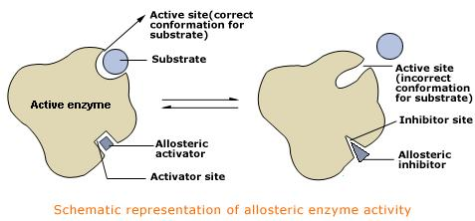

Slide 11
Allosteric inhibitor may be one of the following types:-
Cumulative :- in which single product presents in enough amount inhibit the enzyme.
Concerted:- in which two or more products have to be present simultaneous and in enough amount to inhibit the enzyme.
Co-operative: has the feature of the previous two types.
Enzyme multiplicity: multiple enzymes having different catalytic actions , all are inhibited by single product.

Slide 12
Enzyme Specificity
1- Low or bond specificity: In this type the enzyme acts on substrates that are similar in structure and contain the same type of bonds e.g.
A). Lipase : that hydrolyzes ester bonds in different triglycerides.
B). Protease: that catalyzes the hydrolysis of peptide bonds of different proteins.

Slide 13
Enzyme specificity
2- Moderate or group specificity: In this type of specificity , the enzyme is specific not only to the type of bond but also the chemical groups or atoms surrounding it e.g.
a. Aminopeptidase : is an exopeptidase that hydrolyzes peripheral peptide bond at the amino terminal (end) of the polypeptide chain.
b. Carboxypeptidase: is an exopeptidase that hydrolyzes peripheral peptide bond at the carboxyl terminal (end) of the polypeptide chain.

Slide 14
Enzyme specificity
3- High or substrate specificity: In this type of specificity the enzyme acts only on one substrate e.g.
A) Lactase , which acts only on lactose.
B) Sucrase , which acts only on sucrose.
C) Maltase , which acts only on maltose.

Slide 15
Enzyme specificity
4- Optical or Streo-specificity: In this type of specificity , the enzyme acts on a specific isomer of the substrate and not acts on another isomers e.g.
a. L- amino acid oxidase acts only on L-amino acids.
b. D- amino acid oxidase acts only on D- amino acids.

Slide 16
Enzyme specificity
5- Dual specificity: There are two types of dual specificity:
A- The enzyme may acts on two substrate by one reaction type e.g. xanthine oxidase enzyme acts on xanthine and hypoxanthine (two substrates) by oxidation (one reaction type):

Slide 17
Xanthine oxidase Xanthine oxidase
Hypoxanthine Xanthine uric acid

Slide 18
B- The enzyme may acts on one substrate by two different reaction types
e.g. isocitrate dehydrogenase enzyme acts on isocitrate ( one substrate ) by oxidation followed by decarboxylation ( two different reaction types):
Isocitrate dehydrogenase
Isocitrate α-ketoglutarate
NAD NADH+H⁺ CO₂

Slide 19
Questions
Q1: Compare between various components of holozyme system.
Q2: Enumerate functional sites of enzymes and describe two of them?
Q3: Discuss various classes of the enzymes.
Q4: Describe various types of enzyme specificity.

