Slide 1
سكشن هذا الاسبوع الفرقة الثانية عام
صيدلانيات 1
د. عبير سعد
قسم الصيدلانيات

Slide 2
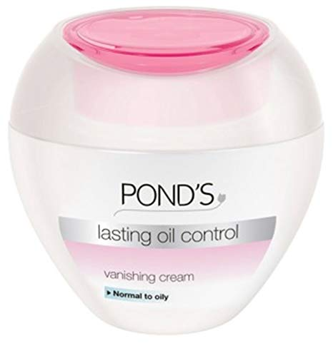
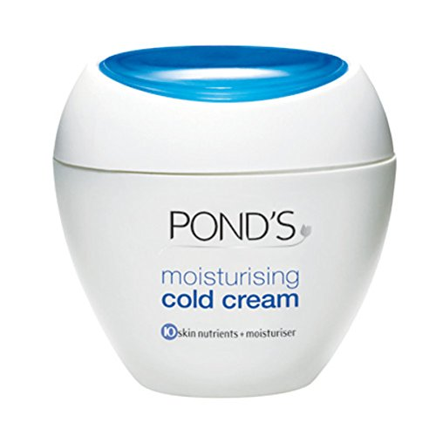
Creams

Slide 3
Cosmetic Creams

Slide 4
Cosmetic Creams USP
1- Creams are defined as semisolid and white emulsions of either O/W or W/O type.
2- Prepared with cetyl esters wax, white wax, mineral oils, sodium borate and purified water.
3- Creams are usually employed as emollients or as medicated application to the skin.

Slide 5
Classification of Cosmetic Creams
Emulsion defines the performance of the product such as emollient, vanishing, shaving, and foundation creams.
Emulsion serves as a vehicle for an active principle for example nourishing, sunscreen, and antiperspirant creams.

Slide 6
Cold Cream
Semisolid, white, water in oil (W/O) emulsion prepared with cetyl esters wax, white wax, mineral oils, sodium borate and purified water.
Sodium Borate ??? Role

Slide 7
Emollient, Cold or Night Cream
Emollient creams serve against unfavorable environmental conditions.
Cold cream can be used as ointment base.
The cooling sensation is produced by the slow evaporation of the water content present in the internal phase of the cream.
Cold creams are used at night for nourishing the skin and as smoothing agent for chapped skin. It is used generally in the summer.
They have good spreadability, to ensure it the melting point of oil phase should be no more than 37cº

Slide 8
Beeswax- Borax Cold Cream:
This type of creams is self- emulsifying.
The emulsifying agent is the product of the reaction between borax and free fatty acids of the oil and beeswax found in the formula.
This combination produce sodium soap which as emulsifier.
Sodium Borate ??? Role

Slide 9
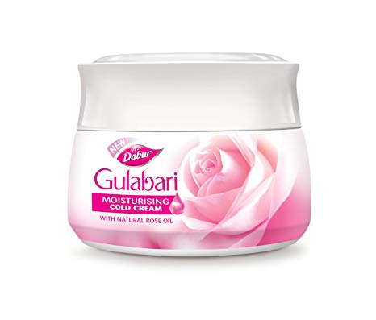
Cold Cream

Slide 10
Cold Cream
Rx
Purified water 24 g
Borax Q.S
Olive oil 50 g
White beeswax 12.5 g
White soft paraffin 12.5 g
Fiat: cream
Mitte: 10 g
Sig. m.d.u

Slide 11
Acid value calculation
Acid value is defined as:
The number of milligrams of KOH required to neutralize one gram of oil or fat (bees wax and olive oil).
Acid value of beeswax = 20
Acid value of olive oil = 2
M.wt of Borax = 381.43
M.wt. of KOH = 56.11
M.wt of NaOH = 40

Slide 12
Calculation of the required amount of Borax:
Amount of KOH required to neutralize Beeswax= 12.5 x 20=250mg
Amount of KOH required to neutralize olive oil = 50 x2 = 100 mg
Since 1 mol Borax → 2 mols NaOH
And 1mol NaOH = 1 mol KOH and
we need 350 /1000 g of KOH
Therefore 1 mol Borax → 2 mols KOH
381.43g → 2 x 56.11g
? g → 350/1000 g

Slide 13
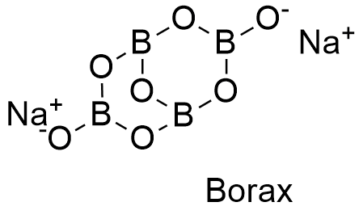
Borax- structure
Sodium borate

Slide 14
Cold cream
R/
Purified water 24 ml
Borax Q.S.
Olive oil 50 g
Beeswax 12.5 g
Soft paraffin to 12.5 g
Make cream, send 10 g
Label: To be used as directed
10/100
2.4 ml
0.119 g
5ml
1.25 g
1.25 g

Slide 15
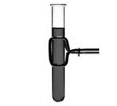
Procedure
1- Dissolve 0.119 g borax in 2.4 ml water

Slide 16
Procedure
Porcelain Dish
1) 1.25 g Bees wax
2) 1.25 g soft paraffin
3) 5 ml olive oil
Water Bath
Melt
3) Heat the test tube and add to dish
4) Stir well in one direction quickly for 3 minute on water bath
Flame
5) Remove the dish from the W.B. then stir well until semi homogenous cream is obtained

Slide 17
Procedure:
1- Melt the beeswax (1.25 g) and white soft paraffin(1.25g) then add the olive oil(5 ml).
2- Dissolve Borax (0.119 g) in the purified water( 2.4 ml) and heat the solution to 75 - 80 °c.
3- Add the aqueous solution to the melted oily phase gradually with trituration (leave on the water bath for 3mins).
4- Remove from the water bath and triturate rapidly in one direction until a cold, viscous, and white cream is obtained.

Slide 18
Label
Name of preparation: Cold Cream
Directions: To be used as directed
Use: External use
Color: Red label
Use
Overall use: nourishing the skin

Slide 19
Notes
This cream is self emulsifier, i.e. the emulgent is a product of reaction between borax and free fatty acids of oils and beeswax.
No humectants (glycerin) are used.
It is shiny so used at night.

Slide 20
Differences between cold and vanishing creams
Property | Cold cream | Vanishing cream
1-Type of emulsion | W/O | O/W
2- Oil content | 45% - 80% | 15% - 30%
3- Water content | 25% | 80%
4- Emulsifying agent | Sodium salt produced by reaction between fatty acid in beeswax and NaOH in borax. | Potassium salt produced by reaction between stearic acid and KOH
5- Time of use | Night | Day
6- humectant | Not incorporated | Is incorporated
6- Appearance | Shinny | Not shinny

Slide 22
Thank you

