Slide 1
سكشن هذا الاسبوع الفرقة الثالثة عام
صيدلة حيوية وحركية الدواء
د.عبير سعد
قسم الصيدلانيات

Slide 2
pharmacokinetics
Intravenous infusion

Slide 3
How to draw?
Log Conc.
Conc. | time
C1 | t1
C2 | t2
C3 | t3
Log C_{a} - Log C_{b}
LogC₀
Slope =
t _{a} - t _{b}
C _{a}
C _{b}
t _{a}
t _{b}
time
Slope : will have –ve sign & this means the conc. of the drug decrease with time
Notes:
In semilog paper we draw c not log C, when taking the slope calculate log C1-LogC2/t1-t2, when taking Co from extrapolation take No. as it is.

Slide 4
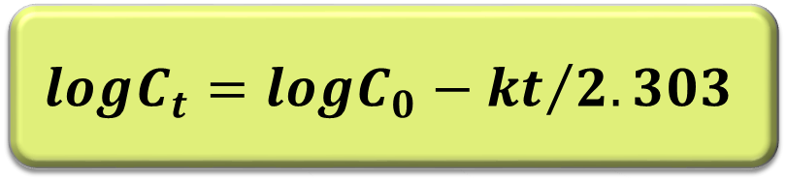
How to calculate pharmacokinetic parameters?
$$logC_{t}=logC_{0}−{kt}/{2.303}$$
Log Conc.
1- Elimination rate const.(K)
Slope= - K / 2.303
k = - Slope x 2.303
2- Half life (t_{0.5})
t _{½} = 0.693 / K
or
from graph t _{½} = ½ C_{o}
Co
½ C_{o}
t _{1/2}
time

Slide 5
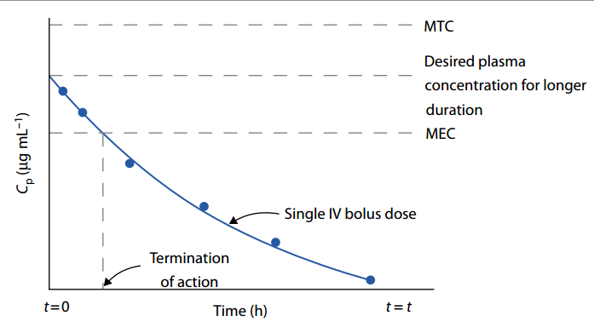
Intravenous bolus
Notes:
Single dose iv bolus ---- desired therapeutic conc. And pharmacological effect immediately ------ and then elimination……
بس ده مش هينفع لما يكون ضرورى نحافظ على التركيز الدواء فى الدم لمده من الوقت ------والحل؟؟ تدى الدوا بمعدل ثابت يوصل للدم لمرحلة الثبات

Slide 6

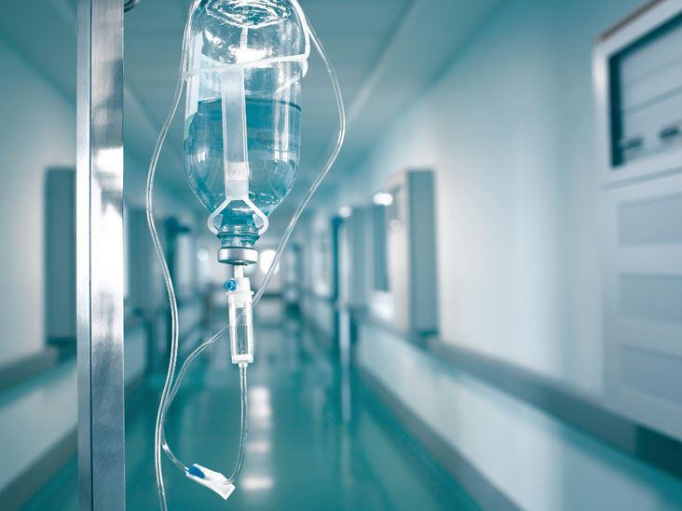
Model II
One-compartment model with intravenous infusion administration

Slide 7
Intravenous infusion
Intravenous infusion is a direct method by which the drug is administered systemically into the body. IV drug solutions may be given either as a bolus dose or infused slowly at a constant or zero order rate.
The main advantage of an IV infusion is the ability to maintain constant plasma drug concentrations, referred to as steady-state drug concentrations (effective or therapeutic concentration).
Infusions are zero-order processes, because they deliver a fixed amount of drug per unit time (e.g., mg/min).
Therefore, I.V infusion is one-compartment model, the infused drug follows zero-order input and first order output.

Slide 8
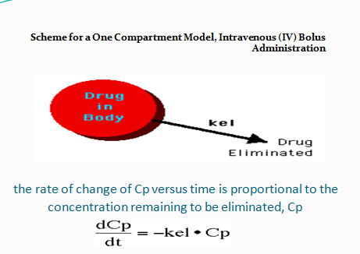
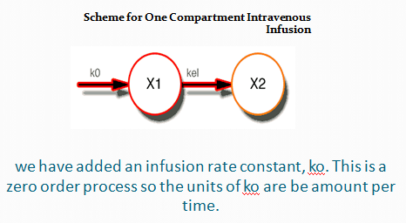
Intravenous bolus
Intravenous infusion

Slide 9
Advantages for giving a drug by IV infusion:
1-Precise control of plasma drug concentration to fit the individual needs of the patient.
2-For drugs with narrow therapeutic window, IV infusion maintains an effective constant plasma drug concentration by eliminating wide fluctuation.
3-The duration of drug therapy may be maintained or terminated as needed using IV infusion.
What happen in I.V infusion?

Slide 10
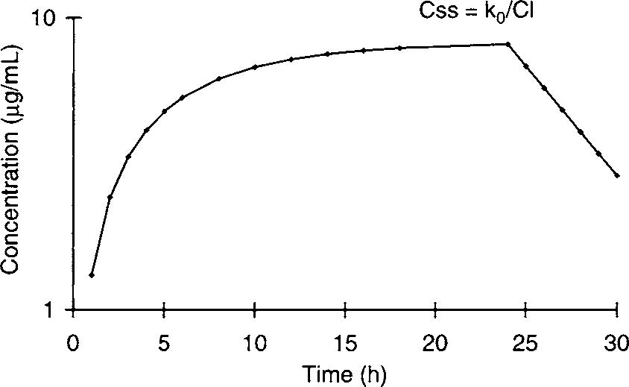

Plateau or steady-state drug concentration
Termination of infusion
2
First order elimination
1
3
Steady-state refers to the condition in which the rate of drug entering the system is equal to the rate of drug leaving the system.
Rate of change in plasma drug conc. dCp/dt equal zerooo

Slide 11
The pharmacokinetics of I.V infusion One – compartment model drugs
- The pharmacokinetics of a drug given by constant IV infusion follows a zero-order input and first-order output.
- The change in the amount of drug in the body at any time (dx/dt) during the infusion is the rate of input minus the rate of output.
By integration
1
Cp: Is the plasma drug concentration at any time during infusion.
t : is the time for infusion.
R : (infusion rate) (Ko) or maintenance dose
K : (elimination rate constant)
Vd :(volume of distribution)

Slide 12
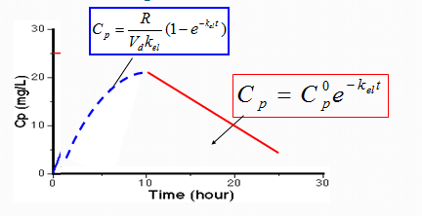
First order elimination
Cp plasma conc. at any time
Css plasma conc. at steady state time (infinity)

Slide 13
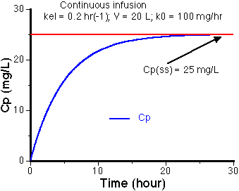

2
Css plasma conc. at steady state time (infinity)

Slide 14
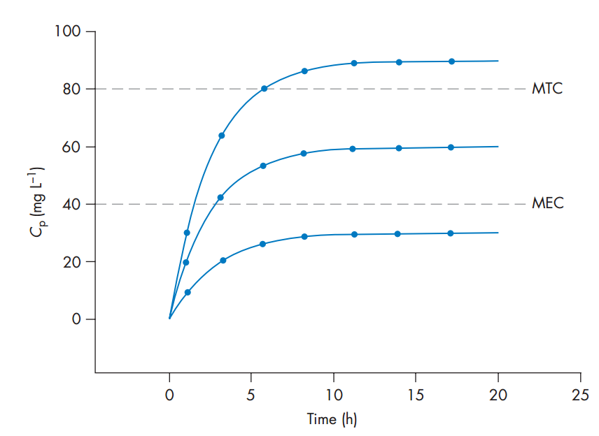
Notes
1-The time to reach steady state is inversely related to k or directly related to the elimination half-life of the drug
2-The plasma drug concentration at steady state is related to the rate of infusion and inversely related to the body clearance or elimination rate.

Slide 15
Notes
Practical steady-state concentration has been reached when the plasma concentration of a drug in the blood represents 95% or greater of the true steady-state plasma concentration.
The time required to reach ‘‘practical’’ steady-state condition is always equal to 4.32 t_{1/2} of that drug
IV infusion of the drug for 5 half-lives, the plasma drug concentration will be between 95% (4.32 t_{1/2}) and 99% (6.65 t_{1/2}) of the steady- state drug concentration.

Slide 16
Time required for 50% of maximum accumulation = 1 t_{0.5}
Time required for 90% of maximum accumulation = 3.32 t_{0.5}
Time required for 95% of maximum accumulation = 4.32- 5 t_{0.5}
Time required for 100% of maximum accumulation = 6-7 t_{0.5}

Slide 17
To reach 99% of Css
Css = R/kVd
Therefore 99% steady state level = 99% R/kVd
99% R/kVd =( R/kVd) .(1-e^{-kt})
99%= 1- e^{-kt}
0.01 = e^{-kt}
Ln 0.01 = -kt
Therefore t_{99% ss}= 4.61/k = 4.61 t_{.05} / 0.693 = 6.65t_{0.5}
Same To reach 95% of Css

Slide 18
Loading Dose plus IV Infusion
Loading dose
Iv infusion
DL + I.V infusion

Slide 19
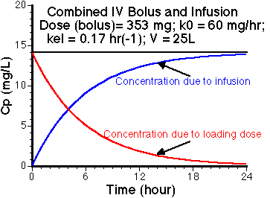
Loading dose equal the amount of drug in the body at steady state
Co is equal to C ss

Slide 20
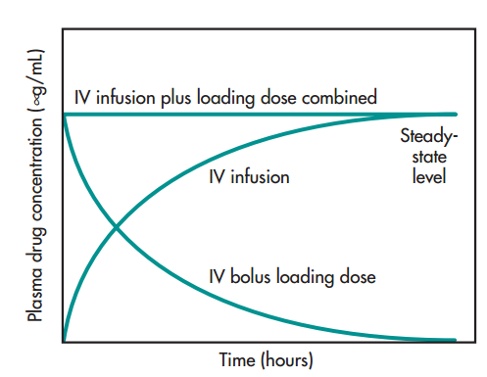
Co is equal to C ss
DL=Css .Vd dose=Co .Vd
•Css=R/k .Vd
•Css.Vd=R/k
DL= R/k
Css= R/CL
DL loading dose (I.V) bolus
Loading dose equal the amount of drug in the body at steady state
Notes:
ندى جرعة DL لانقاظ المريض وبعدين نكمل ب التنقيط الوريدى لنحافظ على التركيز دا فى الدم VERY IMPORATNT
لاننا عرفنا ان تركيز الفعال حيوصل بعد 5 وقت نصفى

Slide 21
Important notes
1 – The total elimination rate constant ( K ) = Ke + Kb.
2 – In patient suffering from anuria, K = Kb .because Ke = zero.
3 – Incase of 50 % renal function, K = Kb + ½ Ke.

Slide 22

Study Hard
Any Questions ??

