Slide 1
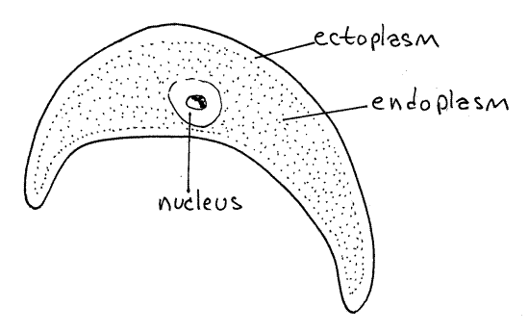
protozoa

Slide 2
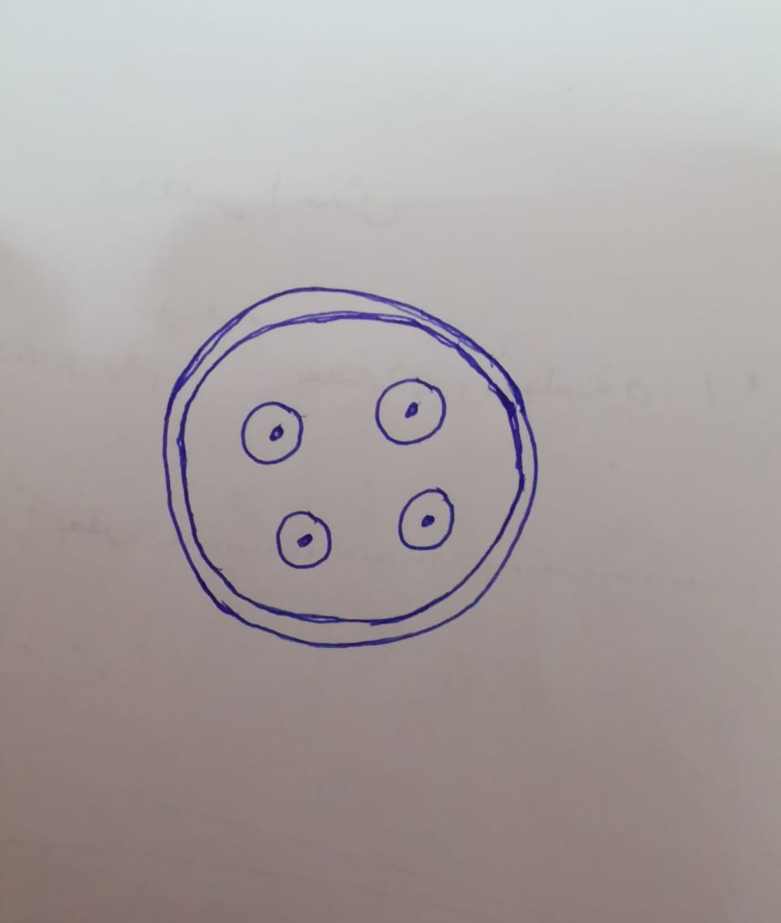
Entameba histolytica cyst with 4 nuclei (quadrinucleated)

Slide 3
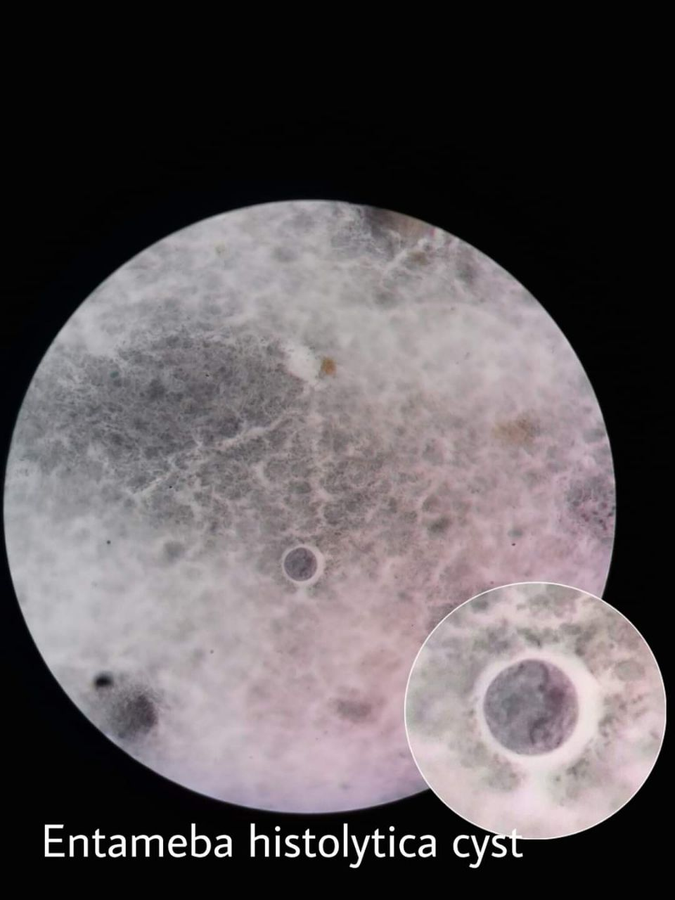

Slide 4
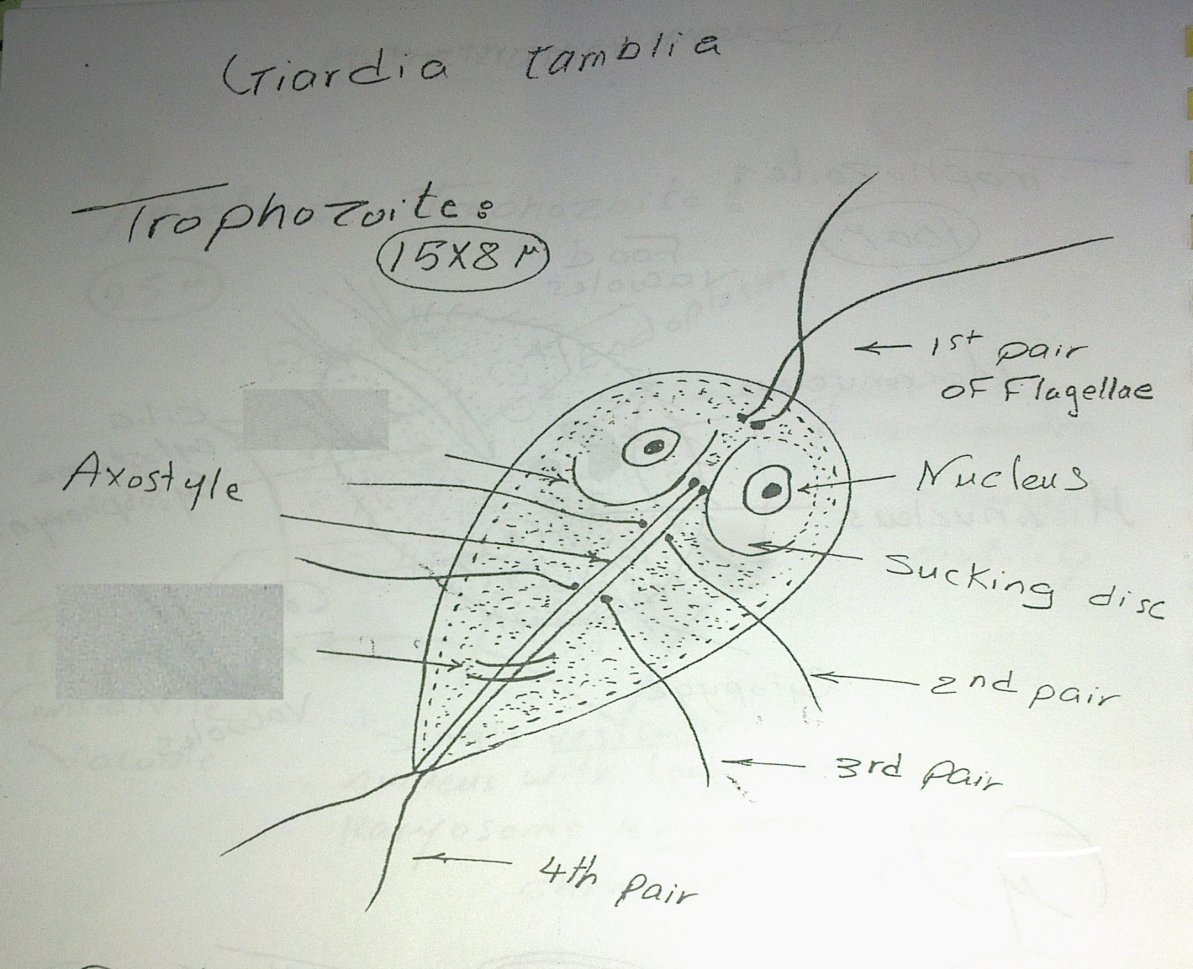
Intestinal Flagellates Giardia lamblia trophozoite

Slide 6
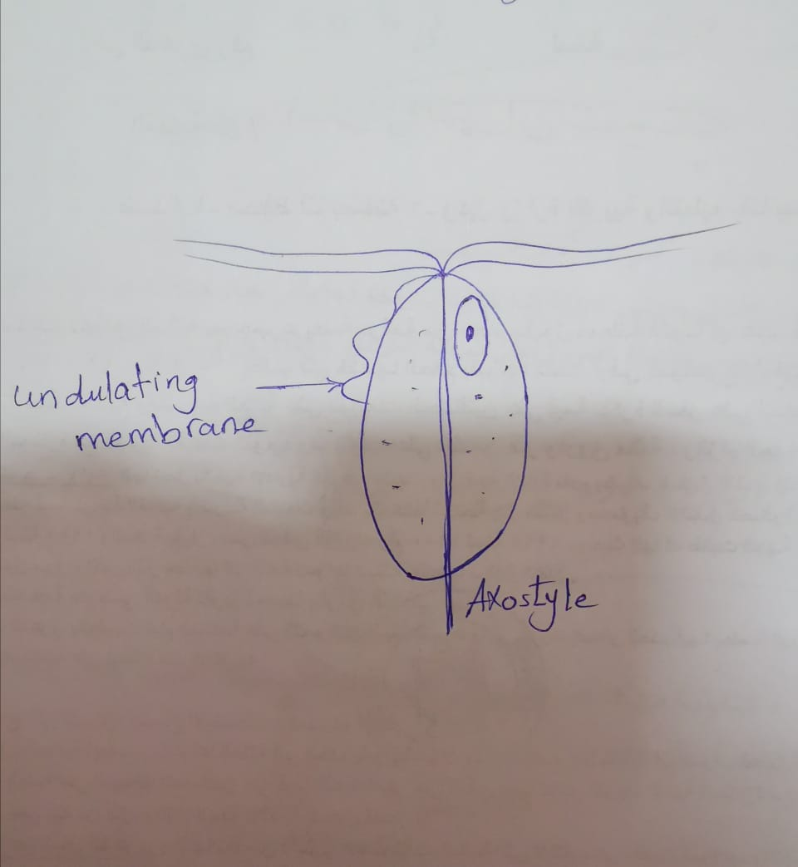
Urogenital Flagellates Trichomonas vaginalis trophozoite

Slide 7
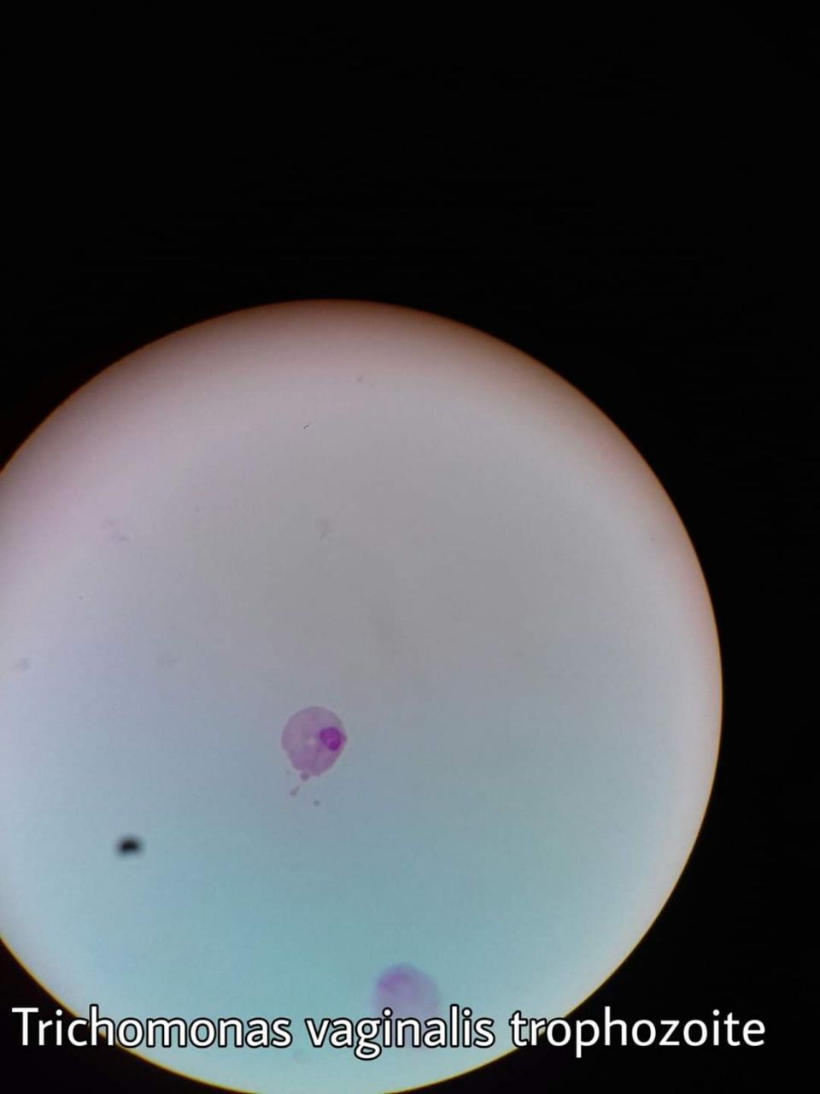

Slide 8
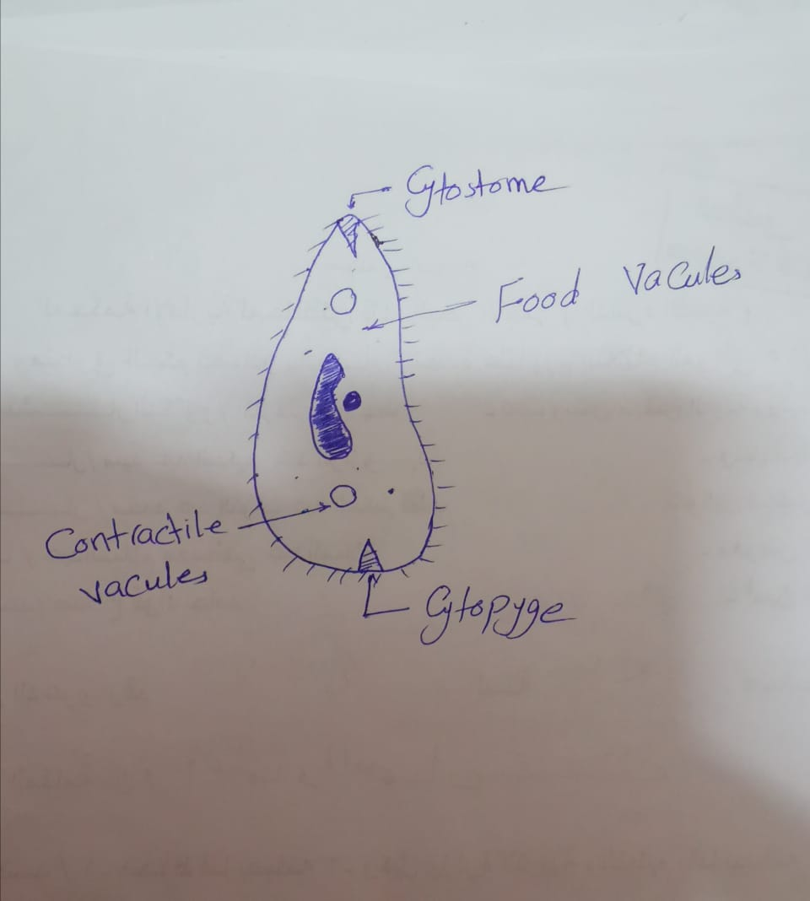
Ciliophora Balantidium coli trophozoite

Slide 9
