Slide 1
Quality Control PG606
Clinical

Slide 2
Phytochemical screening tests.
Continue….

Slide 3
We are going to discuss the screening tests for the following compounds:
Primary metabolites: _ Fixed oils. _ Proteins. _ Mucilages.
Secondary metabolites:
_ Saponins.
_ Coumarins.
_ Anthraquinones
_ Unsaturated Sterols and
/ or Triterpens. _ Lactones and/or esters. _Cardiac glycosides.
_ Volatile oils.

Slide 4
Test for screening of Anthraquinones :`
Aglycone form:
Rose red color in aqueous layer
Shake well
2 ml 5% aq. KOH
Filtrate
+
Filter
5 ml Chloroform
Powdered plant material
Rhubarb and Senna pods

Slide 5
Test for Saponins
Permanent froth that persists for about 10 mins
_{W.B.}
Shake well
Aqueous soln. of saponins
Liquorice

Slide 6
Test for Coumarins
Filter paper moistened with dil NaOH
+
5 ml alc. extract
Place in W.B.
Remove the filter paper and examine it under UV light
The detection of Blue flouresence suggests the presence of coumarins

Slide 7
Tests for unsaturated Sterols and / or triterpens
Lieberman – Burchard reaction.
Salkowiski test.

Slide 8
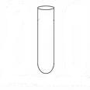
Lieberman – Burchard reaction
1 ml conc. sulfuric acid
1 ml chloroform
evap.
transfer to
few ml of acetic anhydride
residue
2 ml alcoholic extract
Chloroformic solution of dry extract

Slide 9
Positive reaction
Reddish brown ring ( Triterpenes) at junction of 2
liquids superimposed by green color ( Sterols)

Slide 10
Salkowski test
few drops of
conc. Sulfuric acid
dried alcoholic extract
Red or violet color

Slide 11
Test for lactones and \ or esters
1 drop of saturated
alcoholic KOH
1 drop of saturated
alcoholic hydroxyl amine
1 drop 1% FeCl₃
evap.
1 drop 0.5N HCl
w.b (10 min.)
chloroformic
solution of
dried alcoholic extract
Intense violet colour
Venedium and Damsisa

Slide 12
Test for Cardiac Glycosides
A) Deoxy sugar part :
Killer killani test: Positive for Cardenolides and Bufadenolides
B) Sterol part:
Libermann test ,Salkowski test , and Antimony trichloride test: Positive for Cardenolides and Bufadenolides.
C) Active methylene group in Lactone ring:
1)Kedd’s test. 2)Baljet’s test. 3) Raymond’s test.
Positive for Cardenolides only.

Slide 13
Kedd’s test:
1 ml 2 % Alco. m-dinitrobenzoic acid
1 ml 10 % Alco. KOH
evap.
residue
2 ml alcoholic extract
Appearance of Violet color suggests the presence of Cardenoloids

Slide 14
2) Raymond’s test:
1 ml 2 % m-dinitrobenzene
1 ml 10 % Alco. NaOH
evap.
2 ml alcoholic extract
residue
Appearance of Violet color suggests the presence of Cardenoloids

Slide 15
3) Baljet’s test :
1 ml Alc. NaOH
Orange color suggests the presence of Cardenolides
1 ml aq. Picric acid
2 ml alcoholic extract

Slide 16
Tests for screening of V.O.
1) V.O. gives Red colour with Sudan lll reagent
2) V.O. gives Red colour with Alkanna tincture.
3) V.O. gives Brown colour with Osmic acid reagent.
4) On pressing the powder between two filter papers The stain will not persist and disappear after while.
Anise or Fennel

Slide 17
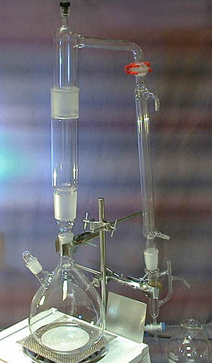
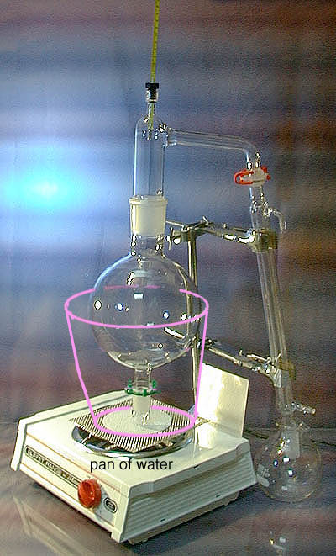

Slide 18
Tests for screening of Mucilage
1) Mucilage gives Red color with Ruthenium red reagent.
2) Mucilage gives Red color also with soln. of
corallin soda.
3) Mucilage gives Blue to Purple color with chlorozinic iodide.

Slide 19
Tests for the screening of Fixed oils
1) Fixed oil + Sudan lll Red colour
2) Fixed oil + Alkanna tincture Purple color
3) Chlorophyll stains the oil by Green colour
4) On pressing the powder between two filter papers Permanent stain will be formed .
Linseed

Slide 20
Tests for screening of Proteins
1) Millon’s reagent when added to protein solution gives white ppt. that turn red upon heating.
2) Picric acid will give yellow color with protein soln.
.
3) Iodine solution stains proteins brown color.

