Slide 1
Glycogen metabolism

Slide 2
Structure:
It is highly branched homopolysaccharides , formed of α-glucose units linked together by α -1,4 glucosidic linkage along the branch & α -1,6 glucosidic linkage at the branching point ( the branch contains 12-14 glucose unit).

Slide 4
Location:
It is stored form of carbohydrates in animals located mainly in the cytoplasm of liver & muscle.
Liver contains 120 gm i.e. about 6% of its total weight.
Muscles contain 350 gm i.e. about 1% of their total weight.

Slide 5
Functions:
In the liver: it provides glucose to the blood to maintain normal blood glucose concentration during early fasting & it is depleted 12-18 hours from fasting.
In muscles: it provides glucose-6-P to enter glycolysis to produce necessary energy for contracting muscle with production of lactate and can provide little amount of glucose to the blood.

Slide 6
Glycogen synthesis "Glycogenesis"
Definition:
It is synthesis of glycogen from:
  In liver:
Glucose.
Other hexoses e.g. galactose & fructose.
Non-carbohydrate source e.g. glycerol, pyruvate & gluconeogenic amino acids.
  In muscles: from glucose only.
Site:
Mainly in the cytoplasm of muscles & liver.

Slide 7
Steps
Formation of UDP-glucose:

Slide 8
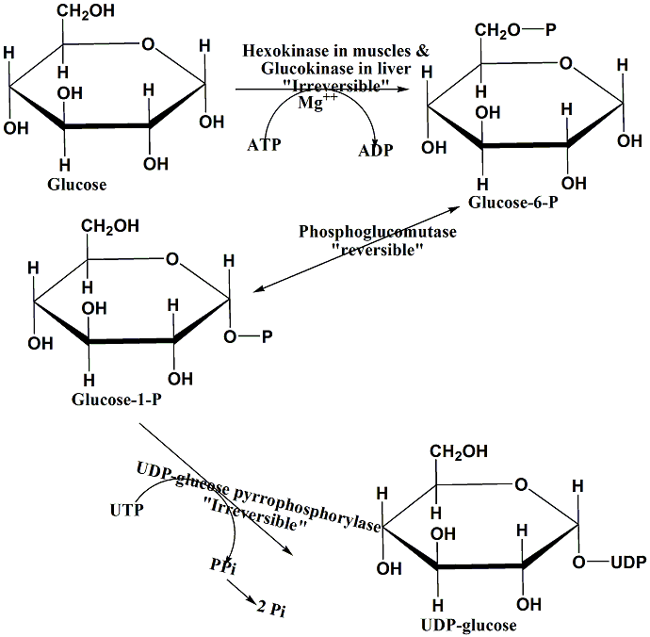

Slide 9
Formation of glycogen
UDP-glucose reacts with a glycogen primer to form glycogen which may be:
Few molecules of glucose units linked together by α -1, 4 glucosidic linkage. Or
Glycogenin: This is protein to which UDP-glucose reacts to the –OH group of its tyrosine residue.
  Glycogen synthase will react C1 of UDP-glucose to C4 of the terminal glucose unit in the glycogen primer linking them by α-1,4 glucosidic linkage , or to the OH-of tyrosine residue of glycogenin, with release of UDP. the reaction is reversible as follow:

Slide 10
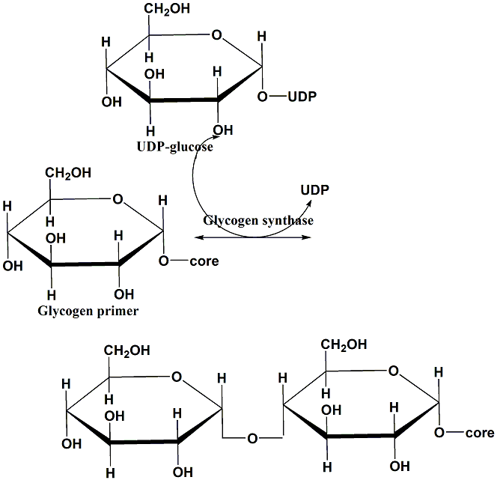

Slide 11
Addition of glucose units to glycogen primer by glycogen synthase & linked by α -1, 4 glucosidic linkage continue till the length of the branch reach 11 glucose units, then branching enzyme transfers a block of 6-7 glucose units to the side of the neighboring branch linking to it by α -1, 6 glucosidic linkage & the branching point should be four glucose unit away from the previous branching point on the same branch.
Then the branch is further elongated by adding glucose units linked by α -1, 4 glucosidic linkage & then further branching occurs and so on.

Slide 12
Glycogen breakdown "Glycogenolysis"

Slide 13
Definition:
It is Breakdown of glycogen into glucose in the liver & into glucose-6-P in the muscle.
Site:
Mainly in the cytoplasm of liver & muscles.

Slide 14
Steps:
Glycogen phosphorylase : it breaks down the α -1, 4 glucosidic linkages between the glucose units in the glycogen along the branch through phosphorolysis i.e. addition of inorganic phosphate with release of glucose-1-P & uses pyridoxal phosphate "PLP" as a coenzyme till the branch contains four glucose units where three of them will be transferred by glucan transferase to the next branch to be in a linear sequence with it & linked to it by α -1, 4 glucosidic linkage while the remaining one glucose unit will be acted upon by debranching enzyme which breakdown α -1, 6 glucosidic linkage through hydrolysis i.e. addition of water with release of free unphosphorylated glucose.

Slide 15
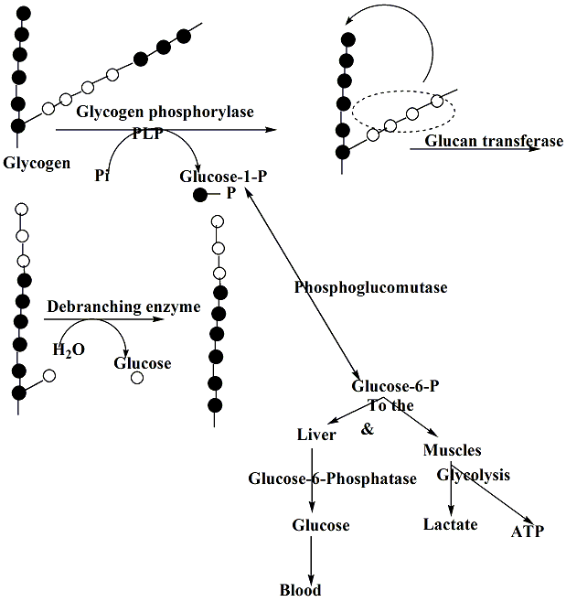

Slide 16
Glucose-1-P will converted into glucose-6-P by phosphoglucomutase which in the:
Liver: will acted upon by glucose-6-phosphatase to provide glucose which pass to the blood.
Muscles: as there is no glucose-6-phosphatase, it will passes into glycolysis to produce energy necessary for the contracting muscles & lactate.

Slide 18
Regulation of glycogenesis & glycogenolysis
Both processes are in a co-ordination as conditions that stimulate glycogenesis will lead at the same time to inhibit glycogenolysis & vice versa.
For example :
During fasting →↓blood glucose → secretion of glucagons , epinephrine & norepinephrine → stimulate glycogenolysis in the liver to maintain normal blood glucose level & at the same time inhibit glycogenesis.

Slide 19
After meal →↑blood glucose → secretion of insulin, 40% of absorbed glucose will pass to the circulation to be utilized while 60% will be stored in the liver in the form of glycogen by glycogenesis stimulated by insulin. At the same time inhibition of glycogenolysis occurs.

Slide 20
  The principle enzymes controlling glycogen metabolism are:
Glycogen synthase.
Glycogen phosphorylase.
  They are regulated by :
1. Allosteric regulation: ATP, glucose & glucose-6-P stimulate glycogen synthase & inhibit glycogen phosphorylase, while excess glycogen inhibits glycogen synthase.
  Glucose is an inhibitor for liver not muscle glycogen phosphorylase.
  2. Covalent modification "phosphorylation – dephosphorylation mechanism".

Slide 21
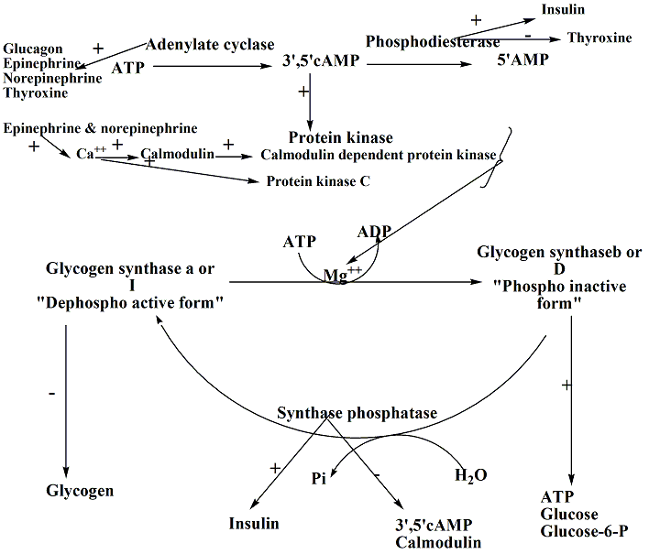

Slide 22
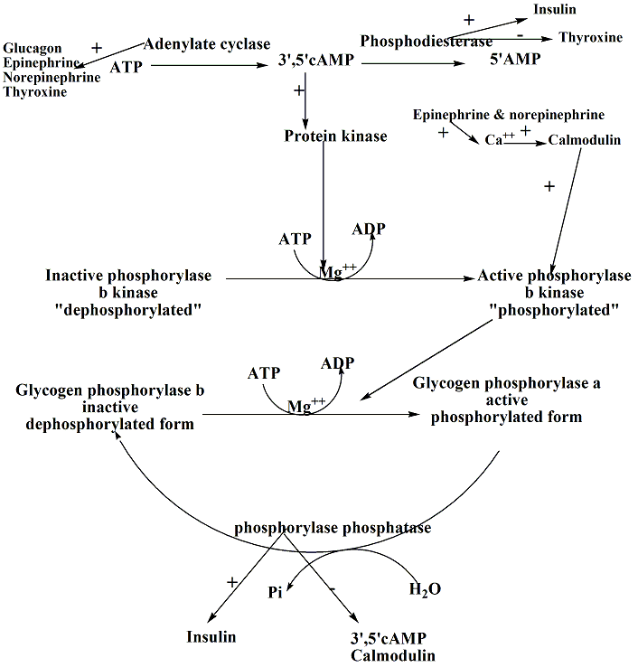

Slide 23
So , during fasting
Fasting →↓blood glucose → stimulate the secretion of glucagon , epinephrine & norepinephrine → activation of adenylate cyclase →formation of 3',5'cAMP from ATP → activation of 3',5'cAMP dependent protein kinase → phosphorylation of both :
Glycogen synthase (directly) → its inactivation, so inhibits glycogenesis.
Glycogen phosphorylase (indirectly through activation of phosphorylase b kinase) → its activation → stimulate glycogenolysis to provide glucose to the blood to maintain normal blood glucose level.

Slide 24
Also epinephrine & norepinephrine increases calcium release from its intracellular stores → binds calmodulin and activates it, active calmodulin will leads to:
  Activation of calmodulin dependent protein kinase → phosphorylation of glycogen synthase → its inactivation, so inhibits glycogenesis.
  Activation of phosphorylase b kinase as it is structural subunit → phosphorylation of glycogen phosphorylase → its activation → stimulate glycogenolysis.

Slide 25
Thyroxine also activates adenylate cyclase & inhibits phosphodiesterase.
3',5'cAMP & calmodulin also inhibit phosphatase whether synthase phosphatase or phosphorylase phosphatase , so no dephosphorylation of glycogen synthase ( so remains inactive) or glycogen phosphorylase (so remains active).

Slide 26
After carbohydrate meal
→↑blood glucose → stimulate the secretion of insulin. Insulin stimulates phosphodiesterase which inactivates 3',5'cAMP by converting it into 5'AMP → inactivation of protein kinase →dephosphorylation of both :
Glycogen synthase (directly) → its activation → stimulate glycogenesis.
Glycogen phosphorylase (indirectly through inactivation of phosphorylase b kinase) → its inactivation, so inhibits glycogenolysis.

Slide 27
Also insulin stimulates phosphatase whether synthase phosphatase or phosphorylase phosphatase , so dephosphorylation of both glycogen synthase ( so remains active) and glycogen phosphorylase (so remains inactive).

Slide 28
Differences between liver & muscle glycogen:
 | Liver glycogen | Muscle glycogen
Source | Glucose, other hexoses (galactose or fructose), non-carbohydrate source (pyruvate, lactate, glycerol & gluconeogenic amino acids). | Only glucose
Amount | 120 gm i.e. 6% of its weight. | 350 gm i.e. 1 % of its weight.
End product of glycogenolysis | Glucose | Lactate as no glucose-6-phosphatase, so glucose-6-phosphate passes into glycolysis.
Function | Maintains normal blood glucose level during early fasting | Provide necessary energy for contracting muscle.
Effects of hormones | Epinephrine, norepinephrine & glucagon stimulate glycogenolysis while insulin stimulates glycogenesis. | The same but glucagon has no effect on muscle glycogen. Glucose has no effect on muscle glycogen phosphorylase

Slide 29
Glycogen storage diseases
"Glycogenosis"

Slide 30
Definition
They are group of hereditary disorders characterized by deposition of abnormal type or quantity of glycogen in tissues as a result of deficiency of one of enzymes involved in glycogenesis or glycogenolysis or phosphofructokinase or lysosomal glycosidases.
Types: 8 types as follow

Slide 31
Type I (Von Gierk's disease):
Due to deficiency of glucose-6-phosphatase leading to deposition of large amount of normal glycogen in :
  Kidneys → nephromegally.
  Liver→ hepatomegally & impaired liver function.
    Fasting hypoglycemia that may leads to hypoglycemic convulsions.
    Ketosis & hyperlipidemia & failure to thrive.
    Hyperuricemia "gout": due to deficiency of glucose-6-phosphatase →↑glucose-6-P→ to HMP→ production of large amount of pentose-5-P → which enters in purine synthesis → catabolism of purine produce large amounts of uric acid.

Slide 32
Type II (Pompe's disease):
Due to deficiency of lysosomal α -1,4 & α -1,6 glycosidases "acid maltases" .
Muscles→ muscle weakness.
Heart→ cardiomegally & death occurs before first year of life from heart failure

Slide 33
Type III (Limit dextrosis, forbe's or cori's disease):
Due to deficiency of debranching enzyme
Type IV (Amylopectinosis or andersen's disease): Due to deficiency of branching enzyme
Type V (McArdle's disease): Due to deficiency of muscle glycogen phosphorylase

Slide 34
Type VI (Her's disease):
Due to deficiency of liver glycogen phosphorylase
TypeVII (Tarui's disease):
Due to deficiency of phosphofructokinase
Type VIII:
Deficiency of phosphorylase b kinase

Slide 35
Gluconeogenesis
Definition:
It is the formation of glucose from non-carbohydrate source e.g.
  3-carbon atoms precursors (glycerol, pyruvate, lactate, propionic acid (in ruminants).
  Some gluconeogenic amino acids.

Slide 36
Biological importance "functions":
1. Gluconeogenesis supply the body with glucose which:
The only source of energy in nervous tissues, R.B.Cs , contracting skeletal muscles.
Provide many important intermediates through TCA cycle in many tissues.
Important in low carbohydrate diet or when liver glycogen is depleted (after 12-18 hours from fasting).
Precursor for glycerol-3-P in adipose tissue (as glycerol kinase is deficient in adipose tissue) & lactose "milk sugar" in mammary glands.
2. Gluconeogenesis clear the blood from waste products of other tissues e.g. lactate produced by the R.B.Cs & contracting skeletal muscles , glycerol produced by the adipose tissue converting them into glucose.

Slide 37
Site:
Intracellular location: Gluconeogenesis occurs partially in the mitochondria & partially in the cytoplasm.
Organ location:
  90% in liver & 10% in the kidneys, since both organs contain all the enzymes of gluconeogenesis.
  It doesn't occur in the skeletal muscles as they are deficient in glucose-6-phosphatase but they can provide glucose to the blood through glucose-alanine cycle.
  It doesn't occur in smooth muscles , heart muscle , adipose tissue as they are deficient in fructose-1,6-diphosphatase.

Slide 38
Steps:
The central comon pathway for gluconeogenesis is the conversion of two molecules of pyruvate into one molecule of glucose.
This occurs by reversal of most of steps of glycolysis i.e. enzymes of glycolysis act in both direction except the three irreversible kinases ( due to thermodynamic barriers) which are replaced by the following enzymes:

Slide 39
Glycolysis | → | Gluconeogenesis
Glucokinase | → | Glucose-6-phosphatase
Phosphofructokinase-1 | → | Fructose 1,6 diphosphatase
Pyruvate kinase | → | Pyruvate carboxylase & phosphoenol pyruvate carboxykinase.

Slide 40
The irreversible reactions are:
1. Pyruvate conversion into phosphoenol pyruvate:
Pyruvate firstly transported into the mitochondria by special pyruvate transporter then it is carboxylated ( CO₂ fixation reaction) into oxaloacetate as follow:

Slide 41
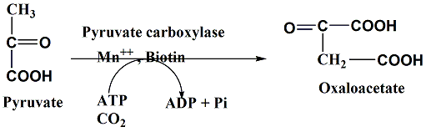

Slide 42
Then the dicarboxylic acid shuttle occurs as follow:
  For the oxaloacetate to be converted into phosphoenolpyruvate by phosphoenolpyruvate carboxykinase , it should crosses the mitochondrial membrane to the cytosol as phosphoenolpyruvate carboxykinase is a cytosolic enzyme but the mitochondrial membrane is impermeable to oxaloacetate , so it will converted to any of the following acids ( malic acid "malate" or α -ketoglutaric acid " α -ketoglutarate "or citrate "citric acid") as follow:

Slide 43
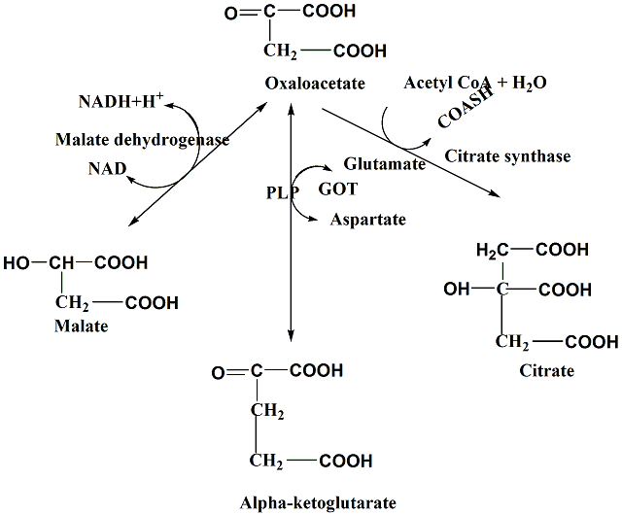

Slide 44
Then these acids can pass through the mitochondrial membrane where they are reconverted into oxaloacetate as follow:
Malate converted into oxaloacetate by malate dehydrogenase.
" α -ketoglutarate converted into oxaloacetate by GOT.
Citrate converted into oxaloacetate by citrate lyase as follow:

Slide 45
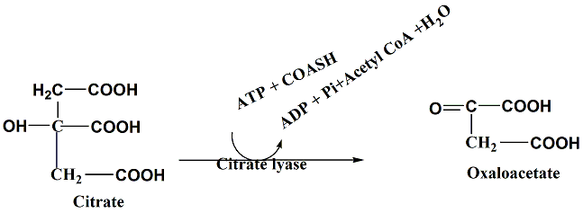
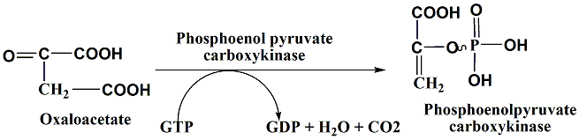

Slide 46
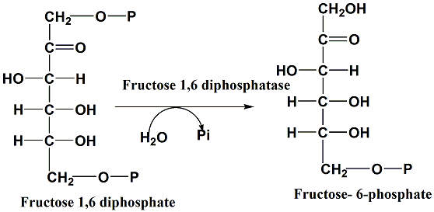
Fructose 1, 6 diphosphate conversion into fructose-1-phosphate as follow:

Slide 47
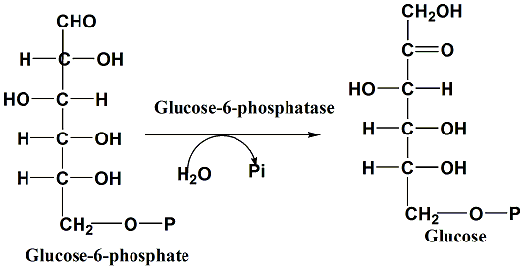
Glucose-6-phosphate conversion into glucose as follow:

Slide 48
So any substrate that can joins this common central pathway of gluconeogenesis can be considered gluconeogenic such as:
Any metabolic intermediates of TCA.
Lactate.
Glycerol.
Propionate "propionic acid".
Some gluconeogenic amino acids.
Acetyl CoA is not a glucogenic substrate as it can’t converted into pyruvate as the reaction is irreversible

Slide 49
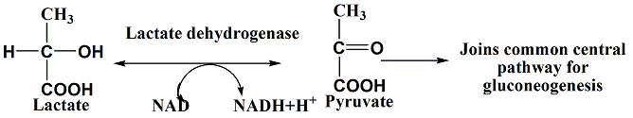
Gluconeogenic pathways:
1. From Lactate:

Slide 50
Cori cycle "lactic acid cycle":
Glucose in the contracting muscles & R.B.Cs undergoes anaerobic glycolysis for production of energy required & lactate which passes to the blood→ liver where it is converted into glucose by gluconeogenesis , then glucose passes to the blood → contracting muscles & R.B.Cs where it undergoes anaerobic glycolysis producing energy & lactate again & so on.

Slide 51
lactic acid (Cori cycle) and glucose-alanine cycles.

Slide 52
Normal lactic acid level in the blood 5-15 mg/dl.
If it is accumulated in the muscles, it causes muscle cramps & fatigue and if accumulated in the blood will leads to life threaten acidosis.

Slide 53
From Glycerol:
Two molecules of glycerol are needed for formation of one glucose molecule as one of the two dihydroxyacetone phosphate will converted to glyceraldehyde-3-P by phosphotriose isomerase as follow:

Slide 54
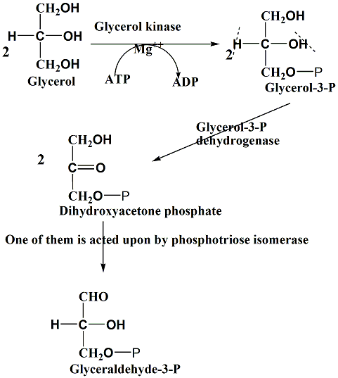

Slide 55
3. From Propionate "propionic acid":
It is major source of glucose synthesized by gluconeogenesis in ruminants.
Sources of propionic acid:
Microfloral fermentation of dietary fibers in the large intestine.
β-oxidation of odd number fatty acids , α -oxidation of phytanic acid.
Methionine , threonine & isoleucine catabolism.
Conversion of cholesterol into bile acids.

Slide 56
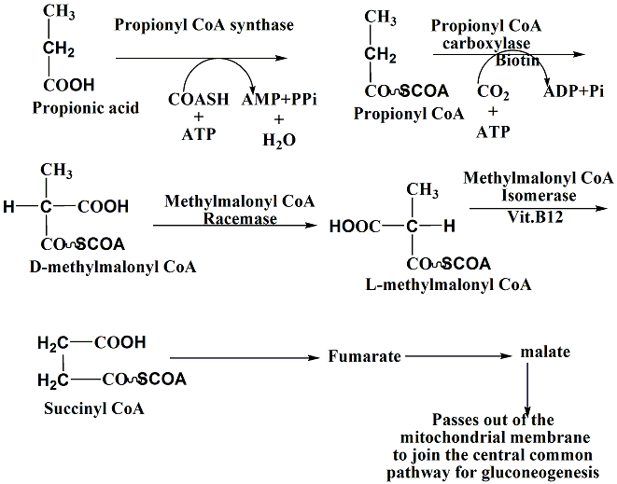

Slide 57
4. From some gluconeogenic amino acids:
This occurs either through transamination or non-oxidative deamination.

Slide 58
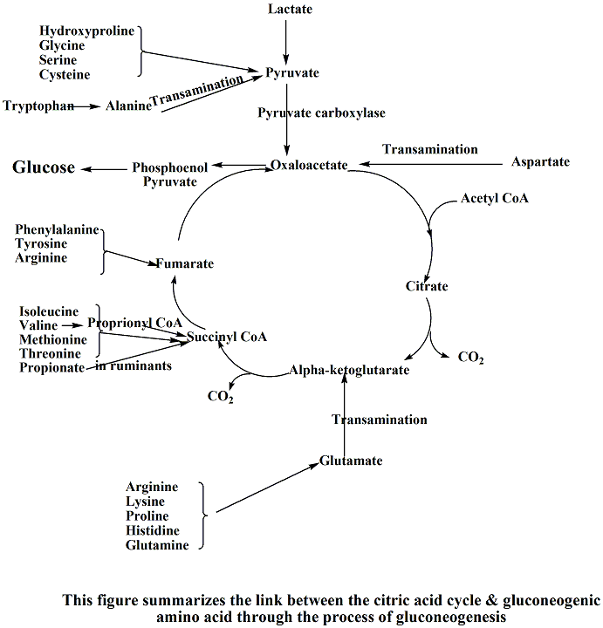

Slide 59
Regulation of gluconeogenesis:
The key regulatory enzymes are:
Glucose-6-phosphatase.
Fructose-1,6-diphosphatase.
Pyruvate carboxylase.
Phosphoenolpyruvate carboxykinase.

Slide 60
1. Hormonal regulation:
Glucagon , adrenaline & noradrenaline→ stimulate gluconeogenesis.
Glucocorticoids e.g.cortisol → stimulate gluconeogenesis through:
a. Induce the synthesis of the key regulatory enzymes of gluconeogenesis.
b. Increase the protein catabolism in the tissues →↑ gluconeogenic amino acids available for the gluconeogenesis.
3. Insulin: Inhibits the gluconeogenesis.

Slide 61
2. Alosteric regulation:
Excess ATP &NADH , citrate & acetyl CoA stimulate gluconeogenesis.
Excess AMP &ADP → inhibit gluconeogenesis.

Slide 62
3. Conditions characterized by active gluconeogenesis:
D.M.
Large doses of ACTH & cortisol.
Cushing's syndrome.
Sever muscular exercise.

Slide 63
Questions
Q1: Tabulate the differences between muscle and liver glycogen.
Q2: Write short notes on :
Glycogen synthase.
Glycogen phosphorylase.
VonGeirk disease.
Q3: Mention the conditions characterized by active gluconeogenesis.
Q4: Outline various gluconeogenic pathways.
Q5: Describe the regulation of gluconeogenesis.

