Slide 1
Medicinal plants
Pharm D PG101

Slide 2
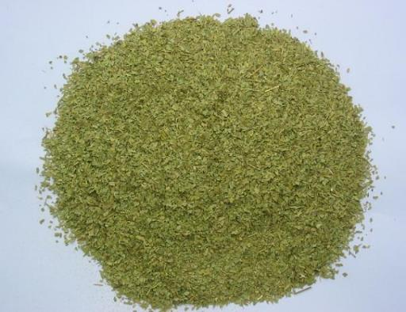
Senna leaf
ورق سنامكى

Slide 3
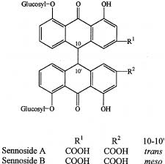

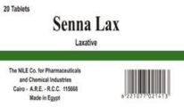
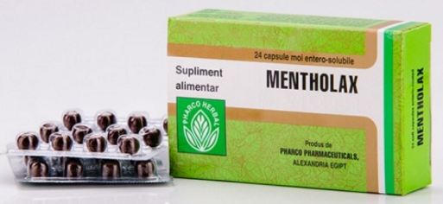

Slide 4
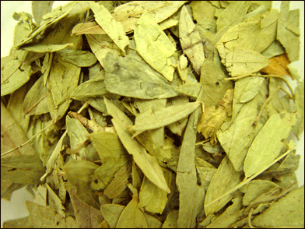

Senna leaf
Origin: dried leaflets of Cassia acutifolia (Alexandrian senna) and Cassia angustifolia (Indian senna) Family Leguminosae

Slide 5
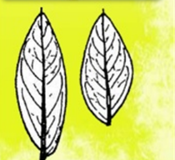
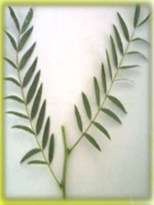
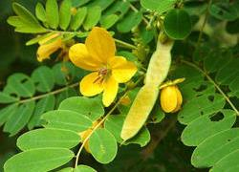
Morphology:
Colour: pale grayish-green
Shape: lanceolate to ovate lanceolate
Margin: entire
Apex: acute
Base: asymmetric
Surface: both are pubescent, small whitish hairs found Especially near the veins.
Odour: slight
Taste: mucilagnous, bitter &unpleasant.

Slide 6
:Surface preparation
1- Epidermis
Epidermal cells have straight walls have paracytic stomata on both surface in the same number and may contain mucilage which stain red with ruthenium red reagent.
2- Hairs
Non glandular unicellular, conical in shape, covered with thick warty cuticle and curved near the base.

Slide 8
Micromorphology:
T.S diagram:
The leaf is isobilateral, The midrib vascular bundles are collateral v.b , surrounded by a zone of lignified pericyclic fibers and a sheath of parenchymatous cells containing prisms of calcium oxalate. The midrib is biconvex below the midrib bundles.

Slide 9
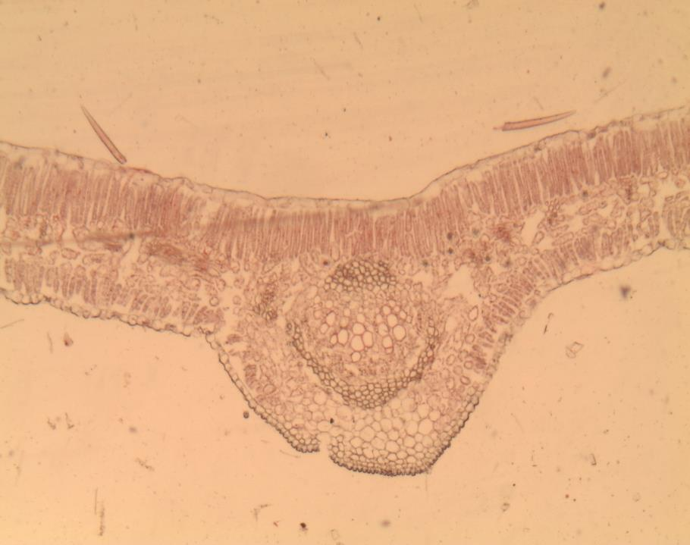

Slide 10
T.S detailed in the Lamina:
Epidermis:
Tabulate flattened cells without intercellular spaces. Epidermal cells contain mucilage and bear unicellular warty hairs.
B) Mesophyll:
Palisade tissue: The lamina is isobilateral having a single palisade layer under each epidermis, the palisade cells is more elongated than that of the lower epidermis.
Spongy tissue: Parenchymatous with clusters of Ca.OX.

Slide 11
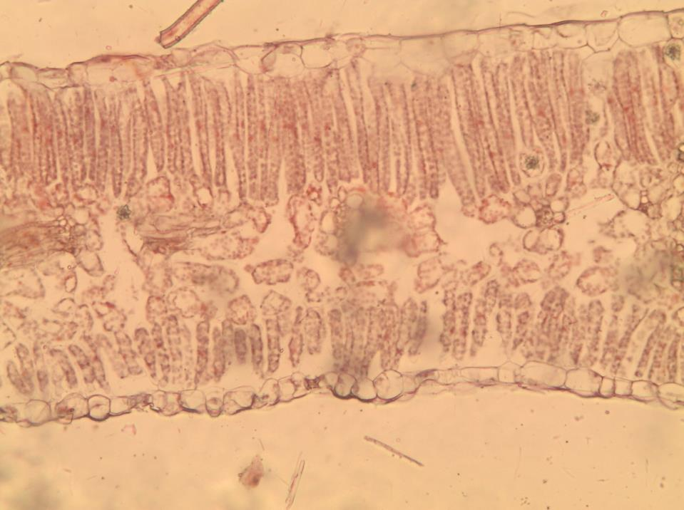

Slide 12
T.S detailed in the Midrib region:
1) Epidermis.
2) Palisade layer: is continues over the vascular bundle but absent on the underside.
3) Vascular bundles: Consists of radiated xylem and phloem with an arc of pericyclic fibers below and compact mass of sclerenchyma above.
4) The pericyclic fibers are surrounded by parenchyma cells containing prisms of calcium oxalate constituting the crystal sheath.

Slide 13
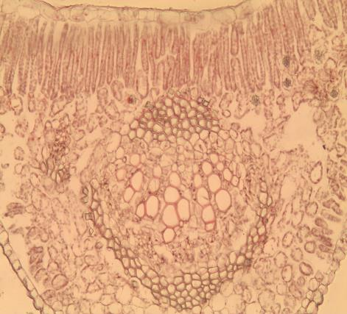
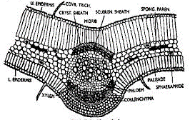
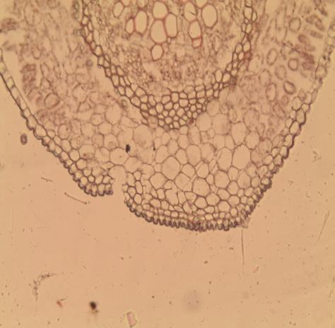

Slide 14
Powder
Physical characters
Colour: yellowish-green Odour: characteristic
Taste: bitter & mucilagenous
Microscopical character
1- Fragment of upper &lower epidermis.
2- Trichomes
3- Calcium oxalate crystals occur as prism in the parenchma cells surrounding groups of pericyclic fibers forming crystal sheath.
4- Palaside cells
5- Xylem vesels
6- Calcium oxalate prisms.

Slide 15
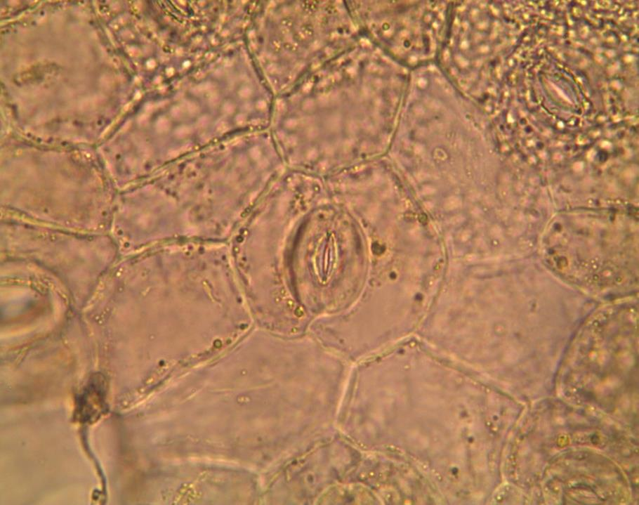

Slide 16
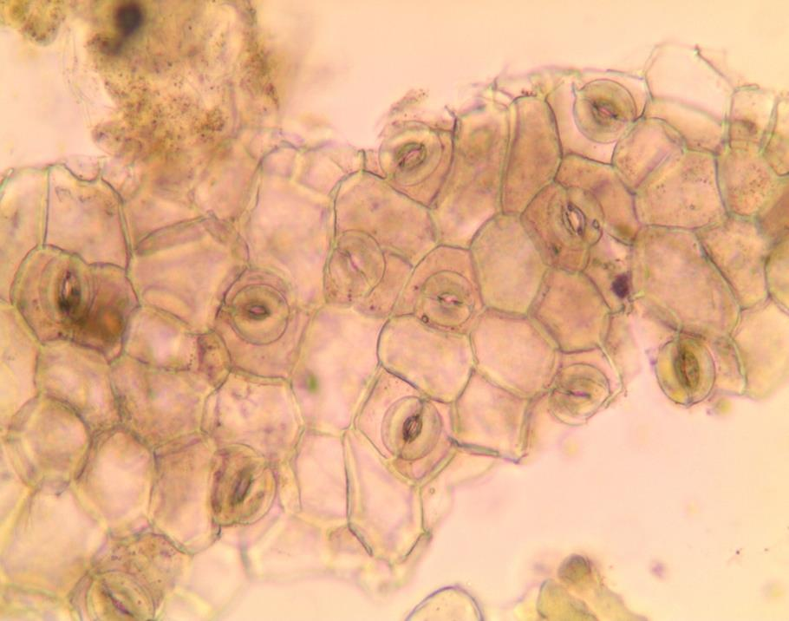

Slide 17
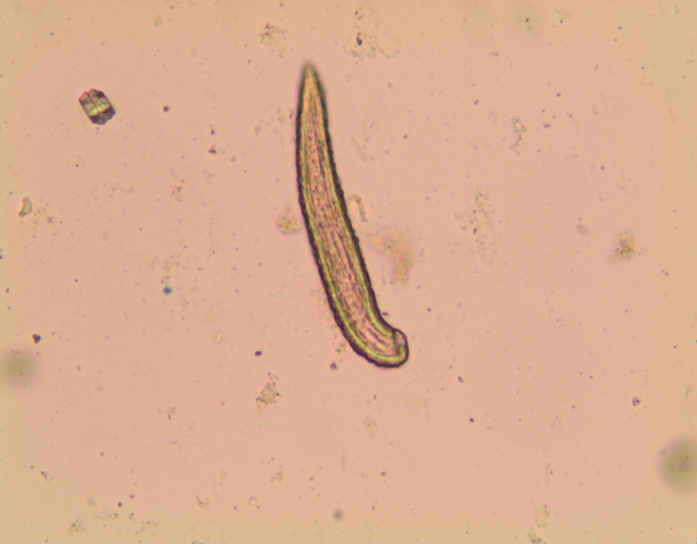

Slide 18
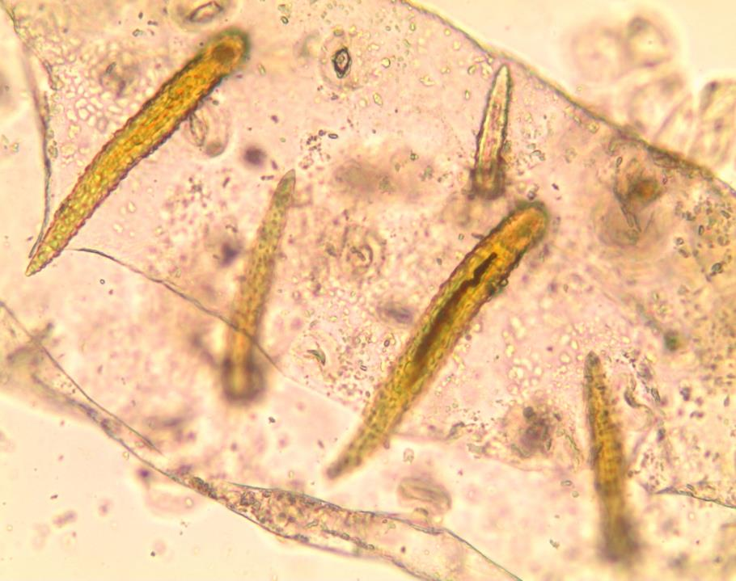

Slide 19
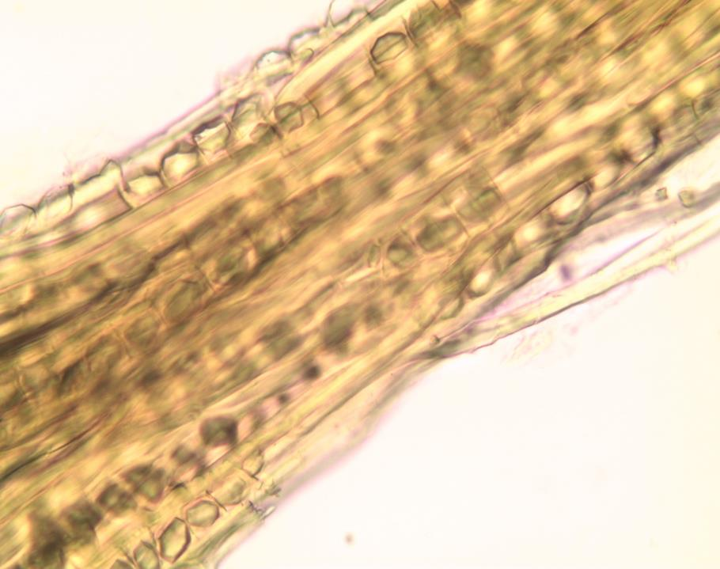

Slide 20
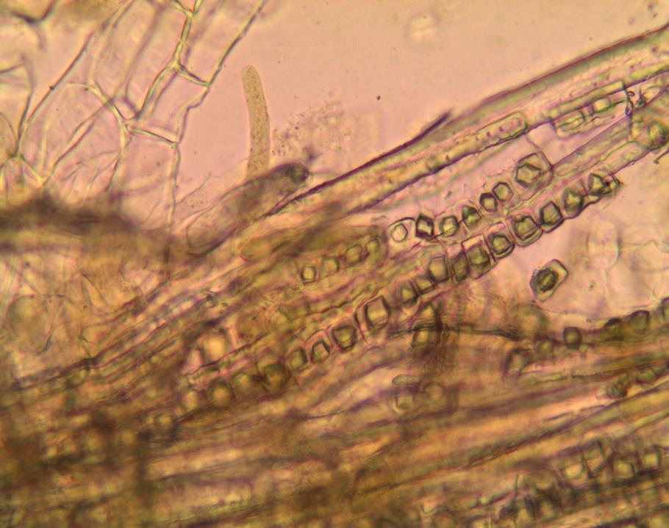

Slide 21
Test for anthraquinone derivatives
Boil the powder with alcoholic potassium hydroxide for about 3 minutes.
Dilute with water and filter. Acidify the filtrate with dilute hydrochloric acid, cool and shake well with ether.
Separate the ether layer in a clean test-tube and shake with dilute ammonia.
Rose red colour in the aqueous layer is produced.

Slide 22
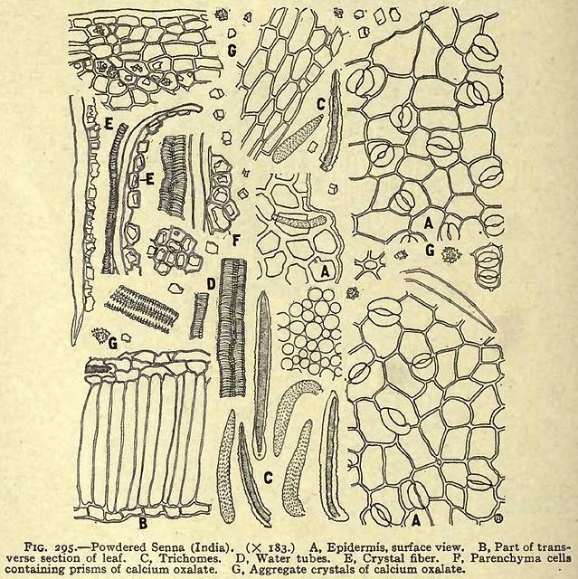

Slide 23
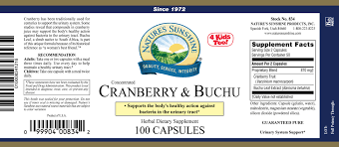
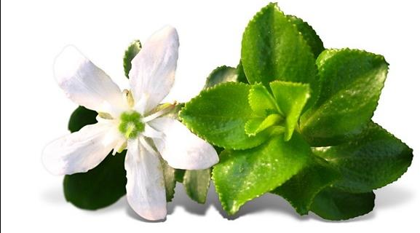
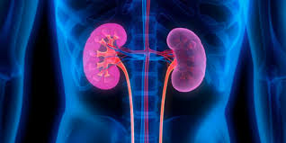
Buchu leaf
Origin: dried leaves of Barosoma betulina(round buchu) Barosoma crenulata (oval buchu) Barosoma serratifolia (long buchu) family Rutaceae

Slide 24
Morphology:
Colour: green to pale green
Shape: rhomboidal
Taste: aromatic(due to volatile oil)
Odour: aromatic(due to volatile oil)
Margin: dentate toward apex & serrate toward base
Base: symmetric
Apex: recurved & blunt
Surface: glabrous& punctate (due to schizolyzogenous)
Petiole: very short petiole

Slide 25
Surface preparation
1- Upper epidermis
Formed of large polygonal cells with moderately thickened which show pitting or beading, stomata are absent.
The cells contain spherocrystals of diosmin which is sol. In KOH giving yellow (spherical larg crystal.

Slide 26
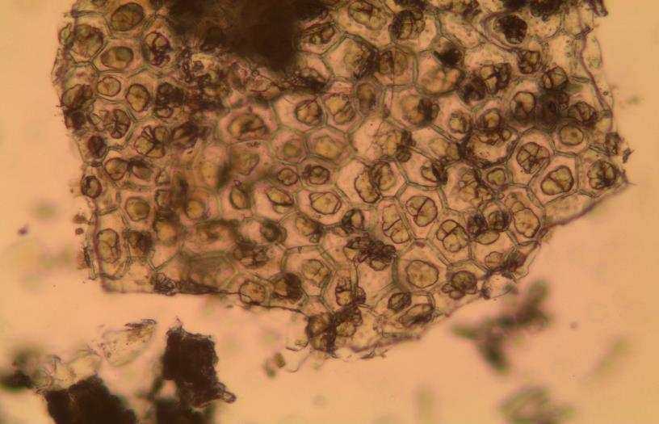

Slide 27
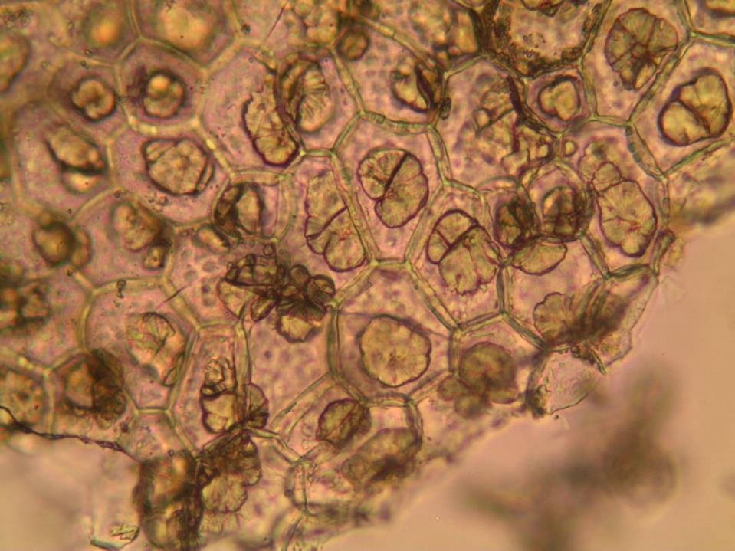

Slide 28
2- lower epidermis
The cells are small, more irregular & the walls are thin & not beaded.
Having numerous anomocytic stomata
3- Hairs
Unicellular non glandular, conical in shape & covered with warty cuticle

Slide 29
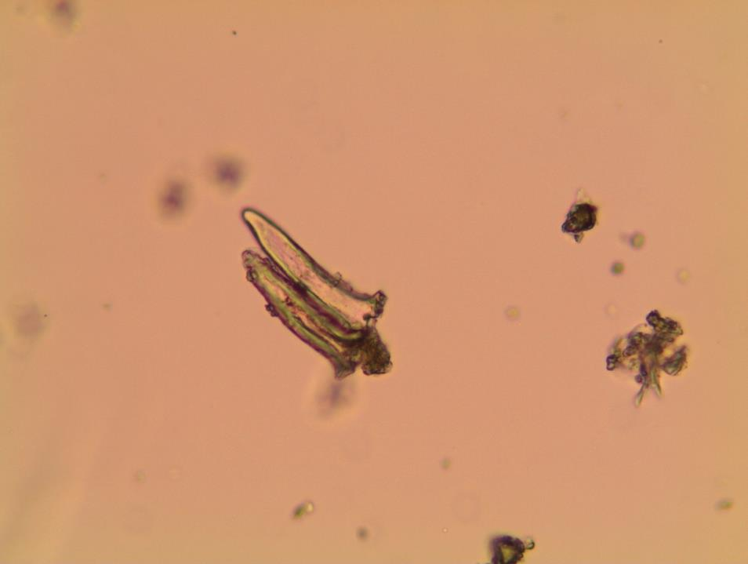

Slide 30
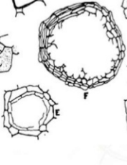
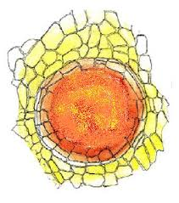
Powder
Physical characters:
Colour: yellowish green
Odour: aromatic
Taste: aromatic
Microscopical character
1- fragment of upper &lower epidermis.
2- trichomes
3- fragment of schizo-lyzogenous gland surrounded by parenchma
4- palaside cells
5- xylem vessels
6- Calcium oxalate

Slide 31
