Slide 1
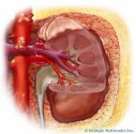
Renal herbal tea

Slide 2
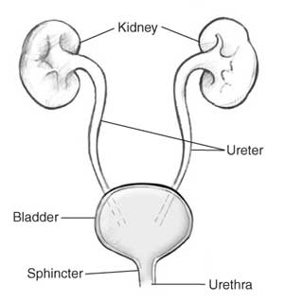
The urinary system

Slide 3
The pattern of disorders of urinary system
Urinary tract infection
Urinary Stones
Renal colic
Cystitis
Renal stones
Urethritis
Ureter stones
Pyelitis
Bladder stones

Slide 4
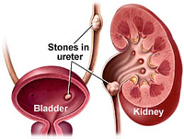

Slide 5
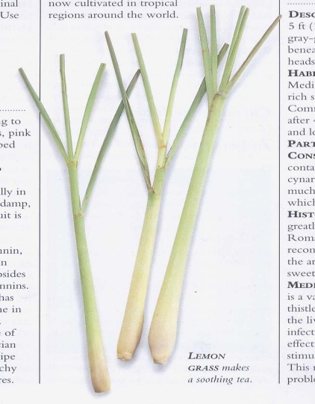
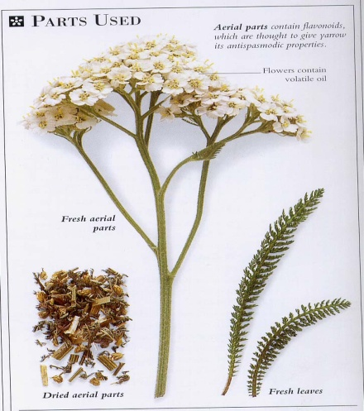
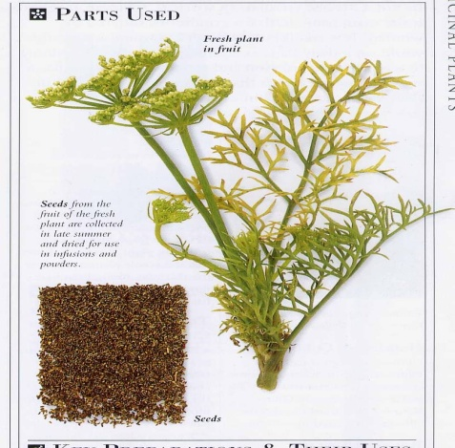
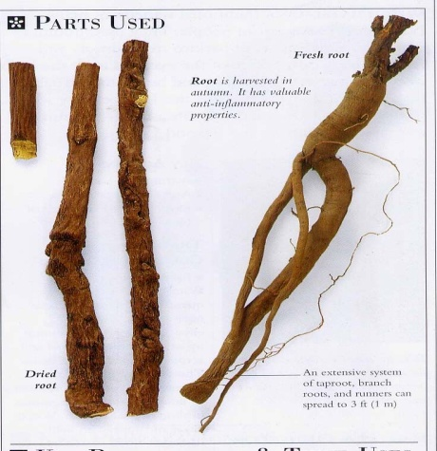
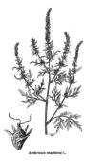
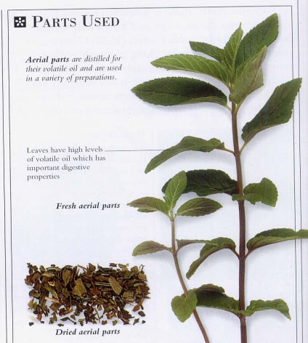
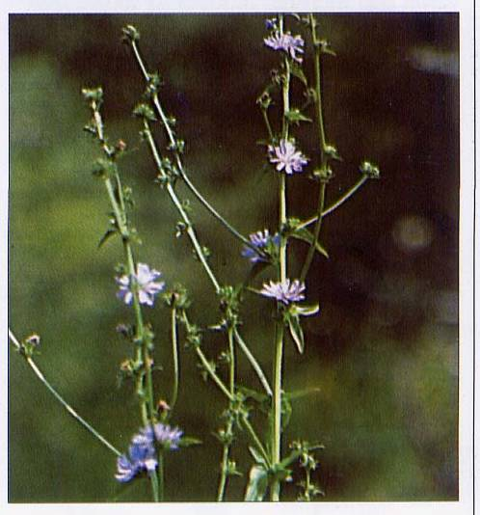
Renal herbal tea

Slide 6
Composition of renal herbal tea :
Each 100g contains:
Ammi visnaga fruits 20g
Cymbopogon leaves 20g
Achillea leaves 5g
Chicory leaves 5g
Peppermint leaves 20g
Ambrosia leaves 10g
Liquorice roots 20g

Slide 7
Ammi visnaga fruits
Origin : Ammi visnaga Family: Umbelliferae

Slide 8
Active constituents :
1) Furanochromones including Khellin , Visnagin and Khellol glycosides. 2) Flavanoids. 3) Sterols.

Slide 9
Main actions of Ammi visnaga
Khellin and visnagin are responsible for the smooth muscle relaxant action on the urinary tubules , so it help expelling stones .

Slide 10
Cymbopogon leaves (Half bar)
Origin: Cymbopogon proximus Family: Graminae

Slide 11
Active constituents:
1) Volatile oil mainly proximol 2) Sesquiterpenes. 3) Triterpenes. 4) Flavanoids.
Main actions and uses:
It has a smooth muscle relaxant action , so used for renal colic and for removal of uretric calculi.

Slide 12
Achillea leaves ( Yarrow )
Origin : Achillea millefolium Family: Compositae

Slide 13
Constituents :
0.5% volatile oil (containing up to 51% of the blue oil azulene )
lactones, cyanogenic glycosides .
flavonoids .
saponins, glycoalkaloid (achilleine) and resins .

Slide 14
Main action and uses of Yarrow in the renal herbal tea:
Yarrow has an antispasmodic , diuretic , antiseptic and anti-inflammatory action and so that it can be used in cases of urinary tract infections and renal colic.

Slide 15
Chicory leaves
Origin: Cichorium intybus Family: Compositae

Slide 16
Active constituents
Inulin (a polysaccharide)
Fructose
Lactucin and lactucopicrin (producing sedative effects and antagonising stimulant properties of caffeine)
Tannin
A fatty acid and volatile oil

Slide 17
Action and uses of Chicory
- Cleansing of urinary tract and so used in case of urinary tract infections.

Slide 18
Peppermint leaves
Origin: Mentha piperita Family: Labiatae

Slide 19
Active constituents
1) Volatile oil including menthol and menthone. 2) Flavanoids. 3) Tannins. 4) Triterpenes.

Slide 20
Main action of Peppermint
1) Carminative. 2) Antispasmodic. 3) Stimulate bile secretion. 4) Antiseptic and astringent.

Slide 21
Liquorice root
Origin: Glycyrrhiza glabra Family: Leguminosae

Slide 22
Constituents :
glycosides called glycyrrhizin (about 7%) and glycyrrhizinic acid, triterpenoid glycosides (saponins)
flavonoids
oestrogenic substances (including beta-sitosterol ).

Slide 23
Main action and uses of Liquorice in renal herbal tea:
Acts as anti-inflammatory , demulcent and soothing herb in case urinary tract infections.

Slide 24
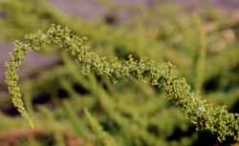
Ambrosia maritima (Damsisa)
Origin: Ambrosia maritima Family: Compositae

Slide 25
Active constituents of Ambrosia:
1) Sesquiterpene lactones including Damsin and ambrosin. 2) Flavanoids: Apigenin. 3) Volatile oil mainly composed of , Cineole, Carvone , Camphor and Camphene.

Slide 26
Main actions and uses of Ambrosia
1) Inhibit the force and frequency of the smooth muscle contraction , so it aids relaxation of the of intestine , uterus and ureter ( Relaxation of ureter aids in stones passage). 2) It has an antimicrobial activity towards Streptococcus pyogens , Pseudomonas aeroginosa , Klebsiella sp. , and Aspergillus sp., So that it can be used against several infections including urinary tract infection.

Slide 27
Thank you

