Slide 1

بسم الله الرحمن الرحيم

Slide 2
Non-Lactose fermenter
salmonella

Slide 3
They are normal inhabitants of the intestine but some can cause diseases.
Morphology:
Gram negative bacilli, motile with peritrichous flagella, non-capsulated.
culture:
Aerobic and facultative anaerobes
Grow rapidly on simple media at 37°C
Resistant to certain chemicals (e.g. brilliant green, Na tetrathionate and Na deoxycholate) that inhibit other bacteria so used for isolation of salmonella from stool samples.
On MacConkey's agar and DCA they produce pale yellow non-lactose fermenting colonies.
On Bismuth sulphite agar: brown to black colonies.
On TSI; S. typhi and S. paratyphi B produce H2S (black butt and alkaline slant).

Slide 4
Biochemical reactions:
Ferment glucose. Do not ferment lactose or sucrose.
Catalase +ve. Indole, urease and oxidase –ve.
sugar fermentation reactions are used to differentiate species
Antigenic structure:
Somatic(O)antigen occur on the surface of outer membrane and is determined by specific sugar sequences on the cell surface
Surface (capsular/ Vi) antigen
Superficial antigen overlaying the O antigen (additional surface antigen)
Protects the organism from phagocytosis and bactericidal effect of drugs.
The antigen occurs in only three Salmonella serovars (out of about 2,200): Typhi, Paratyphi C, and Dublin. Strains of these three serovars may or may not have the Vi antigen.
Surface antigens in Salmonella may mask O antigens, and the bacteria will not be agglutinated with O antisera (removed by heating or centrifugation to unmask O antigen).

Slide 5
Flagellar (H) Antigens:
A few Salmonella strains produce flagella which always have the same antigenic specificity. Such an H antigen is called monophasic.
Most Salmonella serovars, however, can alternatively produce flagella with two different H antigenic specificities. The H antigen is then called diphasic.
Phase 1 is the specific one (unique for each serotype) while phase 2 is group or non specific (shared by most serotypes)
Phase 1 is designated by a,b,c,d…..etc
Phase 2 is designated by 1,2 …. etc

Slide 6
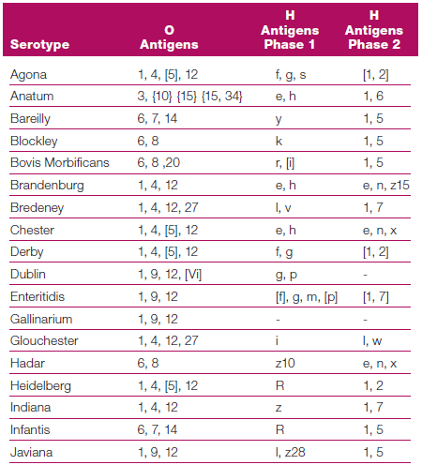
Once the O, H-phase 1, H-phase 2 are identified , the antigenic formula are used to identify the serotype by referring to Kauffman-white reference catalog as followed:
O antigens, VI (when present), H antigens phase 1, H antigens phase 2 (when present)
Ex: salmonella enterica serotype Virchow : 6,7,14:r:1,2
See table for further examples

Slide 7
enteric fever (Typhoid and Paratyphoid)
Typhoid fever is endemic in Egypt, and is caused by S. typhi. S. Paratyphi A, B and very rarely C cause paratyphoid.
Mode of transmission and pathogenesis:
The organism is acquired orally (from the stools or urine of cases or carriers).
It multiplies in the intestine then it passes to the blood stream causing bacteremia for one week (fever).
Then pass to liver and kidney to be excreted in stool in urine from the second week and onward.
After recovery, some individuals continue to carry salmonella in gall bladder as convalescent or chronic carriers and the organism is intermittently excreted in the stools.
The organism may be carried in the urinary tract.
Such individuals should not work as food handlers.

Slide 8
Diagnosis of Enteric Fever (Typhoid)
1. Diagnosis of enteric fever case:
It depends on the stage of the disease and can be done by:
I. During the first week (the organism is isolated from the blood):
The organism is found in the blood during the 1st week
Sample: Is blood for culture.
1. Blood culture:
* It is done by adding 5-10 ml of blood to 50-100 ml of bile salt broth which is incubated at 37°C.
* Subcultures are made on:.
MacConkey's agar they produce pale yellow non-lactose fermenting colonies.
Bismuth sulphite agar (selective): brown to black colonies due to reduction of sulphite to sulphide.
2. Film from the culture: Gram negative bacilli, motile, non-capsulated.

Slide 9
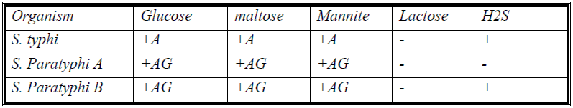
Biochemical reactions to identify isolated organism:
sugar fermentation:
Oxidase, indole and urease negative. Reduce nitrate to nitrite.
Serological identification of isolated organism by slide agglutination with anti-salmonella sera.
II. In the second week and onward:
Samples: are stool and urine for isolation of the organism and serum for serological diagnosis.
a. Isolation of the organism:
1. Isolation from stools:
The organism is found in the stools throughout the course of illness but is most readily isolated from stools during the second and third week of illness.
A stool sample is inoculated into tubes of selenite F broth and tetrathionate broth (enrichment media) to inhibit the normal intestinal flora and incubated at 37C overnight.
Subculture on MacConkey.

Slide 10
2. Isolation from urine:
The organism appears in urine from the second week onwards. It is centrifuged and deposit is cultured on MacConkey, DCA and bismuth sulphite agar.
b. Serological diagnosis:
Widal test:
It is a tube dilution agglutination test that detects antibodies in the serum of the patient that appear during the second week of illness and reach maximum titer during the 4th week.
Procedures:
Serial dilutions of the patient's serum (1/20, 1/40, 1/80, 1/160... etc) are made in sets of test tubes.
To each set add a suspension of O Ag of S.typhi and then H antigens of the different salmonella.
Tubes are incubated, and then examined for presence of agglutination with the different suspensions.
The highest dilution of the serum which gives agglutination is the end titre.

Slide 11
Interpretations of the Widal test:
Two serum samples separated by 10 days should be tested. The detection of a "rising titre" in the second serum sample indicates active enteric fever.
If only one serum sample is available, we should consider the following:
High titre of O and H (>1/160) or rising titre indicates recent active infection. Note that O antibodies disappear faster than H antibodies.
High titres of H only (> 1/160) suggest past infection or past vaccination.
If the test is done during the first week; it gives false negative results as the antibodies start to appear during the second week and onward.
Titres below 1/80 are of no significance because typhoid fever is endemic in Egypt and this may indicate previous subclinical infection.
Early antibiotic treatment lowers the antibody titer due to reduction of the antigenic mass.
Non-enteric infections by e.g. other salmonella or autoimmune diseases may cause a non-specific rise of antibody titer due to the presence of cross-reacting antibodies.of the serum which gives agglutination is the end titre.

Slide 12
ELISA and immunoblot tests are more sensitive and specific and replaced the Widal.
2. Diagnosis of carriers
We give a cholagogue to empty the gall bladder (where the organism is present) followed by a saline purge. Then we take a stool sample for isolation and identification of the organism (as described above)
Urinary carriers are diagnosed as mentioned in a case.

Slide 13
shigella

Slide 14
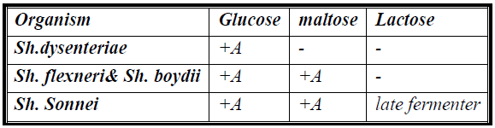
Members of genus Shigella (more than 45 O antigen based serogroups) cause bacillary dysentery/ shigellosis.
Stools contain blood, mucous and pus. Human is the only reservoir of the organism
Morphology:
G –ve bacilli, non motile and non capsulated.
Cultural characters:
Aerobic and facultative anaerobes.
Enrichment media (selenite F broth and tetrathionate broth) are used for their isolation from stool samples.
On MacConkey's agar plates they give non lactose fermenting colonies.
On TSI they produce acid butt and alkaline slant without H2S or gas production.
Biochemical reactions:
Species are differentiated according to fermentation of lactose and maltose:

Slide 15
Virulence factors:
The organism invades the mucosa of the distal ileum and colon. Microorganism does not invade the blood stream i.e. infection is limited to the gastrointestinal tract without blood invasion.
Shiga toxin produced by Sh. dysenteriae type 1. Heat labile exotoxin that has 3 activities: enterotoxic, cytotoxic and neurotoxic.
Enterotoxin: causing the diarrhoea similar to that caused by E. coli verotoxin
Cytotoxin: inhibit protein synthesis
Neurotoxin: causing meningitis and coma in severe fatal infections with Sh. dysenteriae.
Endotoxin: contributes to the irritation of the bowel wall.
Mode of transmission:
By the faecal-oral route. Infective dose is as low as 103 organisms.
The four F’s -fingers, flies, food, and faeces- are the main factors in transmission.

Slide 16
Diagnosis of bacillary dysentery or shigellosis:
Sample:
Fresh stool, mucus flecks and rectal swab.
Macroscopic examination:
Stool contains mucous and blood.
Microscopic examination:
Gram –ve bacilli, non-motile, with pus and RBCs.
Culture:
Stools samples are inoculated selenite and tetrathionate broth, then Subcultures are on:
MacConkey's agar or DCA: pale yellow colonies
Biochemical reactions:
Ferment sugars with acid production only. Sugar fermentation reactions are used to differentiate species.
Serologically by agglutination with specific antisera.

Slide 17
Prevention:
- No vaccine is available.
- Proper sewage disposal, chlorination of water, and personal hygiene (hand washing by food handlers).
treatment:
- The main treatment is restoration of the fluid and electrolyte balance.
- Ciprofloxacin is the drug of choice.

Slide 18
THANKS
FOR ATTENTION

