Slide 1



Slide 2
Culture media

Slide 3
Selective media: these media contain substance (chemicals, dyes or antibiotics) that inhibit all but a few types of bacteria. They facilitate the isolation of a particular species from a mixed inoculum
Lowenstein Jensen medium (L-J): used for cultivation of M. Tuberculosis. It is composed of beaten egg, mineral salts and malachite green which inhibits other types of bacteria. It is sterilized by inspissation at 80°C for 1 hr and dispensed in screw capped bottles to avoid drying during incubation (TB grow after 2-8 weeks).

Slide 4
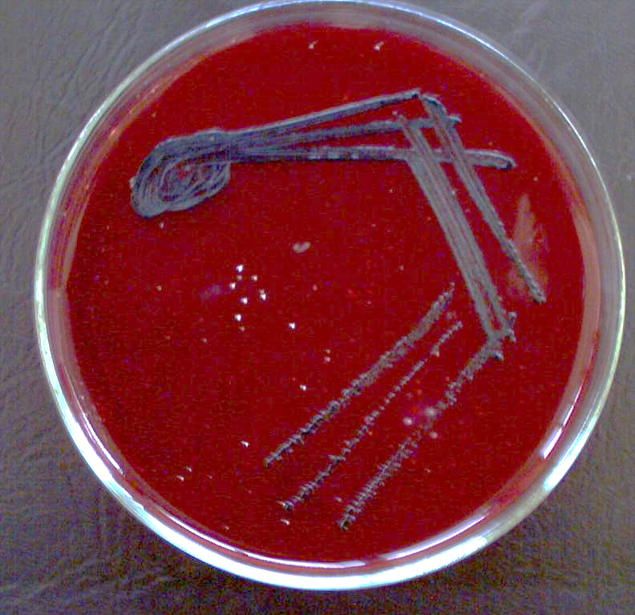
Blood tellurite: it is a blood agar to which potassium tellurite (selective substance) is added in a concentration of 0.03%. it is sterilized as blood agar. It is used for the isolation of C. Diphtheriae which appears as black colonies due to reduction of tellurite to tellurium

Slide 5
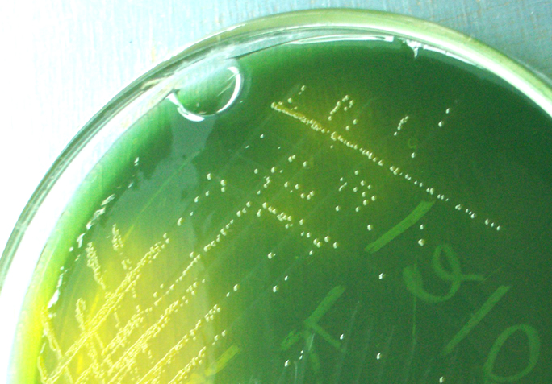
T.C.B.S (thiosulphate citrate bile salt sucrose) agar: it is a (selective indicator medium) and used for the isolation of Vibrio Cholera. It contains thiosulphate, citrate and bile salt as selective substance. It also contains sucrose as test sugar, thymol blue and bromothymol blue as mixed indicator that give yellow color in acidic pH. Vibrio Cholera produces yellow colonies due to fermentation of sugar and acid production. It is sterilized by Tyndallization

Slide 6

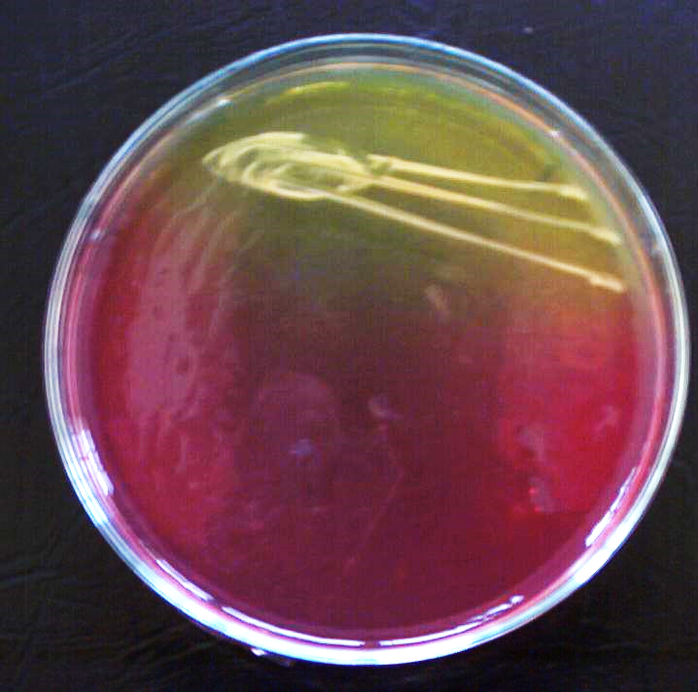
Mannitol salt agar: it is a (selective indicator medium) and used for the isolation of staph. Aureus from contaminated specimens. It contains high salt concentration (about 10% NaCl) as selective substance and phenol red as indicator. It also contains mannitol as test sugar. staph. Aureus produces yellow colonies due to fermentation of sugar and acid production. It is sterilized by Tyndallization or autoclaving . pH of medium = 7.4

Slide 7
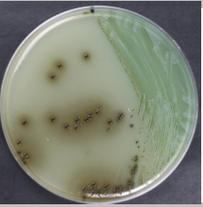
Bismuth sulphite: it contains Bismuth sulphite as indicator and brilliant green as selective substance. It is sterilized by steaming or boiling water bath. It is used for isolation of salmonella which appear as colonies with black center, light edges surrounded by black precipitate with metallic lustre (fish eye)

Slide 8
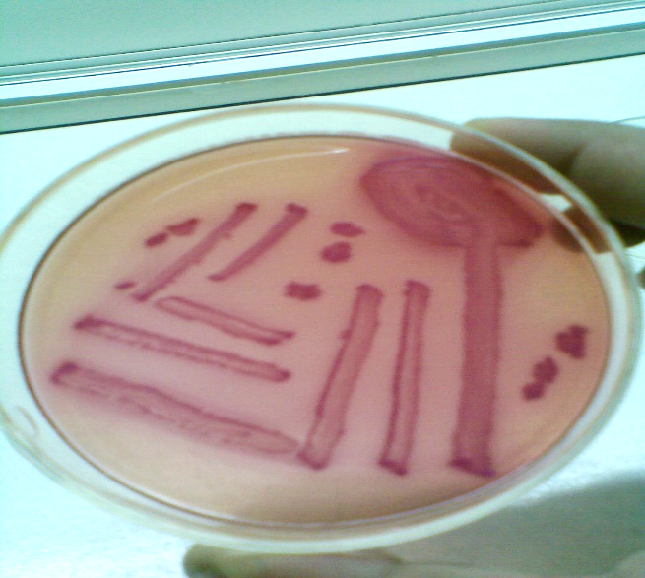
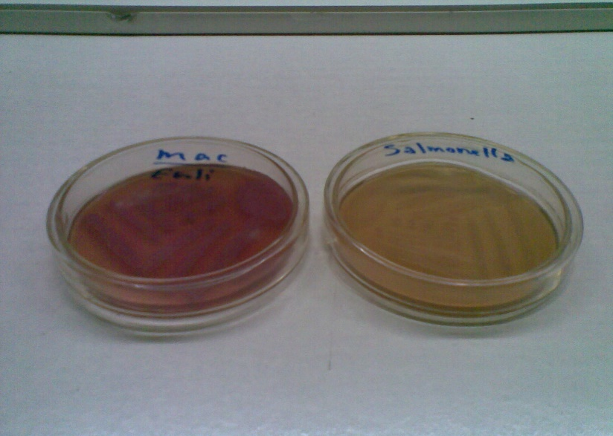
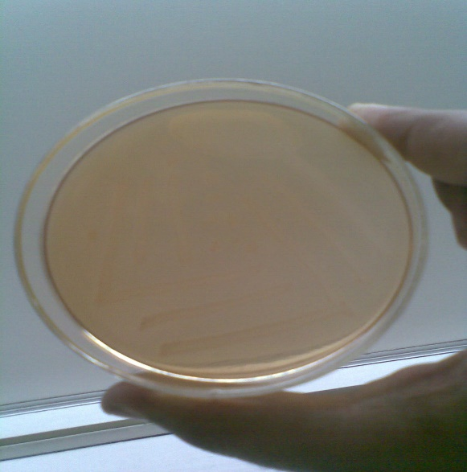
Differential (indicator) media:
MacConkey agar: it is useful for the cultivation of enteric bacteria. It is composed of peptone as a nutrient, lactose as a test sugar and neutral red as an indicator which turns pink in acidic environment created by lactose fermentation. It also, contains bile salts as selective agent that inhibit non-intestinal bacteria. It is a differential medium as it can differentiate between two gr. Of enteric bacteria, lactose fermenters which give pink colonies like E-Coli and Klebsiella and non-lactose fermenters which give pale yellow colonies like salmonella and shigella. It is sterilized by Tyndallization or autoclaving.

Slide 9
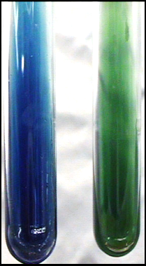
Simmon´s citrate medium: it contains sodium citrate and bromothymol blue as an indicator and used to test the ability of organism to utilize citrate as a source of carbon. E-Coli is citrate -ve and gives green color while Klebsiella is citrate +ve and gives deep blue color due to alkalinization of the medium as a result of citrate utilization. It is sterilized by autoclaving

Slide 10
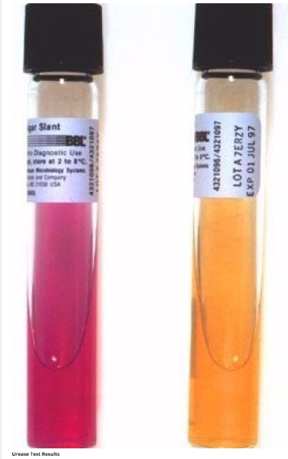
christensen´s urea medium: it contains phenol red as indicator and urea solution. It is prepared by suspending about 20 g of powdered medium in 1 liter of distilled water and autoclaving it. The medium is then cooled to about 55°C and 50 ml of filter sterilized 40% urea solution is added and then slant tubes are prepared. pH of medium = 6.8. It is used to detect urease +ve organisms like proteus and klebsiella through the hydrolysis of urea into CO₂ and NH₃ that changes the color of indicator from yellow to purple

Slide 11
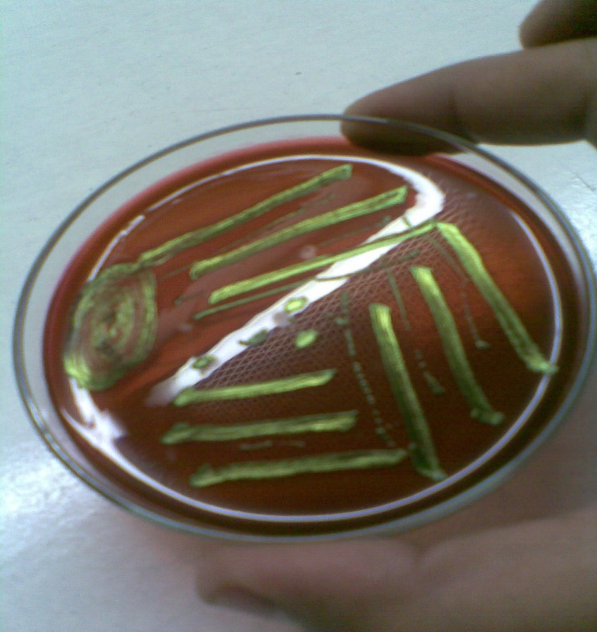
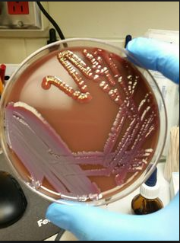
eosin methylene blue (EMB): it contains lactose, sucrose and mixture of eosin and methylene blue. It is sterilized by Tyndallization or autoclaving. It is used to differentiate between E-Coli (greenish metallic sheen in reflected light) and Klebsiella (pink mucoid large colonies)

Slide 12
Triple Sugar iron (TSI): it contains 0.1% glucose, 1% lactose, 1% sucrose, iron salt (ferric citrate) and phenol red indicator, peptone, yeast extract, sodium thiosulfate and low concentration of agar 0.5% (soft agar cracks on gas production). pH of medium = 7.4. it is sterilized by Tyndallization or autoclaving and poured in test tubes in the form of slant with deep butt. Degradation of sugar and acid production are detected by color change from red orange to yellow. On alkalinization, it becomes deep red. Thiosulphate is reduced to hydrogen sulfide by certain bact. Species which reacts with iron salt to form black iron sulphide.
Bacteria with no carbohydrate fermenting activity will give red slant and red butt like (pseudomonas aeruginosa)
Bacteria that ferment lactose and sucrose will release large amount of acid and give yellow slant and yellow butt with gas at the bottom like (E-Coli, Klebsiella and Citrobacter).
Bacteria that ferment glucose only will release small amount of acid and give red slant and yellow butt like (Shigella) but with gas observed at the bottom like (Salmonella para. A)
Bacteria that ferment glucose only with H₂S production will give red slant and black butt like (Salmonella typhi) but with gas observed at the bottom like (Salmonella para. B and some Proteus species that produce copious H₂S)

Slide 13
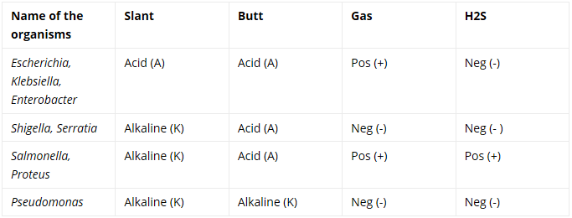
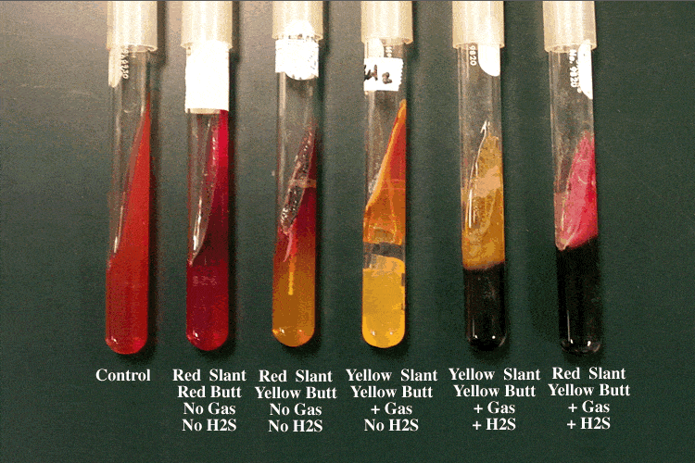

Slide 14
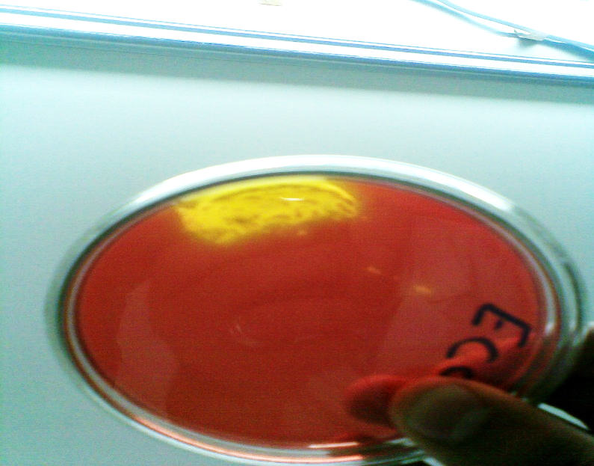
Xylose lysine deoxycholate: it contains the sugars: xylose, lactose, sucrose, l-lysine, ferric ammonium citrate, bile salt and phenol red indicator. It is used for primary isolation of salmonella and shigella.
Red colonies are produced by non-lactose fermenter like salmonella and shigella
Red colonies with black center are produced by H₂S producing organism like salmonella typhi
Yellow colonies are produced by lactose fermenter like E-Coli, Klebsiella and Citrobacter

Slide 15
Enrichment media: they are fluid media containing substances that stimulate the growth of some organisms and inhibit the growth of others
Selenite F broth and tetrathionate broth are used for isolation salmonella and shigella
Sugar media: the media consist of 1% sugar (any fermentable substances like glucose, lactose, sucrose and mannitol) in peptone water along with appropriate indicator (andrade´s indicator- 0.005% acid fuchsin in NaOH). A small tube (Durham´s tube) is kept inverted in the sugar tube to detect gas production. The color of media is light yellow which turns pink on acid production as a result of sugar fermentation.

Slide 16
Anaerobic culture media:
Thioglycolate broth: contains reducing agents like sodium thioglycolate, glucose, vit C, cysteine, and agar 0.05% with methylene blue or resazurin. The reducing agents create an anaerobic environment deeper in the tube while the agar prevents convection currents of air. methylene blue or resazurin act as oxidation reduction potential indicator which should show that the medium is anaerobic except in the surface layer
robertson´s cooked meat medium: It contains nutrient broth and pieces of fat free minced cooked meat of ox heart. Meat particles are placed in 30 mL bottles to a depth of about 2.5 cm and covered with about 15 mL broth. The meat contains reducing agents like hematin and glutathione which maintain the anaerobic condition

Slide 17
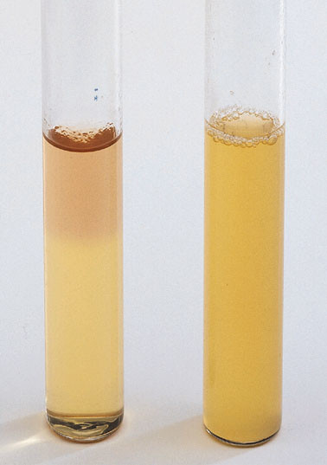
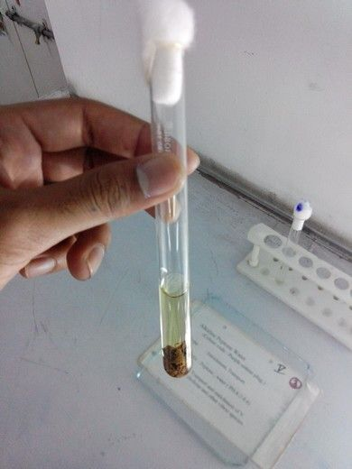

Slide 18
THANKS
FOR ATTENTION

