Slide 1
Phytochemistry 2 -3 general

Slide 2
7- Phytochemical screening and identification of carbohydrates

Slide 3
Phytochemical screening and identification of glycosides
Gravimetrically , through quantitative isolation and purification of glycosides.
Hydrolysis and estimation of sugar residue after acid hydrolysis.
Determination of aglycone part after acid hydrolysis.
Biological methods: e.g cardiac glycosides and anthraquinones.
Biochemical methods.
Spectrophotometric methods:
Colorimetry:
Flavonoids with KOH or ALCL₃.
Anthraquinones glycosides with KOH.
U. V. spectroscopy: as flavonoids and coumarins.
Quantitative chromatographic techniques.

Slide 4
Anthracene glycoside
Phenolic Glycosides
extracted drug with an immiscible organic solvent
( ether- benzene or CH2CL2)
filter, take part of filtrate
NH4OH or NaOH or KOH
red color
Acid hydrolysis
extracted drug with an immiscible organic solvent
( ether- benzene or CH2CL2)
FeCL3
blue color.
Micro sublimation test.

Slide 5
Phytochemical screening and identification of Cyanogenic glycoside
alc KOH,FeSO₄,FeCL_{3,}HCL
herbal extract
Prussian blue color.
herbal extract
(Hg)
+ mercurous nitrate black ppt

Slide 6
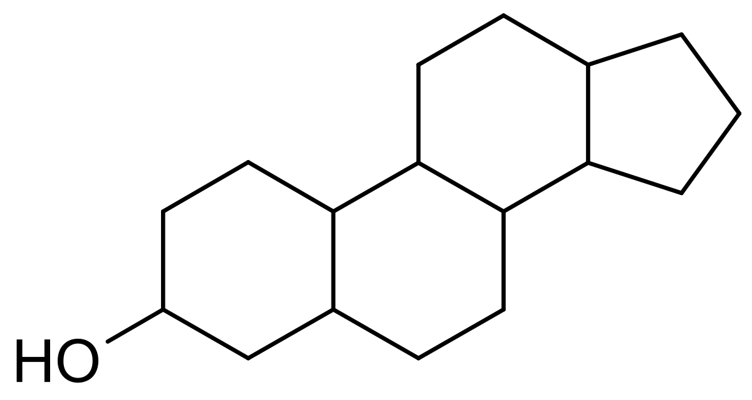
Libermann test for sterol
Test for Terpenoids
2.0ml of chloroform was added with the 5 ml aqueous plant extract
evaporated on the water path
boiled with 3 ml of H2SO4 conc.
A grey color formed.
Solution of the glycoside
1 drop of conc H2SO4
in glacial acetic acid.
red violet blue green.

Slide 7
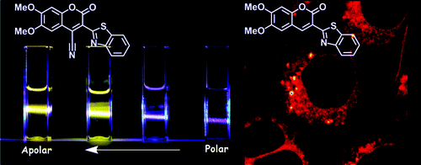
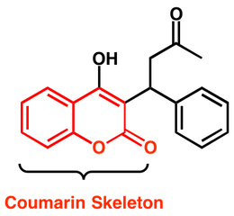
Test for coumarins
0.5 g of the moistened extract was taken in a test tube.
The mouth of the tube was covered with filter paper treated with 1 N NaOH solution.
Test tube was placed for few minutes in boiling water
the filter paper was removed and examined under the UV light
yellow fluorescence.

Slide 8
Test for Detection of alkaloids
1) Alkaloidal precipitants
Mayer’s reagent (Potassium mercuric iodide soln.)
Dragendorff’s reagent ( Potassium bismuth iodide)
Wagner’s reagent ( Soln. of iodine in potassium iodide)
Hager’s reagent ( Saturated soln. of picric acid)
2) Alkaloidal coloring reagents
Marqui’s reagent (HCHO/H2SO4).
Mandalin’s reagent (sulfovanidic acid).
Erdmann’s reagent (HNO3/H2SO4).
Modified Dragendroff’s reagent .

Slide 9
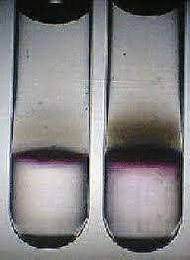
Identification of Monosaccharides
(glucose & fructose)
1- Molisch’s test:
1ml of the sugar soln.
2-3 drops alc.α-naphthol
1ml conc. H₂SO₄ dropwise on the wall
Purple ring in the junction between 2 layers.
This test gives positive result with all carbohydrates.

Slide 10
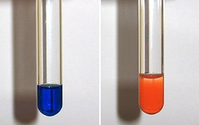
Identification of Monosaccharides
(Glucose & Fructose)
2- Fehling’s test:
1ml sugar soln.
1ml Fehling’s A
1ml Fehling’s B
heat on water bath
Reddish brown ppt. of Cu₂O
This test gives a positive result with reducing sugars (Monosaccharides and reducing disaccharides)

Slide 11
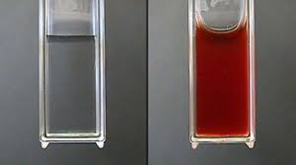
Identification of Monosaccharides
(glucose & fructose)
3- Resorcin (Selwianoff’s) test:
2ml sugar soln.
2ml 12%HCl
Few crystals of resorcin
Heat on W.B
Deep red colour
This test gives a positive result with fructose(keto sugar) but not with glucose (aldo sugar).

