Slide 1

Sever Acute pancreatitis
Prepared by
Ragaa Dahi Mohamed
Lecturer in Critical Care &Emergency Department
For 2nd year students
Monday 23/3/2020

Slide 2
Introduction
The pancreas, located in the upper abdomen, has endocrine as well as exocrine functions.
The secretion of pancreatic enzymes into the gastrointestinal tract through the pancreatic duct represents its exocrine function.
The secretion of insulin, glucagon, and somatostatin directly into the bloodstream represents its endocrine function.

Slide 3
Acute pancreatitis is defined as acute inflammation of the pancreas that can also involve surrounding tissues, remote organs, or both.
Acute pancreatitis can be mild or severe.
In mild acute pancreatitis, there are areas of fat necrosis in and around pancreatic cells, with interstitial edema. It is not associated with organ dysfunction or complications.
In severe acute pancreatitis, also called necrotic or hemorrhagic pancreatitis, there is extensive fat necrosis in and around the pancreas, pancreatic cellular necrosis, and hemorrhage in the pancreas. It is associated with local and systemic complications.

Slide 4
Etiology
Biliary disease: gallstones or microlithiasis, common bile duct obstruction, biliary sludge
Alcohol abuse
Drugs: thiazide diuretics, furosemide, procainamide, tetracycline, sulfonamides, azathioprine, 6-mercaptopurine, angiotensin-converting enzyme (ACE) inhibitors, valproic acid
Hypertriglyceridemia
Hypercalcemia (hyperparathyroidism)

Slide 5
Idiopathic
Miscellaneous (postoperative, ectopic pregnancy, ovarian cyst, total parenteral nutrition)
Abdominal trauma
Systemic lupus erythematosus
Endoscopic retrograde cholangiopancreatography (ERCP)
Infectious processes
Tumor
Toxins (ethyl alcohol, methyle alcohol, scorpion)

Slide 6
Scoring system developed to predict the severity of acute pancreatitis
(Ranson's Criteria)
DURING INITIAL 48 HOURS OF HOSPITALIZATION Fall in hematocrit >10% with hydration or hematocrit <30% Necessity for massive fluid and colloid replacement Hypocalcemia (<8 mg/dl) Arterial Po2 <60 mm Hg with or without acute respiratory distress syndrome Hypoalbuminemia (<3.2 mg/dl) Base deficit >4 mEq/L Azotemia | AT ADMISSION Age >55 years Hypotension Abnormal pulmonary findings Abdominal mass Hemorrhagic or discolored peritoneal fluid Increased serum LDH levels (>350 units/L) AST >250 units/L Leukocytosis (>16,000/mm3) Hyperglycemia (>200 mg/dl; no diabetic history) Neurologic deficit (confusion, localizing signs)

Slide 7
If the patient has 0 to 2 factors present, predicted mortality is 2%.
with 3 to 4 factors, 15% mortality;
with 5 to 6 factors, 40% mortality; and
with 7 to 8 factors, predicted mortality is 100%.

Slide 8
Pathophysiology
In acute pancreatitis the normally inactive digestive enzymes become prematurely activated within the pancreas itself, leading to autodigestion of pancreatic tissue.
The enzymes become activated through various mechanisms, including obstruction of or damage to the pancreatic duct system, alterations in the secretory processes of the acinar cells, infection, ischemia, and/or other unknown factors

Slide 9
Assessment & Diagnosis
Clinical manifestation:
Abdominal pain is the hallmark,
  it is usually mid-epigastric or periumbilical, with radiation to the back, but may radiate to the spine, flank, or left shoulder.
  The pain usually begins abruptly, often after a large meal. It may be steady and severe, or increase in intensity over several hours.
  The pain is usually exacerbated when the patient lies supine and is usually relieved when the patient sits and leans forward or lies in a fetal position.

Slide 10
Nausea, vomiting without pain relief,
Tachycardia
Abdominal distension, and hypotension are other common symptoms.
A low-grade fever may or may not be present. A persistent fever may indicate complications, such as peritonitis, cholecystitis, or intra-abdominal abscess.
Depending on the extent of fluid loss and hemorrhage, the patient may exhibit signs of hypovolemic shock.

Slide 11
Physical Examination.
Hypoactive bowel sounds and abdominal tenderness, guarding, distention, and tympany.
Findings that could indicate pancreatic hemorrhage include
  Grey Turner's sign (gray-blue discoloration/bruising of flank) and
  Cullen's sign (discoloration/bruising of the umbilical region), however, they are rare and would generally be seen several days into the illness.
A palpable abdominal mass indicates the presence of a pseudocyst or abscess.

Slide 12
Laboratory findings:
Serum amylase Elevated
Serum isoamylase Elevated
Urine amylase Elevated
Serum lipase Elevated
Serum triglycerides Elevated
Glucose Elevated
Calcium, Magnesium, Potassium Decreased
Albumin Decreased or increased
WBC count Elevated
Bilirubin May be elevated
Liver enzymes May be elevated
Prothrombin time Prolonged
Arterial blood gases Hypoxemia, metabolic acidosis

Slide 13
Diagnostic procedures:
Abdominal Ultrasonography
Computed Tomography scan (gold standard)
Magnetic resonance imaging
Endoscopic Retrograde Cholangiopancreatography (ERCP)
Abdominal radiographs (flat plate and upright or decubitus)
Chest radiographs (posteroanterior and lateral)

Slide 14
Complications
Local
■ Pancreatic necrosis
■ Pancreatic pseudocyst
■ Pancreatic abscess
Pulmonary
■ Atelectasis
■ ARDS
■ Pleural effusions
Cardiovascular
■ Hypotensive shock
■ Septic shock
■ Hemorrhagic shock
Renal
■ Acute renal failure
Hematological
■ Disseminated intravascular coagulation (DIC)
Metabolic
■ Hyperglycemia
■ Hypertriglyceridemia
■ Hypocalcemia
■ Metabolic acidosis
Gastrointestinal
■ Gastrointestinal bleed

Slide 15
Medical management
Fluid & Electrolytes management:
Because pancreatitis if often associated with massive fluid shifts, IV crystalloids and colloids, such as albumin and Ringer’s lactate solution, are administered immediately to prevent hypovolemic shock and maintain hemodynamic stability. Patient may need 5-10L of fluid within 24hr.
Patients with acute hemorrhagic pancreatitis may also need packed red blood cells to restore volume.

Slide 16
Fluid replacement is evaluated by monitoring intake and output and daily weights, use of a pulmonary artery catheter, or CVP.
If hyperglycemia develops, exogenous insulin may be required.
Patient with hypotensive given dopamine at a low dose (2 to 5 μg/kg/minute). An advantage of this drug is that at low doses it maintains renal perfusion while supporting blood pressure.
Electrolytes are monitored closely; and abnormalities such as hypocalcemia, hypokalemia, and hypomagnesemia are corrected.

Slide 17
Patients with severe hypocalcemia are placed on seizure precautions with respiratory support equipment on hand.
Calcium replacements are infused through a central line because peripheral infiltration can cause tissue necrosis. The patient monitored for calcium toxicity; symptoms include lethargy, nausea, shortening of the QT interval, and decreased excitability of nerves and muscles.
Low serum magnesium levels usually need to be corrected before calcium levels can return to normal.
Potassium may need to be replaced early in the treatment regimen because it is lost through vomiting and sequestration of potassium-rich pancreatic juices.

Slide 18
PAIN MANAGEMENT
Adequate pain medication is essential during the course of acute pancreatitis to provide sufficient pain relief which may stimulate pancreatic secretion further.
Morphine and morphine derivatives are often avoided because it has been thought that they cause spasm of the sphincter of Oddi.
Meperidine (Demerol/pethidine) is often prescribed because it is less likely to cause spasm of the sphincter.
Antiemetic agents may be prescribed to prevent vomiting.

Slide 19
Biliary drainage
Placement of biliary drains (for external drainage) and stents in the pancreatic duct through endoscopy has been performed to reestablish drainage of the pancreas. This has resulted in decreased pain and increased weight gain.
Surgical intervention
Surgery may be performed to assist in the diagnosis of pancreatitis (diagnostic laparotomy), to establish pancreatic drainage, or to resect or débride a necrotic pancreas.
The patient who undergoes pancreatic surgery may have multiple drains in place postoperatively as well as a surgical incision that is left open for irrigation and repacking every 2 to 3 days to remove necrotic debris.

Slide 20
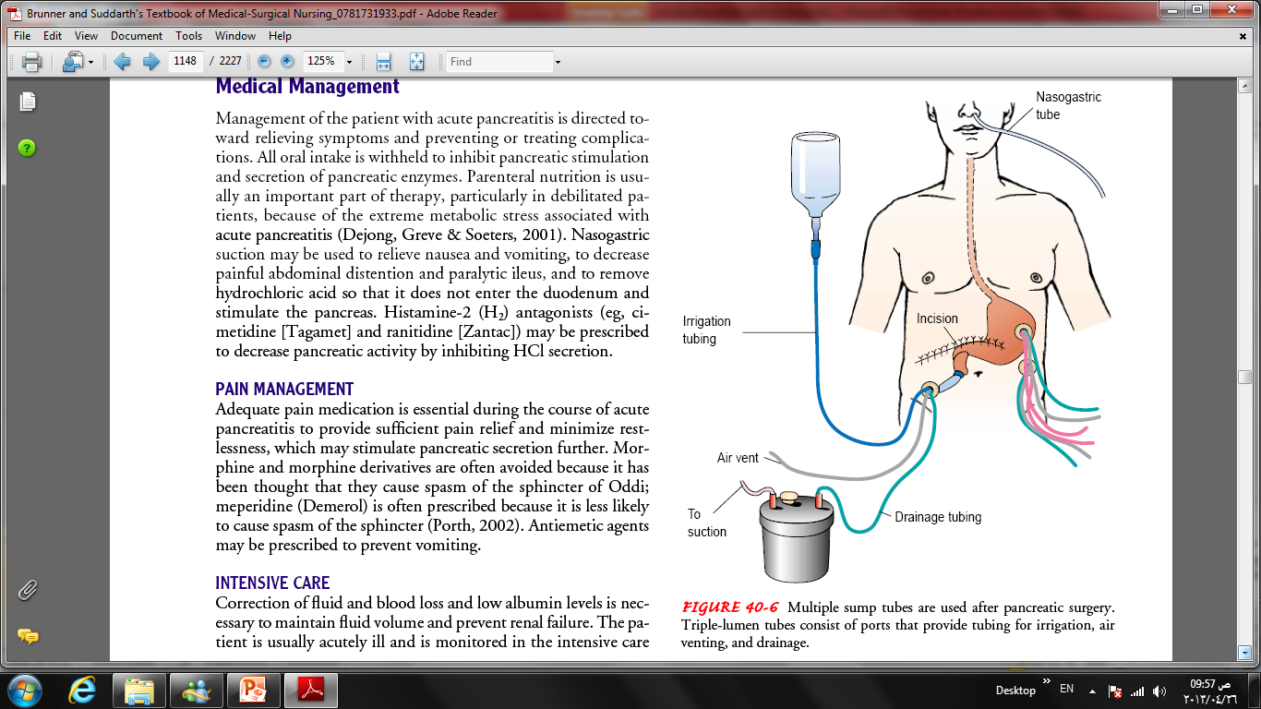

Slide 21
Nursing diagnosis
Acute pain related to inflammation, edema, distention of the pancreas, and peritoneal irritation
Deficit fluid volume related to relative fluid loss.
Decreased cardiac out put related to alterations in preload.
Ineffective breathing pattern related to decreased lung expansion, severe pain, pulmonary infiltrates, pleural effusion, atelectasis, and elevated diaphragm.

Slide 22
Imbalanced nutrition, less than body requirements, related to reduced food intake and increased metabolic demands
Impaired skin integrity related to poor nutritional status, bed rest, and multiple drains and surgical wound.
Anxiety related to fear.
Deficit knowledge related to lack of previous exposure to information.

Slide 23
Goals
The major goals for the patient include
relief of pain and discomfort,
improved respiratory function,
improved nutritional status,
maintenance of skin integrity, and
absence of complications.

Slide 24
Nursing intervention
Relief of pain and discomfort:
Administer Meperidine (Demerol) to relief pain.
Oral feedings are withheld to decrease the formation and secretion of secretin.
Nasogastric suction is used to remove gastric secretions and to relieve abdominal distention.
Oral hygiene and care to decrease discomfort from the nasogastric tube and relieve dryness of the mouth.
bed rest to decrease the metabolic rate and reduce the secretion of pancreatic and gastric enzymes.

Slide 25
Improved respiratory function
a semi-Fowler’s position to decrease pressure on the diaphragm by a distended abdomen and to increase respiratory expansion.
Frequent changes of position are necessary to prevent atelectasis and pooling of respiratory secretions.
Pulmonary assessment and monitoring of pulse oximetry.
The nurse instructs the patient in techniques of coughing and deep breathing to improve respiratory function every 2 hours.

Slide 26

Improve nutritional status
Until recently, conventional nutritional management was to place the patient on NPO regimen and institute IV hydration. The rationale was to rest the inflamed pancreas and prevent enzyme release. Oral feeding was only initiated when the attack had subsided and enzymes had normalized.
TPN was started on patients anticipated to have oral feedings held for greater than 5 days.

Slide 27
Maintenance of skin integrity:
The patient is at risk for skin breakdown because of poor nutritional status, enforced bed rest, and restlessness, which may result in pressure ulcers and breaks in tissue integrity. In addition, the patient who has undergone surgery, has had multiple drains inserted, or has an open surgical incision is at risk for skin breakdown and infection.

Slide 28
Monitoring And Managing potential Complications
Hemodynamic monitoring of BP, HR, PAWP, or CVP.
Monitor the total intake and output, with carful attention to urinary output greater than 30ml/h to assess the renal perfusion. Weight the patient daily.
Assesses the patient for ascites and measures abdominal girth daily if ascites is suspected.
Closely monitors patient for early signs of neurologic, cardiovascular, renal, and respiratory dysfunction. And respond quickly to rapid changes in the patient’s status, treatments, and therapies.
Monitoring calcium, magnesium, and potassium levels, administering replacement solutions, and evaluating the patient’s response to any supplementation.

Slide 29
Thank you

