Slide 1

Pap smear
Prepared BY Sanaa Ali

Slide 2
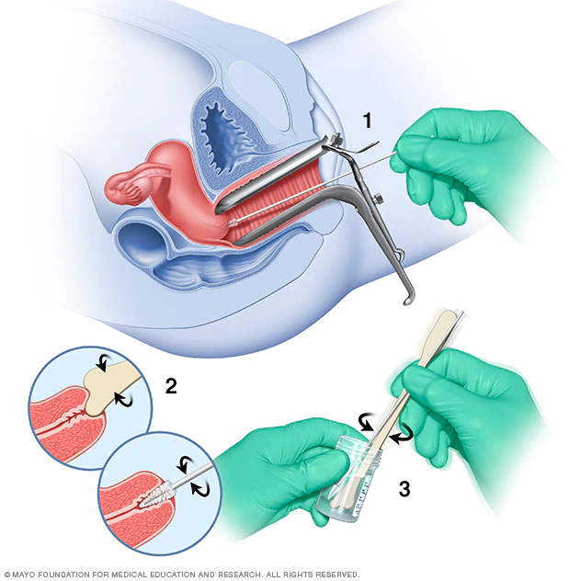

Slide 3
A Pap smear, also called a Pap test, is a screening procedure for cervical cancer. It tests for the presence of precancerous or cancerous cells on your cervix. The cervix is the opening of the uterus.
During the routine procedure, cells from your cervix are gently scraped away and examined for abnormal growth. The procedure is done at your doctor’s office. It may be mildly uncomfortable, but doesn’t usually cause any long-term pain.

Slide 4
Pap test
A procedure in which a small brush or spatula is used to gently remove cells from the cervix so they can be checked under a microscope for cervical cancer or cell changes that may lead to cervical cancer.
A Pap smear may also help find other conditions, such as infections or inflammation. It is sometimes done at the same time as a pelvic exam and may also be done at the same time as a test for certain types of human papillomavirus (HPV). Also called Pap test and Papanicolaou test.

Slide 5
Who performs my Pap test?
A gynecologist typically performs a Pap test. A gynecologist is a medical doctor who specializes in treating diseases of a woman’s reproductive organs. Sometimes other health care providers perform Pap tests. This may include primary care doctors, physician assistants, or nurse practitioners. If the person performing the test is a man, a female assistant or nurse may also be in the room.
If the results of the Pap test show cervical cancer, your health care provider will refer you to a gynecologist or an oncologist. An oncologist is a doctor who specializes in treating cancer.

Slide 6
How often you need to have a Pap test depends on your age, results of previous tests, and other factors. Learn more about cervical cancer screening guidelines.

Slide 7
When to screen?
Start within 3 years of onset of sexual activity or by age of 21, whichever is first.
High risk factors for cervical dysplasia:
Early onset of sexual activity
Multiple sexual partners
Smoking habits
Oral contraceptives
HPV and HIV positive women

Slide 8
When to stop routine screening
Age 70 and “adequate recent screening”
Three consecutive negative pap smears
No abnormal pap smears in last 10 years
Hysterectomy for benign lesion

Slide 9
Screening frequency
Yearly until three consecutive normal pap smears, then may decrease frequency to every 2-3 years
Annual screening for high-risk women is highly recommend.

Slide 10
How should I prepare for a Pap test?
To ensure that the Pap test results are as accurate as possible, do not have sexual
intercourse for 2 to 3 days before the test. Also, to avoid washing away abnormal cells, do not use the following for 2 to 3 days before the test:
Tampons
Birth control foams
Vaginal medicines
Douches
Vaginal creams or powders
The best time to schedule your Pap test is at least 5 days after the end of your menstrual period. A Pap test can be done during your menstrual period, but it is better to schedule the test at another time.

Slide 11
Preparing pap test
You should not douche (rinse the vagina with water or another fluid).
You should not use a tampon.
You should not have sex.
You should not use a birth control foam, cream, or jelly.
You should not use a medicine or cream in your vagina.
Avoid the use of personal lubricants

Slide 12
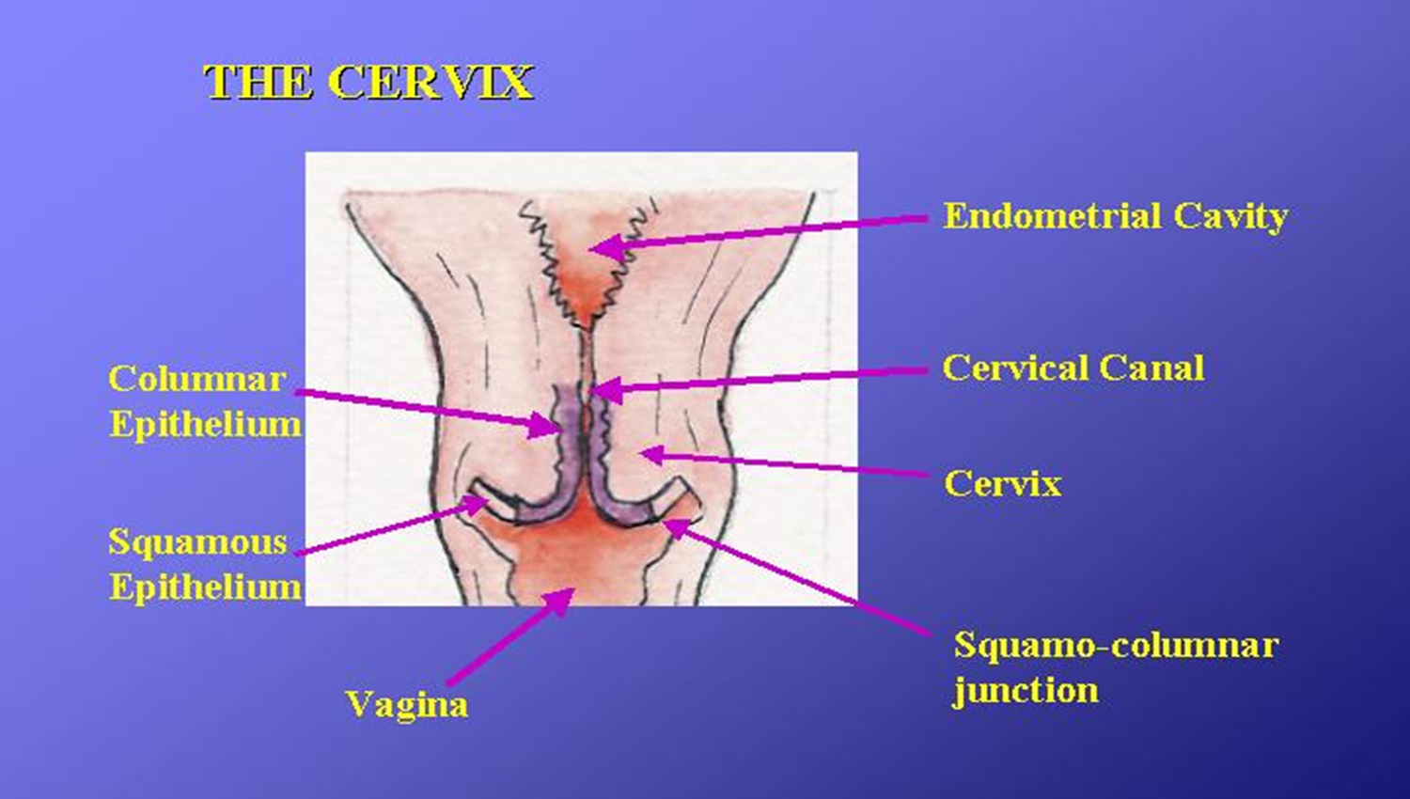
Cervical histology

Slide 13
Equipment
Private exam area
Examination table
Trained health professionals
Sterile vaginal speculum
Supplies and equipment for preparing and interpreting
the Pap smears (e.g., spatulas, glass slides, fixative, stains, microscopes
Marker/pencil/glass writer/labels
specimen collection
Light source

Slide 14
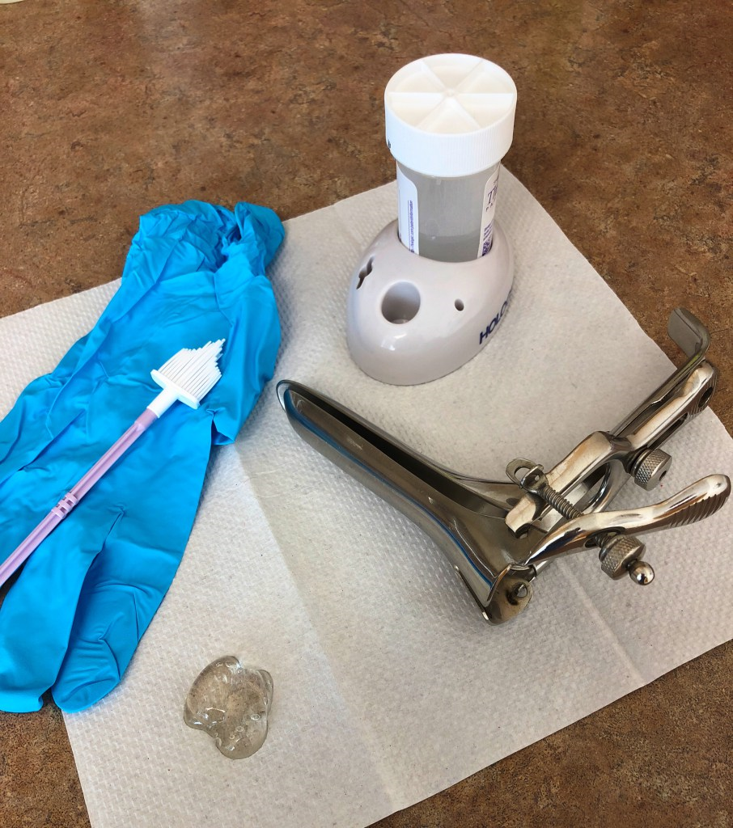

Slide 15
Procedure Steps
Step 01
Introduce yourself to the patient and clarify her identity. Explain what you would like to do and obtain consent. Explain she should feel little, if any, discomfort and that the examination should be over fairly quickly.
A chaperone is required for this examination.

Slide 16
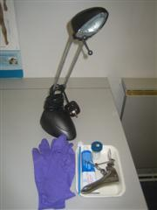
Step 02
Ensure you have all of the necessary equipment ready. This includes:
Gloves.
Speculum).
Lubricant.
A cervical brush.
A pot of cytology preservative solution.
A light source.
Smear test equipment

Slide 17
Step 03
The patient should be exposed from the waist down. Ask her to lie on the bed with her ankles together and allow her knees to spread apart as much as possible.

Slide 18
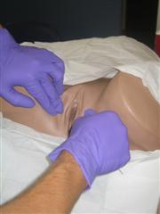
Step 04
Wash you hands, put on your gloves and examine the outer vagina checking for any obvious abnormalities.

Slide 19
Step 05
Warm the blades of the speculum with warm water. The water also acts to lubricate the speculum) but you may also like to apply some lubricant. Ensure the lubricant is not placed at the end of the speculum as this may alter the result.

Slide 20
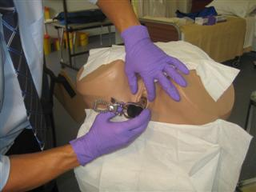
Step 06
Inform the patient that you are about to start the procedure. Use your left hand to part the labia minora and insert the speculum with the screw facing sideways

Slide 21
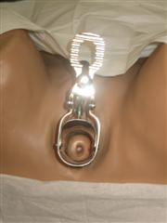
Step 07
As you advance the speculum), turn it so that the screw faces upwards. Open the blades and fix them open with the screw. Ensure that you can see well by adjusting the light source. Check for any gross pathology and identify the transition zone.

Slide 22
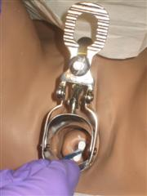
Step 08
Place the tip of the cervical brush into the external cervical os and rotate it three times through 360 degrees ensuring that it is always in contact with the cervix.

Slide 23
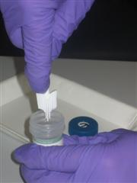
Step 09
Remove the brush ensuring it does not wipe against anything. Tap the brush 10 times on the edge of the pot of cytology medium.

Slide 24
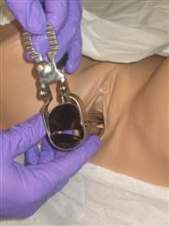
Step 10
Release the screw on the speculum and carefully remove it from the vagina, completing the examination.

Slide 25
Step 11
Offer the patient some tissue, cover the patient, and thank her. You should explain to the patient that her smear results will be sent to them in approximately six weeks, thus ensuring appropriate follow-up.

Slide 26
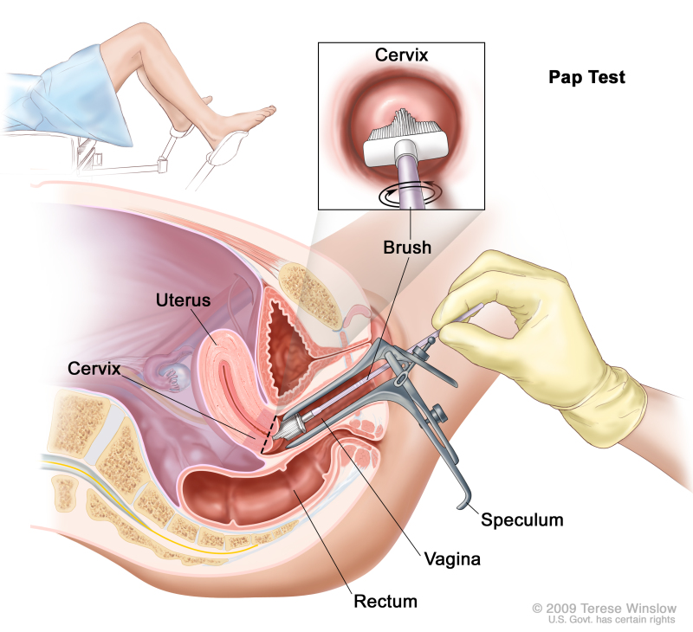

Slide 27
Technique
Visualize entire cervix if possible
Carefully remove any obscuring discharge
Sample ectocervix first with spatula
Sample endocervix with gentle cytobrush rotation
Apply material uniformly to slide
Fix rapidly with spray or liquid fixative

Slide 28
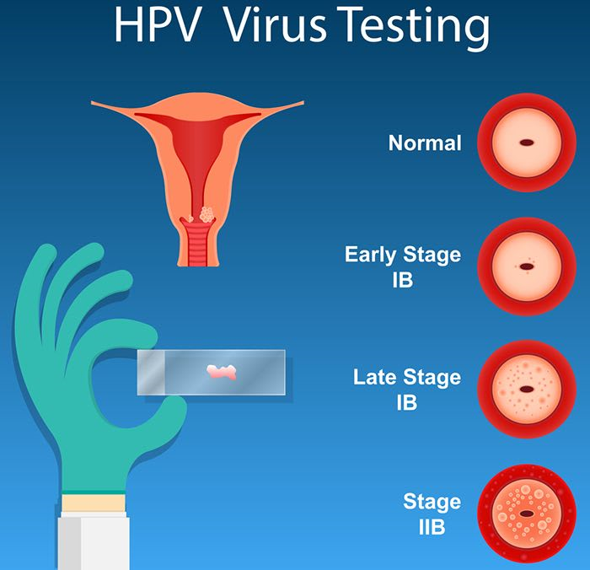

Slide 29
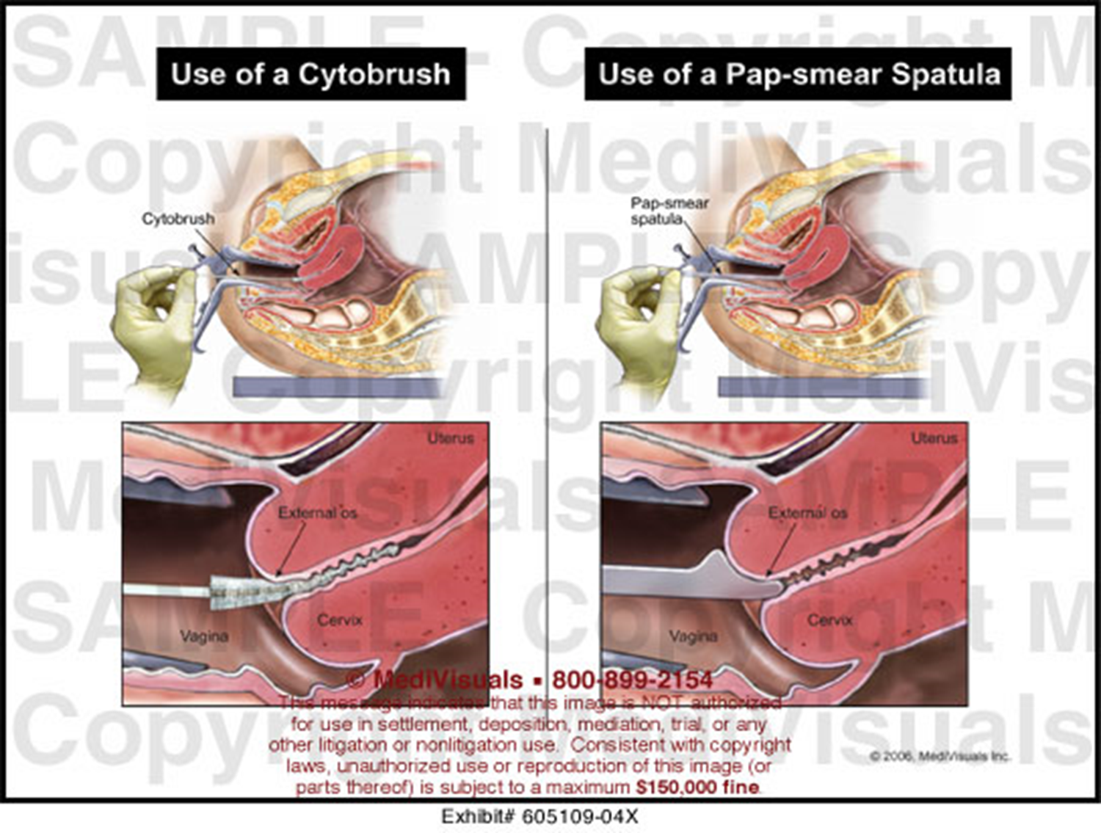

Slide 30
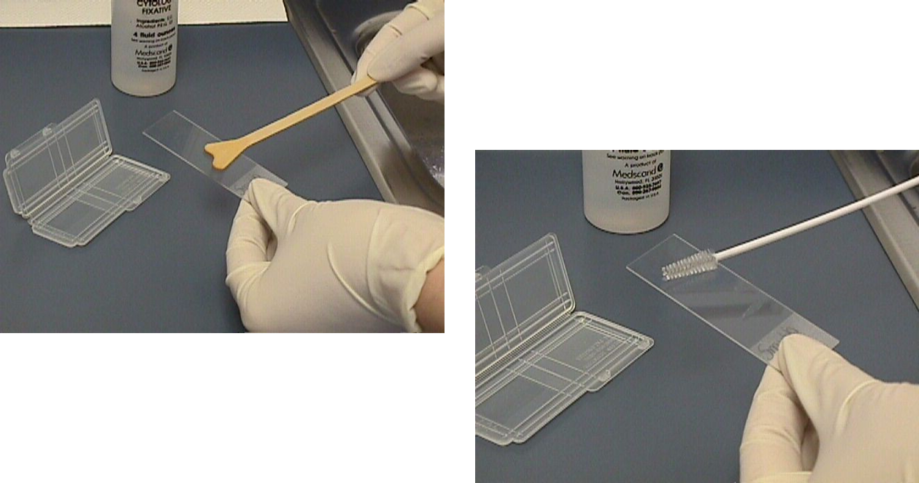

Slide 31


