Slide 1



First year
Adult Nursing Department
Prepared by : Nehad Abdelrazik

Slide 2
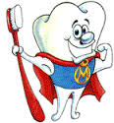
Mouth care
Part 1

Slide 3
Definition
Oral hygiene cleaning the teeth and the oral cavity of the patient.

Slide 4
Purpose
To promote the patient’s sense of well-being
To improve the patient’s self-image
. To prevent deterioration of the oral cavity
To improve oral health and limit the growth of pathogens in the oropharyngeal secretion.
. To stimulate appetite.

Slide 5

Providing Oral Care for
the Independent Patient
Providing Oral Care for the Dependent Patient
Providing Denture Care

Slide 6
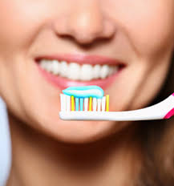
Providing Oral Care for the Independent Patient

Slide 7
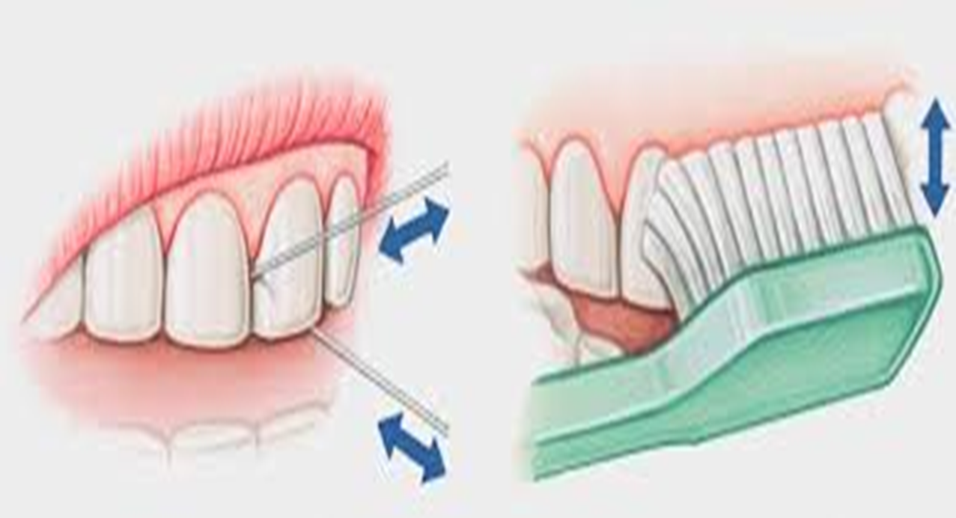
Brushing and flossing teeth

Slide 8
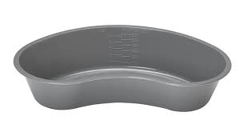
Equipment:
Tooth brush and tooth paste.
Towel.
Clean gloves.
Emesis basin.
Cup of water.
Mouthwash.
Dental floss at least two pieces 20 cm in length.

Slide 9
Preparation:
Inspect lips, gums, oral mucosa and tongue for lesions or inflammation.
Identify presence of oral problems as tooth caries.
Determine patient's ability to assist with procedure.
Assess patient's risk for aspiration.

Slide 10
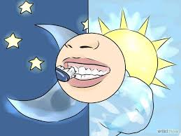
Brushing:
Introduce self and verify patient's identity.
Explain procedure to patient.
Perform hand hygiene.

Slide 11
collect equipment on over bed table within patient’s reach.
Provide for patient privacy(Close the room door or curtains). Place the bed at
an appropriate and comfortable working height.
Maintain body mechanics.

Slide 12
Lower side rail and assist patient to sitting position (a high fowler's position), if permitted, or turn patient onto side.
Rationale: Decreases risk of aspiration.
Place the towel across patient’s chest .

Slide 13
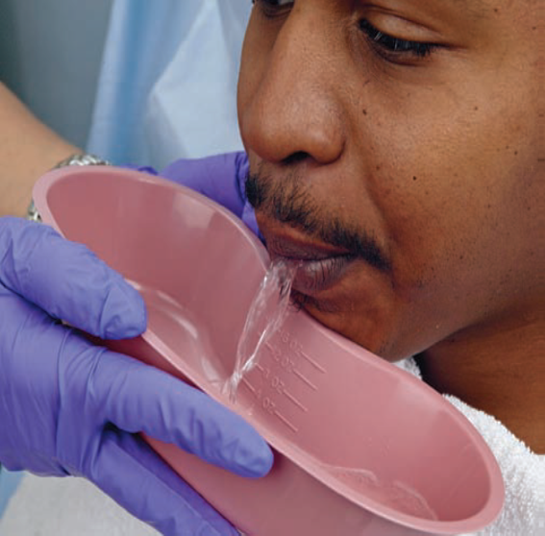
Moisten toothbrush in cup of water.
Apply toothpaste to brush.
Place the emesis basin under
patient's chin.
Encourage patient to brush
own teeth, or assist, if necessary
Inspect the mouth, gums and teeth.

Slide 14
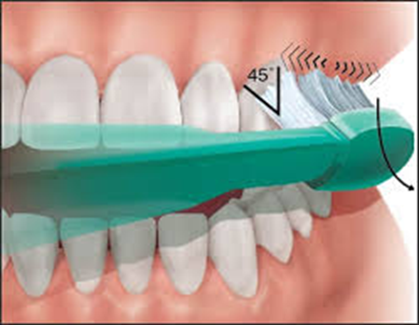
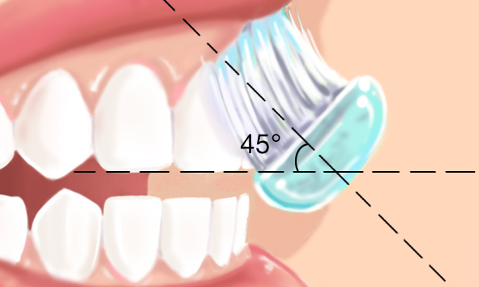
Brush the patient's teeth holding the bristles at a 45 degree angle. Brush from gum line to the crown of the tooth.

Slide 15
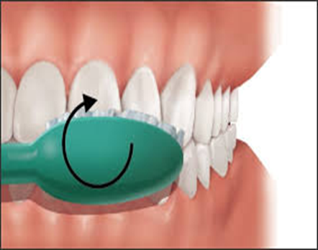
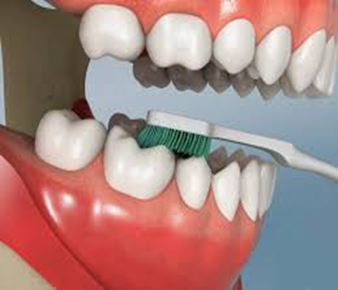
Move the bristles up and down gently. Repeat until all outer and inner surfaces of the teeth are cleaned.
Brush the biting surfaces of the teeth by moving the brush back and forth on top of the tooth's surface.

Slide 16
Brush tongue gently with toothbrush .
Assist patient in rinsing of mouth with cup of water.

Slide 17
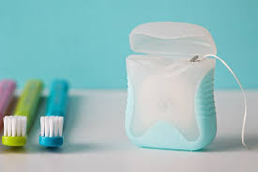
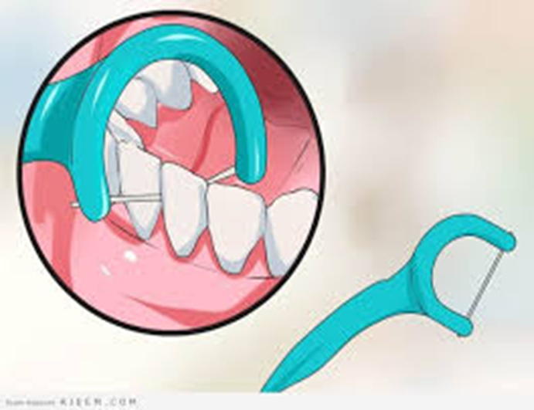
Flossing:
Remove approximately 6 inches (almost =15cm) of dental floss from container or use a plastic floss holder.

Slide 18
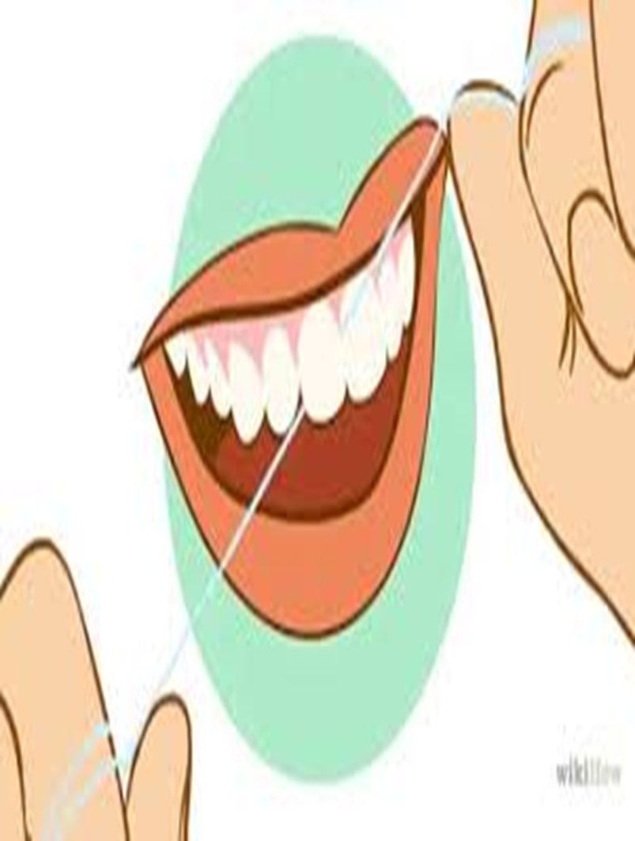
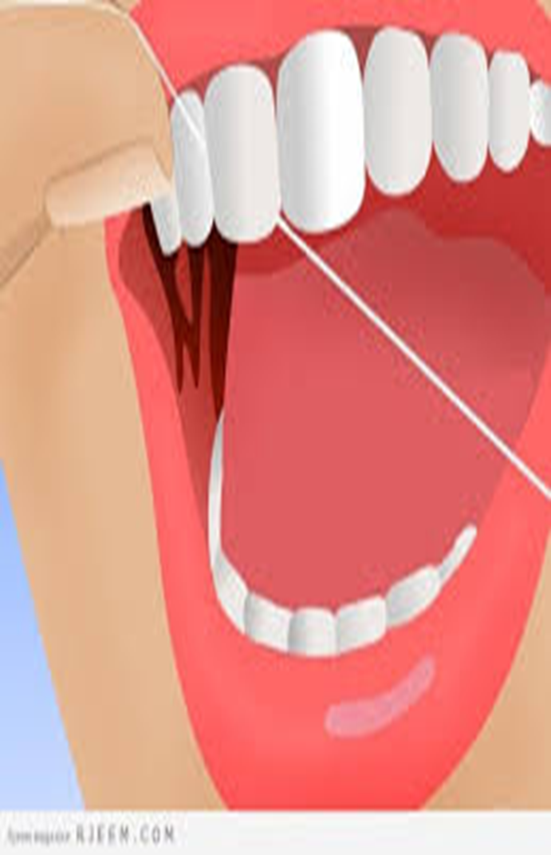
Wrap the floss around the index fingers, keeping about 1 to 1.5 inches of floss taut between the fingers.
Ask patient to open mouth and smile to reveal teeth

Slide 19
Insert floss gently between teeth, moving it back and forth downward to the gums
Move the floss up and down between the teeth.
first on one side of a tooth and then on the side of the other tooth, until the surfaces are clean Repeat in the spaces between all teeth.

Slide 20
Assist patient to rinse mouth.
Offer mouthwash if patient prefers
Apply lubricant to patient lips as needed
(prevents drying).
Remove and dispose of equipment appropriately.
Remove and discard gloves and wash hands.

Slide 21

Place patient in comfortable position.
Raise side rail and lower bed.
Documentation: Record oral assessment, significant observations, and unusual findings, such as bleeding or inflammation, any teaching done, procedure and patient response.

Slide 22


