Slide 1

The fundus and lochia examination
Prepared by Sanaa Ali

Slide 2
introduction
The uterus begins a process known as involution immediately after the delivery of the placenta. The uterus, with the assistance of the uterine muscles, contracts the uterine vessels and impedes blood flow. Large vessels at the site of placental attachment thrombose to control bleeding.
Exfoliation also occurs at this time. Exfoliation is the sloughing off of dead tissue at the site where the placenta is attached to the uterine wall.

Slide 3
UTERUS
The fundus is assessed for:
By approximately one hour post delivery, the fundus is firm and at the level of the umbilicus.
The fundus continues to descend into the pelvis at the rate of approximately 1 cm or finger-breadth per day and should be nonpalpable by 14 days postpartum.
In addition, patients are assessed for uterine cramping and treated for pain as needed.
Patients or a family member can be taught to assess the firmness of the fundus and to provide massage in the event of a boggy uterus or excessive bleeding. Patients are encouraged to void before palpation of the uterine fundus because a full bladder displaces the uterus and can lead to excessive bleeding.

Slide 4
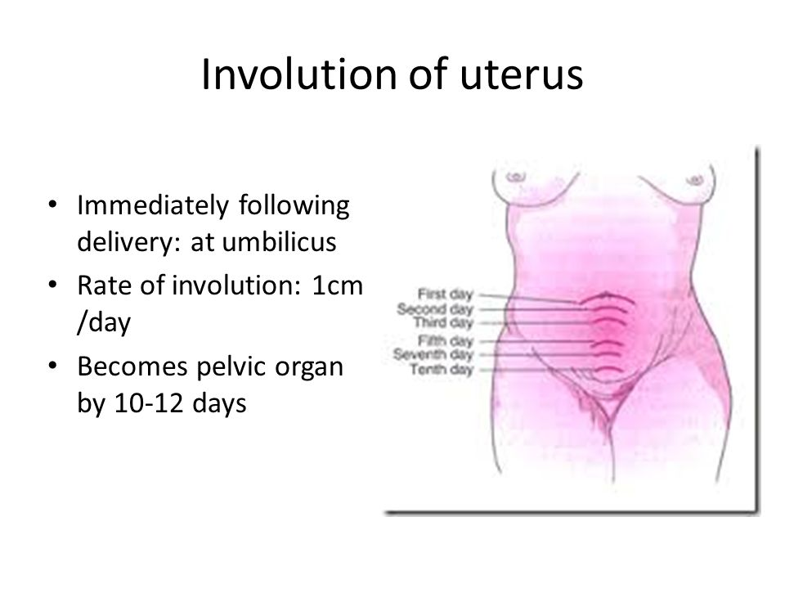

Slide 5
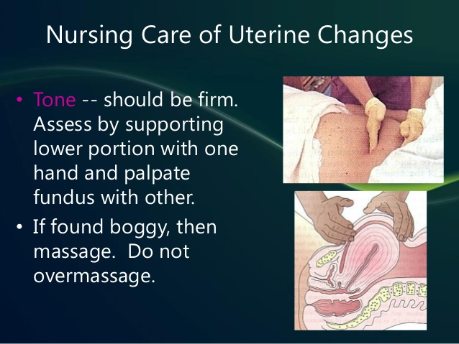

Slide 6
Definition of lochia
lochia is the vaginal discharge after giving birth, containing blood, mucus, and uterine tissue.[1] Lochia discharge typically continues for four to six weeks after childbirth,[2] a time known as the postpartum period or puerperium.

Slide 7
Type of lochia
Lochia rubra
(or cruenta) is the first discharge, Composed of blood, shreds of fetal membranes, decidua, vernix caseosa, lanugo and membranes. It is red in color because of the large amount of blood it contains. It typically lasts no longer than 3 to 5 days after birth.

Slide 8
2-Lochia serosa:
is the term for lochia that has thinned and turned brownish or pink in color. It contains serous exudate, erythrocytes, leukocytes, cervical mucus and microorganisms. This stage continues until around the tenth day after delivery. Lochia serosa which persists to some weeks after birth can indicate late postpartum hemorrhaging, and should be reported to a physician

Slide 9
3-Lochia alba (or purulenta) :
is the name for lochia once it has turned whitish or yellowish-white. It typically lasts from the second through the third to sixth weeks after delivery. It contains fewer red blood cells and is mainly made up of leukocytes, epithelial cells, cholesterol, fat, mucus and microorganisms. Continuation beyond a few weeks can indicate a genital lesion, which . should be reported to a physician

Slide 10
              Complications
In general, lochia has an odor similar to that of normal menstrual fluid. Any offensive odor or change to a greenish color indicates contamination by organisms such as chlamydia .

Slide 11
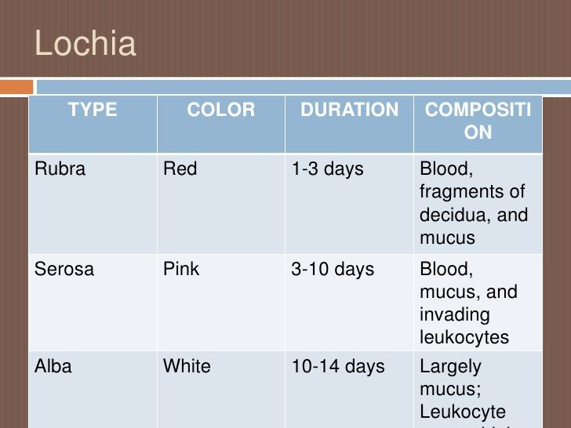

Slide 12
Equipment
(clean gloves
sterile pad,
antiseptic solution)

Slide 13
Procedure:
1- Hand washing
2- Prepare the necessary equipment and taken to the bed side table (clean gloves, sterile pad, and antiseptic solution)
3- Great the woman, and explain the procedure to obtain her consent.
4-ask the woman to empty her bladder before the procedure.
5- Maintain privacy through the procedure.
.

Slide 14
A- Fundus and Lochia Assessment Steps.
6- Wash hands and wear the clean examination gloves.
7-Ask the woman to lie on her back with her knees slightly bent.
8- Do fundal massage using one hand and the other gloved hand lowered the perineal pad to assess the lochia flow in the bad.
9- Ask the woman since how many hours she changed her perineal pad.
10- Assess the fundal level, position, size and consistency first then massage as needed.
11- Assess the lochia flow in the bad during massage.
12- Support the uterus by cupping one hand against the lower uterine segment (just above the symphysis pubis)
13- Measure by finger breadth how far the fundus from the umbilicus.
14- Use anew-perineal pad to cover the perineum after perineal care

Slide 15
B- Post procedure tasks.
12- Remove and dispose gloves according to procedure.
13- Inform the woman about the findings and document the procedure accurately

Slide 16

Any question

