Slide 1
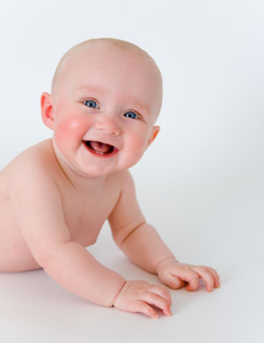
Immediate Care of the Newborn Baby
Prepared by Sanaa Ali

Slide 2
Out lines:

Slide 3
outlines
objective
Introduction
Definition of immediate newborn care
Definition of neonatal period
Principles of immediate care of newborn
Equipment

Slide 4
Objectives
*To establish and maintain respiratory function
*To provide warmth and prevent hypothermia
*To observe and assist newborn in adaptation to extra uterine life
*To ensure safety from injury and infection
*To identify actual and potential problems that might require immediate action
*To initiate chosen method of breast feeding

Slide 5
introduction

Slide 6
Of the 3.1 million newborn deaths that occurred in 2010, a quarter to half of them occurred within the first 24 hours after birth
. Many of these deaths occurred in babies born too early and too small, babies with infections, or babies asphyxiated around the time of delivery. Labour, birth and the immediate postnatal period are the most critical for newborn and maternal survival..

Slide 7
Care of all newborns includes immediate and thorough drying, skin to skin contact of the newborn with the mother, cord clamping and cutting after the first minutes after birth, early initiation of breastfeeding, and exclusive breastfeeding. Newborns who do not start breathing on their own by one minute after birth should receive positive pressure ventilation with room air by a self-inflating bag and mask.

Slide 8
Definition immediate new born care
Care of newborn immediately following birth.

Slide 9
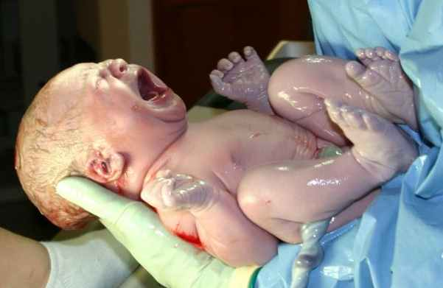
• Definition of neonatal period:
The time from birth though the twenty eight day of life.
During this time the neonate must make many adjustments to extra uterine life

Slide 11
Principles of immediate care of newborn
Remember ABCW principles
Airway
Breathing
Circulation
Warmth

Slide 12
Equipment
*Resuscitation equipment
*Thermometer
*Cord clamp
*Identification band
*Latex gloves
*Baby clothes
*Stethoscope
*Infant scale

Slide 13
The following measures are designed to assist the infant in accomplishing the adaptations to extra uterine life.
1-Clearing the air way • As soon as the head is born, and before the baby takes its first breath, the pharynx (mouth) and Nasopharynx (nose) must be suctioned to prevent aspiration of mucous, blood and meconium and debris into the trachea when breathing begins.

Slide 14
Suction the Airway
First suction from mouth
Then suction from nose

Slide 15
Position the Baby
The optimal position for the baby is with the head neither markedly flexed against the chest, nor extended with the chin up in the air. Instead, the head should be in a "military" attitude, looking straight up.
Position the baby on its' back with the head looking straight up. This will usually provide for good airflow.
If there is any airway obstruction, make small adjustments to the head position to try to straighten the trachea and eliminate the obstruction

Slide 16
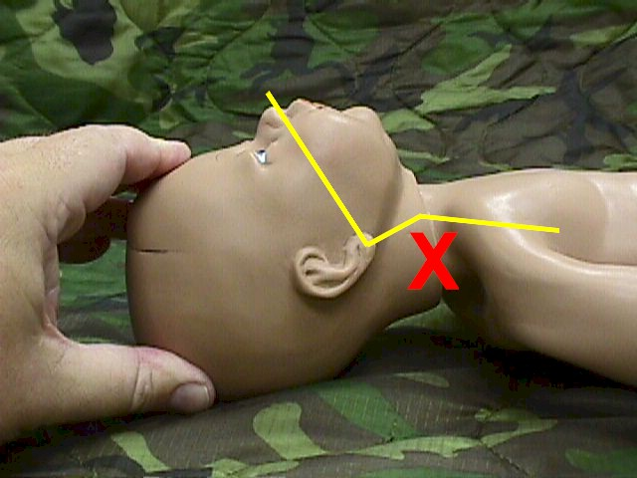
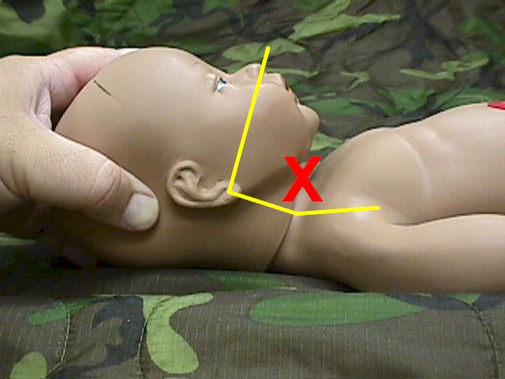
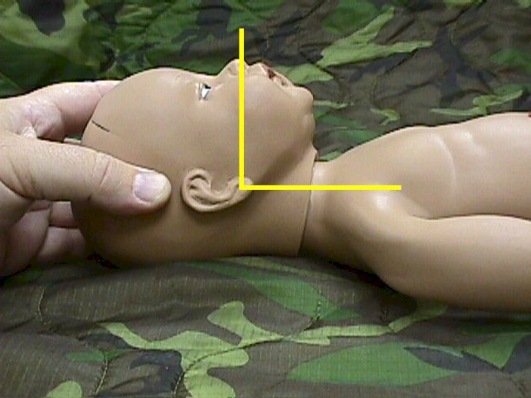

Slide 17
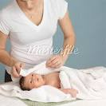
2-Dry the Baby
Immediately after delivery, the baby should be dried. Ideally, this is with a warm, soft towel, but don't delay in drying the baby while searching for a warm, soft towel.
In an emergency, any dry, absorbing material will work well for this purpose. This would include:
T-shirts
Gloves
Jackets
Socks

Slide 18
-Replace the Wet Towels
Babies can lose a tremendous amount of heat very quickly, particularly if they are wet. By removing the wet towels and replacing them with dry towels, you will reduce this heat loss.
Babies, during the first few hours of life, have some difficulty maintaining their body heat and may develop hypothermia if not attended to carefully. This is particularly true of premature infants

Slide 19
-Keep the Baby Warm
Pay particular attention to keeping the head covered (but the airway open) as heat loss from the newborn head can be substantial.
*Typically, the baby is wrapped in warm, soft blankets and a head covering put in place.
*In sub-optimal circumstances, nearly any cloth material can be used keep the baby warm.

Slide 20
Causes and prevention of heat loss in delivery room

Slide 21
1-Evaporation
Definition
Occurs when wet surfaces are exposed to air
causes
At birth the infant loses heat when amniotic fluid on the skin evaporates.
prevention
Dry with towel (preferably warmed)
2-Radiation
Definition
Transfer of body heat to a cooler solid object not in contact with the body
Causes
Many cold surfaces (e.g. windows)
prevention
Wrap in warm dry towel or blanket

Slide 22
3-Convection
Definition
Flow of heat from body surface to cooler surrounding
causes
.Draughts
prevention
Close doors and windows
4-Conduction
Definition
Transfer of body heat to a cooler solid object in contact with the body
causes
Cold surface of trolley.
prevention
Pre-warm with overhead heate

Slide 23
3-Assessment of baby's condition using Apgar score :
The Apgar score is a commonly-used method to assess the newborn status and need for continuing treatment. Points are assigned according to each of five categories. The total score is the sum of the points from each category.
The Apgar score is usually assigned at 1-minute after birth and again at 5-minutes after birth. Scores of 7 or more are considered normal. Those with normal scores may need some assistance and those with very low scores (0, 1 or 2) may need considerable assistance. Most newborn infants with low Apgar scores will be fine, once they are supported and resuscitated.

Slide 24
Apgar score
Category | 0 Points | 1 Point | 2 Points
Heart Rate | Absent | < 100 b.p.m | ≥ 100 b.p.m
Respiratory Effort | Absent | Slow, Irregular (Weak cry, hypoventilation ) | Good, crying
Muscle Tone | Flaccid (No response) | Some flexion of extremities | Active motion
Reflex Irritability | No Response | Grimace | Vigorous cry
Color | Blue, pale | Body pink, extremities blue | Completely pink

Slide 25
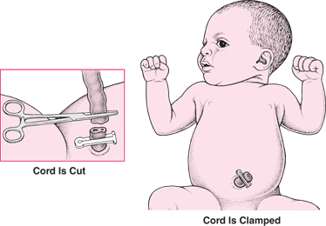
4-Care of the cord
The cord is clamped and cut approximately within 30 seconds after birth. In the delivery room, the cord is clamped twice about 8 inches from the abdomen and cut in between.

Slide 26
5-Eye Prophylaxis
Within an hour of birth, treat the newborn's eyes to prevent gonococcal infection. Alternative medications include:
1% silver nitrate solution
1% tetracycline ophthalmic ointment
0.5% erythromycin ophthalmic ointment (This also prevents Chlamydia infections)

Slide 27
Erythromycin or tetracycline Ophthalmic Ointment:
These ointments are the ones commonly used now days for eye prophylaxis because they do not cause eye irritation and are more effective against Chlamydia conjunctivitis.
Apply over lower lids of both eyes, then, manipulate eyelids to spread medication over the eyes.

Slide 28
6-Vitamin K
During the first few hours following delivery, a vitamin k single injection 0.5 to 1.0 mg of natural vitamin K can help prevent hemorrhage. newborn has a sterile intestine at birth, hence, the newborn does not possess the intestinal bacteria that manufactures vitamin K which is necessary for the formation of clotting factors. This makes the newborn prone to bleeding. As a preventive measure, .5 (preterm) and 1 mg (full term) Vitamin K or aquamephyton is injected IM in the newborn in lateral anterior thigh muscle.

Slide 29
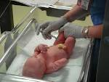

Slide 30
7-Identification
It is very important to identify the baby by its sex and its mother name Awrist or ankle band or foot print may be used. Matching band serial numbers ensure infants and parents are properly correlated. Bands made from extra soft plastic with non-irritating snap for comfort 3-part and 4-part styles available - in white, pink or blue

Slide 31
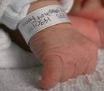

Slide 32
Breast-feeding
Babies can be breast-fed as soon as the airway is cleared and they are breathing normally. Some babies nurse vigorously while others are not particularly interested in feeding until several hours after birth. It is unwise to try to breast-fed babies with respiratory difficulties until the breathing problems are resolved. Breast-feeding babies generally make their needs known by crying when they are hungry. They also cry when they are uncomfortable from a wet or soiled diaper. Sometimes, they cry because they need to be picked up and held.

Slide 33
Other information
Early skin-to-skin contact for mothers and their healthy newborn infants
Skin-to-skin contact between mother and baby at birth reduces crying, improves mother-baby interaction, keeps the baby warmer, and helps women breastfeed successfully

Slide 34
Early versus delayed umbilical cord clamping in preterm infants
Delayed cord clamping for babies born early improves their health.In the womb, blood flows to and from the baby and the placenta bringing oxygen to the baby from the mother's blood. If the cord is left unclamped for a short time after the birth, some of the baby's blood from the placenta passes to the baby to help the flow of blood to the baby's lungs. In the review of studies on babies born prematurely, delaying cord clamping for just a very short time helped the babies to adjust to their new surroundings better. Further studies are needed on longer delays to see whether this brings even more benefits.

Slide 35
Immediate Care of the Newborn Baby vedio

