Slide 1



second year
Adult Nursing Department
Hydrotherapy
م/مروة حمدي احمد

Slide 2
Definition:
Hydrotherapy or water therapy defined as the use of water, in any of its forms (hot, cold, steam, or ice), for the maintenance of health or the treatment of disease or to relieve dis comfort and promote physical well-being.

Slide 3
Purposes:
To clean the wound.
Promote the healing by debriding the wound.
Hydrotherapy can stimulate the circulatory system and improve the immune system.
To assess and evaluate the healing process.
To provide comfort for the patient.

Slide 4
Assessment:
Assess patient vital sings (respiration, blood pressure, pulse, temperature).
Assess patient level of comfort and if require pain medication.
Assess patient level of anxiety.

Slide 5
Equipment needed:
Sterile gloves.
Sterile dressing set containing scissors & forceps.
Clean, disposable gloves.
Antiseptic solution.

Slide 6
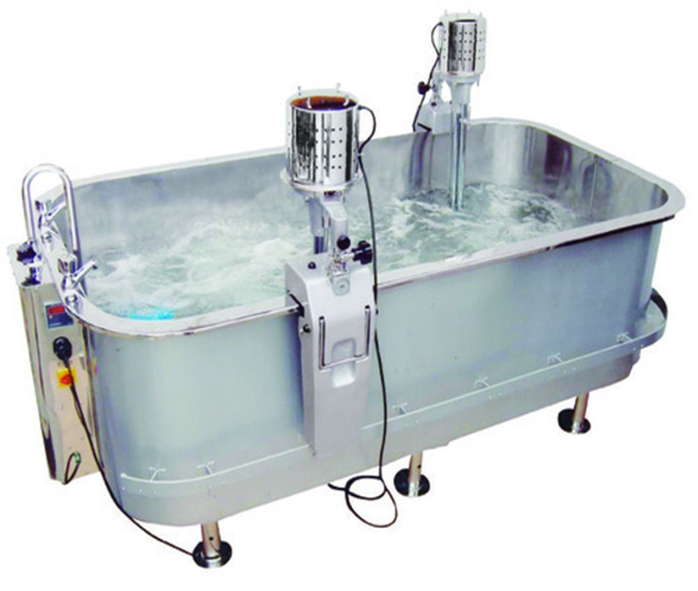
Variety of gauze dressings and pads.
Sterile basin, sit bath, warm water baths.
Sterile solution.
Antiseptic ointment.
Disposable mask.

Slide 7


Slide 8
Implementation:
Step 1: Hand washing.
Rationale: To reduce infection
Step 2: prepare equipment.
Step 3: Identify the patient and introduce self to patient.
Rationale: To gain their cooperation and for reassurance.
Step 4: Maintain body mechanics.

Slide 9
Step 5: Explain procedure to patient and its purposes.
Step 6: Review the physician’s order to determine the need for hydrotherapy, particular antiseptic solution.
Step 7: Maintain patient privacy.
Step 8: Place supply within easily reach.

Slide 10
Step 9: Apply face mask, overhead, and wash hands.
Rationale: To reduce transmission of microorganisms.
Step 10: Assist patient to comfort position.
Rationale: Provide for comfort.
Step 11: Place opened cuffed disposal plastic bag near working area.
Rationale: Place soiled dressing without contaminating outside surfaces of bag.

Slide 11
Step 12: Don Clean disposable gloves and remove soiled dressing in a clean to less clean direction.
Rationale: Protect the nurse from handing contaminated dressing.
Step 13: Administer patient narcotics and short –acting as order.
Rationale: To relive patient pain.

Slide 12
Step 14: Use warm water for socking the patient body from (10-20 min).
Rationale: Help to assess wound condition and document if there is infection.
Step 15: Expose, clean, and rewrap less infected areas first. Discard dressing in plastic bag. Pull off glove and drop it in the bag.
Rationale: Prevent spread of microorganisms by contaminated dressing.

Slide 13
Step 16: Gently debridement of the wound died tissue, and permit for rang of motion for all affective joint.
Rationale: To promote healing and good blood supply.
Step 17: Assist the patient to transfer from the hydrotherapy set to the site of dressing.
Rationale: To complete the dressing procedure.

Slide 14
Step 18: Pour antiseptic solution over gauze sponges or over sponges placed in sterile iodine bowel.
Rationale: Maintain sterility of dressing and solution.
Step 19: Don sterile gloves.
Rationale: Maintain surgical asepsis.
Step 20: Dry wound using gauze sponge move from least contaminated area to most contaminated area.
Rationale: Move from least contaminated area to most contaminated area.

Slide 15
Step 21: Apply antiseptic ointment if ordered. Ointment is applied to dressing if direct application of dressing causes discomfort.
Rationale: Helps to reduce growth of microorganisms and improve healing process.
Step 22: Apply a layer of dry sterile gauze over wound (as a contact layer).
Rationale: Primary dressing serves as a wick for drainage.

Slide 16
Step 23: Apply second layer of gauze to wound.
Rationale: Provides for increased absorption of drainage.
Step 24: Place pad dressing over wound as outer layer.
Rationale: Protects wound from external environment.
Step 25: Remove gloves from inside out and discard it in plastic bag.
Rationale: Reduces transmission of microorganisms.

Slide 17
Excepted out comes:
Step 28: The wound heal and the skin is intact and the wound is free from infection.

Slide 18
Documentation
Step 29: Report bright red bleeding or evidence of wound complications.

Slide 19


