Slide 1



First year
Adult Nursing Department
Applying a sterile gloves and gown via the closed method
م/ ايمان سمير فهمي

Slide 2
Indications:
To prevent soiling of the health care worker's clothes from the patient's blood and body fluids.
Serve as a barrier to decrease the risk of wound contamination.
Allow the nurse to move more freely in the environment with sterile drapes and objects.

Slide 3
Assessment:
Examine the package containing the gown and gloves for signs of contamination or tears.
Place the gown package waist – high level on a clean, flat, dry surface.

Slide 4
Equipment:
Sterile gown.
Sterile proper size gloves.

Slide 5
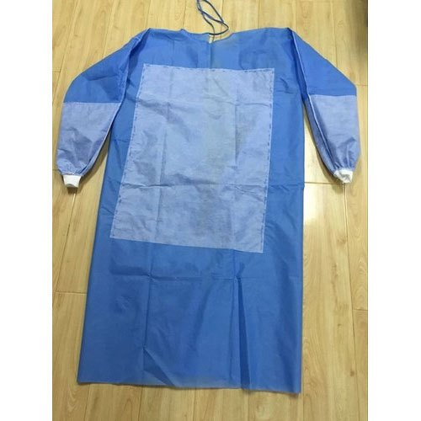
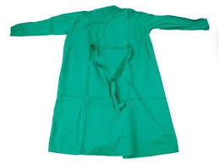
Sterile gown:
May be either paper "disposable" or cloth "reusable".

Slide 6
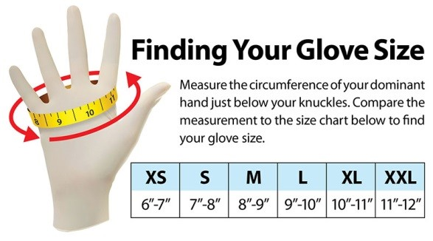

Slide 7
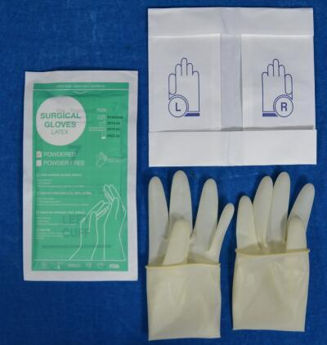

Slide 8
What Are Gloving Methods?
Open method.
Closed method.

Slide 9
Definition:
Closed gloving: refer to a technique in which, after the surgical scrub, the gown is put on firstly; then the gloves are put on by grasping the gloves with the hands still in the sleeves of the gown.

Slide 10
In the closed-glove technique, the person's hands remains inside the sleeves and should not touch the cuffs of the gown.

Slide 11
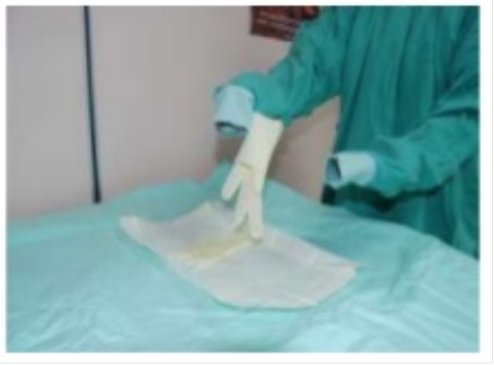
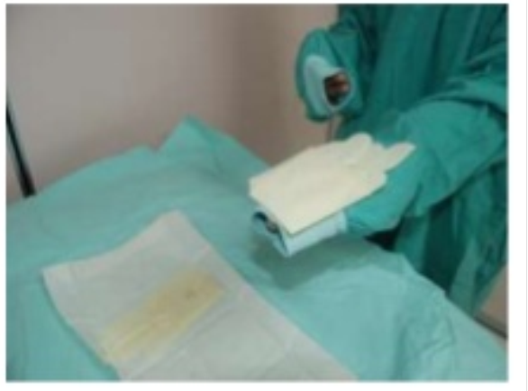
(1)
(2)
(4)
(3)

Slide 12
In the open-glove technique, the scrub person's hands slide through the sleeves out beyond the cuffs.

Slide 13
Nursing implementation
Before entering operation room applies cap, facemask and over shoes.
Do surgical hand washing.
Ask the circulating nurse to assist by opening sterile pack containing sterile gown.

Slide 14
Have circulating nurse prepare glove package by peeling outer wrapper, open while keeping inner contents sterile, inner glove package is then placed on sterile field.

Slide 15
Pick up the gown by the folded edges inside the neck of the gown. Touch only the side of the gown that will be next to your uniform when the gown is tied.

Slide 16
Place your arms, one then the other into the sleeves of the gown.
Have an assistant tie the gown in the back.

Slide 17
With hands covered by gown sleeves open inner sterile glove package.
Slip fingers between glove and pull onto hand. Bring cuff of glove over to cover the gown cuff.

Slide 18
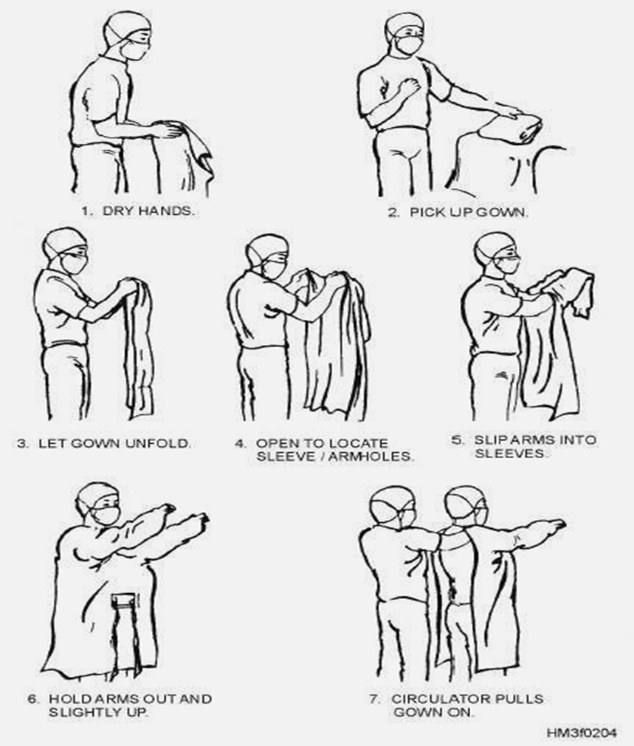

Slide 19
Apply gloves via the closed method

Slide 20
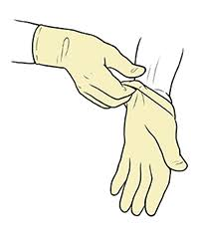
After completing the procedure (surgery):
First: Remove gloves, grasp (external) edge of glove cuff and pull it off hand until the inside is out.

Slide 21
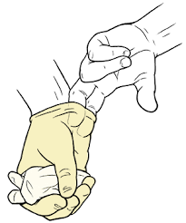
To remove the second glove: slip ungloved fingers under cuff (internal surface) of remaining glove. Touch only the inside cuffs. Pull inside out. Discard it in special bag.

Slide 22
Second: With ungloved hands remove gown at the neck tapes or ties roll the gown inside out, discard it in special bag.
Third: Remove mask.
Wash hands and record.

Slide 23


