Slide 2
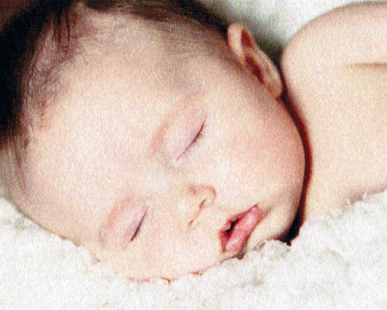
Fibroid uterus
By
Nawal Kamal Abd El khalek
Lecturer of Obstetrics and Gynecology Faculty of Nursing South Valley University

Slide 3
Outlines:
Introduction
Definition
Etiology
Types of fibroid
Risk factor
Symptoms
Complications of fibroid
Treatments
Nursing care for fibroid

Slide 4
Introduction
Uterine leiomyomas (fibroids or myomas) are the most common pelvic tumor in women. They are benign tumors arising from the smooth muscle cells of the myometrium. They arise in reproductive age women (40s and early 50s) and typically present with symptoms of heavy or prolonged menstrual bleeding or pelvic pain/pressure. If the fibroid was very large they can make the women like pregnant. The Uterine fibroids may also have reproductive effects (e.g, infertility, adverse pregnancy outcomes).

Slide 5
Definition:
A fibroid uterus is a leiomyoma (benign neoplasm from smooth muscle fibers) that originates from the smooth muscle layer (myometrium) of the uterus. However, the tumor contains connective tissue fibers it is also called myoma, myofibroma or fibromyoma.

Slide 6
Etiology:
The exact cause is unknown, however, the tumour is oestrogen dependent and excessive oestrogen stimulation predisposes to fibroids and this is evidence by:
Fibroid never start before puberty or after menpause and existing tumour undergo atrophy after the menopause.
They are frequently associated with other lesions caused by excessive oestrogen as endometrial hyperplasia, endometriosis, and endometrial carcinoma.

Slide 7
Etiology: cont.
They are more common in nullipara because the high progesterone level during pregnancy anatogonises oestrogen.
The tumour has more oestrogen receptors compared with the normal surrounding myometrium.
Anovulation may lead to development of fibroids.

Slide 8
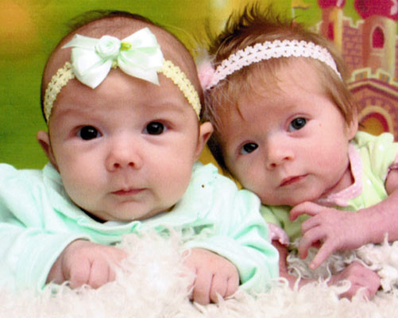

Slide 9
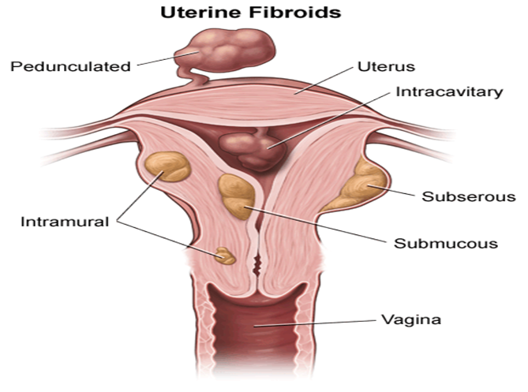
Types of fibroid:

Slide 10
Types of fibroid: cont.
Intramural fibroids: are located in the muscle wall of the uterus and are the most common type.
Subserosal fibroids: are located just under the outside covering of the uterus and can become very large.
Submucosal fibroids: are located just under the surface of the uterine lining.

Slide 11
Types of fibroid: cont.
Pendunculated leiomyomas: these fibroids develop occurring on a long stalk on the outside of the uterus or inside the cavity of the uterus; it may become twisted, causing severe pain.
Cervical fibroids: are located in the wall of the cervix (neck of the uterus).

Slide 12
Risk Factors:
Age: Fibroids are most common in women who are 30s through early 50s. (After menopause, fibroids tend to shrink.) About 20 - 40% of women age 35 and older have fibroids of significant enough size to cause symptoms.
Family History: having a mother or sister who had fibroids, may increase risk.
Race and Ethnicity: Uterine fibroids are particularly common in African-American (black) women, and these women tend to develop them at a younger age than white women.

Slide 13
Risk Factors: cont.
4. Obesity: Women who are overweight are at higher risk for fibroids. For very heavy women, the risk is two to three times greater than average.
5. Eating habits: Eating a lot of red meat (e.g., beef) and ham is linked with a higher risk of fibroids. Eating plenty of green vegetables seems to protect women from developing fibroids.

Slide 14
Symptoms of Fibroids

Slide 15
Symptoms of fibroids:
Most fibroids do not cause any symptoms, but some women with fibroids can have:
Abnormal bleeding/menorrhagia, polymenorrhea, metrorrahagia: menorrhagia being the most common abnormal pattern observed.
Pelvic Discomfort: Women with large fibroids may feel heaviness or pressure in their lower abdomen or pelvis.

Slide 16
Symptoms of fibroids: cont.
Pelvic Pain:
Bladder Problems: The most common bladder symptom is frequent urination.
Low Back Pain

Slide 17
Symptoms of fibroids: cont.
Rectal Pressure: Fibroids also can press against the rectum and cause a sensation of rectal fullness.
Large abdominal fibroid may cause dyspnea and palpitation
Discomfort or pain with sexual intercourse.
Miscarriage or infertility.

Slide 18
Complications:
1- Menorrhagia which lead to iron-deficiency anaemia.
2- Torsion of pedunculated fibroid lead to acute abdominal pain.
3- Bladder frequency, constipation (due to increased pelvic pressure).
4- Ureteral obstruction causing hydronephrosis.

Slide 19
Complications: cont.
5- Infertility
6- Infection of the tumour
7- Malignant changes
8- Inversion of uterus
9- Uterine prolapse.

Slide 20
Complication during pregnancy:
there are increased incidences of
Recurrent miscarriage.
Fetal malpresentation.
Premature labour.
Ectopic pregnancy.

Slide 21
Complication during pregnancy: cont.
Non engagement of the head.
Placenta previa
Red degeneration: presents with fever, pain and vomiting.
Intrauterine growth restriction.
Hydronephrosis.

Slide 22
Complication during labour
Obstructed labour
Prolonged labour
Retained placenta
Cesarean section
Postpartum hemorrhage

Slide 23
Complication during puerperium
Sub involution of the uterus
Secondary postpartum hemorrhage
Puerperal sepsis.

Slide 24
Treatment

Slide 25
Treatment:
1- No treatment:
Small symptomless fibroid require no treatment but the patient is kept under observation and examined every 6 months. The exceptions to this rule are:
If the size of the tumors is more than 12 weeks pregnancy.
Pedunculated subserous fibroid which is liable to torsion.
If the tumor is growing rapidly.
The presence of infertility

Slide 26
Treatment: cont.
2- Medical treatment:
Birth control pills and other types of hormonal birth control methods as progesterone injection (e.g. depoprovera). These drugs often are used to control heavy bleeding and painful periods.

Slide 27
Treatment: cont.
3- Surgical:
Surgery is indicated when:
There is excessively enlarged uterine size.
Pressure symptoms are present.
Medical management is not sufficient to control symptoms.
Subfertility is also a factor.

Slide 28
Treatment: cont.
Surgical options include:
A) Myomectomy is the surgical removal of fibroids while leaving the uterus in place. Because a woman keeps her uterus, she may still be able to have children. Fibroids do not regrow after surgery, but new fibroids may develop.
B) Hysterectomy is the removal of the uterus. Hysterectomy is done when other treatments have not worked or fibroids are very large. A woman is no longer able to have children after having a hysterectomy.

Slide 29
Treatment: cont.
C) Uterine artery embolization (UAE) – Also called uterine fibroid embolization, UAE is a newer minimally-invasive (without a large abdominal incision) technique. The arteries supplying blood to the fibroids are identified, and then embolized (blocked off). The embolization cuts off the blood supply to the fibroids, thus shrinking them.
D) Myolysis – A needle is inserted into the fibroids, usually guided by laparoscopy, and electric current or freezing is used to destroy the fibroids.

Slide 30
Treatment: cont.
E) Endometrial Ablation: The lining of the uterus is removed or destroyed to control very heavy bleeding. This can be done with laser, wire loops, boiling water, electric current, microwaves, freezing, and other methods.
F) Radio frequency ablation: Is one of the newest minimally invasive treatments for fibroids. In this technique the fibroid is shrunk by inserting a needle-like device into the fibroid through the abdomen and heating it with radio-frequency (RF) electrical energy to cause necrosis of cells.

Slide 31
Nursing care for myomectomy:
Before surgery:
Informed consent is a legal document that explains the tests, treatments, or procedures that may needed.
Inform and explain to the patient about investigation needed to performed as Physical exam and Blood tests

Slide 32
Immediately after the operation:
After the operation, the nurse should:
Observed temperature, pulse, respiration and blood pressure
Note any vaginal discharge.
Give an intravenous fluid line to replace fluids loss.
Monitor tubes at the wound site to drain off excess fluid.

Slide 33
Immediately after the operation: cont.
You may have a catheter to drain off urine for the next day or so.
Encourage the patient to perform breathing, coughing and leg exercises hourly when she awakes.
Assisted the patient out of bed and taken for a walk the day following surgery.

Slide 34
Possible complications
Possible complications of myomectomy include:
Haemorrhage
Injury to the uterus
Damage to the nearby organs of the urinary system

Slide 35
Possible complications cont.
Formation of scar tissue (adhesions) within the uterus
Infection
Blood clots
Eventual re-growth of fibroids.

