Slide 1



second year
Applying an External
Condom Catheter
م/مروة حمدي احمد
Adult Nursing Department

Slide 2
Definition:
is an external catheter used for the treatment of urine incontinence in men. This external catheter is not a true catheter, as it is not inserted into the body cavity duct or vessel.

Slide 3
Purpose:
To allow for urinary drainage externally while maintaining skin integrity and prevention of urinary tract infection.

Slide 4
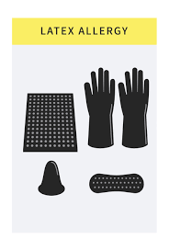
Equipment:
Condom in appropriate size Bath blanket Basin of warm water and soap Washcloth and towel | Skin protectant Reusable leg bag with tubing or urinary drainage setup Disposable gloves Scissors

Slide 5
Procedure:
Step 1: Bring necessary equipment to the bedside.
Rationale: conserves time and energy
Step 2: Perform hand hygiene and put on PPE, if indicated.
Rationale: prevent the spread of microorganisms.
Step 3: Identify the patient.
Rationale: ensures the right patient receives the intervention and helps prevent errors.

Slide 6
Step 4: Close curtains around bed and close the door to the room, if possible.
Rationale: This ensures the patient’s privacy
Step 5: Explain the procedure with patient.
Rationale: promotes reassurance
Step 6: Ask the patient if he has any allergies, especially to latex.
Rationale: Some condom catheters are made of latex.

Slide 7
Step 7: Adjust bed to comfortable working height.
Rationale: prevents back and muscle strain.
Step 8: Stand on the patient’s right side if you are right-handed, or on patient’s left side if you are left-handed.
Rationale: Positioning on one side allows for ease of use of dominant hand for catheter application.

Slide 8
Step 9: Prepare urinary drainage setup or leg bag for attachment to condom sheath.
Rationale: Provides for an organized approach to the task.
Step 10: Position patient on his back with thighs slightly apart.
Rationale: Positioning allows access to site.

Slide 9
Step 11: Drape patient so that only the area around the penis is exposed.
Rationale: Draping prevents unnecessary exposure and promotes warmth. Slide waterproof pad under patient.
Step 12: Put on disposable gloves.
Rationale: Prevent contact with body fluids.

Slide 10
Step 13: Trim any long pubic hair that is in contact with penis.
Rationale: Prevents pulling of hair by adhesive without the risk of infection associated with shaving.
Step 14: Clean the genital area with washcloth, skin cleanser, and warm water.
Rationale: Washing removes urine, secretions, and microorganisms

Slide 11
Step 15: Clean the tip of the penis first, moving the washcloth in a circular motion from the meatus outward. Wash the shaft of the penis using downward strokes toward the pubic area. Rinse and dry.
Rationale: The penis must be clean and dry to minimize skin irritation
Step 16: Remove gloves.
Step 17: Perform hand hygiene again.

Slide 12
Rationale: Reduce transmission of infection
Step 18: Apply skin protectant to penis and allow drying.
Rationale: minimizes the risk of skin irritation from adhesive and moisture and increases adhesive’s ability to adhere to skin

Slide 13
Step 19: Roll condom sheath outward onto itself. Grasp penis firmly with non-dominant hand.
Rationale: allows for easier application.
Step 20: Apply condom sheath by rolling it onto penis with dominant hand (Figure 1). Leave 1 to 2 inches (2.5 to 5 cm) of space between tip of penis and end of condom sheath.
Rationale: Prevents irritation to tip of penis and allows free drainage of urine.

Slide 14
Step 21: Apply pressure to sheath at the base of penis for 10 to seconds.
Rationale: Ensures good adherence of adhesive with skin.
Step 22: Connect condom sheath to drainage setup (Figure 2). Avoid kinking or twisting drainage tubing.
Rationale: The collection device keeps the patient dry. Kinked tubing encourages backflow of urine.

Slide 15
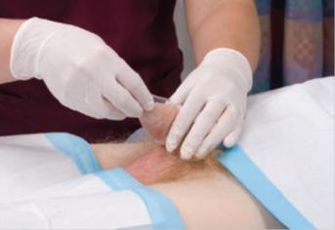
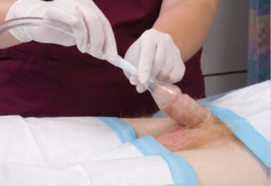

Slide 16
Step 23: Remove gloves. Secure drainage tubing to the patient’s inner thigh with tape
Rationale: Prevents tension on the sheath and potential inadvertent removal.
Step 24: Assist the patient to a comfortable position.
Step 25: Cover the patient with bed linens.
Rationale: Covering provides warmth and promotes comfort

Slide 17
Step 26: Place the bed in the lowest position.
Rationale: Promotes patient safety.
Step 27: Secure drainage bag below the level of the bladder.
Rationale: This facilitates drainage of urine
Step 28: Check that drainage tubing is not kinked and that movement of side rails does not interfere with the drainage bag.
Rationale: Prevents the backflow of urine.

Slide 18
Step 29: Remove equipment.
Step 30: Remove gloves.
Rationale: Prevents transmission of microorganisms.
Documentation: Document the application of the condom catheter, the condition of the patient’s skin, record urine output on the intake and output record.

Slide 19


