Slide 1

Step 13: Use the dominant hand to pick up the catheter and hold it an inch or two from the tip.
Step 14: Ask the patient to bear down as if voiding. Insert catheter tip into meatus

Slide 2
Step 15: Ask the patient to take deep breaths. Advance the catheter to the bifurcation or “Y” level of the ports.
Step 16: Repeat steps from 30- 37.

Slide 3
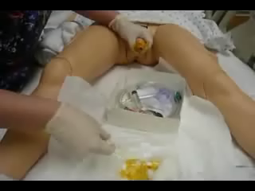

Slide 4


