Slide 1
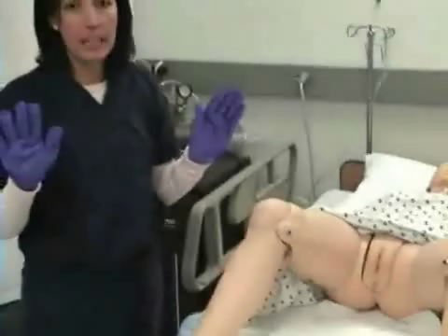


Slide 2
Step 29: Hold the catheter securely at the meatus with your non-dominant hand. Use your dominant hand to inflate the catheter balloon .Inject entire volume of sterile water supplied in prefilled syringe.
Step 30: Pull gently on catheter after balloon is inflated to feel resistance.
Step 31: Attach catheter to drainage system if not already pre attached

